Slide 1
Permutations (Using Decrease and Conquer)
Abdelrahman Moustafa - 225075

Slide 2
Permutating this sequence of elements would produce the following 6 unique sequences:
1
2
3

Slide 3
Permutating this sequence of elements would produce the following 6 unique sequences:
1
2
3
1
2
3

Slide 4
Permutating this sequence of elements would produce the following 6 unique sequences:
1
2
3
1
2
3
1
3
2

Slide 5
Permutating this sequence of elements would produce the following 6 unique sequences:
1
2
3
1
2
3
1
3
2
2
1
3

Slide 6
Permutating this sequence of elements would produce the following 6 unique sequences:
1
2
3
1
2
3
3
1
2
1
3
2
2
1
3

Slide 7
Permutating this sequence of elements would produce the following 6 unique sequences:
1
2
3
1
2
3
3
1
2
1
3
2
2
3
1
2
1
3

Slide 8
Permutating this sequence of elements would produce the following 6 unique sequences:
1
2
3
You could find the number
of permutations of a
sequence of n numbers by
calculating n!
Therefore, since we have 3
elements in this sequence,
to calculate it we find:
3! = 6
Giving us 6 unique sequences
or 6 permutations.
1
2
3
3
1
2
1
3
2
2
3
1
2
1
3
3
2
1

Slide 9
Python Code:
def perm(n):
permsList = []
if(n == 1):
permsList.append("1")
else:
for i in perm(n - 1):
for j in range(len(i) + 1):
permsList.append(i[:j] + str(n) + i[j:])
return permsList
print(perm(3))

Slide 10
Python Code:
Firstly, we begin thinking of the base case:
def perm(n):
permsList = []
if(n == 1):
permsList.append("1")
else:
for i in perm(n - 1):
for j in range(len(i) + 1):
permsList.append(i[:j] + str(n) + i[j:])
return permsList
print(perm(3))
We are using decrease-by-one technique, so
think of decreasing the number 3 by one in
each recurrence. How would you write the base
case?

Slide 11
Python Code:
Firstly, we begin thinking of the base case:
def perm(n):
permsList = []
if(n == 1):
permsList.append("1")
else:
for i in perm(n - 1):
for j in range(len(i) + 1):
permsList.append(i[:j] + str(n) + i[j:])
return permsList
print(perm(3))
We are using decrease-by-one technique, so
think of decreasing the number 3 by one in
each recurrence. How would you write the base
case?
In this example, n in the main is passed as 3,
which means our sequence should consist of
the numbers 1, 2, 3.

Slide 12
Python Code:
Firstly, we begin thinking of the base case:
def perm(n):
permsList = []
if(n == 1):
permsList.append("1")
else:
for i in perm(n - 1):
for j in range(len(i) + 1):
permsList.append(i[:j] + str(n) + i[j:])
return permsList
print(perm(3))
We are using decrease-by-one technique, so
think of decreasing the number 3 by one in
each recurrence. How would you write the base
case?
In this example, n in the main is passed as 3,
which means our sequence should consist of
the numbers 1, 2, 3.
Therefore, by decreasing 3 by one each time,
we end up with 2 and then 1. (Which is where
we stop since 0 isn’t in the sequence in this
example)

Slide 13
Python Code:
Firstly, we begin thinking of the base case:
def perm(n):
permsList = []
if(n == 1):
permsList.append("1")
else:
for i in perm(n - 1):
for j in range(len(i) + 1):
permsList.append(i[:j] + str(n) + i[j:])
return permsList
print(perm(3))
Hence, we end up with 1 in the list at first.
1
permsList = [
]
Finally, the list is returned to the previous
recurrence.

Slide 14
Python Code:
1
for i in [
]:
def perm(n):
permsList = []
if(n == 1):
permsList.append("1")
else:
for i in perm(n - 1):
for j in range(len(i) + 1):
permsList.append(i[:j] + str(n) + i[j:])
return permsList
print(perm(3))
The list is returned in the for-loop to the
recurrence where n = 2.
There is only 1 item in the list which is [‘1’];
hence, i = ‘1’.
len(i) = 1
range(1 + 1) = [0, 1]
So, j starts as 0 and iterates until 1.

Slide 15
Python Code:
1
for i in [
]:
def perm(n):
permsList = []
if(n == 1):
permsList.append("1")
else:
for i in perm(n - 1):
for j in range(len(i) + 1):
permsList.append(i[:j] + str(n) + i[j:])
return permsList
print(perm(3))
for j in [ 0,1 ]:
When j = 0:
Starting
from
beginning
Until
index
-1
Starting
from
index 0
Until
the
end
i[:0]
str(n)
i[0:]
[]
+
2
1
+
permsList = []

Slide 16
Python Code:
1
for i in [
]:
def perm(n):
permsList = []
if(n == 1):
permsList.append("1")
else:
for i in perm(n - 1):
for j in range(len(i) + 1):
permsList.append(i[:j] + str(n) + i[j:])
return permsList
print(perm(3))
for j in [ 0,1 ]:
When j = 1:
Starting
from
beginning
Until
index
0
Starting
from
index 1
Until
the
end
i[:1]
str(n)
i[1:]
1
2
[]
+
+
2
1
permsList = [
]

Slide 17
Python Code:
2
1
1
2
]
def perm(n):
permsList = []
if(n == 1):
permsList.append("1")
else:
for i in perm(n - 1):
for j in range(len(i) + 1):
permsList.append(i[:j] + str(n) + i[j:])
return permsList
print(perm(3))
permsList = [
,
We are then left with these sequences in
permsList which is returned to the
recurrence where n = 3.
Same steps are done to achieve the 6
Unique sequences seen before.

Slide 18
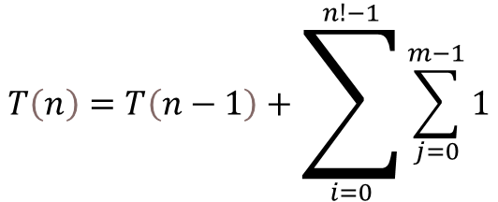
Analysis of Time Complexity
for i in perm(n - 1):
for j in range(len(i) + 1):
permsList.append(i[:j] + str(n) + i[j:])
n! because it is the number
of elements returned from
the recursive call
m is the number of
elements represented
by range(len(i) + 1)
T(n-1) is the recursive
call in the first for-loop
$$T\left(n\right)=T\left(n−1\right)+\sum_{i=0}^{n!−1}{\sum_{j=0}^{m−1}{1}}$$

Slide 19



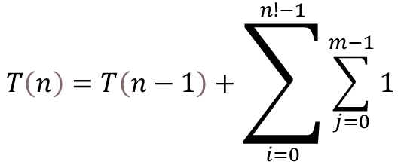


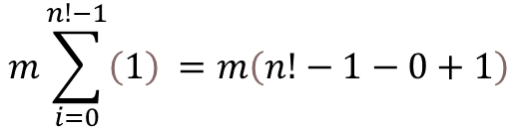

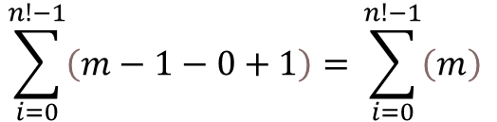

Analysis of Time Complexity
$$T\left(n\right)=T\left(n−1\right)+\sum_{i=0}^{n!−1}{\sum_{j=0}^{m−1}{1}}$$
$$T\left(n−1\right)=T\left(n−2\right)+Ω\left(mn!\right)$$
$$T\left(1\right)=0$$
$$\sum_{i=0}^{n!−1}{\left(m−1−0+1\right)= }\sum_{i=0}^{n!−1}{\left(m\right) }$$
$T\left(n\right)=T\left(n−2\right)+Ω\left(mn!\right)$…
$$m\sum_{i=0}^{n!−1}{\left(1\right) }=m\left(n!−1−0+1\right)$$
$$T\left(n\right)=T\left(n−k\right)+Ω\left(mn!\right)$$
$$k=n−1$$
$$T\left(n\right)=Ω\left(mn!\right)$$
Average & Best Cases
$$Ω\left(mn!\right)$$
$$T\left(n\right)=Ω\left(nn!\right)$$
Worst Case

Slide 20



Analysis of Time Complexity
$$T\left(n\right)=T\left(n−1\right)+\sum_{i=0}^{n!−1}{\sum_{j=0}^{m−1}{1}}$$
$$T\left(n\right)=θ\left(mn!\right)$$
Average Case
$$T\left(n\right)=O\left(nn!\right)$$
Worst Case
(where m = n)
$$T\left(n\right)=Ω\left(1\right)$$
Best Case
(where n = 1)

