Slide 1
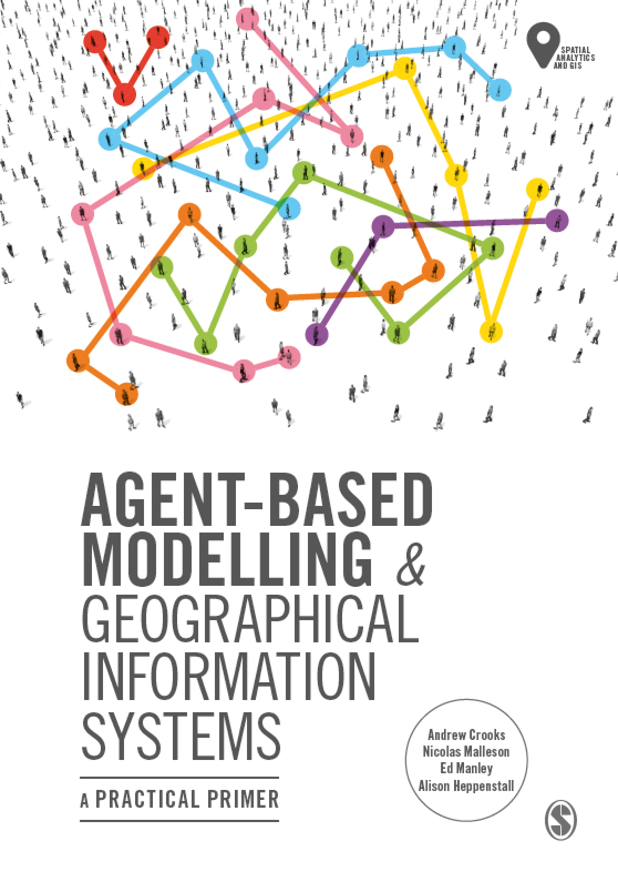
Chapter 7
Modelling Human Behavior
Notes:
This chapter explores the most common approaches by which researchers incorporate human behaviour into agent-based models. We explain why it can be necessary to model human behaviour and the main considerations that the researcher needs to be aware of when developing an agent-based model. From this, we present an overview of the two main broad approaches, mathematical and conceptual cognitive models when it comes to modelling human behaviour in agent-based models. We supplement this discussion with two case-studies that provide examples of how these approaches can be implemented, both examples have the model code available that can be downloaded and experimented with. The chapter finishes with a discussion of some of the thorny issues that researchers need to be aware of when attempting to simulate behaviour within agent-based models.

Slide 2
Learning Objectives

Slide 3
Introduction

Slide 4
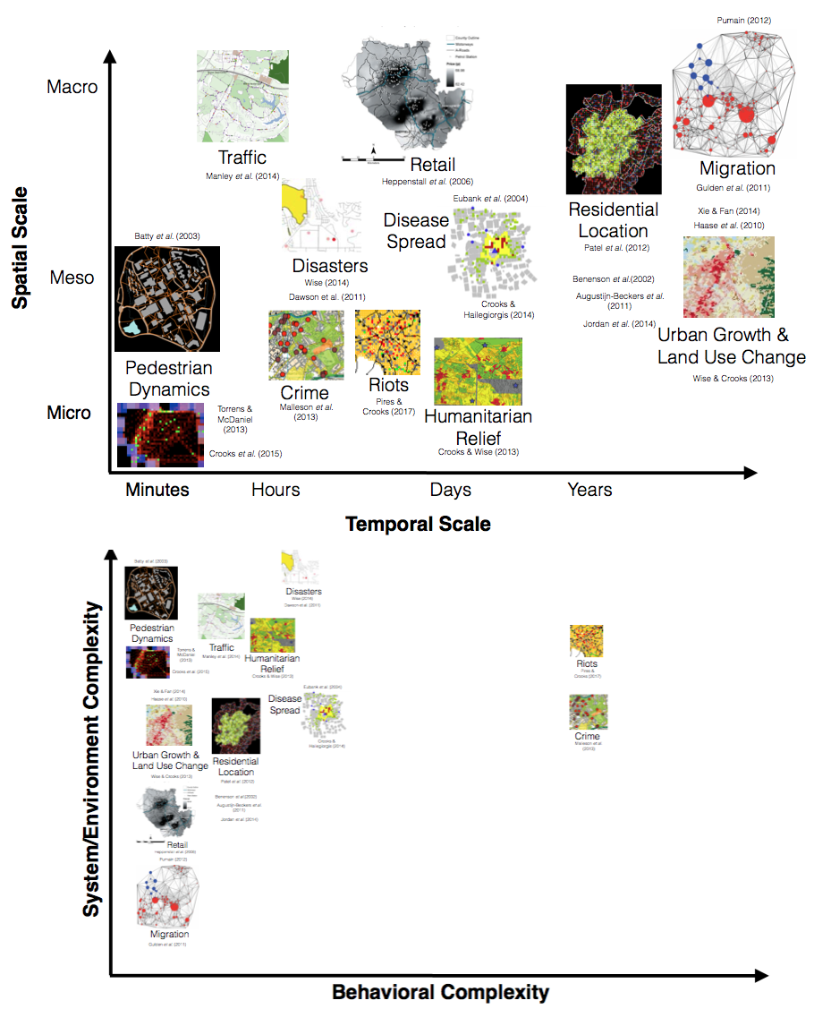
Behavioural complexity plotted against environmental complexity for selected applications
Notes:
Figure 7.1 Behavioural complexity plotted against environmental complexity for selected
applications

Slide 5
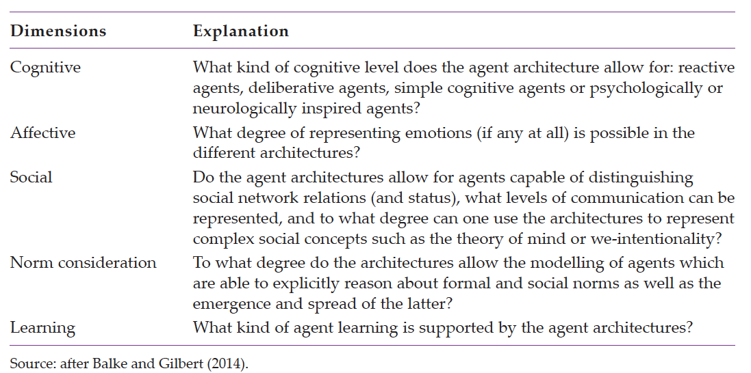
The five main dimensions for distinguishing agent architectures

Slide 6
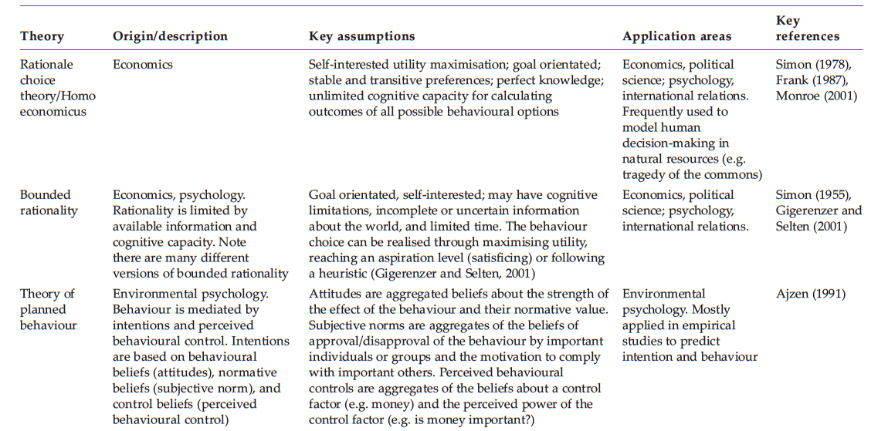
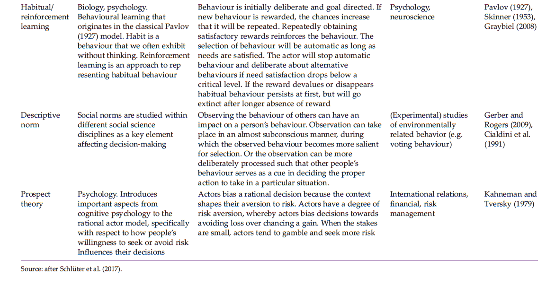
Overview of the key assumptions and application areas of popular theories used in representing behaviour

Slide 7
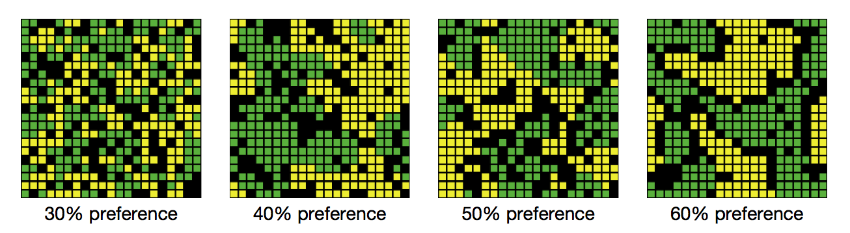
Resulting patterns of segregation from different threshold levels

Slide 8
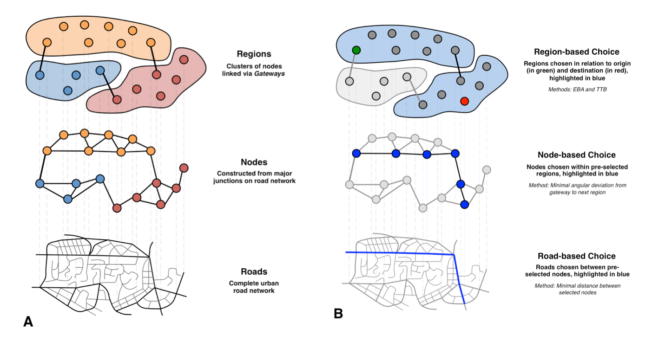
Heuristic model of route choice
(A) breakdown of space into a hierarchy, differentiating regional, node-based, and road segment-based decision-making; (B) an example route choice process, where different heuristic rule sets are engaged at each level of the hierarchy
Notes:
Heuristic model of route choice: (A) breakdown of space into a hierarchy, differentiating regional, node-based, and road segment-based decision-making; (B) an
example route choice process, where different heuristic rule sets are engaged at each level of the hierarchy

Slide 9
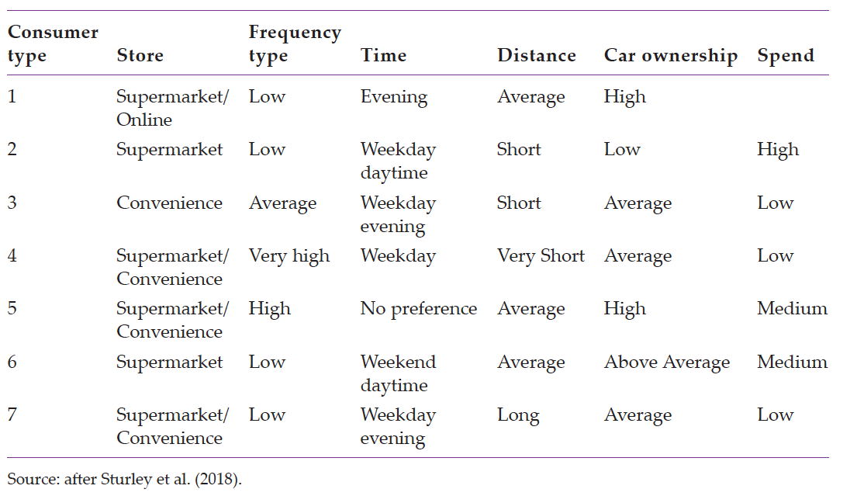
Summary of customer group characteristics

Slide 10
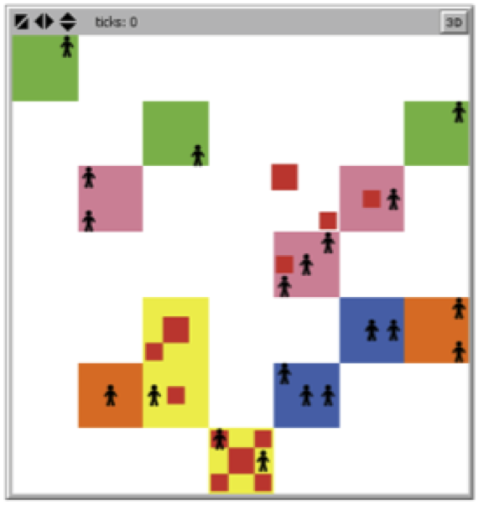
Basic spatial environment created within NetLogo that the consumer agents occupy
Model Available at: https://github.com/abmgis/abmgis/tree/master/Chapter07-ModellingHumanBehaviour/Models/Store_choice_model

Slide 11
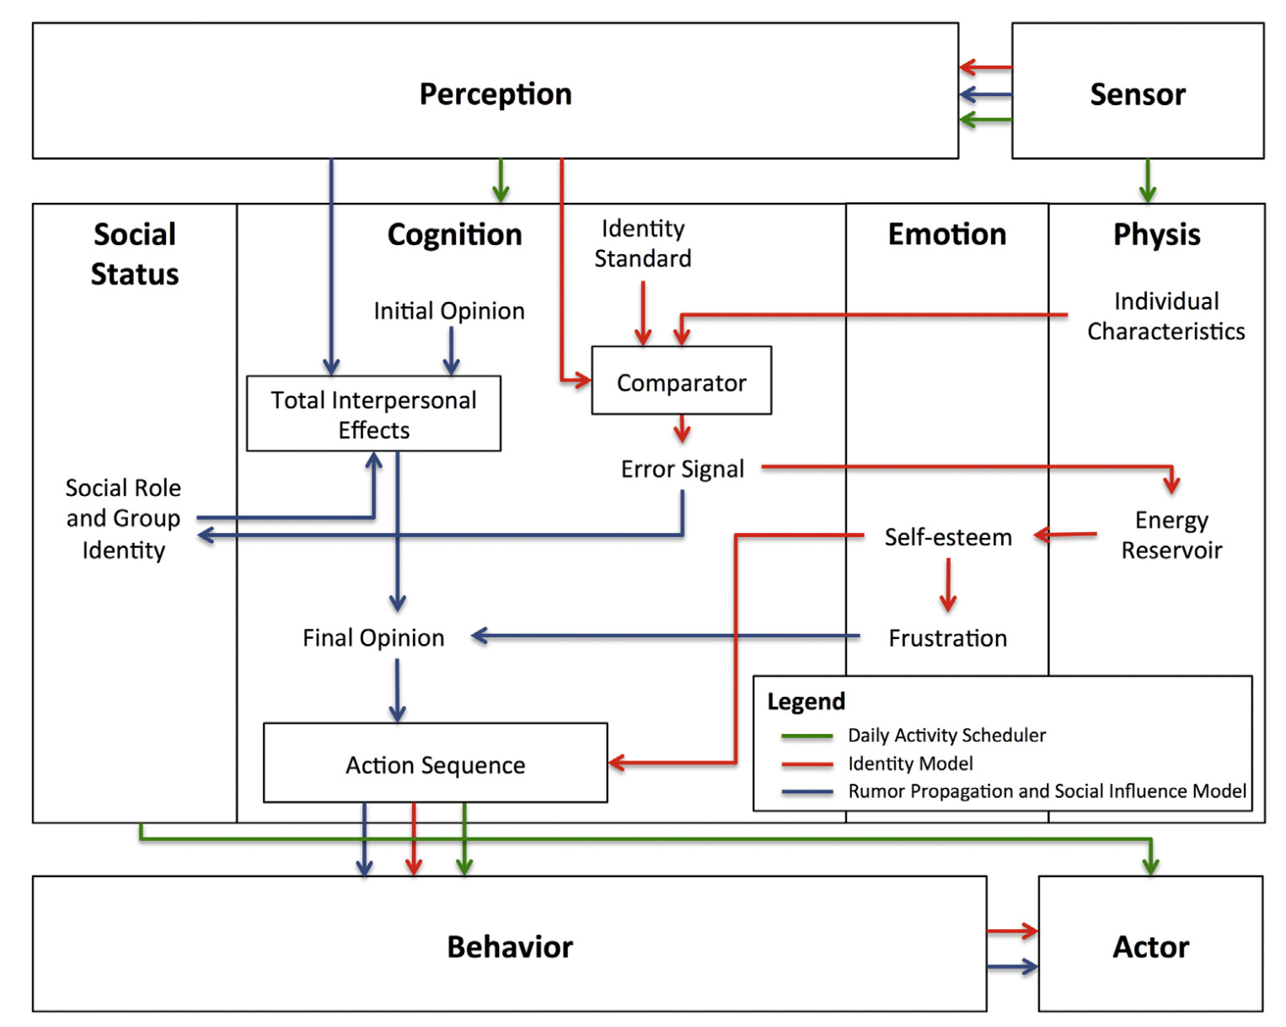
A high-level representation of the resident agent behaviour incorporated into the PECS framework
After Pires and Crooks, 2017, which was adapted in turn from Schmidt, 2000)

