Slide 1

Chapter 6 Tutorial
Integrating Agent-Based Models and GIS
Notes:
Model evaluation is one of the central challenges associated with agent-based models. A key question that all modelers face is “how well does this model simulate the phenomenon of interest?”. While there are no universally accepted methods for evaluating agent-based models, researchers often adopt the same three stage process of verification, calibration and validation. This chapter presents an overview of the methods that are commonly used within each of these stages. The overarching aim of this chapter is to provide the reader with the knowledge to design their own approach to evaluating agent-based models.

Slide 3
Box 6.2 NetLogo’s GIS extension
NetLogo’s GIS extension provides support for reading both vector data (in
the form of ESRI shapefiles) and raster data (in the form of ESRI ASCII grid
files). The NetLogo documentation states: ‘This extension adds GIS
(Geographic Information Systems) support to NetLogo. It provides the ability
to load vector GIS data (points, lines, and polygons), and raster GIS data
(grids) into your model.’
As with all NetLogo extensions, the model needs to ‘activate’ it with the
following line at the beginning of the model code:
extensions [gis]
For more information about the functionality provided by the GIS extension,
refer to the documentation at https://ccl.northwestern.
edu/netlogo/docs/gis.html. For detailed code examples, see
Section 6.4.1 (raster) and Section 6.4.2 (vector).

Slide 4
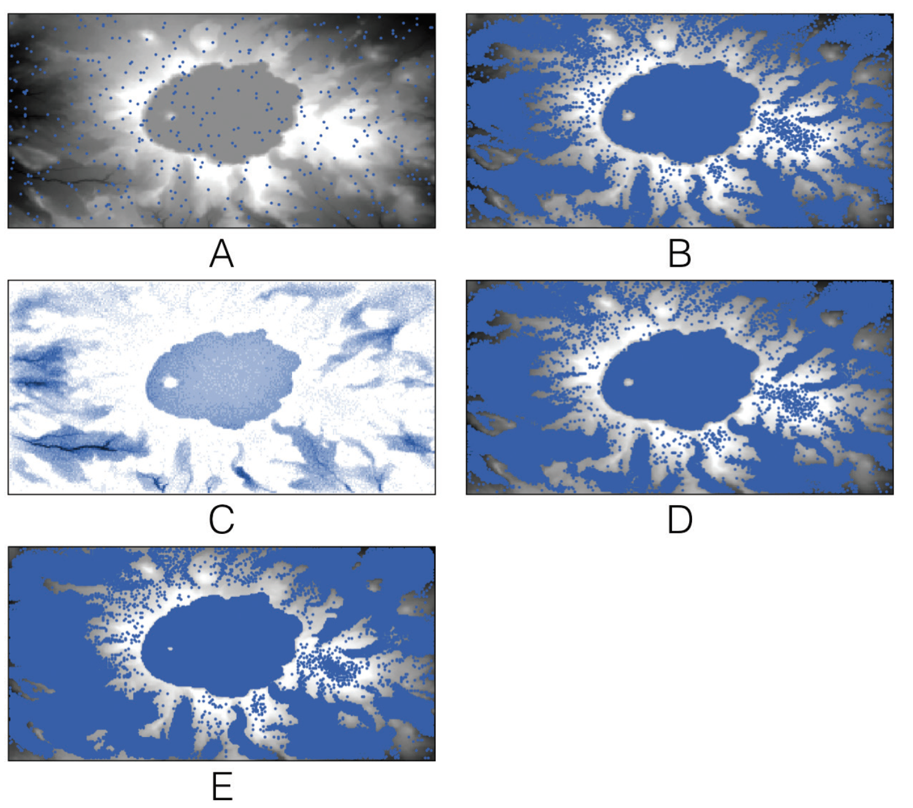
A simple hydrological model in which rain falls from the sky and flows downhill
(A) initial starting conditions where the blue dots represent agents (i.e. water) and the underlying digital elevation model;
(B) over time rain accumulates in Crater Lake;
(C) water depth at time step 500 and
(D) the corresponding water;
(E) Crater Lake has enough water for it to discharge.
Experiment with the Rainfall model, which is available in the accompanying
material. If you change the landscape (MapType) to Flat, Cone, and Hill, does the water behave as expected?
Click here to download the model

Slide 5
It is also necessary to define some global variables and some turtle and patch variables.
In particular, note the elevation-dataset global variable (this is used to store the raster GIS data) and the elevation patch variables (these are used to keep track of the initial elevation and current elevation once water starts to flow onto each patch).
Next it is necessary to read the DEM data. They are stored as an .asc file. This is a common raster format used by most GIS applications

Slide 6
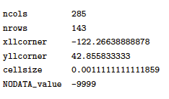
To load the DEM data into NetLogo it is first necessary to resize the model environment so that there is precisely one NetLogo patch per raster pixel.
It is possible to find the number of rows and columns in a raster data set using a GIS, but the process is even simpler with .asc files.
The first few lines of the file provide some information about the rest of the data. For example, the first six lines of the elevation.asc file, which we will read here, contain the following:

Slide 7
The first two lines declare the number of columns and rows of pixels. Therefore the NetLogo environment must be resized so that it has exactly that many rows and pixels.
In this example we would like the origin to remain in the centre of the world, hence it can be resized as follows:
resize-world -142 142 -71 71
Following this, the envelope needs to be configured so that it will map exactly on to the raster GIS data extent (refer to the gis:set-world-envelope documentation for more information).
gis:set-world-envelope gis:envelope-of elevation-dataset

Slide 8
Then the two apply-raster commands read the value of each raster cell and store this value in the patches’ elevation and initial-elevation variables (to begin with the elevation and initial elevation are the same because the model has not simulated any water). In effect this creates the mapping between raster cells and NetLogo patches.
gis:apply-raster elevation-dataset elevation
gis:apply-raster elevation-dataset initial_elevation

Slide 9
In effect “elevation” and “initial_elevation” creates the mapping between raster cells and NetLogo patches.
globals [
elevation-dataset
border ;; keep the patches around the edge in a global
;; so we don't ever have to ask patches in go
min-e ;;minimum elevation
max-e ;;maximum elevation
the-row ;;used in export-data. it is the row being written
list_of_rain_amount
]
patches-own [
elevation
initial_elevation
elevation_change
amount_rain ;;how many drops of rain here
]

