Slide 1

Chapter 6 Tutorial
Integrating Agent-Based Models and GIS
Notes:
Model evaluation is one of the central challenges associated with agent-based models. A key question that all modelers face is “how well does this model simulate the phenomenon of interest?”. While there are no universally accepted methods for evaluating agent-based models, researchers often adopt the same three stage process of verification, calibration and validation. This chapter presents an overview of the methods that are commonly used within each of these stages. The overarching aim of this chapter is to provide the reader with the knowledge to design their own approach to evaluating agent-based models.

Slide 2
Add Segregation Model (Text Box 6.5 etc)

Slide 3
Box 6.2 NetLogo’s GIS extension
NetLogo’s GIS extension provides support for reading both vector data (in
the form of ESRI shapefiles) and raster data (in the form of ESRI ASCII grid
files). The NetLogo documentation states: ‘This extension adds GIS
(Geographic Information Systems) support to NetLogo. It provides the ability
to load vector GIS data (points, lines, and polygons), and raster GIS data
(grids) into your model.’
As with all NetLogo extensions, the model needs to ‘activate’ it with the
following line at the beginning of the model code:
extensions [gis]
For more information about the functionality provided by the GIS extension,
refer to the documentation at https://ccl.northwestern.
edu/netlogo/docs/gis.html. For detailed code examples, see
Section 6.4.1 (raster) and Section 6.4.2 (vector).

Slide 4
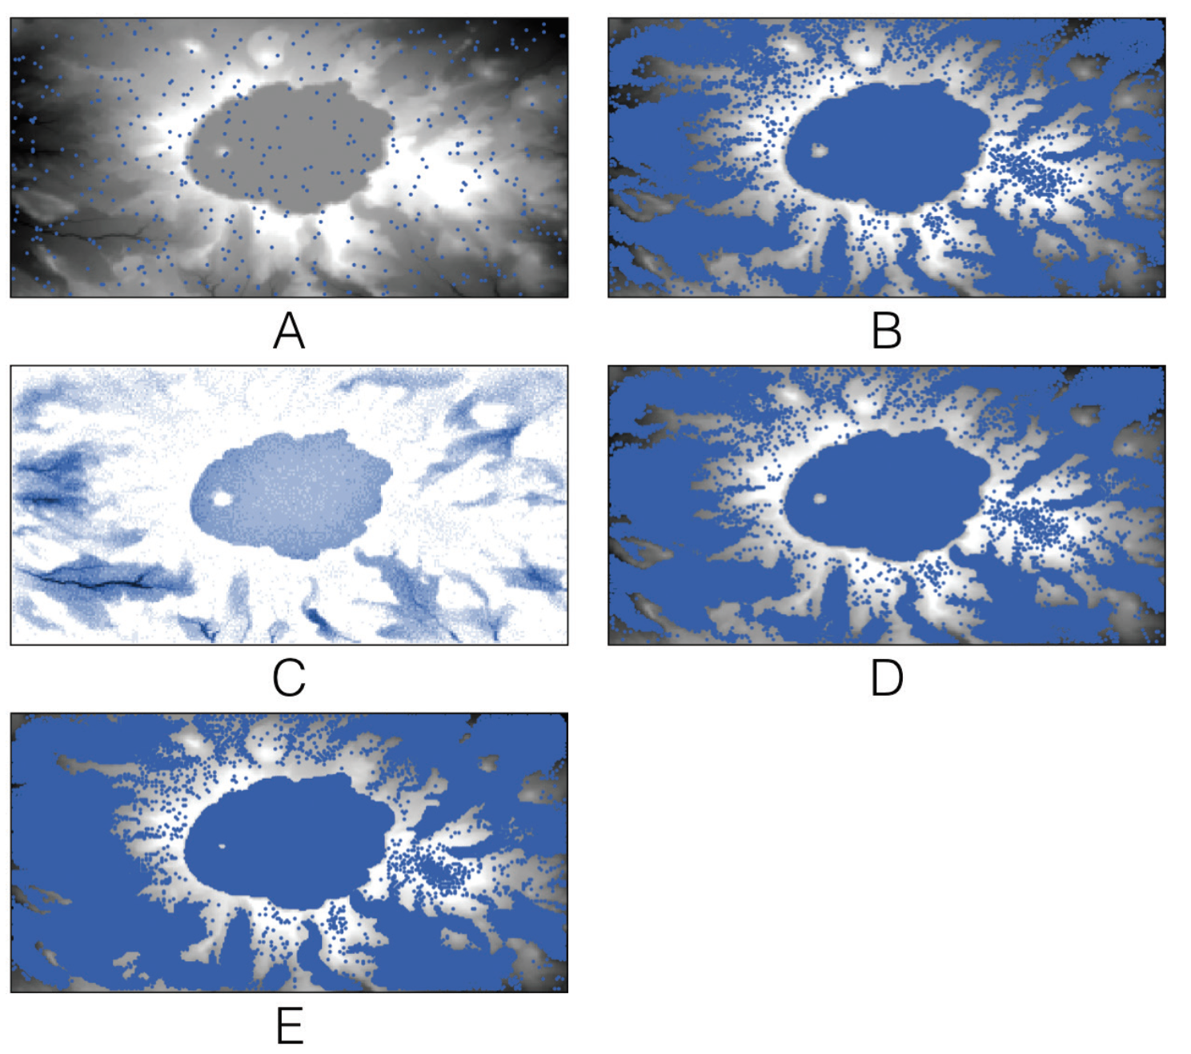
A simple hydrological model in which rain falls from the sky and flows downhill
(A) initial starting conditions where the blue dots represent agents (i.e. water) and the underlying digital elevation model;
(B) over time rain accumulates in Crater Lake;
(C) water depth at time step 500 and
(D) the corresponding water;
(E) Crater Lake has enough water for it to discharge.
Experiment with the Rainfall model, which is available in the accompanying
material. If you change the landscape (MapType) to Flat, Cone, and Hill, does the water behave as expected?
Click here to download the model

