Slide 1
REST. MySQL. Express. Handlebars
The Coding Bootcamp

Slide 2
HTTP & REST

Slide 3
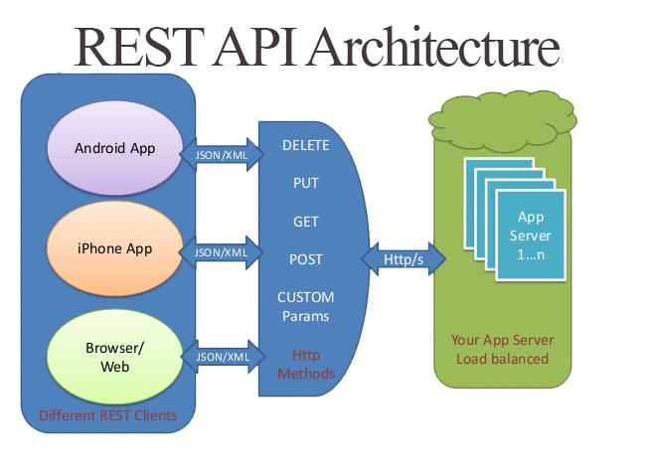

Slide 4
URLs and HTTP methods: Nouns and verbs
URLs refer to a thing; they are the nouns of REST
/
/api/movies
/api/movies/3
/customers/33245/orders/8769/lineitems/1
HTTP methods describe what to do to the thing; they are the verbs of REST
POST – Create
GET – Retrieve
PUT – Update
DELETE – Delete

Slide 5
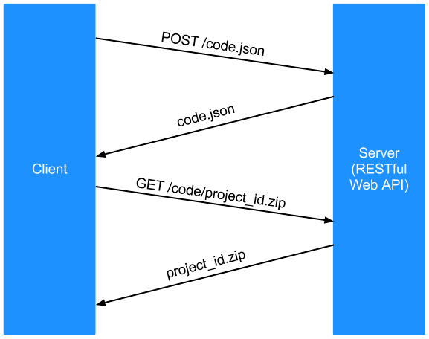



Slide 6
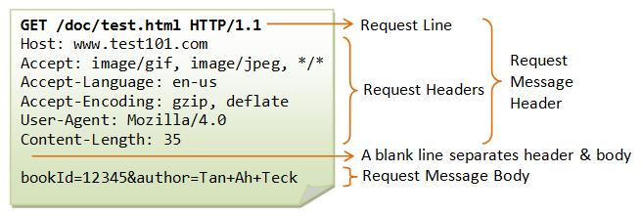

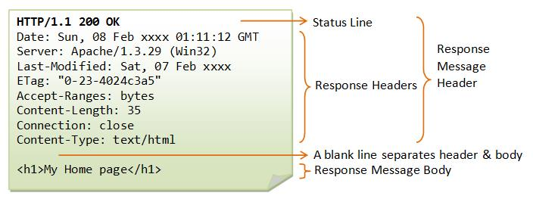
HTTP Request / Response
Request from Browser to Server →
← Response from Server to Browser

Slide 7
POST Request with a body
POST /api/books HTTP/1.1

Slide 8
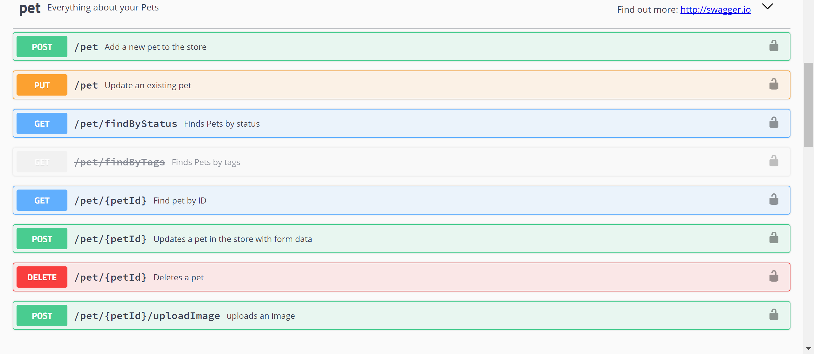
Example REST API
http://petstore.swagger.io/

Slide 9
Common HTTP response codes
200 OK
This response code indicates that the request was successful.
400 Bad Request
The request was malformed. This happens especially with POST and PUT requests, when the data does not pass validation, or is in the wrong format.
401 Unauthorized
This error indicates that you need to perform authentication before accessing the resource.
404 Not Found
This response indicates that the required resource could not be found. This is generally returned to all requests which point to a URL with no corresponding resource.
500 Internal Server Error
When all else fails; generally, a 500 response is used when processing fails due to unanticipated circumstances on the server side, which causes the server to error out.
https://code.tutsplus.com/tutorials/a-beginners-guide-to-http-and-rest--net-16340

Slide 10


Implementing REST with Express and MySQL

Slide 11
Serving browser assets

Slide 12
There are 2 kinds of data/files that web servers need to be able to send to a browser:
Data/files/assets for use by the browser
HTML
CSS
Javascript
Images
Fonts
Data for use by the Javascript running in the browser
REST APIs
Usually use JSON, could also be XML
res.sendFile
res.render
express.static
res.json

Slide 13
How HTML, CSS, & Javascript gets to the browser
Web browser
GET /index.html
Web server
index.html
GET /assets/css/app.css
app.css
GET /assets/js/app.js
app.js

Slide 14


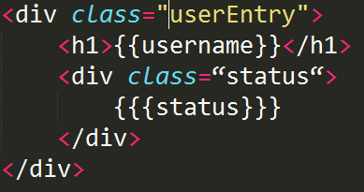
Static HTML vs dynamic HTML
Web browser
Web server
GET /index.html
index.html
res.sendFile()
index.html
or express.static()
Static
GET /movies.html
movies.handlebars
res.render()
movies.html
Dynamic

Slide 15
Handlebars
From https://www.slideshare.net/iivanoo/handlebars-and-requirejs

Slide 16
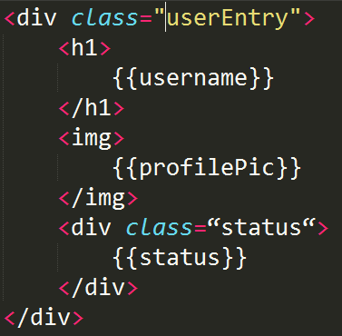
Handlebars template
A handlebars expression is
{{ something }}

Slide 17
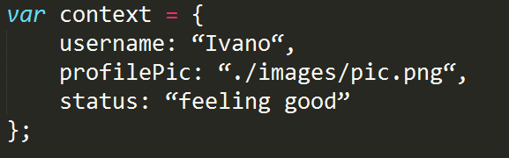
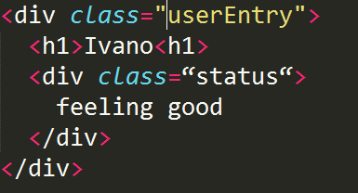
Templates with placeholders.
Stored in views/*.handlebars
Context object; the keys of the object must match with the name of the placeholder to be populated
Combine like Voltron in res.render to form final HTML

Slide 18
Built-in helpers
each
Inside the block, you can use this to reference the element being iterated
To iterate over a list
{ people: [ “Ivano", “Andrea", “Paolo" ] }
<ul class="people_list">
{{#each people}}
<li>{{this}}</li>
{{/each}}
</ul>
<ul class="people_list">
<li>Ivano</li>
<li>Andrea</li>
<li>Paolo</li>
</ul>

Slide 19
Built-in helpers
#if / else
The unless helper is the inverse of if
It renders the block if its argument is not equal to false, undefined, null, []
{ title: "My first post!", author: undefined }
}
<div class="entry“>
<h1>{{title}}</h1>
{{#if author}}
<h2>By {{firstName}} {{lastName}}</h2>
{{#else}}
<h2>Unknown author</h1>
{{/if}}
<div class="entry“>
<h1>My first post!</h1>
<h2>Unknown author</h2>
</div>

Slide 20
How views and layouts fit together
Layout template
View template #1
<html lang="en">
<head>
<meta charset="UTF-8">
<title>Day planner!</title>
</head>
<body>
{{{ body }}}
</body>
</html>
<h1>Day Planner</h1>
<ul>
{{#each plans}}
<li>
<p>
{{id}}. {{plan}}
<button type="submit">Delete Plan!</button>
</p>
</li>
{{/each}}
</ul>
res.render()
Returned to the browser
View template #2
<h1>Movies To Watch</h1>
<ul>
{{#each movies}}
<li>
{{id}}. {{movie}}
</li>
{{/each}}
</ul>

Slide 21
HTML escaping
Handlebars HTML-escapes all the values returned by an {{ expression }}
If you don't want Handlebars to escape a value, use the "triple-stash" →→ {{{ expression }}}

