Slide 1
Parallelizations of the Viterbi Algorithm
Kenan Karavoussanos
1348582

Slide 2
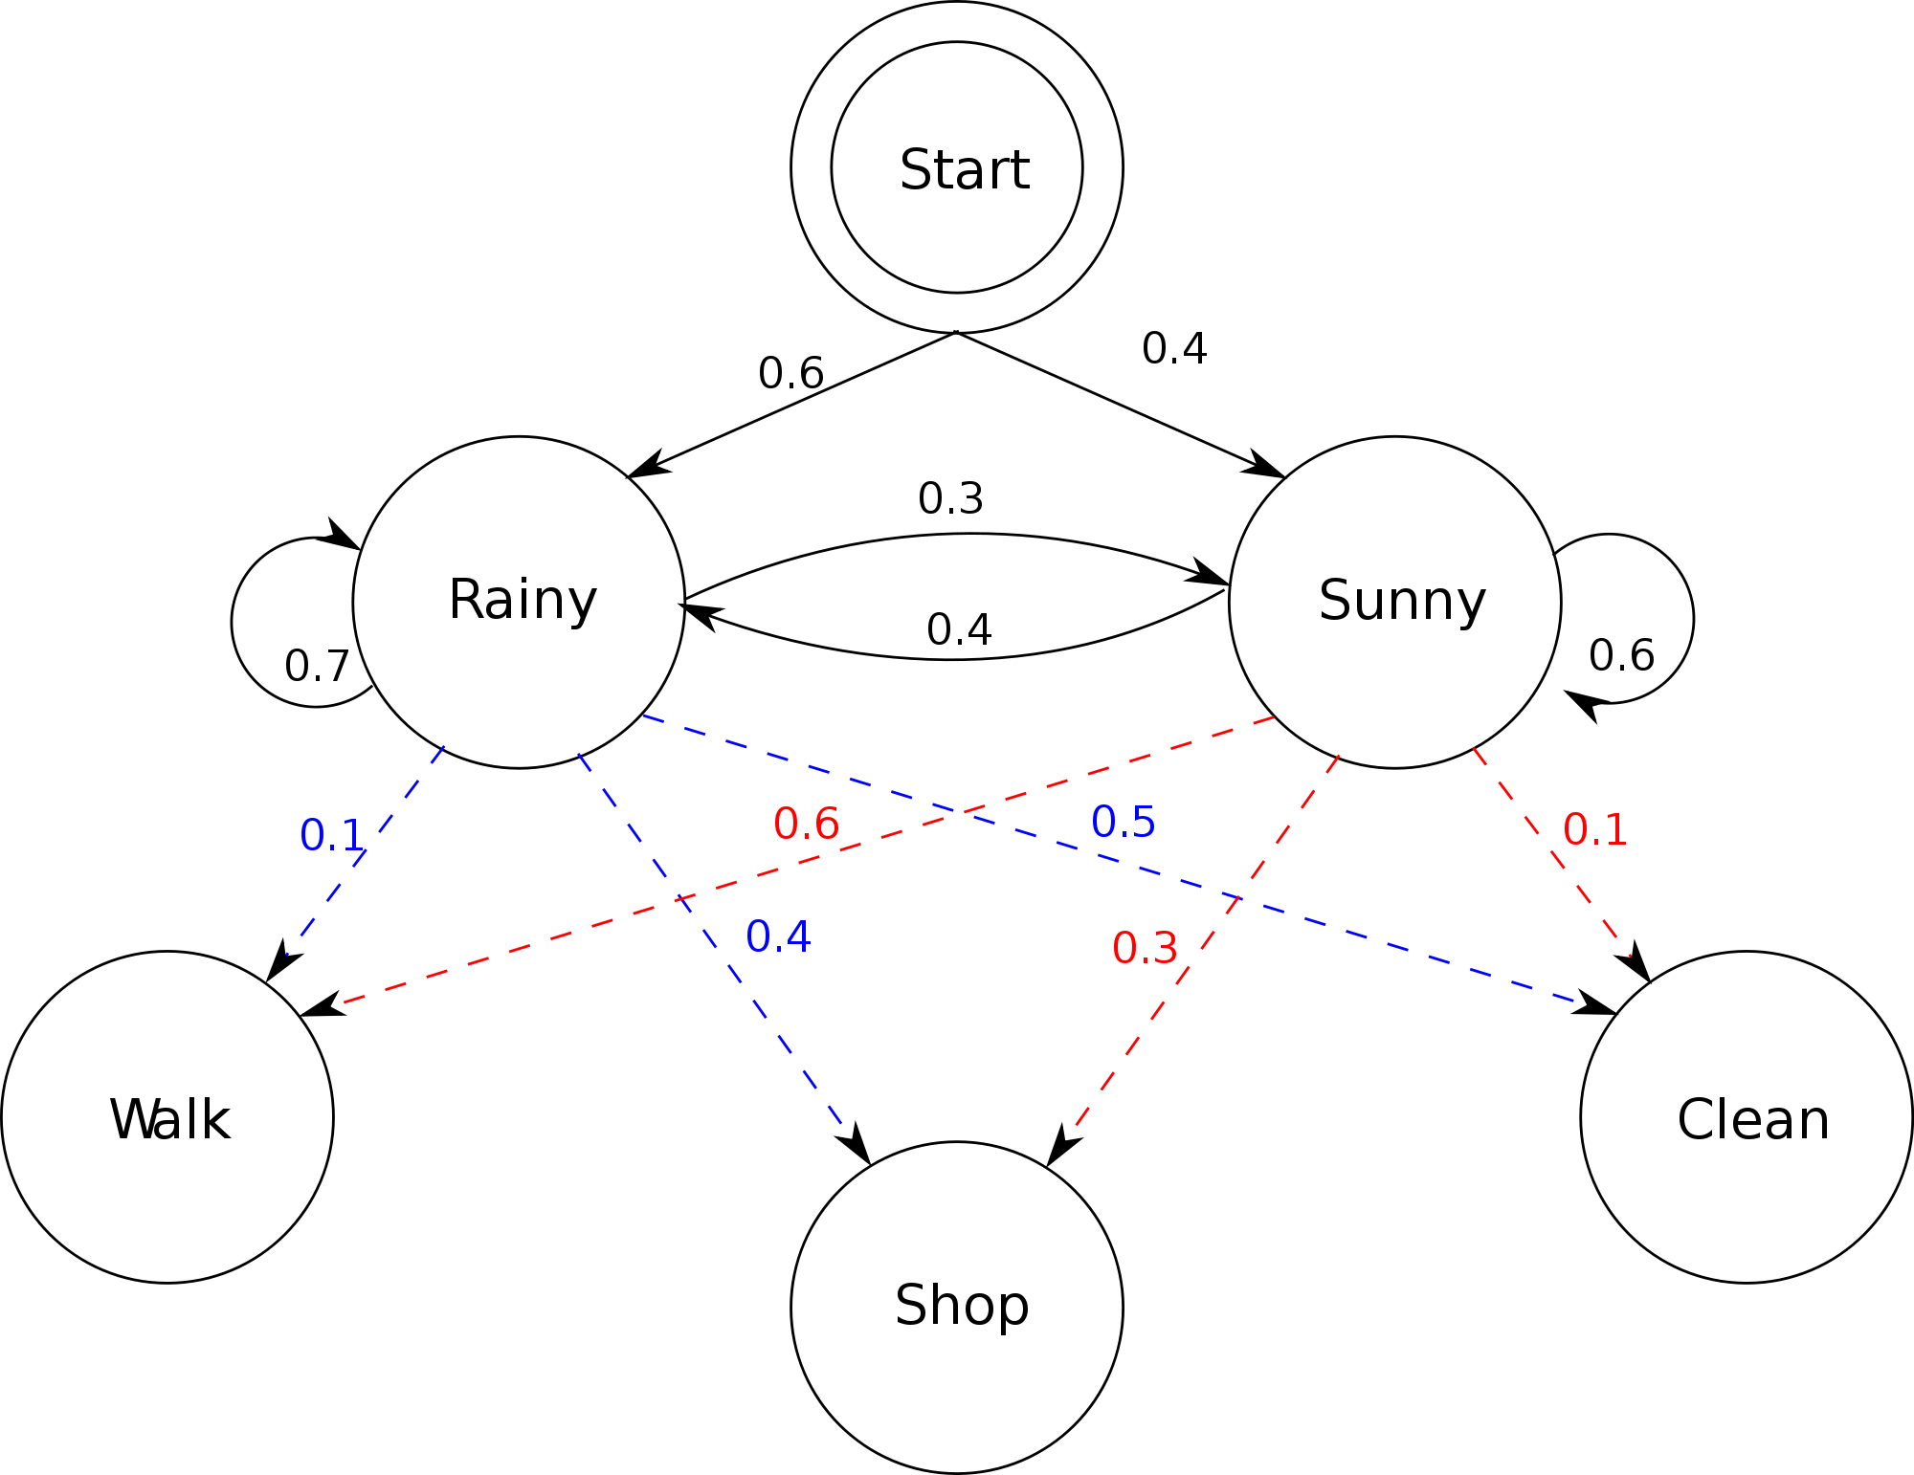
Hidden Markov Models

Slide 3
Problem
Given a set of observations Y
Determine the most likely path of states, X, which produces Y.

Slide 4
Viterbi Algorithm
Dynamic Programming Algorithm
Populates 2 tables column by column.
Each entry in column j requires all values in column j-1 to be calculated.
Once the tables are populated, the path X is generated by backtracking.

Slide 5
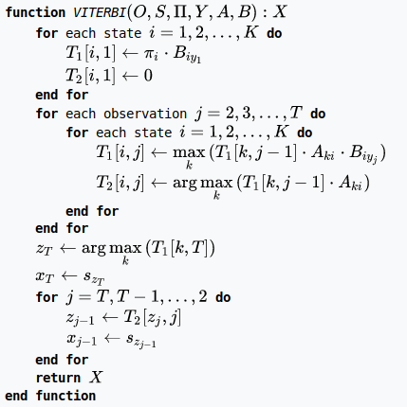
Viterbi Pseudocode

Slide 6
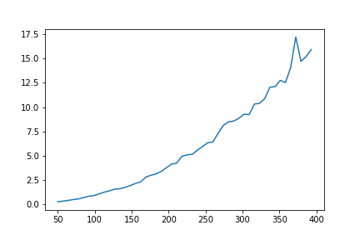
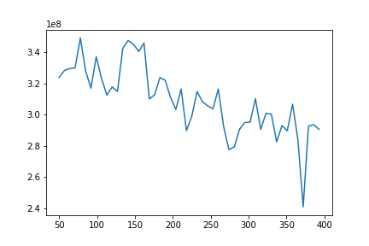
Serial Implementation
Complexity: O(K^2 * T)
Where K is the number of states and T is the number of observations

Slide 7
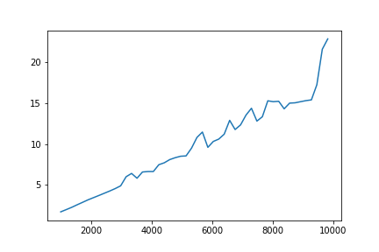
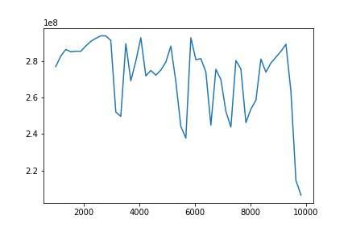
Serial Implementation

Slide 8
CUDA Implementation
Each state, k, corresponding to a row in our tables is assigned a thread.
For each column the values are calculated and the threads are synchronized at the end

Slide 9
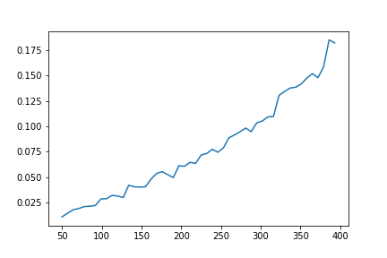
CUDA Experiments: Varying K

Slide 10
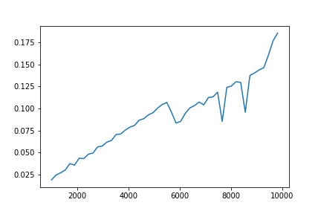
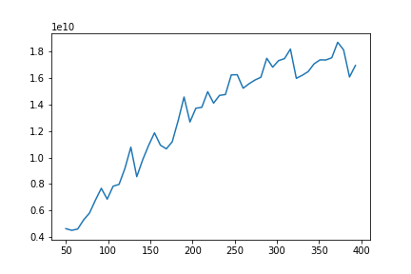
CUDA Experiments: Varying T

Slide 11
MPI Implementation
Each node is assigned a set of states (rows in our table)
Load is balanced by assigning approaximately equal chunks to each node.
For each column, each node computes its own subcolumn
These subcolumns are combined on a single node then the combined column is broadcast to all nodes.

Slide 12
MPI results
Full experiments still to be run.
However for K = 400
T = 10000
running on 8 nodes on the MSCluster
Execution time is approximately 15.5 seconds

Slide 13
Serial Vs MPI
Serial Implementation achieved 22.8 seconds
~1.5 times faster
Large communication cost

