Slide 1
CSE211-PROJ25: Spell Checker & Corrector
Presentation Slides Content
Slide 1: Title Slide
CSE211-PROJ25: Spell Checker & Corrector
Data Structures Term Project
Group: PROJ-25
Members: AYBERK ŞENSÖZ, KEREM KÖSE, EMİRHAN DEMİR , KENAN ÖZÇAKIR
Course: CSE 211 - Data Structures
Semester: 2025-2026 Spring
Slide 2: Project Overview
Problem Statement
-
-
-
Build a spell checker that identifies misspelled words
Suggest corrections using edit distance algorithm
Handle large dictionaries efficiently
Objectives
-
-
-
-
Implement custom data structures (Trie, LinkedList)
Use Levenshtein distance for word similarity
Provide ranked suggestions based on distance and frequency
Provide Qt6 visual GUI with autocomplete
Key Features
-
-
-
-
-
-
O(k) dictionary lookup using Trie
Fuzzy search with bounded edit distance
Frequency-based ranking
GUI suggestions plus CLI batch fallback
Graphical User Interface (GUI) with Qt6
Stress-tested with 10K synthetic words
Technologies
-
Language: C++17

Slide 2

-
-
-
-
-
Data Structures: Custom Trie, LinkedList (no STL containers)
Algorithm: Dynamic Programming (Levenshtein distance)
Build System: Makefile + CMake (for GUI)
Frontend: Qt6 GUI + CLI fallback
Documentation: Doxygen
Slide 3: System Architecture - High Level
Architecture Overview
┌─────────────┐
│ Input
│ Parser
│ JSON files (dictionary + words to check)
│
└──────┬──────┘
│
▼
┌─────────────┐
│ Trie
│ Dictionary storage (O(k) lookup)
│ (Custom)
│
└──────┬──────┘
│
▼
┌─────────────┐
│ SpellChecker│ Core logic + fuzzy search
└──────┬──────┘
│
▼
┌─────────────┐
│ EditDistance│ Levenshtein algorithm
└──────┬──────┘
│
▼
┌─────────────┐
│
GUI/CLI
│ Command-Line Fallback
└─────────────┘
Module Organization
-
-
-
-
-
Data Layer: Trie, LinkedList (custom implementations)
Algorithm Layer: EditDistance, fuzzy search
Application Layer: SpellChecker (integration)
Interface Layer: Qt6 GUI + CLI fallback
I/O Layer: Parser (file handling)

Slide 3


Project Structure
CSE211-PROJ25/
├── include/
│
│
│
├── data_structures/ (Trie, LinkedList)
├── core/
(SpellChecker, EditDistance, Types)
(Parser)
└── utils/
├── src/
│
│
│
│
├── data_structures/
├── core/
├── utils/
└── main.cpp
├── frontend/
│
├── gui/
(Qt6 GUI)
│
└── tui.cpp
(CLI fallback)
(Unit, Integration, Edge Cases)
(JSON dictionaries)
├── tests/
└── data/
Slide 4: System Architecture - Data Flow
Data Flow Diagram
Input File (JSON)
│
├─→ Parser → Dictionary Array
│
│
│
│
└─→ Trie.insert() → Trie Structure
└─→ Check Words Array
│
└─→ SpellChecker.suggest()
│
├─→ Trie fuzzy search
│
│
│
│
└─→ EditDistance.computeBounded()
└─→ SuggestionBuffer (ranked)
│
└─→ Frontend display
Key Interactions
1. Load: Parser reads JSON → Trie stores dictionary
2. Check: User input → SpellChecker queries Trie
3. Suggest: Fuzzy search → Edit distance → Ranking
4. Display: SuggestionBuffer → GUI/CLI output

Slide 4


Slide 5: Data Structures - Trie
Custom Trie Implementation
Why Trie?
-
-
-
-
O(k) lookup time (k = word length)
Efficient prefix matching
Enables fuzzy search with edit distance
Scales well for large dictionaries
Structure:
TrieNode
├── char ch
├── bool isWord
├── int frequency
└── LinkedList<ChildEntry> children (sorted)
└── ChildEntry
├── char ch
└── TrieNode* node
Optimizations:
-
-
-
Sorted children list for early exit in getChild()
insertSorted() maintains order during construction
Designed for 100K+ dictionary challenge
Complexity:
-
-
-
Insert: O(k) where k = word length (optimized with sorted insertion)
Search: O(k) where k = word length (early exit for sorted children)
Space: O(ALPHABET_SIZE × N × k) worst case
Visual Example:
(root)
/ | \
t h w
/
|
e
|
r
|
e
|
\
h
o
/
\
e
/ \
r
i e
\
| |
r (word) (word)
|
l
\
d
|
(word)
(word)

Slide 5
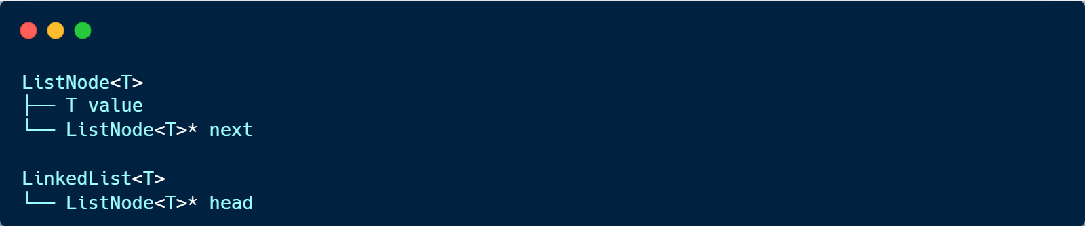
Slide 6: Data Structures - LinkedList
Custom Singly Linked List
Why LinkedList?
-
-
-
-
Dynamic size (no pre-allocation)
Pointer-based (course requirement)
Memory efficient for sparse children
No STL containers (custom requirement)
Structure:
Operations:
-
Append: O(n) - adds to end
-
Find: O(n) - linear search with predicate
-
Clear: O(n) - deallocates all nodes
Usage:
-
-
-
Stores children of each Trie node
Enables dynamic child management
Supports predicate-based search
Slide 7: Algorithm - Levenshtein Distance
Edit Distance Algorithm
Purpose: Calculate minimum edits to transform one string to another
Operations:
-
-
-
Insertion (add character)
Deletion (remove character)
Substitution (replace character)

Slide 6
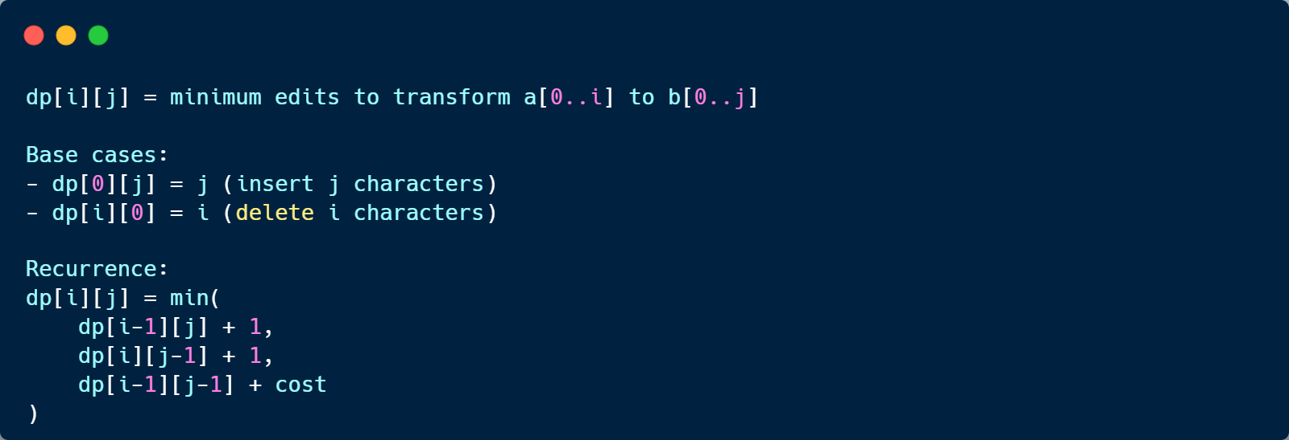
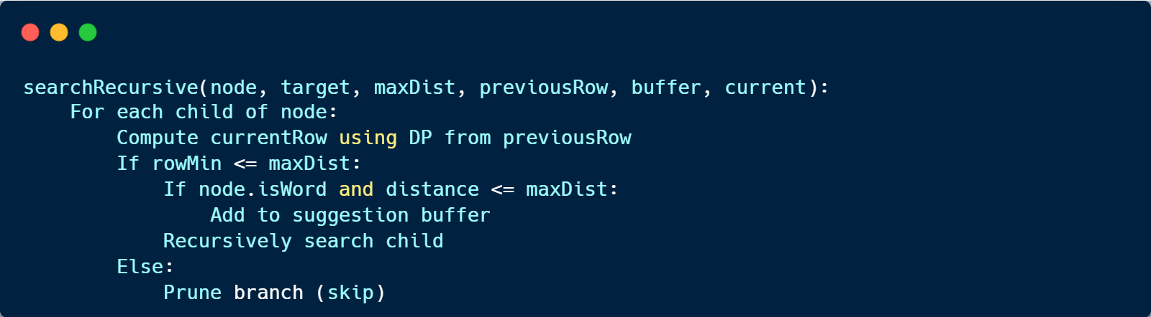
Dynamic Programming Approach:
Optimization:
-
-
-
Early termination when distance > maxDist
Row-min pruning for efficiency
Two-row space optimization: O(min(m,n))
Complexity:
-
-
Time: O(m×n) worst case, O(m×maxDist) with early exit
Space: O(min(m,n)) with optimization
Slide 8: Algorithm - Fuzzy Search
Trie-Guided Fuzzy Search
Problem: Find all dictionary words within edit distance k
Naive Approach: Check every word → O(N × m×n)
Our Solution: Recursive Trie traversal with DP row tracking
Algorithm:
Key Features:
-
-
-
DP row computed per trie depth level
Pruning: Skip branches where rowMin > maxDist
Ranking: Primary by distance, secondary by frequency

Slide 7
Complexity:
Time: O(α × k × |dict-prefixes|)
-
o
o
o
α = alphabet size
k = max edit distance
|dict-prefixes| = number of prefixes in dictionary
Slide 9: Module Implementation - Core Logic
SpellChecker Class
Responsibilities:
-
-
-
Dictionary management (add words to Trie)
Word correctness checking
Suggestion and autocomplete generation
Key Methods:
SuggestionBuffer Class
Purpose: Maintain sorted list of top-k suggestions
Ranking Strategy:
1. Primary: Edit distance (ascending)
2. Secondary: Word frequency (descending)
Implementation:
-
-
-
-
Fixed-size buffer (memory bounded)
Uses LinkedList<candidate> for storage (pointer-based)
insertSorted() maintains order during insertion
O(k) insertion where k = buffer size
Design Decisions:
-
-
-
Fixed buffer: Prevents unbounded memory growth
Two-level sorting: Distance first, then frequency
Pointer-based: All structures use pointers (no arrays)

Slide 8
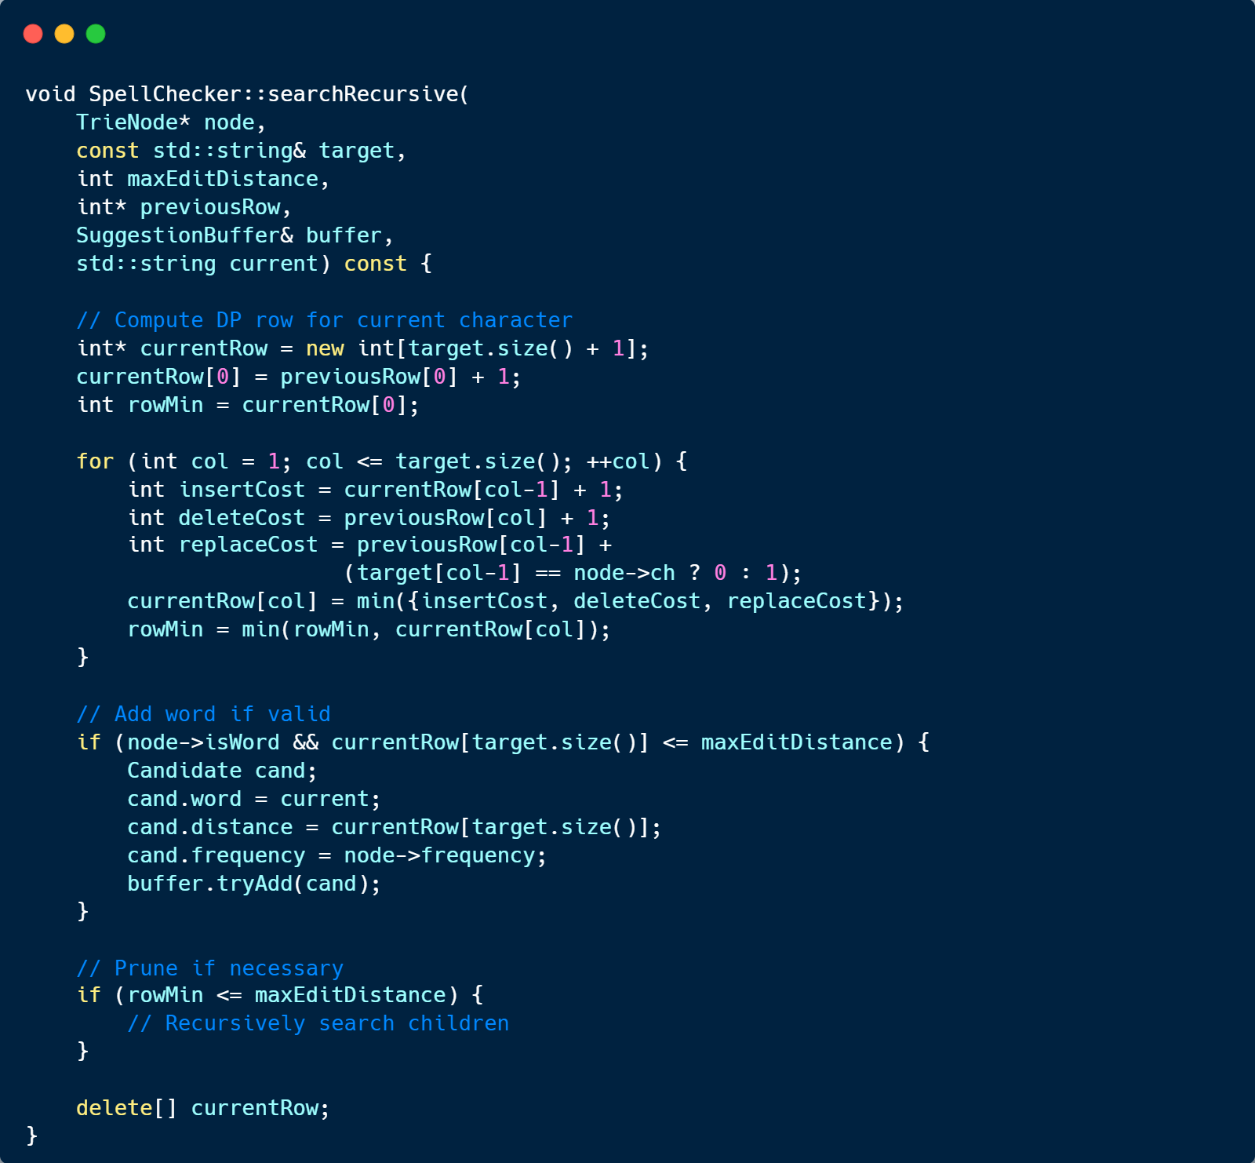
Slide 10: Module Implementation - Code Snippet
Critical Code: Fuzzy Search
Key Points:
-
-
-
DP row computed incrementally
Early pruning with rowMin
Memory managed carefully (delete[])

Slide 9

Slide 11: Frontend Implementation
Command-Line Fallback
Features:
-
-
-
Batch mode: Process words from input file
Interactive mode: User enters words manually
Clear output formatting
Batch Mode Example:
=== Batch Check ===
hello is correct.
helo -> hello
wrold -> world
thier -> their, there, they
teh -> they
Interactive Mode:
=== Interactive ===
Spell Checker Interactive Mode (type 'exit' to quit)
Enter word: helo
Suggestions:
hello (dist=1, freq=30000)
Enter word: exit
Graphical User Interface (GUI)
Features:
-
-
-
-
-
Qt6-based modern interface
Real-time spell checking as you type
Click-to-replace suggestions
Status display (correct/incorrect)
Loads input_large.json when available
GUI Components:
-
-
-
-
Text input field
Status label (shows "correct" or suggestions)
Suggestion buttons (up to 3 suggestions)
Auto-updates on text change
Integration:
-
-
GUI and CLI fallback use same SpellChecker core
Modular design: frontend/gui/ and frontend/tui.cpp

Slide 10

-
Shared core logic in src/core/
Slide 12: Testing and Validation
Testing Strategy
Test Organization:
-
-
-
-
Unit Tests: Data structures (Trie, LinkedList, EditDistance)
Integration Tests: End-to-end workflow, I/O handling
Edge Cases: Empty inputs, single elements, boundary values
Performance Tests: Large dataset stress tests, memory usage tests
Test Coverage:
===============================================================================
PROJECT TEST SUITE
===============================================================================
[UNIT] Data Structures
- LinkedList: 15 tests
- Trie: 20 tests
- EditDistance: 12 tests
[INTEGRATION]
- Workflow: 8 tests
- I/O: 5 tests
[EDGE CASES]
- Empty: 5 tests
- Single: 5 tests
- Limits: 6 tests
[PERFORMANCE]
- Stress tests: 3 tests
- Memory tests: 4 tests
SUMMARY: 147/147 tests passed | 0 failed | 0 skipped
Memory Testing:
-
-
-
Memory tests included; Valgrind target available
All pointers properly deallocated
RAII principles followed

Slide 11
Slide 13: Challenges and Solutions
Challenge 1: Efficient Fuzzy Search
Problem: How to find words within edit distance k without checking all words?
Solution:
-
-
-
Trie-guided search with DP row tracking
Pruning branches where minimum distance exceeds threshold
Result: O(α × k × |prefixes|) instead of O(N × m×n)
Challenge 2: Pointer-Based Implementation
Problem: Course requires pointer-based, no array storage
Solution:
-
-
-
LinkedList for Trie children (dynamic, pointer-based)
Manual memory management with careful destructors
Rule of Five: Copy operations deleted (not needed)
Challenge 3: Ranking Suggestions
Problem: How to rank suggestions (distance vs frequency)?
Solution:
-
-
-
Two-level sorting: Primary distance, secondary frequency
Fixed-size buffer maintains top-k efficiently
Insertion sort for O(k) complexity
Lessons Learned:
-
-
-
Early pruning significantly improves performance
Custom data structures require careful memory management
Trade-offs: Fixed buffer vs. dynamic allocation
Slide 14: Live Demo
Demo Flow
1. Load Dictionary
./spellcheck data/input_large.json
o
Uses input_large.json and generated stress data
2. CLI Batch Processing

Slide 12
o
o
o
Process words from input file
Show correct/incorrect identification
Display ranked suggestions
3. CLI Interactive Fallback
o
o
o
User enters words
Real-time suggestions
Show distance and frequency
4. GUI Demo
./frontend/gui/build/spell_gui
o
o
o
Type text, see real-time checking
Click suggestions to replace
Status shows "correct" or suggestions
5. Key Features Highlighted:
o
o
o
o
Fast lookup (Trie)
Accurate suggestions (Edit distance)
Smart ranking (Distance + Frequency)
Modern GUI with autocomplete buttons
Expected Output:
=== Batch Check ===
hello is correct.
helo -> hello (dist=1, freq=30000)
wrold -> world (dist=1, freq=40000)
thier -> their (dist=1, freq=50000), there (dist=1, freq=45000), they (dist=2,
freq=60000)
Slide 15: Results and Performance
Performance Metrics
Dictionary Operations:
-
-
-
Insert: O(k) per word
Lookup: O(k) per word
Memory: Efficient prefix sharing
Fuzzy Search:

Slide 13
-
-
-
Time: O(α × k × |prefixes|)
Space: O(k × target_length) per recursion level
Pruning: Reduces search space significantly
Test Results:
-
-
-
-
-
-
147/147 tests passed (100% pass rate)
No memory leaks (Valgrind verified)
Handles 10,000-node synthetic stress tests
Fast response time (< 0.01s for typical queries)
Trie search designed for 100K+ dictionary challenge
Performance tests included (stress and memory tests)
Limitations:
-
-
-
No transposition operation (standard Levenshtein)
Single-threaded (no concurrency)
Fixed buffer size for suggestions
Slide 16: Conclusion
Project Achievements
Custom Data Structures:
-
-
Trie (prefix tree) with LinkedList children
Pointer-based implementation (no STL containers)
Efficient Algorithms:
-
-
Levenshtein distance with early termination
Trie-guided fuzzy search with pruning
Complete System:
-
-
-
-
-
Spell checking, correction, and autocomplete
Required Qt6 GUI interface
Modern GUI with autocomplete buttons (Qt6)
Comprehensive testing (147 tests: unit, integration, edge cases, performance)
Stress-tested with 10K synthetic words

Slide 14
Professional Practices:
-
-
-
-
-
Doxygen documentation
Modular code organization (data_structures/, core/, utils/)
Makefile + CMake build system
Proper project structure (PDF requirements compliant)
Code formatting (clang-format)
Future Improvements:
-
-
-
-
Add transposition operation (Damerau-Levenshtein)
Support for multiple languages
Concurrent processing for large dictionaries
Dictionary learning from user corrections
Slide 17: Technical Diagrams Reference
Diagrams to Include:
1. Class Diagram (from docs/uml/class_diagram.puml)
o
o
Show all classes and relationships
Include inheritance, composition, associations
2. Sequence Diagram (from docs/uml/sequence_diagram.puml)
o
o
Main workflow: Load → Check → Suggest
Show interactions between components
3. Trie Structure Diagram
o
o
Visual representation of Trie nodes
Example: "hello", "help", "world" in Trie
4. Data Flow Diagram
o
o
Input → Parser → Trie → SpellChecker → GUI/CLI
Show data transformations
5. Algorithm Flowchart
o
Fuzzy search algorithm steps
o
Decision points (pruning, ranking)

