Slide 1

Pizza Order App
Teamname: Cheesus Crust
Team: Kata, Melina, Manuel, Viki

Slide 2
Project cornerstones:
Application/Website for ordering pizza
Filter Functions
Technologies: React, JS, JSX, HTML/XML, CSS, APIs

Slide 3
Saturday, 18th: Project start – defining issues on GitHub
Tuesday, 21th: Filter components
Thursday, 23th: Make all components work together flawlessly
Saturday, 25th: Final touches

Slide 4
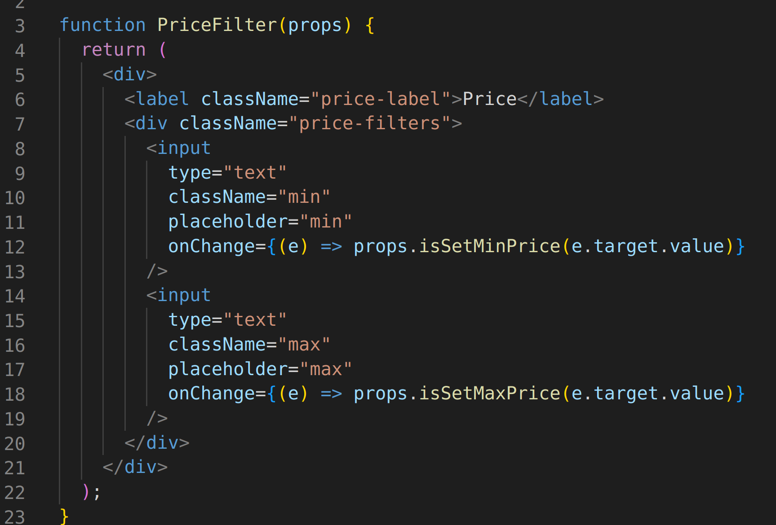
Code Snippet

Slide 5
What we would like to share
A slice of pizza :)

Slide 6
Struggles?
React components working together (eg. filters)
React in combination with APIs
React in general

Slide 7

Demo :)

