Slide 1

Final Project - Group 8
Adjunct Professors Payment Analysis
Hankun Ding (r0772442)
Kendall Brown (r0773111)
Yang Hu (r0773663)
Yue Huang (r0768557)
Xinyi Xu (r0766854)

Slide 2

I. Introduction
Purpose: Study factors that affect payments received by 45 adjunct professors
Response: Payment (,000)
Factor A: Subject matter of course (1-Humanities, 2-Social Sciences, 3-Engineering, 4-Management)
Factor B: Highest degree earned (1-Bachelor, 2-Master, 3-Doctorate)

Slide 3
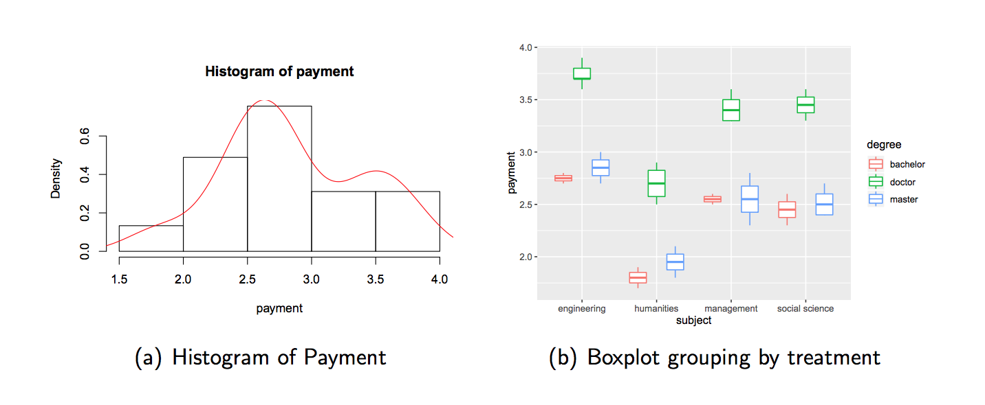
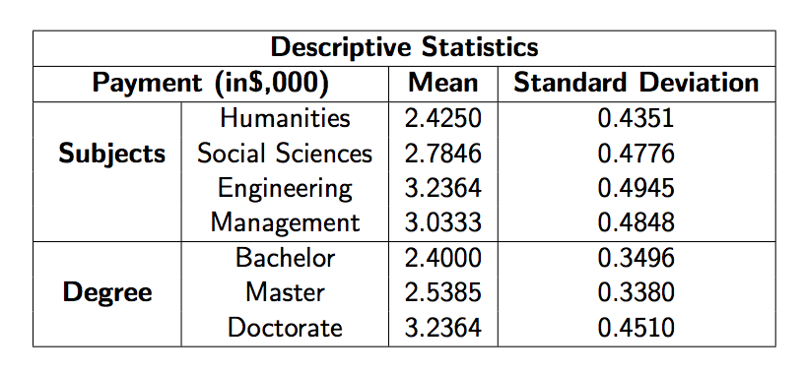
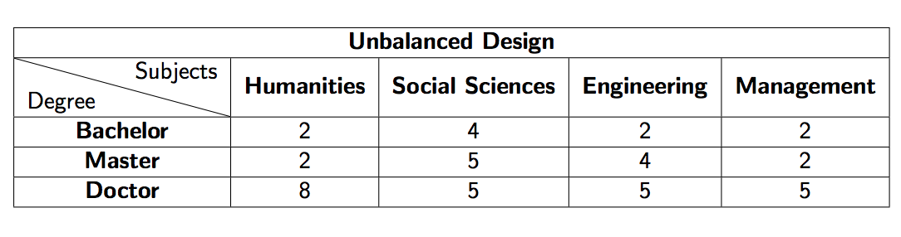
II. Descriptive Analysis
Table 1: Descriptive Statistics

Slide 4
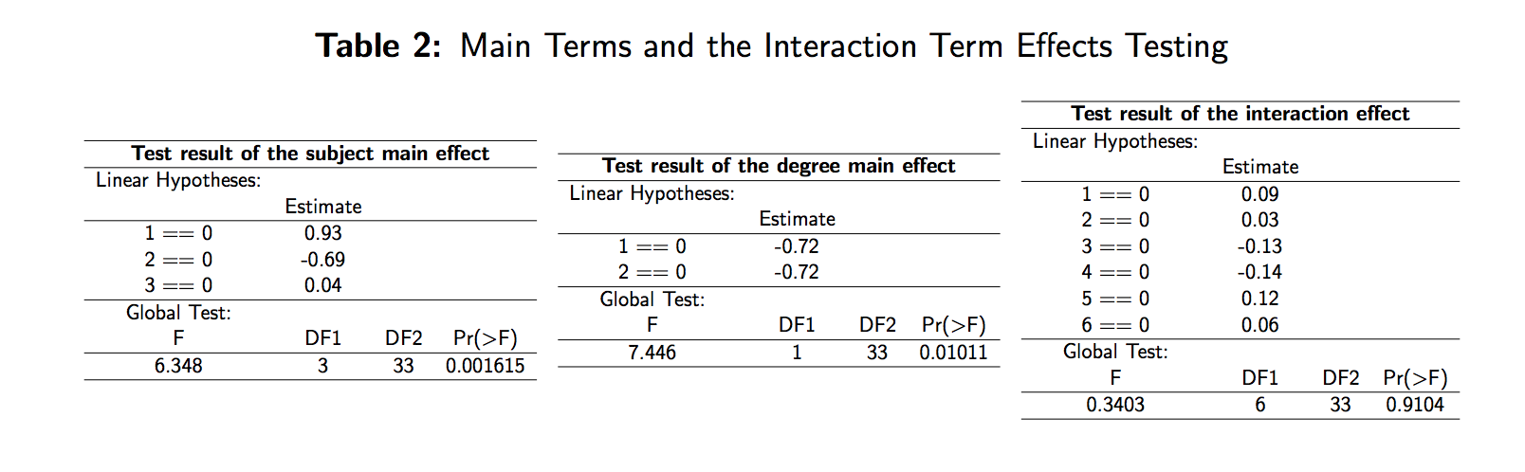
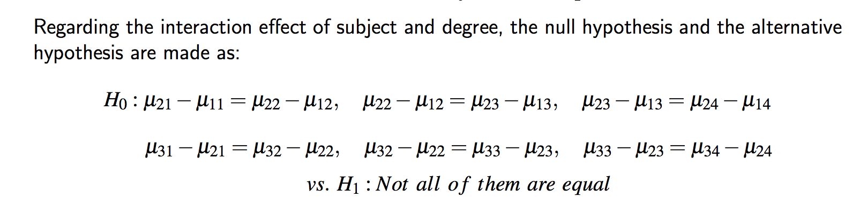
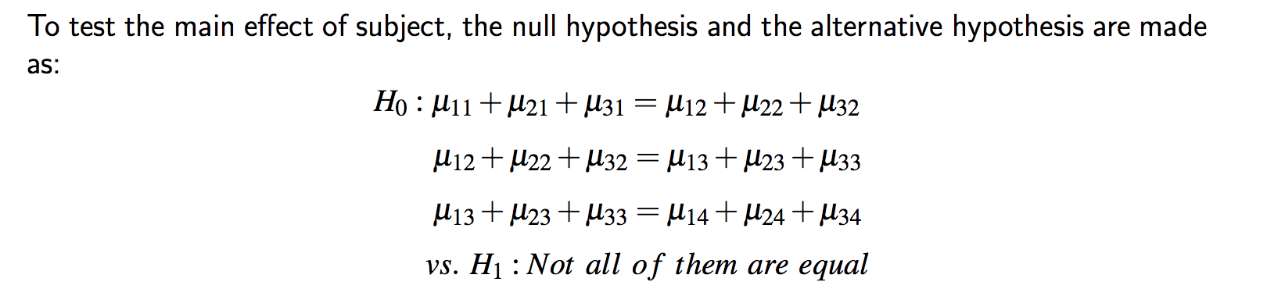
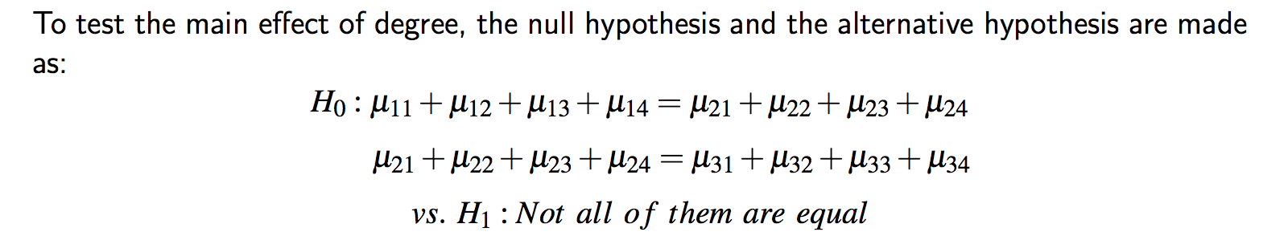
III. Cell Mean Model
Illustration:
Subject has the significant main effect
Degree has the significant main effect
There is no significant interaction effect between them

Slide 5
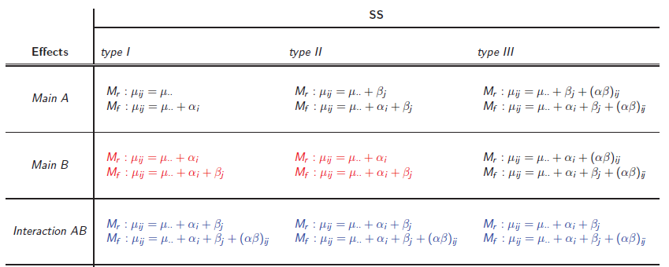
IV. Factor Effect Model
*Herr, G., D. (1986), On the History of ANOVA in Unbalanced, Factorial Designs: The First 30 Years. The American Statistician, Vol. 40, No. 40 (Nov., 1986), pp. 265-270.

Slide 6
IV. Factor Effect Model
Table 3: Test Results of Type I, Type II and Type III SS
Type I SS: Subject + Degree + Subject: Degree |  |  |  |  | Type II SS
 | Sum Sq | Df | F value | Pr(>F) |  | Sum Sq | Df | F value | Pr(>F)
Subject | 4.168 | 3 | 63.85 | 7.9E-14 | Subject | 5.979 | 3 | 91.60 | 4.4E-16
Degree | 8.382 | 2 | 192.63 | 2.2E-16 | Degree | 8.383 | 3 | 192.63 | 2.2E-16
Subject: Degree | 0.044 | 6 | 0.34 | 0.91 | Subject: Degree | 0.044 | 6 | 0.34 | 0.91
Residuals | 0.718 | 33 |  |  | Residuals | 0.718 | 33
Type I SS: Subject + Degree + Degree: Subject |  |  |  |  | Type III SS
 | Sum Sq | Df | F value | Pr(>F) |  | Sum Sq | Df | F value | Pr(>F)
Degree | 6.571 | 2 | 151.00 | 2.2E-16 | Subject | 4.233 | 3 | 64.85 | 6.3E-16
Subject | 5.979 | 3 | 91.60 | 4.4E-16 | Degree | 8.229 | 2 | 189.10 | 2.2E-16
Degree: Subject | 0.044 | 6 | 0.34 | 0.91 | Subject: Degree | 0.044 | 6 | 0.34 | 0.91
Residuals | 0.718 | 33 |  |  | Residuals | 0.718 | 33

Slide 7
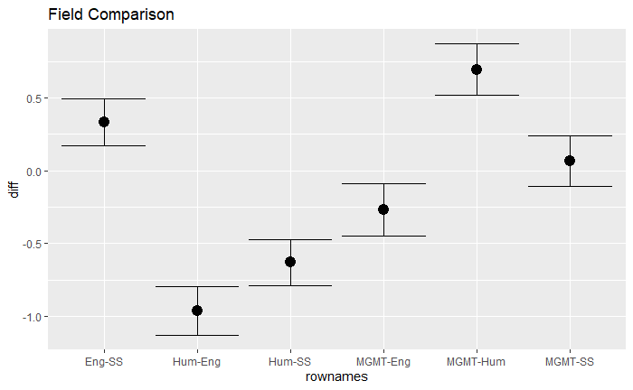
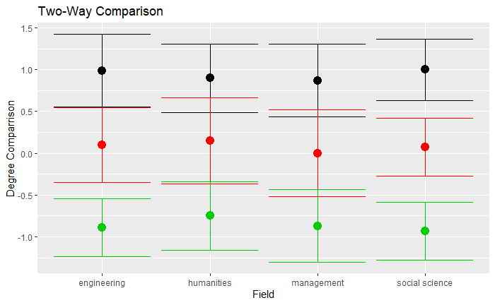
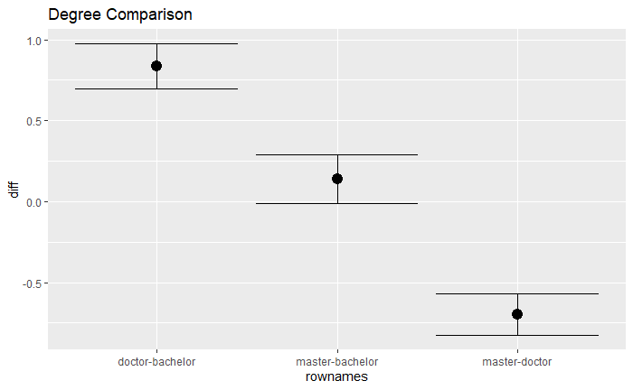
V. Tukey Confidence Interval Plots
Engineering > Management ≈ Social Science > Humanities
Doctorate > Master ≈ Bachelor
No significant interaction effect

Slide 8
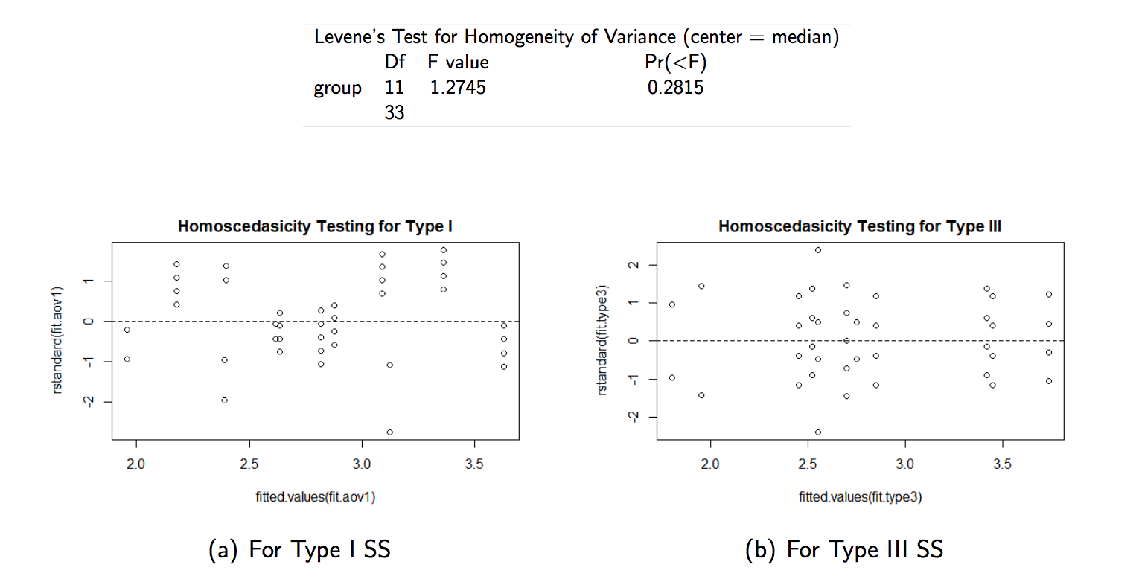
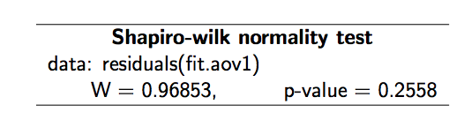

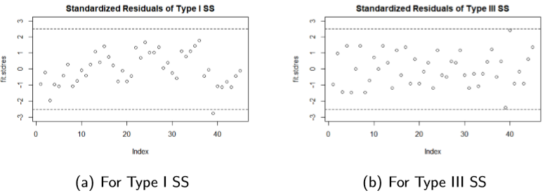
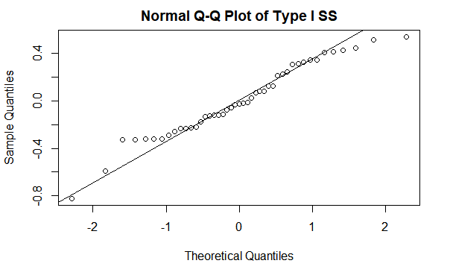
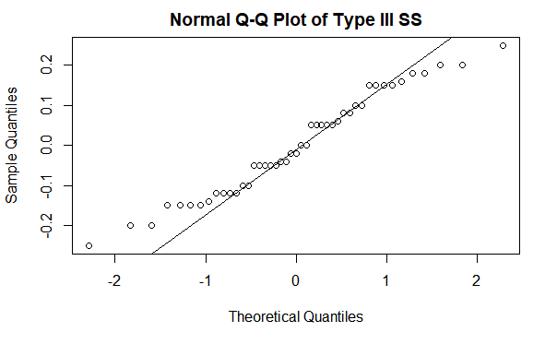
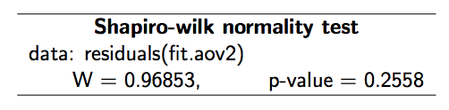

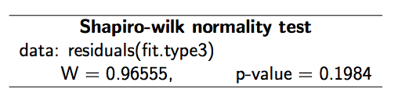
VI. Assumptions & Outliers
Normality
Independency
Homoscedasticity
Durbin Watson Test
Outliers

Slide 9

VII. Conclusion
For an adjunct professor, a master's degree may not bring more income, while a doctorate degree can.
Majoring Engineering tends to bring more payment and majoring humanities brings the less
The highest degree and subject will not have an interactive effect on your income

Slide 10
Q & A Session

Slide 11
Thanks for Listening !

