Slide 1

Contour detection
圖片介紹
讀進來後會是一個三維矩陣
[$\begin{matrix}… & … & … \\ … & … & … \\ … & … & …\end{matrix} ]$
[ R G B]

Slide 2
Contour detection
Python 讀圖
首先import相關的module
import matplotlib.pyplot as plt
import matplotlib.image as mpimg
import numpy as np
可利用as來表達簡寫

Slide 3
Contour detection
圖片介紹
這樣就讀進來囉!!
img = mpimg.imread('flower.jpg') # open image
# img would be a numpy array
h,w,c = img.shape # (height,width,color)

Slide 4
Contour detection
numpy
numpy是一種矩陣工具
[$\begin{matrix}… & … & … \\ … & … & … \\ … & … & …\end{matrix} ]$
[ R G B]
若要取出第一行第一列的R值則可用img[0,0,0]

Slide 5
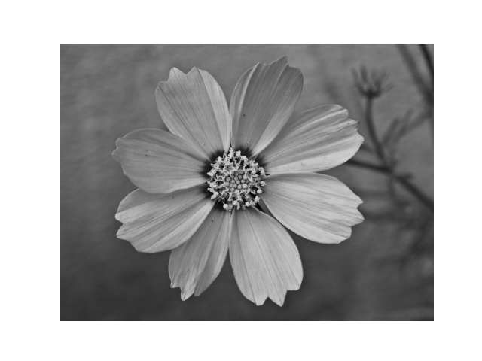
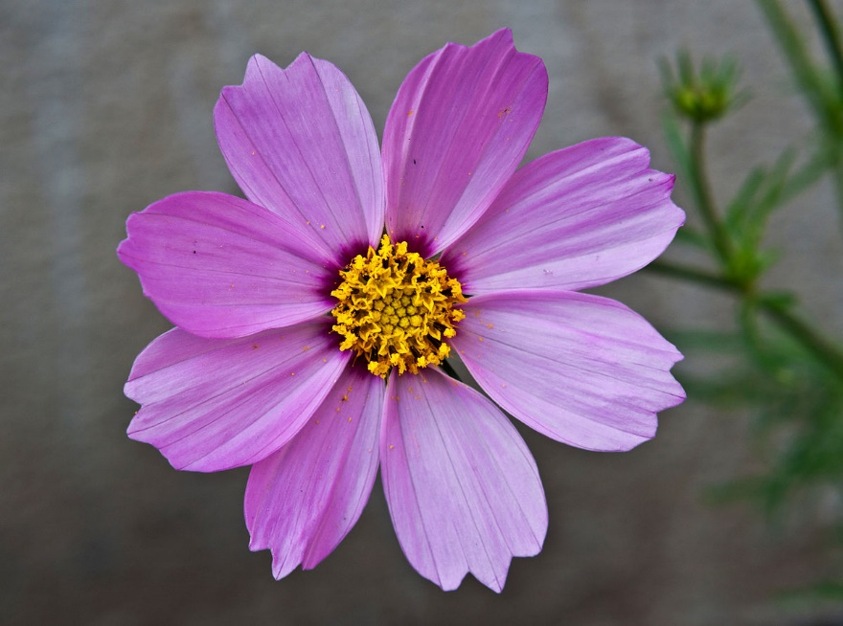
Contour detection
Gray scale
先將圖片作灰階處理

Slide 6
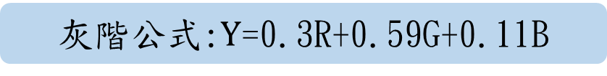
Contour detection
Gray scale
灰階公式:$Y$=0.3R+0.59G+0.11B
#----------------------convert to gray scale----------------------------
print('RBG to gray scale...')
gray = np.ones(img.shape) # new array for gray scale
for i in range(h):
for j in range(w):
Y = (0.3*img[i,j,0]+0.59*img[i,j,1]+0.11*img[i,j,2])/255
gray[i,j]=np.array([Y,Y,Y])
#-----------------------------------------------------------------------
normalize
若要取出第i行第j列的R值則可用img[i,j,0]

Slide 7

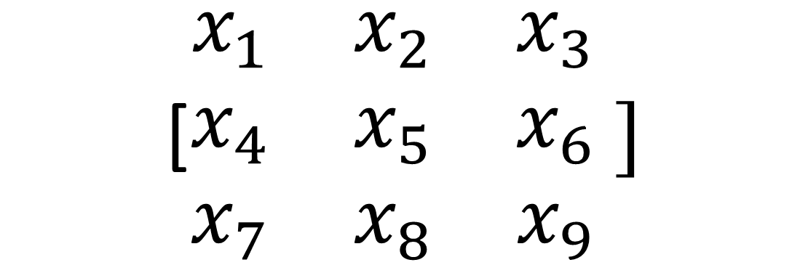
Contour detection
prewiit
公式:$\left\{\begin{aligned}G_{x}=−x_{1}−x_{4}−x_{7}+x_{3}+x_{6}+x_{9} \\ G_{y}=−x_{1}−x_{2}−x_{3}+x_{7}+x_{8}+x_{9}\end{aligned}\right.$
[$\begin{matrix}x_{1} & x_{2} & x_{3} \\ x_{4} & x_{5} & x_{6} \\ x_{7} & x_{8} & x_{9}\end{matrix} ]$

Slide 8

Contour detection
prewiit
$$G=\sqrt{G_{x}^{2}+G_{y}^{2}}$$
#-----------------------prewiit edge detector---------------------------
print('start to prewiit...')
result = np.ones(img.shape)*255 # new array for prewiit
for i in range(1,h-1):
for j in range(1,w-1):
Gx=-gray[i-1,j-1,0]-gray[i,j-1,0]-gray[i+1,j-1,0]+gray[i-1,j+1,0]+gray[i,j+1,0]+gray[i+1,j+1,0]
Gy=-gray[i-1,j-1,0]-gray[i-1,j,0]-gray[i-1,j+1,0]+gray[i+1,j-1,0]+gray[i+1,j,0]+gray[i+1,j+1,0]
G = (np.sqrt(Gx**2+Gy**2))
if G>1:
G=1
result[i,j]=np.array([G,G,G])
#------------------------------------------------------------------------
將周圍邊框設為255

Slide 9
Contour detection
Save and show
把結果儲存起來
#--------------------- show the image------------
plt.imshow(result)
plt.axis('off')
plt.show()
plt.savefig('result.jpg') # save the image
儲存的路徑與檔名

Slide 10
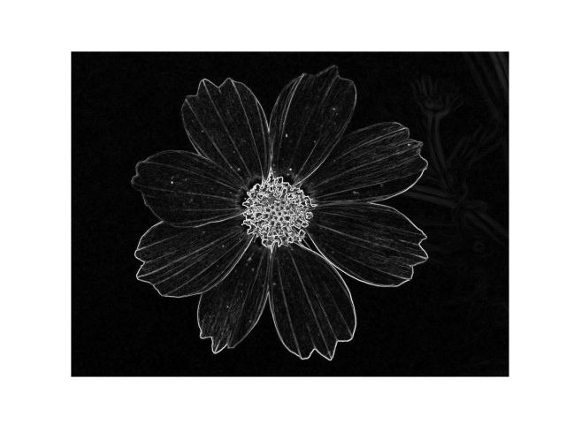
Contour detection
Save and show
看看自己的成果吧!!

