Slide 1
DDS Analytics: Talent management

Slide 2
Overview of the Data
Looking at data on 870 different employees:
Departments:
Research & Development
Sales
Human Resources
Predictions were done for Attrition and Monthly Income:
Attrition was analyzed using KNN
Monthly Income predictions were done with Linear Regression

Slide 3
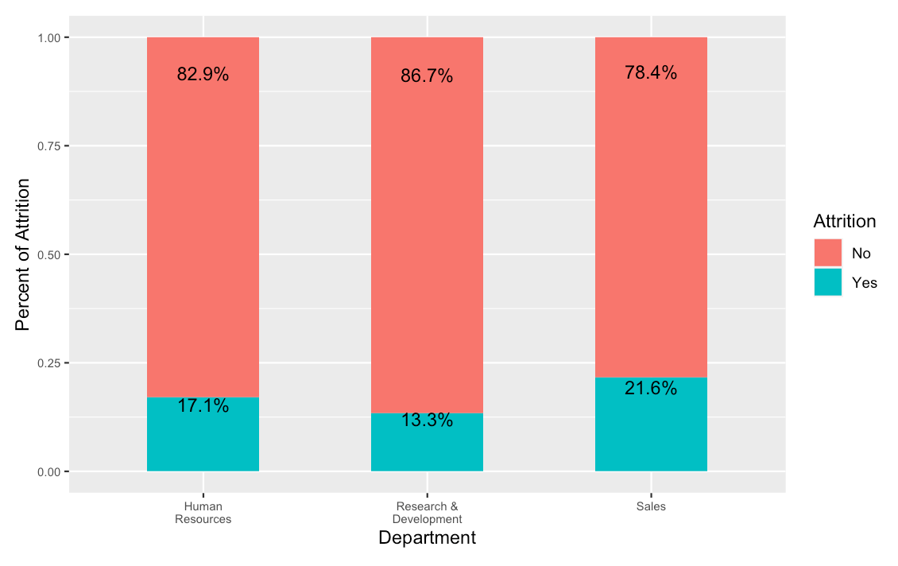
Attrition by Department
The Sales Department has the highest % of Attrition (21.6%)
54% of Attrition comes from Research and Development, but Research and Development is the largest Department.

Slide 4
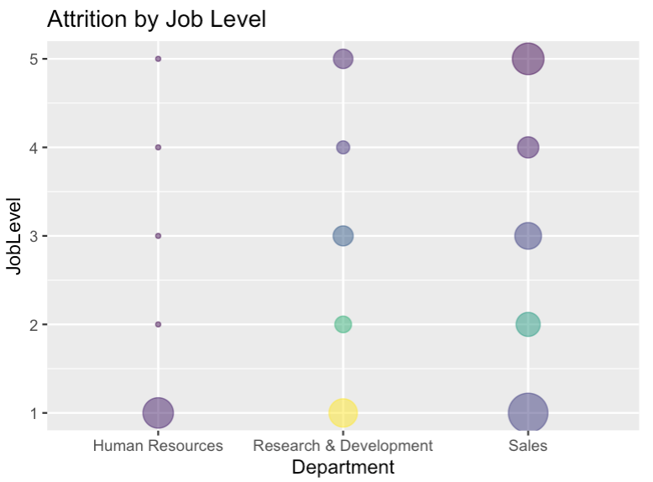
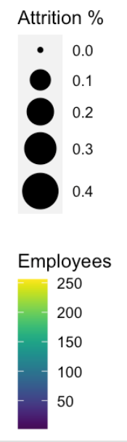
Attrition by Job Level
Overall Job Level 1 has the highest % of Attrition
Within the Sales Department– JobLevel 5 has higher attrition % (29%) than Job Level 1 in other departments.

Slide 5
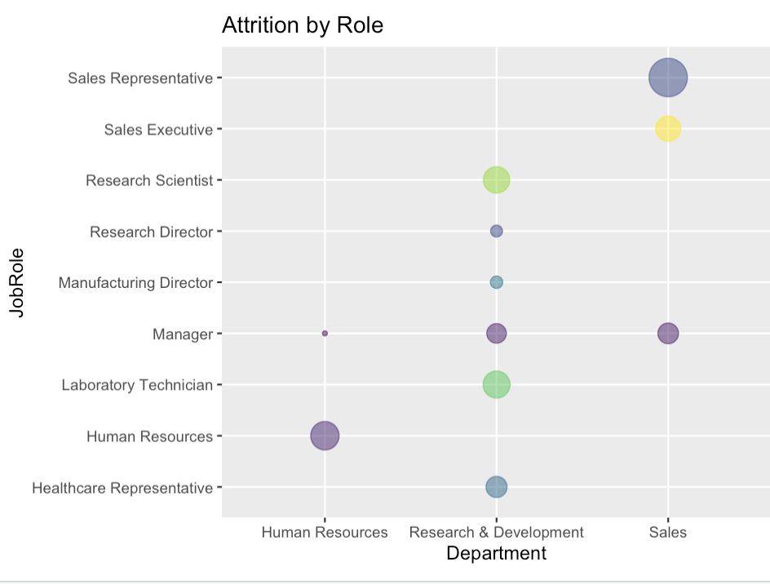
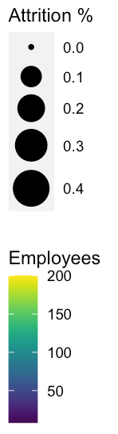
Attrition by Department and Job Role
68% of attrition is from 3 Job Roles:
Sales Executive (Sales)
Research Scientist (Research & Development)
Laboratory Technician (Research & Development)

Slide 6
Attrition predictions

Slide 7
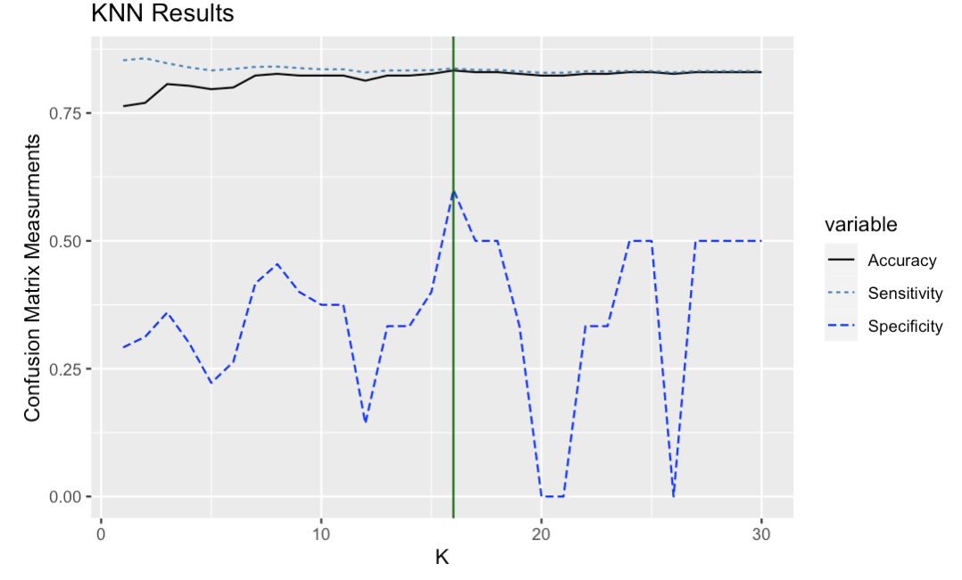
Predicting Attrition
Looking at the 16 closest employees (k=16) produces best results
Model accuracy 83.3%
Specificity 83.7%
Sensitivity 60.0%
Factors for the model were:
Age
Job Involvement
Job Level
Distance
Stock Option Level
Environment Satisfaction
Relationship Satisfaction
Job Satisfaction
Year Since Last Promotion
Years in Current Role
Education

Slide 8
Monthly income predictions

Slide 9
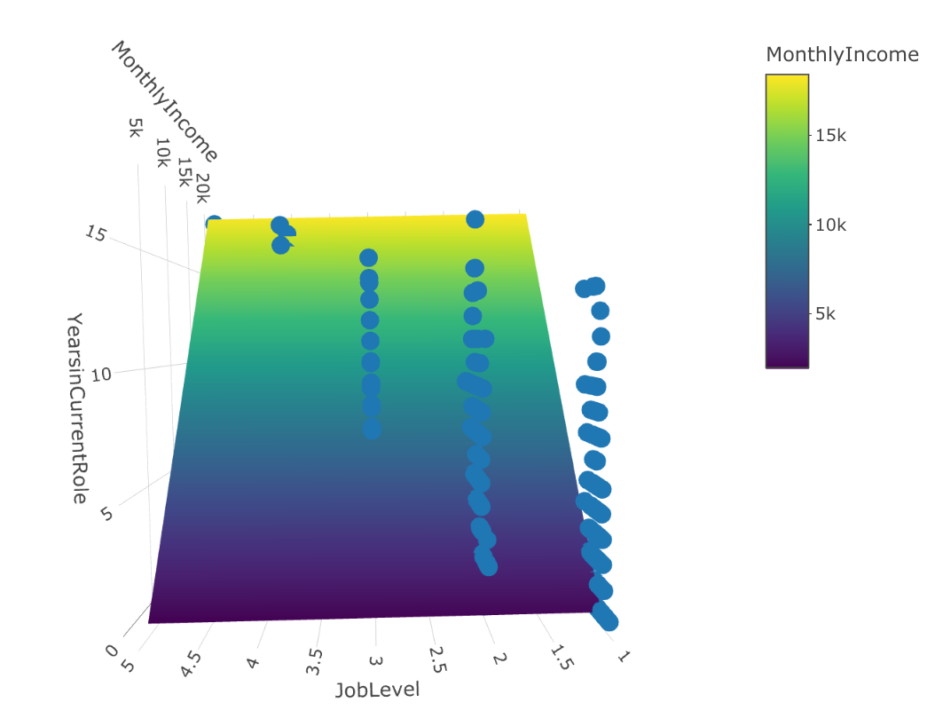
Predicting Income
Used linear regression to predict monthly incoming using:
Job Level
Years in Current Role
RMSE(root mean squared error) of $1,413

Slide 10
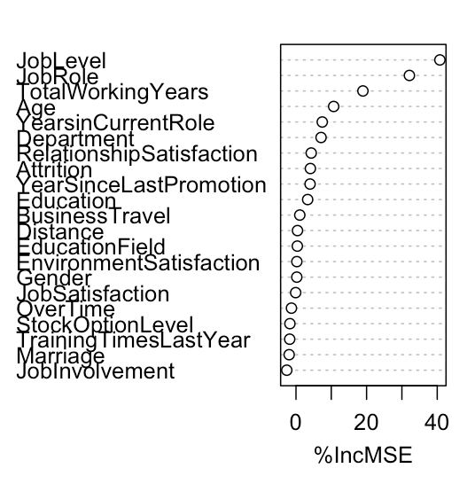
Conclusion
Overall the most important factors for Attrition leveraging Random Forest:
Job Level*
Job Role
Years in Current Role*
*Data was also leveraged to predict Income.

