Slide 1
KinecDrone

Slide 2
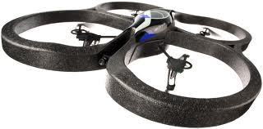
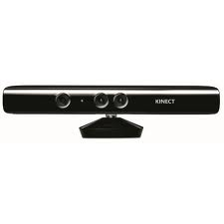
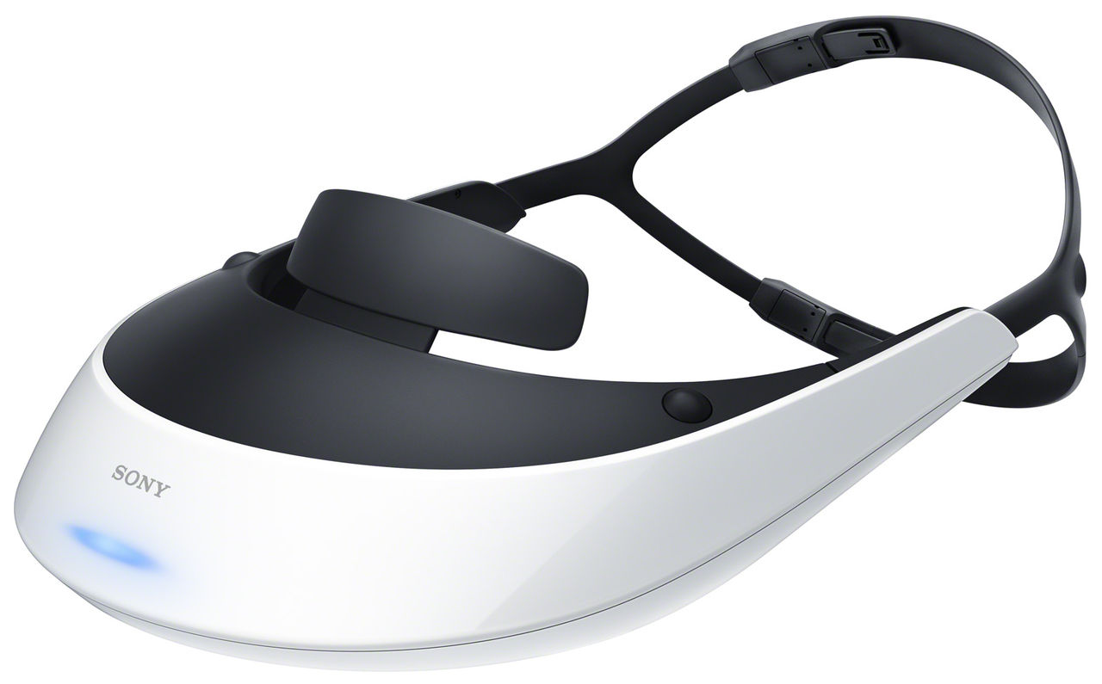
KinecDrone
Kinect
×
AR.Drone
×
HMD

Slide 3
Kinect
openNI

