Slide 1
Optimizing Advertising Budget Allocation
Kendra Mosholder 8/18/2025
Notes:
Welcome, this project explores how to maximize sales by optimally splitting advertising spend across TV, Radio, and Newspaper channels using regression and budget allocation analysis. I’ll walk through the dataset, the analysis steps, and finish with a recommendation for budget allocation.

Slide 2

Project Objective
The goal of this project is to determine the most effective way to allocate a fixed advertising budget across TV, Radio, and Newspaper channels to maximize sales. Marketing budgets are limited, and allocating funds to the wrong channel reduces ROI. By analyzing past advertising and sales data, I identified which channels drive results and how to distribute spending for maximum impact.
Notes:
If a company gives me $100,000 to spend on advertising, where should it go for the best return? This is the central question guiding the analysis.

Slide 3
Data Set
Source: Advertising dataset (commonly used in marketing analytics case studies).
Size: 200 rows, 4 columns.
Variables:
TV advertising spend (in thousands $)
Radio advertising spend (in thousands $)
Newspaper advertising spend (in thousands $)
Sales (in thousands of units sold)
Context: Represents a small to mid-sized business with an annual revenue of ~$1M–1.5M. This makes the simulated $100k budget realistic in terms of scale.
Notes:
This dataset contains 200 rows of marketing spend and sales results. TV, Radio, and Newspaper spending are recorded in thousands of dollars. Sales are also measured in thousands of units. We’re treating this as representative of a small-to-medium sized business with about $1M–1.5M in annual revenue.

Slide 4
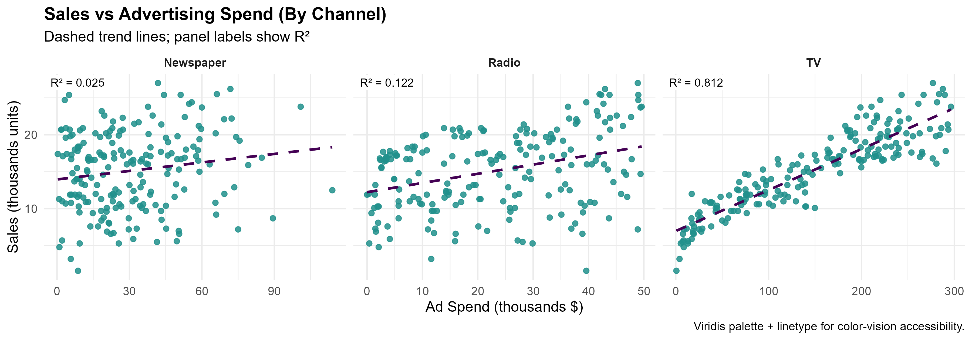
Initial Data Insights & First Prediction Model
Initial scatterplots showed that:
TV spending had the strongest positive relationship with sales.
Radio spending had a moderate relationship with sales.
Newspaper spending showed little to no relationship.
To confirm these findings, I ran a linear regression using all three channels.
Results:
TV → statistically significant predictor of sales.
Radio → statistically significant predictor of sales.
Newspaper → not significant.
The model explained ~90% of the variation in sales (Adjusted R² = 0.90).
This gave me a clear direction: focus on TV and Radio, exclude the Newspaper from allocation decisions.
Notes:
I started by looking at scatterplots to see how each channel relates to sales. TV and Radio both showed clear positive relationships, while Newspaper spending had no effect. To confirm this, I ran my first prediction model using all three channels. The results lined up: TV and Radio were significant drivers of sales, while Newspaper added no measurable value. This first model explained about 90% of the variation in sales, which gave me the direction I needed for the next stage of analysis.

Slide 5
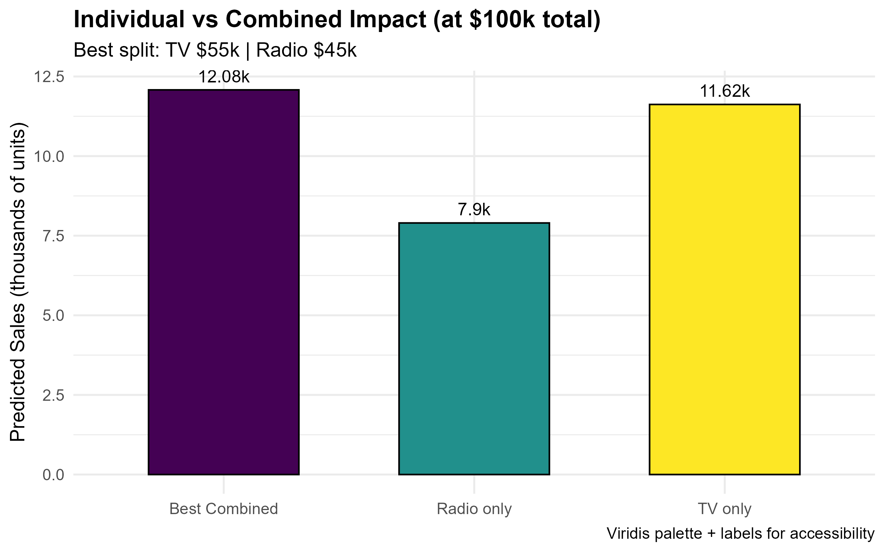
Individual vs Combined Impact
I compared scenarios for $100k spend:
TV only: 100k on TV predicted ~11.6k units sold.
Radio only: Capped at 50k (the max observed in the dataset), predicted ~7.9k units sold.
Best combined: 55k TV + 45k Radio predicted ~12.1k units sold.
This confirmed that TV and Radio reinforce each other. The interaction term in the regression was statistically significant, meaning multichannel campaigns perform better than single-channel.
Notes:
To see if TV and Radio reinforce each other, I tested them separately versus in combination. This chart compares TV only, Radio only, and the best combined split within the dataset’s observed range. TV by itself predicted about 11.6k units sold, Radio by itself predicted about 7.9k, and combining TV and Radio predicted about 12.1k. The interaction term in my model was significant, which means campaigns that include both channels outperform single-channel efforts. It’s important to note that the dataset only included Radio campaigns up to about 50k, so I capped Radio at that level to avoid over-extrapolating.

Slide 6
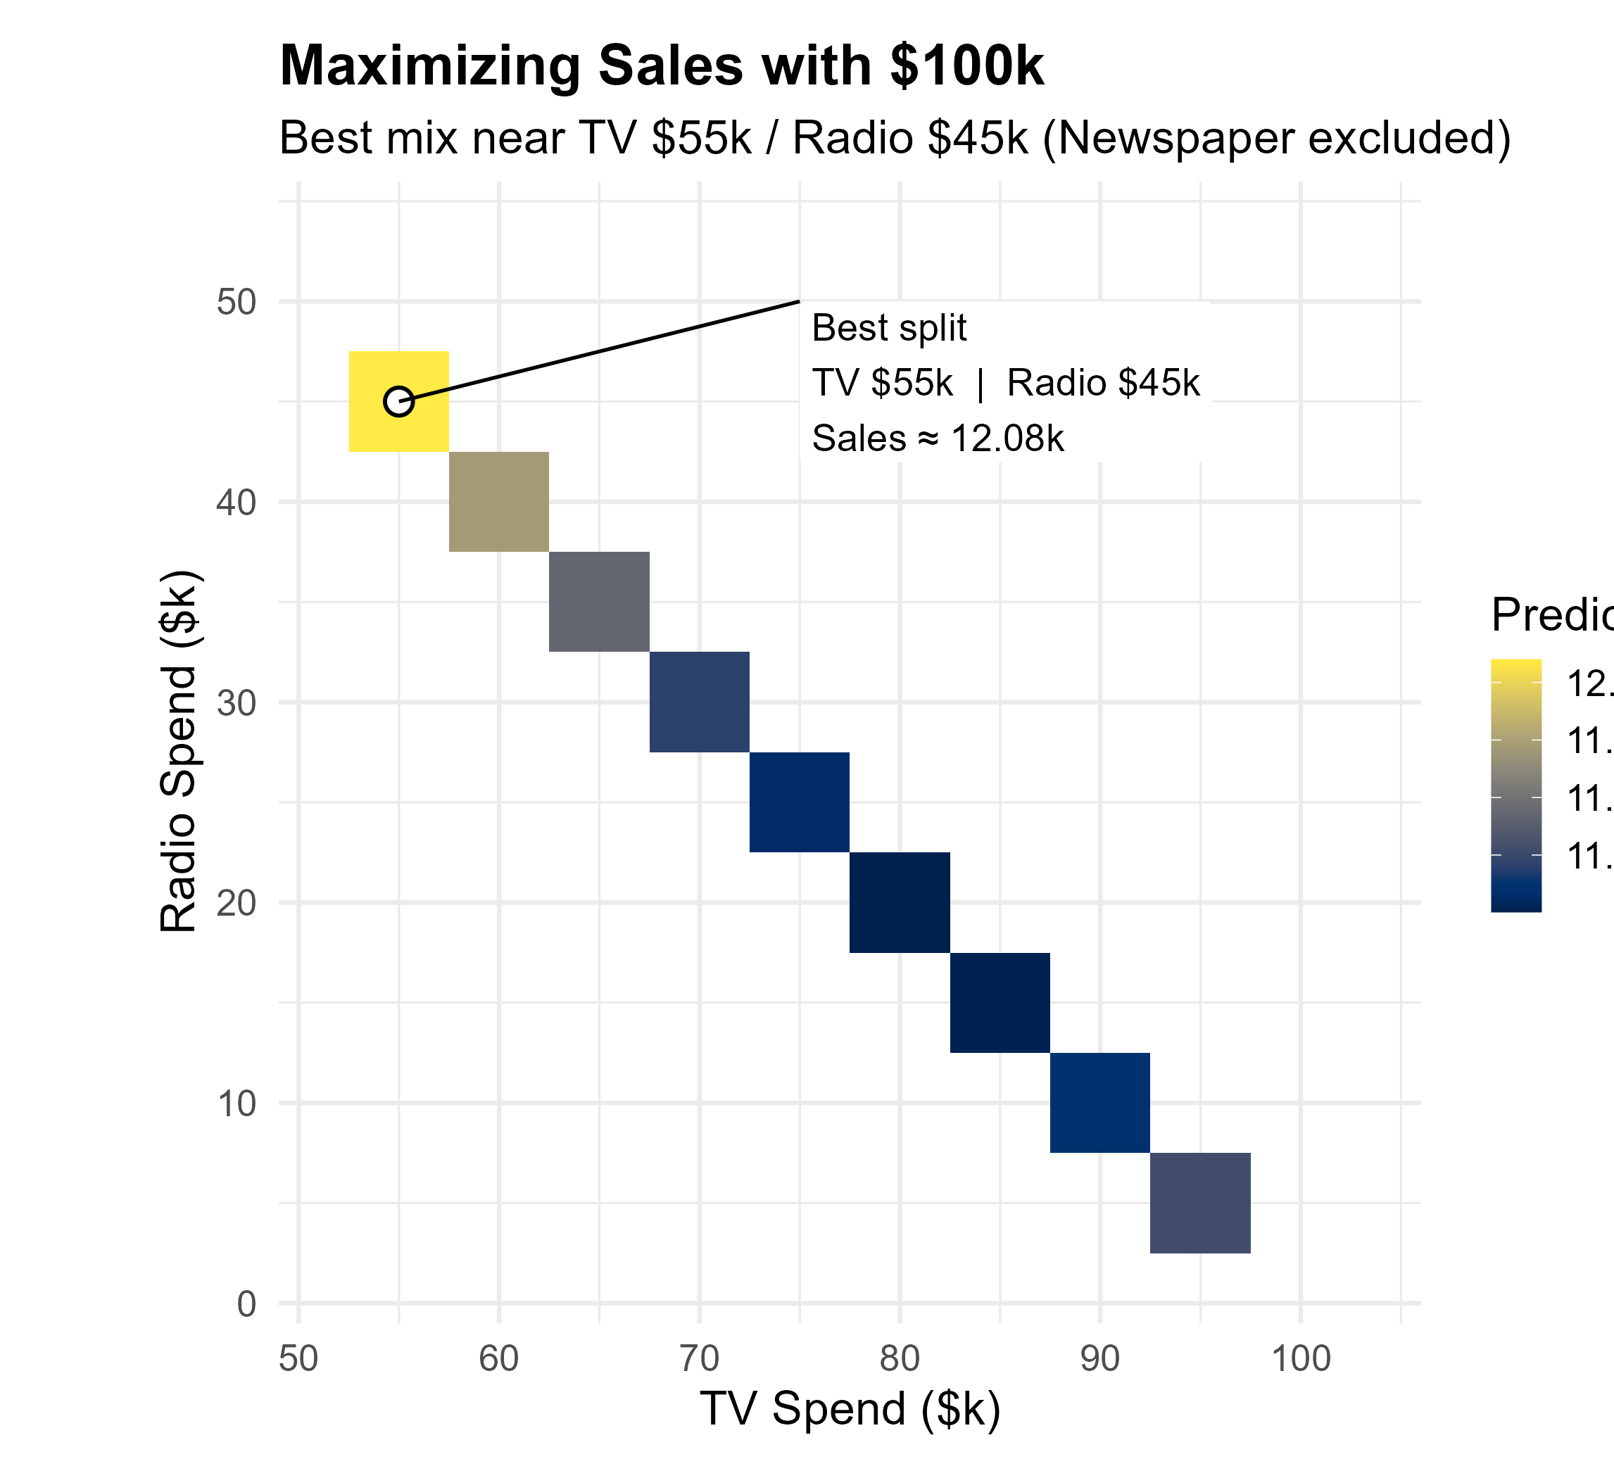
Maximizing Sales with $100k
To simulate budget allocation, I tested every possible TV/Radio split (in $5k increments) within the dataset’s observed range. The heatmap shows predicted sales at each split.
The best mix is ~55% TV, 45% Radio.
This allocation maximizes predicted sales at ~12.1k units.
Newspaper is excluded since it had no measurable impact.
This result demonstrates how optimization can directly guide marketing decisions to achieve better ROI.
Notes:
I tested every possible way to spend a $100,000 budget across TV and Radio. The heatmap shows predicted sales for each split. The best outcome is a balanced mix of TV and Radio — neither channel alone is optimal. Newspaper was excluded because it didn’t contribute to sales in the earlier models. This analysis shows the best way to maximize sales given the budget provided.

Slide 7
Data Limits & Next Steps
Data set didn’t include higher spending levels → can’t test for diminishing returns
Newspaper spend was not predictive here, but still valuable to track
No data on online/ digital marketing channels
The dataset only includes Radio spending up to ~50k. Predictions beyond this range are less reliable.
Notes:
I tested for diminishing returns in case stakeholders asked what the best budget level would be if they wanted to spend more than $100,000. Unfortunately, the dataset I used didn’t include enough high-spend campaigns to give me that answer. If stakeholders do want to explore higher budget levels, we would need to collect more data to make accurate recommendations

Slide 8
Recommendations
Allocate
Digital
Incorporate digital marketing data in future studies to ensure recommendations reflect modern advertising strategies.
Re-evaluate
If the business increases budgets beyond $100k, additional data should be collected to test for saturation points.
Based on the analysis, I recommend allocating the $100k budget across TV and Radio, with an optimal split near 55% TV and 45% Radio.
Notes:
Based on the analysis, I recommend allocating the $100,000 budget across TV and Radio, with a balanced split between the two channels. Newspaper spending didn’t have a measurable impact, so I would not include it in the allocation.
If stakeholders decide to increase the budget beyond $100,000, my recommendation would be to first gather additional data at those higher spending levels. That way I could test whether sales continue to increase at the same rate or begin to level off. Until that data is available, my advice is to maximize sales by splitting the $100,000 budget evenly between TV and Radio

Slide 9
Key Insights
This project demonstrates my ability to:
Translate a business problem into a data-driven question.
Use regression modeling and simulation to evaluate options.
Communicate results through clear visuals and actionable recommendations.
By combining curiosity with strategic thinking, I ensured that data analysis not only answers technical questions but also supports business decisions that maximize value.

