Slide 1
Evaluator.AI
July 2024

Slide 2
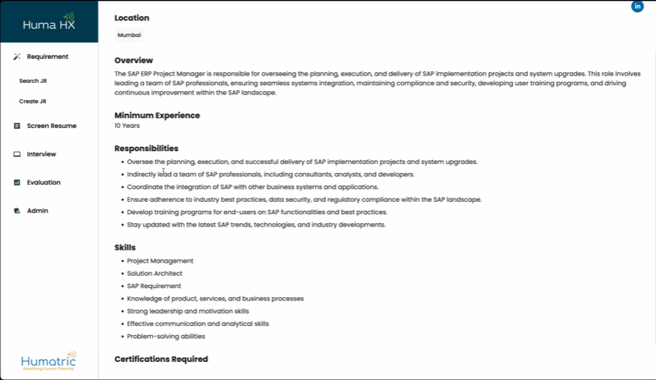
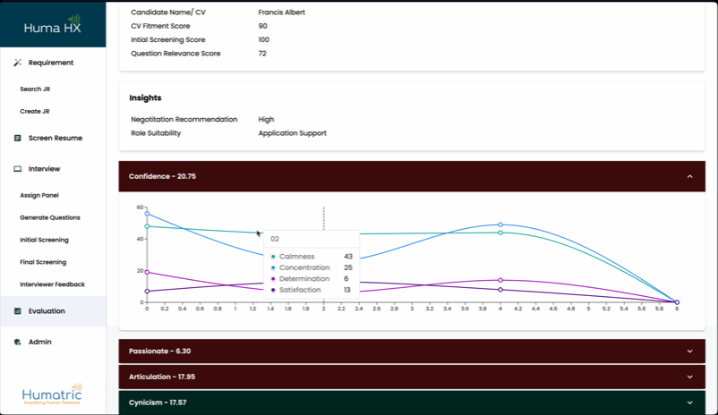
Evaluator.AI - Recruitment Enabler
Evaluate Profiles
Generate JD based on high level role descriptions
generate interview questions
analyze teams call transcripts for QA evaluation and scoring
human behavioral analysis
role fitment and negotiation scope analysis

