Slide 1


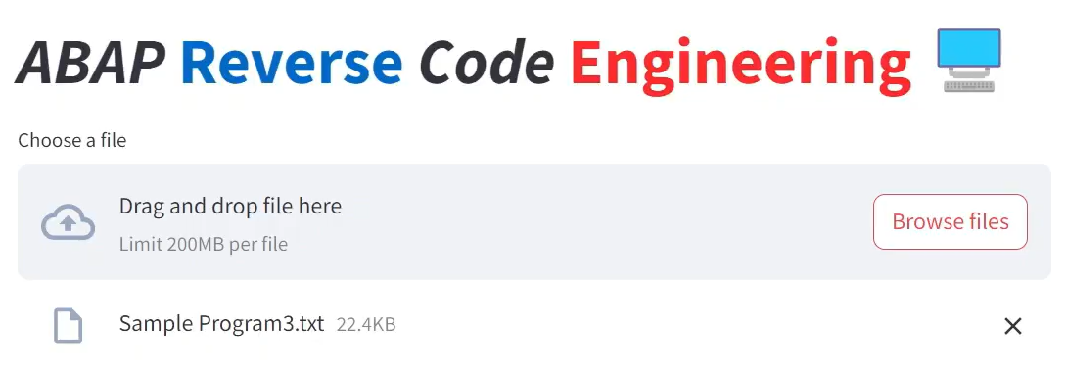
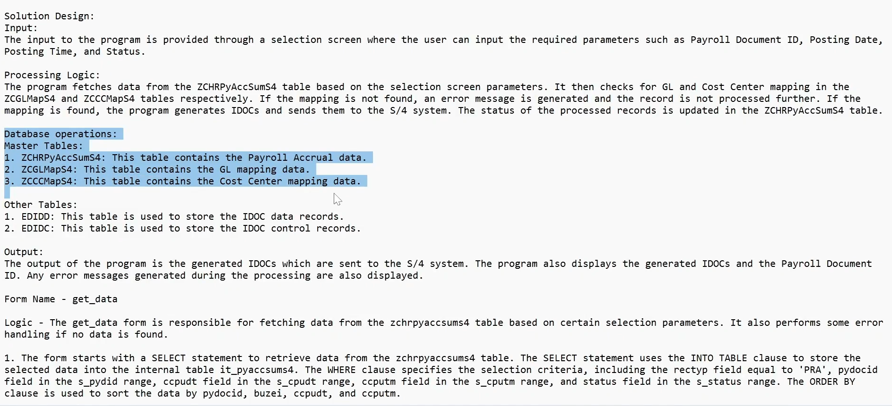
Demystify ABAP code using Code2Logix.AI
Knowledge Transition
30%
effort
reduction
Fit-Gap Analysis
40%
effort
reduction

Slide 2






Improving Developer Productivity & Code Quality using CodeEZ.AI
Key challenge solved
Applicable across industries
CHALLENGE
RESULTS
Higher knowledge transition efforts
Higher time spent on understanding legacy code
SLA misses due to lack of understanding of legacy code
30% effort reduction in Knowledge Transition
40% effort reduction in fit-gap analysis for S/4HANA transformation
SOLUTION
Demystify your ABAP code with Gen AI. Build the Functional Specifications, identify business process, generate pseudo logic from ABAP code
60% effort reduction in understanding legacy code

