Slide 1

Group 4 / Team 4
MYSignVoice
Traffic-sign information through vision and speech
Visual accessibility support
with driver awareness as a secondary use
Aedan Loh / Crystalina Dibble / Tan Hui Min / Kendrew Lim Yan Zhe
Notes:
Presenter: Aedan Loh
Suggested time: 18 seconds
Introduce MYSignVoice as a traffic-sign information prototype. The main design goal is to make visible sign information available through speech. It is not a navigation system or a medical aid.
Sources:

Slide 2
Presented by Aedan Loh
1.1 PURPOSE AND TARGET USERS
Primary design goal
Current boundary
Make traffic-sign labels and meanings available through speech for users who find visual sign information difficult to read.
The prototype identifies signs.
It does not locate safe crossings, detect approaching vehicles or guide an independent journey.
Secondary use
Support driver sign awareness and road-sign learning in demonstrations and supervised use.
Accessibility is the intended use. Effectiveness with target users still requires evaluation.
02
Notes:
Presenter: Aedan Loh
Suggested time: 51 seconds
Describe an example: a person can hear the name and meaning of a sign instead of relying only on the screen. Our prototype can support access to sign information, but this is a design goal rather than a proven outcome for people with visual impairment. Driver awareness is a secondary application. We have not implemented route guidance or crossing decisions.
Sources:
webapp/sign_catalog.py
webapp/static/app.js

Slide 3
Presented by Aedan Loh
1.2 OUR CONTRIBUTION
Sign labels and meanings
Speech for multiple signs
63 Malaysian sign classes, with a plain-language meaning and an action message.
The camera announces newly confirmed classes. Uploaded images have a replay button.
Confirmation before speech
Numeric cross-check
Spatial matching, repeated observations and a cooldown reduce unstable or repeated speech.
OCR checks speed-limit digits while YOLO remains the fallback when OCR is uncertain.
Contribution: integration and interaction design using existing detection and OCR methods.
03
Notes:
Presenter: Aedan Loh
Suggested time: 45 seconds
Present novelty as the way the system combines components for Malaysian sign information, not as a new neural-network architecture. The output includes meaning and speech, and the camera confirms signs over time. The system also checks the number inside a speed-limit sign. Hand over to Hui Min for the working interface.
Sources:
webapp/sign_catalog.py
webapp/static/app.js
webapp/speed_limit_ocr.py

Slide 4
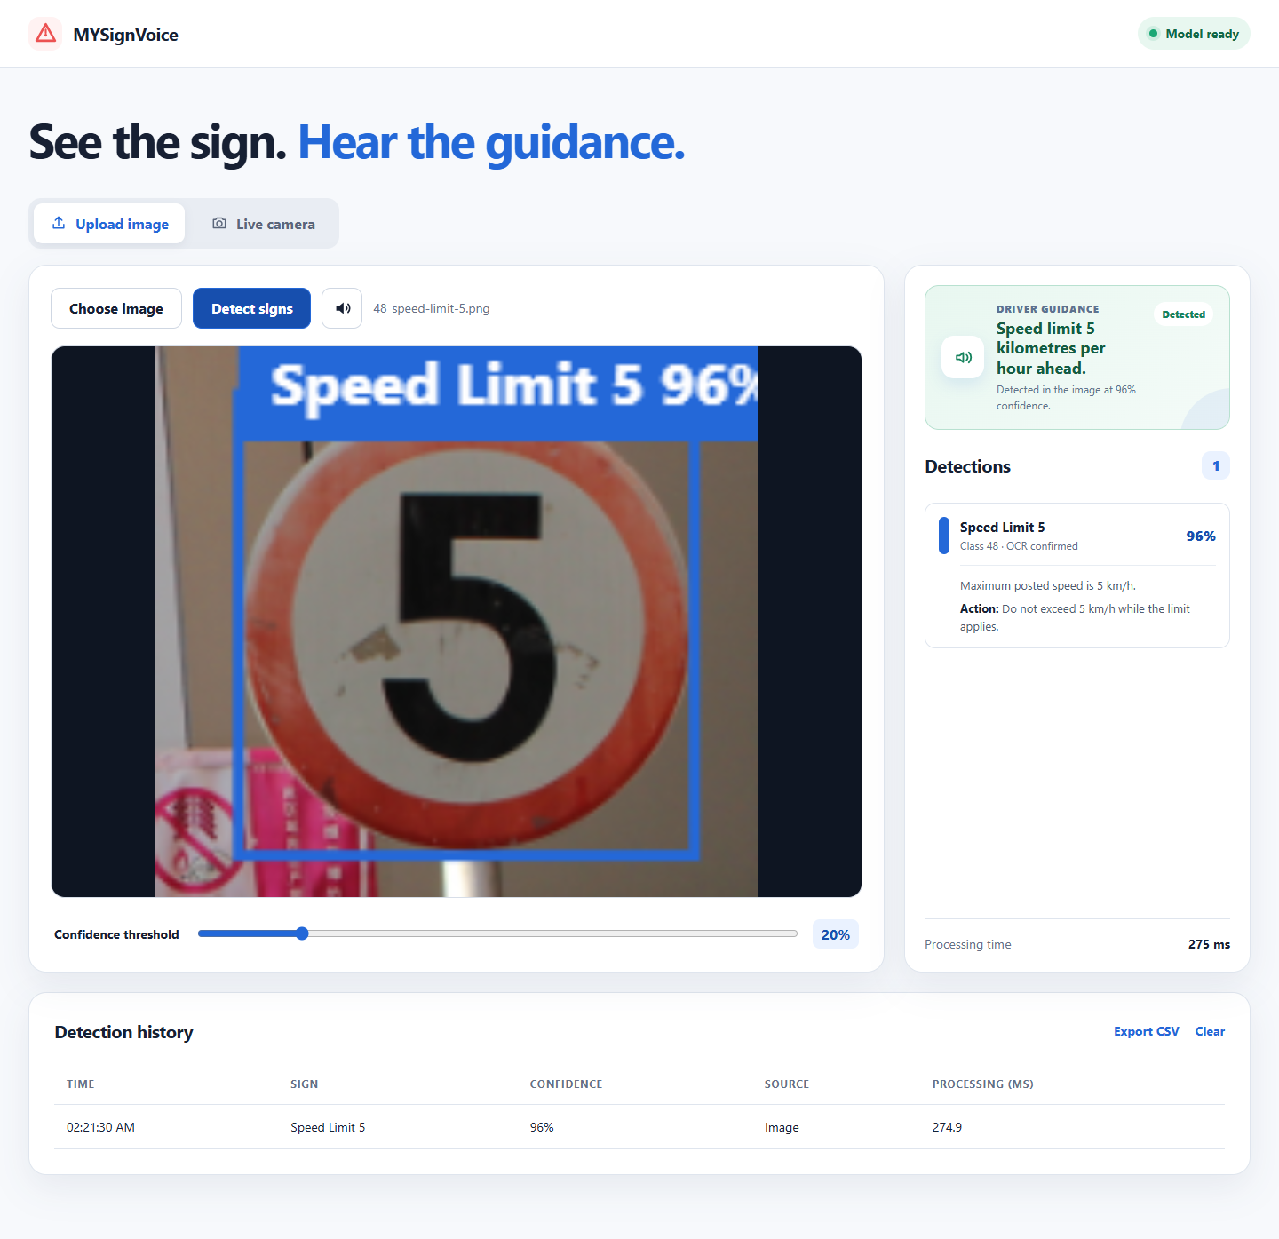
Presented by Tan Hui Min
3.1 FRONTEND AND USER EXPERIENCE
Visual and audio output
Image upload or live camera
Sign label, confidence and box
Meaning and guidance
Speech replay for uploads
History with processing time
Actual application capture. Voice output complements the visual result.
04
Notes:
Presenter: Tan Hui Min
Suggested time: 48 seconds
Explain the two modes and point to the real interface. A user can upload an image, read the class and meaning, and press the speaker icon to hear it. The live camera uses automatic confirmation before speech. History includes processing milliseconds. These functions support the accessibility goal, although we still need a target-user evaluation.
Sources:
webapp/static/index.html
webapp/static/app.js

Slide 5
Presented by Tan Hui Min
3.2 BACKEND DESIGN
Stage | Backend responsibility
Receive | Accept an image and confidence threshold
Validate | Check file type, content and 12 MB limit
Infer | Run the loaded YOLO26s OpenVINO model
Check digits | Apply OCR only to speed-limit detections
Respond | Return class, confidence, box and processing time
FastAPI service
Model loads once at startup.
A lock serializes detector calls.
Normal frames are decoded in memory.
The browser receives structured JSON.
The laptop runs inference. The phone supplies images and presents the response.
05
Notes:
Presenter: Tan Hui Min
Suggested time: 54 seconds
Explain one request from the browser. The API checks the upload, decodes it to an image, runs the detector, and returns JSON. The model stays loaded instead of loading again per frame. Detector calls use a lock to avoid simultaneous access. OCR only runs on speed-limit proposals, so ordinary signs avoid that work.
Sources:
webapp/main.py
webapp/inference.py

Slide 6
Presented by Tan Hui Min
3.3 CAMERA CONFIRMATION AND SPEECH
1. Capture the next frame
2. Match the sign over time
Camera requests do not overlap. The browser waits for a response before sending another frame.
A strong detection needs 2 matches. Other accepted signs need 3 matching detections.
3. Confirm and announce
4. Control repetition
Newly confirmed sign classes enter one speech message, including multiple classes in the frame.
A 5-second class cooldown limits repeat announcements. Upload speech starts when the user taps replay.
These rules filter unstable messages; they do not guarantee that a class is correct.
06
Notes:
Presenter: Tan Hui Min
Suggested time: 54 seconds
The camera has to balance missed signs against noisy speech. Spatial matching compares overlapping boxes, centre movement and size. High-confidence signs require two observations; others need three. Multiple confirmed classes can be spoken together. The five-second cooldown reduces repetition. Explain that an error repeated consistently could still be announced.
Sources:
webapp/static/app.js
webapp/static/camera_safety.js

Slide 7
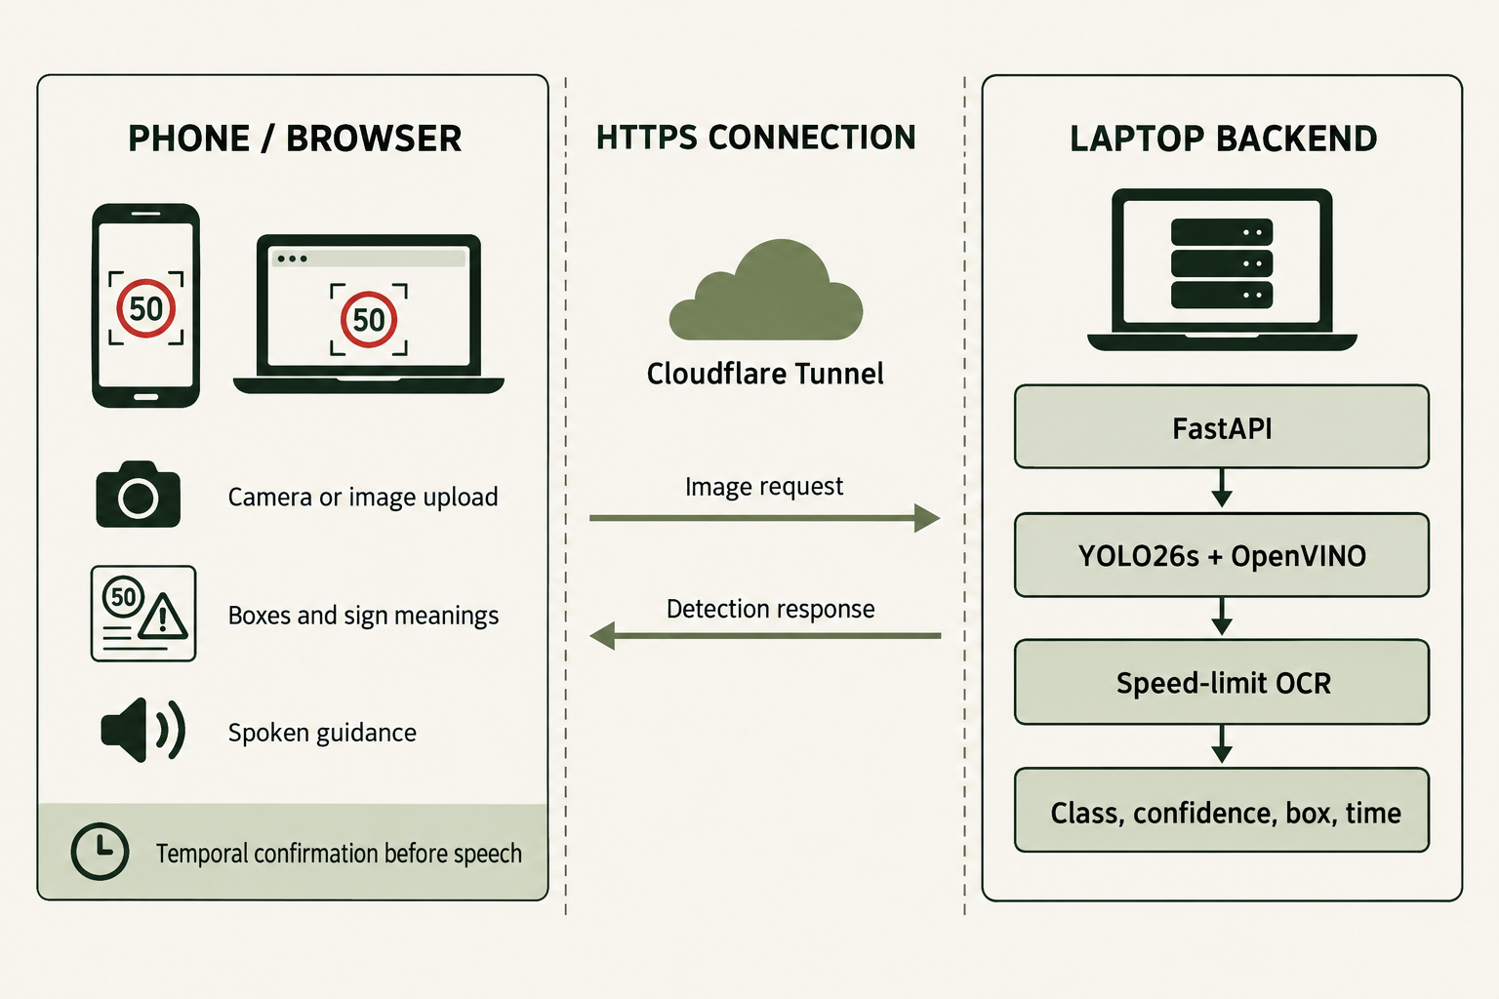
Presented by Kendrew Lim Yan Zhe
3.4 SYSTEM ARCHITECTURE
Deployment used for the demo
Phone browser
HTTPS tunnel
Laptop server
YOLO26s + OCR
Results back to browser
OCR is optional per detection. The laptop and tunnel must remain running.
07
Notes:
Presenter: Kendrew Lim Yan Zhe
Suggested time: 54 seconds
Walk through the diagram from left to right, then back to the browser. Cloudflare provides an HTTPS route to the laptop; it does not run the model. FastAPI executes inference using OpenVINO. Only speed-limit candidates go through OCR. Browser logic confirms camera detections and produces speech. The illustration represents the implementation; it is not a cloud-compute architecture.
Sources:
webapp/main.py
webapp/inference.py
README.md: Run on a phone with Cloudflare Tunnel
Architecture illustration generated for this project

Slide 8
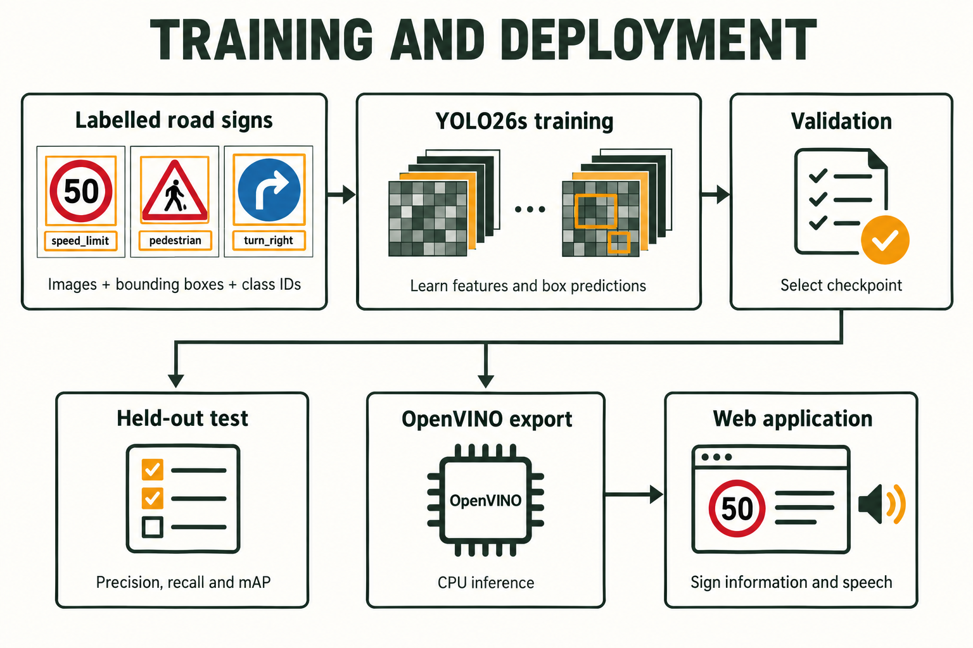
Presented by Kendrew Lim Yan Zhe
3.5 DEEP LEARNING WORKFLOW
What the model learns
Image features
Sign location
Sign class
Training updates weights. Validation selects a checkpoint. The test set measures the selected model.
YOLO26s is the detector. OpenVINO is the exported runtime used on the CPU.
08
Notes:
Presenter: Kendrew Lim Yan Zhe
Suggested time: 48 seconds
Explain supervised object detection using labelled images, bounding boxes and class IDs. Training adjusts weights; validation informs checkpoint selection; the held-out test is reserved for evaluation. Export changes the runtime format rather than replacing the trained task. Avoid implying that our project invented YOLO or that the test set updates the model.
Sources:
models/model_manifest.json
models/best_openvino_model/metadata.yaml
training/build_yolo26_v3_runpod_notebook.py

Slide 9
Presented by Kendrew Lim Yan Zhe
3.6 DATASET AND EVALUATION DESIGN
8,731 images
63 classes
Related camera images stay in the same split.
Augmentation applies to training.
The final test has 838 images and 867 labelled signs.
Version 3 dataset. Class support is uneven, so aggregate scores do not describe every class.
09
Notes:
Presenter: Kendrew Lim Yan Zhe
Suggested time: 48 seconds
These are the final Version 3 image counts. Explain the separate roles of the training, validation and test splits. Related frames must stay together to avoid similar images leaking across sets. The class distribution is uneven. Some rare classes have very few test examples, which limits conclusions about those classes.
Sources:
training/results/v3/report_artifacts/dataset_split_summary.csv
training/results/v3/report_artifacts/class_distribution.csv
models/model_manifest.json

Slide 10
Presented by Kendrew Lim Yan Zhe
4.1 TRAINING AND VALIDATION CURVES
VERSION 1 TRAINING RECORD
Box loss
Validation mAP
Earlier Version 1 run: learning progresses and then levels off. Final deployed scores appear on slide 12.
10
Notes:
Presenter: Kendrew Lim Yan Zhe
Suggested time: 60 seconds
These curves come from the saved Version 1 baseline training record. Lower loss means the predicted boxes better match the labels. Validation mAP increases and then approaches a plateau. The stricter mAP across IoU thresholds stays lower because it demands more accurate localization. Version 3 is a later fine-tuned model, and its test results are reported separately.
Sources:
training/results/final_v1/baseline_results.csv
training/results/final_v1/report_artifacts/baseline_summary.csv

Slide 11
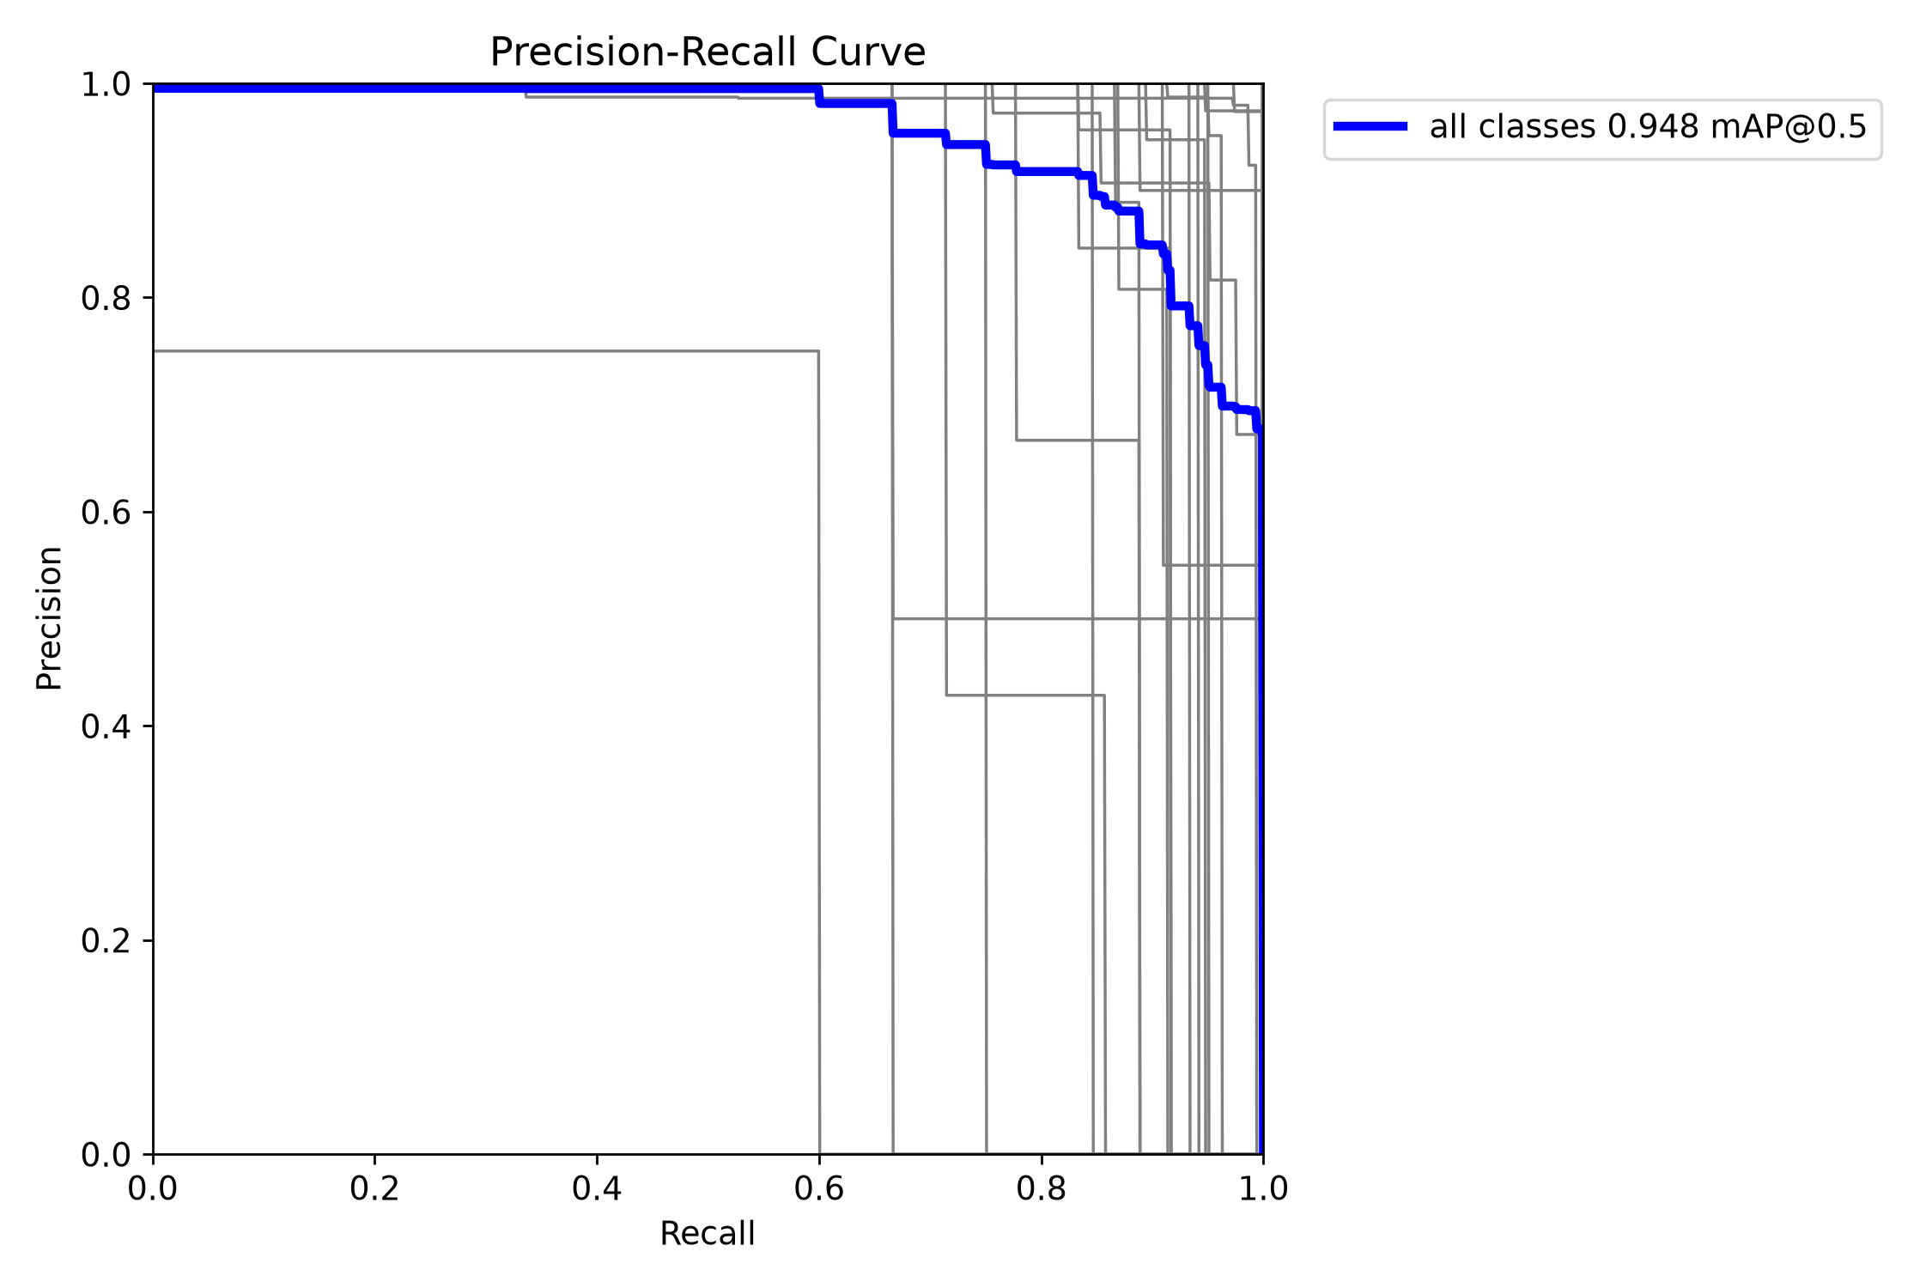
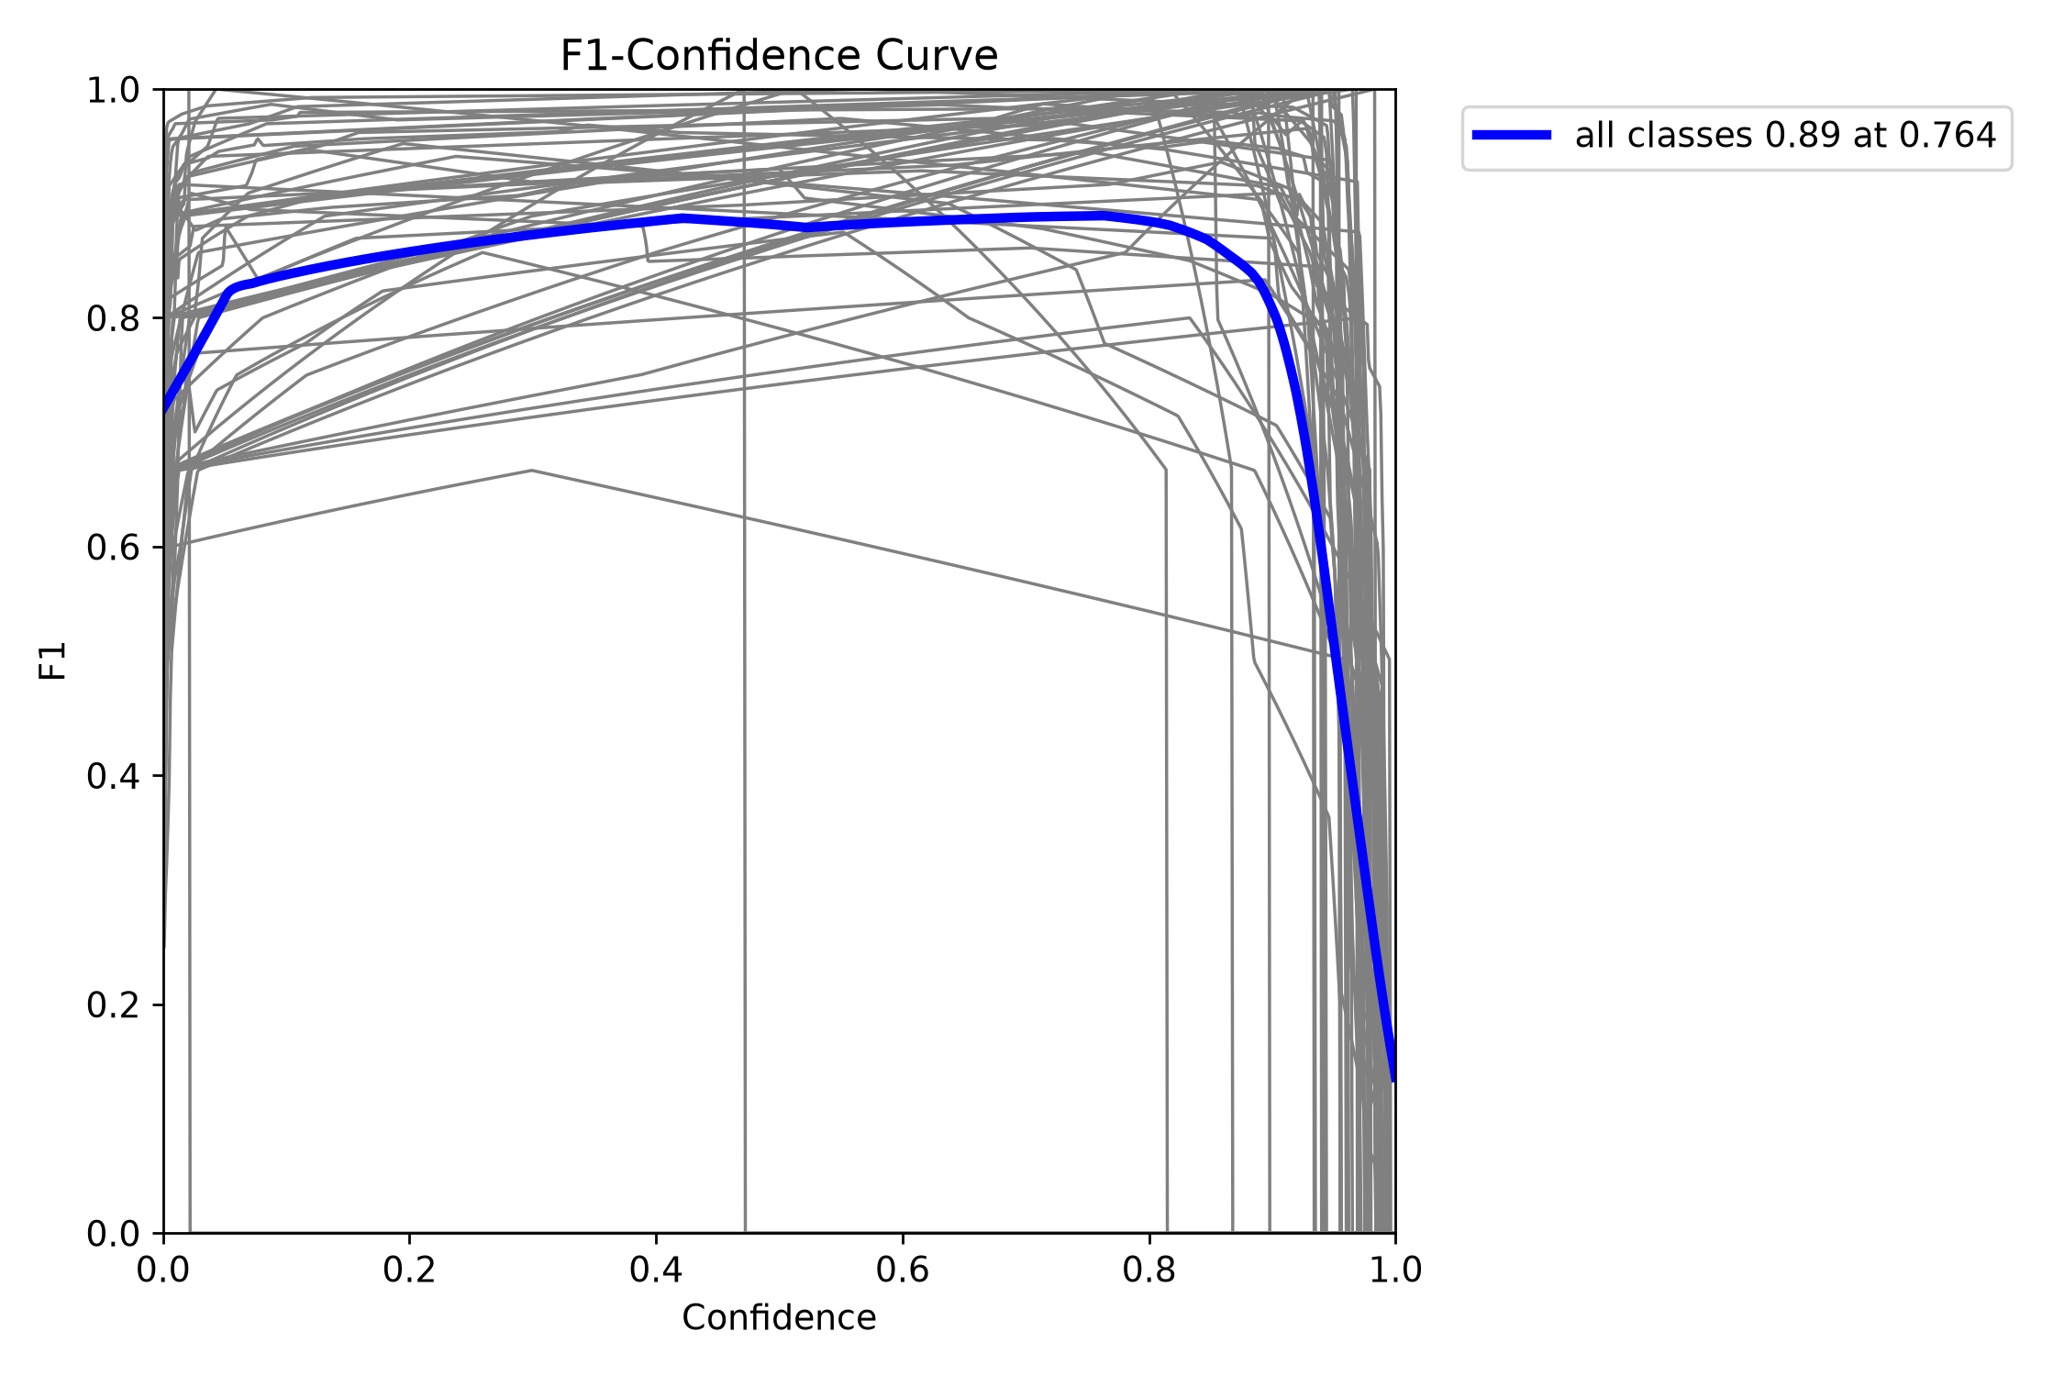
Presented by Kendrew Lim Yan Zhe
4.2 PRECISION, RECALL AND CONFIDENCE
Precision–recall curve
F1 versus confidence
Version 1 tuned-model test curves. The deployed app uses separate upload and camera thresholds.
11
Notes:
Presenter: Kendrew Lim Yan Zhe
Suggested time: 48 seconds
Explain precision as how often a reported sign is correct and recall as how many labelled signs are found. Raising confidence can reduce false positives but also miss more signs. F1 balances precision and recall. These are Version 1 tuned-model curves and do not establish an optimal threshold for every camera condition. The app uses 20% for uploads and a higher default for camera mode.
Sources:
training/results/final_v1/report_artifacts/final_test_tuned_cls_pw_025/BoxPR_curve.png
training/results/final_v1/report_artifacts/final_test_tuned_cls_pw_025/BoxF1_curve.png
webapp/static/app.js

Slide 12
Presented by Crystalina Dibble
4.3 FINAL DEPLOYED MODEL RESULTS
93.86%
mAP@0.5
838 test images
867 labelled signs
Recall remains below precision: some signs are still missed.
Version 3 held-out detection evaluation. mAP is a detection metric, not per-image classification accuracy.
12
Notes:
Presenter: Crystalina Dibble
Suggested time: 51 seconds
State the final deployed Version 3 results: precision 93.04%, recall 86.70%, F1 89.76%, mAP at 0.5 of 93.86%, and stricter mAP of 77.70%. The precision-recall difference means missed signs remain important. The test set contains 838 images and 867 labelled objects. Do not describe the 84-image recognition result as the test-set accuracy.
Sources:
models/model_manifest.json
training/results/v3/report_artifacts/final_test_comparison.csv

Slide 13
Presented by Crystalina Dibble
4.4 DETECTION SPEED
Detector mode | Frames with detections | Throughput
Full frame | 84 / 84 | 3.34 FPS
ROI only | 2 / 84 | 76.63 FPS
Periodic hybrid | 19 / 84 | 13.98 FPS
Why we kept full frame
The fast ROI route skipped most signs in this image sequence.
Full-frame processing retained detection coverage.
About 300 ms per image in this saved benchmark.
Same 84-image sequence, CPU benchmark, detector stage before temporal confirmation. Coverage is not recall.
13
Notes:
Presenter: Crystalina Dibble
Suggested time: 48 seconds
Explain why the fastest measured option was not selected. ROI-only processing ran quickly because it submitted very few candidate crops to YOLO. It found detections on only 2 of the 84 images. Full-frame processing detected a sign in every image, at about 3.34 FPS. This benchmark has no ground-truth boxes, so the coverage measure must not be called recall. The hybrid interval also skips full scans in this independent-image sequence; it is not a video tracking comparison.
Sources:
outputs/v3_84_benchmark/benchmark_summary.json

Slide 14
Presented by Crystalina Dibble
4.5 FUNCTIONAL AND CLASS TESTING
Held-out detection test
Reviewed image check
838 images and 867 labelled objects. Precision, recall and mAP measure detection quality.
84 / 84 expected top classes at a 20% threshold. The set represents 48 distinct classes.
Prepared demonstration set
Application checks
48 / 48 selected original images returned the expected class through the local API.
Image upload, live camera, speech replay, multi-sign confirmation and history support the demonstration.
Current prepared demo coverage: 48 of 63 supported classes.
14
Notes:
Presenter: Crystalina Dibble
Suggested time: 42 seconds
Keep the evidence levels separate. Held-out detection metrics assess a labelled test set. The reviewed 84 images assess the highest-confidence class only and cover 48 classes. We have also rechecked one original demo image for each available class through the running API; all 48 returned the expected class. The team will supply the remaining 15 examples. A prepared successful demo is not a replacement for an unbiased test.
Sources:
outputs/v2_v3_84_comparison/summary.json
outputs/MYSignVoice_Presentation/demo/verification_results.json
outputs/MYSignVoice_Presentation/demo/class_coverage.csv

Slide 15
Presented by Crystalina Dibble
4.6 ERROR ANALYSIS
Crowded frames
Missed detections
Only 4 / 12 trial collages returned all four expected classes. Sign scale and context changed after compositing.
Final test recall is 86.70%. High precision does not mean the detector finds every sign.
Uneven class support
Unknown signs and OCR
Rare classes have few test examples. More varied samples are needed to assess them reliably.
The model has 63 classes. Unsupported signs may receive a known label; weak digit crops remain difficult.
Collage test: 36 / 48 expected signs found, with 11 extra class detections across 12 frames.
15
Notes:
Presenter: Crystalina Dibble
Suggested time: 51 seconds
Use the new collage test as an honest stress example. Every selected sign worked alone, but putting four full images in one square frame changed apparent size and context. Across 12 collages, 36 of 48 expected classes appeared and 11 additional class detections appeared; only four frames recovered all four expected classes. These figures are not mAP and we have not isolated the exact cause of each error. The model also has a closed set of supported labels.
Sources:
outputs/MYSignVoice_Presentation/demo/verification_results.json
models/model_manifest.json
training/results/v3/report_artifacts/class_distribution.csv

Slide 16
Presented by Crystalina Dibble
4.7 BETA TESTING
PROPOSED USER EVALUATION
Participants and tasks
What we will measure
Invite non-team participants and, where feasible, users who experience difficulty reading signs. Use a stationary demonstration.
Task completion, spoken-message clarity, repeat-message burden, readability and time to understand the result.
Short procedure
Upload a sign, listen to the result, explain its meaning, then rate the experience and suggest improvements.
Planned evaluation. No participant results are reported.
16
Notes:
Presenter: Crystalina Dibble
Suggested time: 30 seconds
Describe beta testing as the next user-evaluation step. Ask participants outside the team to complete tasks and provide feedback, and involve target users where feasible. Use the questionnaire to assess speech clarity, repetition and readability. Participant results remain to be collected and verified.
Sources:
D:/MYSignVoice_Final_Report_5_Chapters_final.docx: sections 4.6, 5.2 and Appendix B

Slide 17
Presented by Crystalina Dibble
5.1 LIMITATIONS AND IMPROVEMENTS
Current limitation | Next improvement
Limited real-world evidence | Test blur, night, glare, occlusion and unsupported signs
Laptop and internet dependence | Evaluate on-device inference and a persistent host
Accessibility still unvalidated | Co-design controls, contrast and speech with target users
Crowded scenes and small signs | Collect multi-sign scenes and evaluate larger input sizes
Uneven training examples | Add rare classes and negative scenes, then re-evaluate
Performance and usability improvements need evaluation on the same held-out and realistic camera sets.
17
Notes:
Presenter: Crystalina Dibble
Suggested time: 39 seconds
Link each limitation to a concrete follow-up. More data is needed for rare signs and challenging conditions. Accessible interaction requires work with target users, including control sizes, contrast and speech. A portable deployment could remove laptop dependence but must be tested for speed and accuracy. Higher resolution and multi-sign training may help crowded scenes, but these are proposed improvements rather than proven fixes.
Sources:
models/model_manifest.json
webapp/static/app.js
outputs/v3_84_benchmark/benchmark_summary.json

Slide 18
Presented by Aedan Loh
5.2 CONCLUSION
Sign recognition connected to spoken information
Working prototype
Measured outcome
YOLO26s, OpenVINO, OCR and a browser interface form one functioning pipeline.
93.86% mAP@0.5 on the final held-out test and 84 / 84 expected top classes in the reviewed check.
Next priority: validate useful, understandable speech with target users and improve difficult-scene detection.
The current result supports a prototype demonstration, not independent navigation or a vehicle-safety claim.
18
Notes:
Presenter: Aedan Loh
Suggested time: 39 seconds
Summarize the implemented system and its main evidence. The project contributes an integrated sign-to-speech experience around a trained detector. Our key next step is user validation and more demanding camera tests. Then introduce Hui Min, who will play the recorded demonstration and show class coverage.
Sources:
models/model_manifest.json
webapp/main.py

Slide 19
Presented by Tan Hui Min
DEMONSTRATION
1–2 minutes
About 3 minutes
School-zone video
Class-coverage demonstration
Recorded road scene with detection labels and spoken sign guidance.
Original sign examples with predicted class names, confidence values and selected speech output.
Recorded demonstration and class examples
19
Notes:
Presenter: Tan Hui Min
Suggested time: 300 seconds
Switch to the external video. Allocate about 1–2 minutes to the school-zone recording and the remaining time to class coverage. Use a fixed camera or a passenger to operate recording equipment; the driver should not operate the app. The supplied 48 originals cover 48 classes; add and test the remaining 15. A montage of actual detections can make the coverage video short enough, but keep every class name readable. The current deck does not contain the video.
Sources:
outputs/MYSignVoice_Presentation/demo/README.md

Slide 20
MYSignVoice
Presented by Team 4
THANK YOU
Questions and discussion
Questions?
Group Member
Universiti Tunku Abdul Rahman
We welcome your questions and feedback
Aedan Loh Yi Cheng
Crystalina Dibble
Tan Hui Min
Kendrew Lim Yan Zhe
Faculty of Information and Communication Technology
Notes:
Presenter: Team 4
Suggested time: Backup / transition
Return to this slide after the demonstration and invite questions. Backup plots follow only if needed.
Sources:

Slide 21
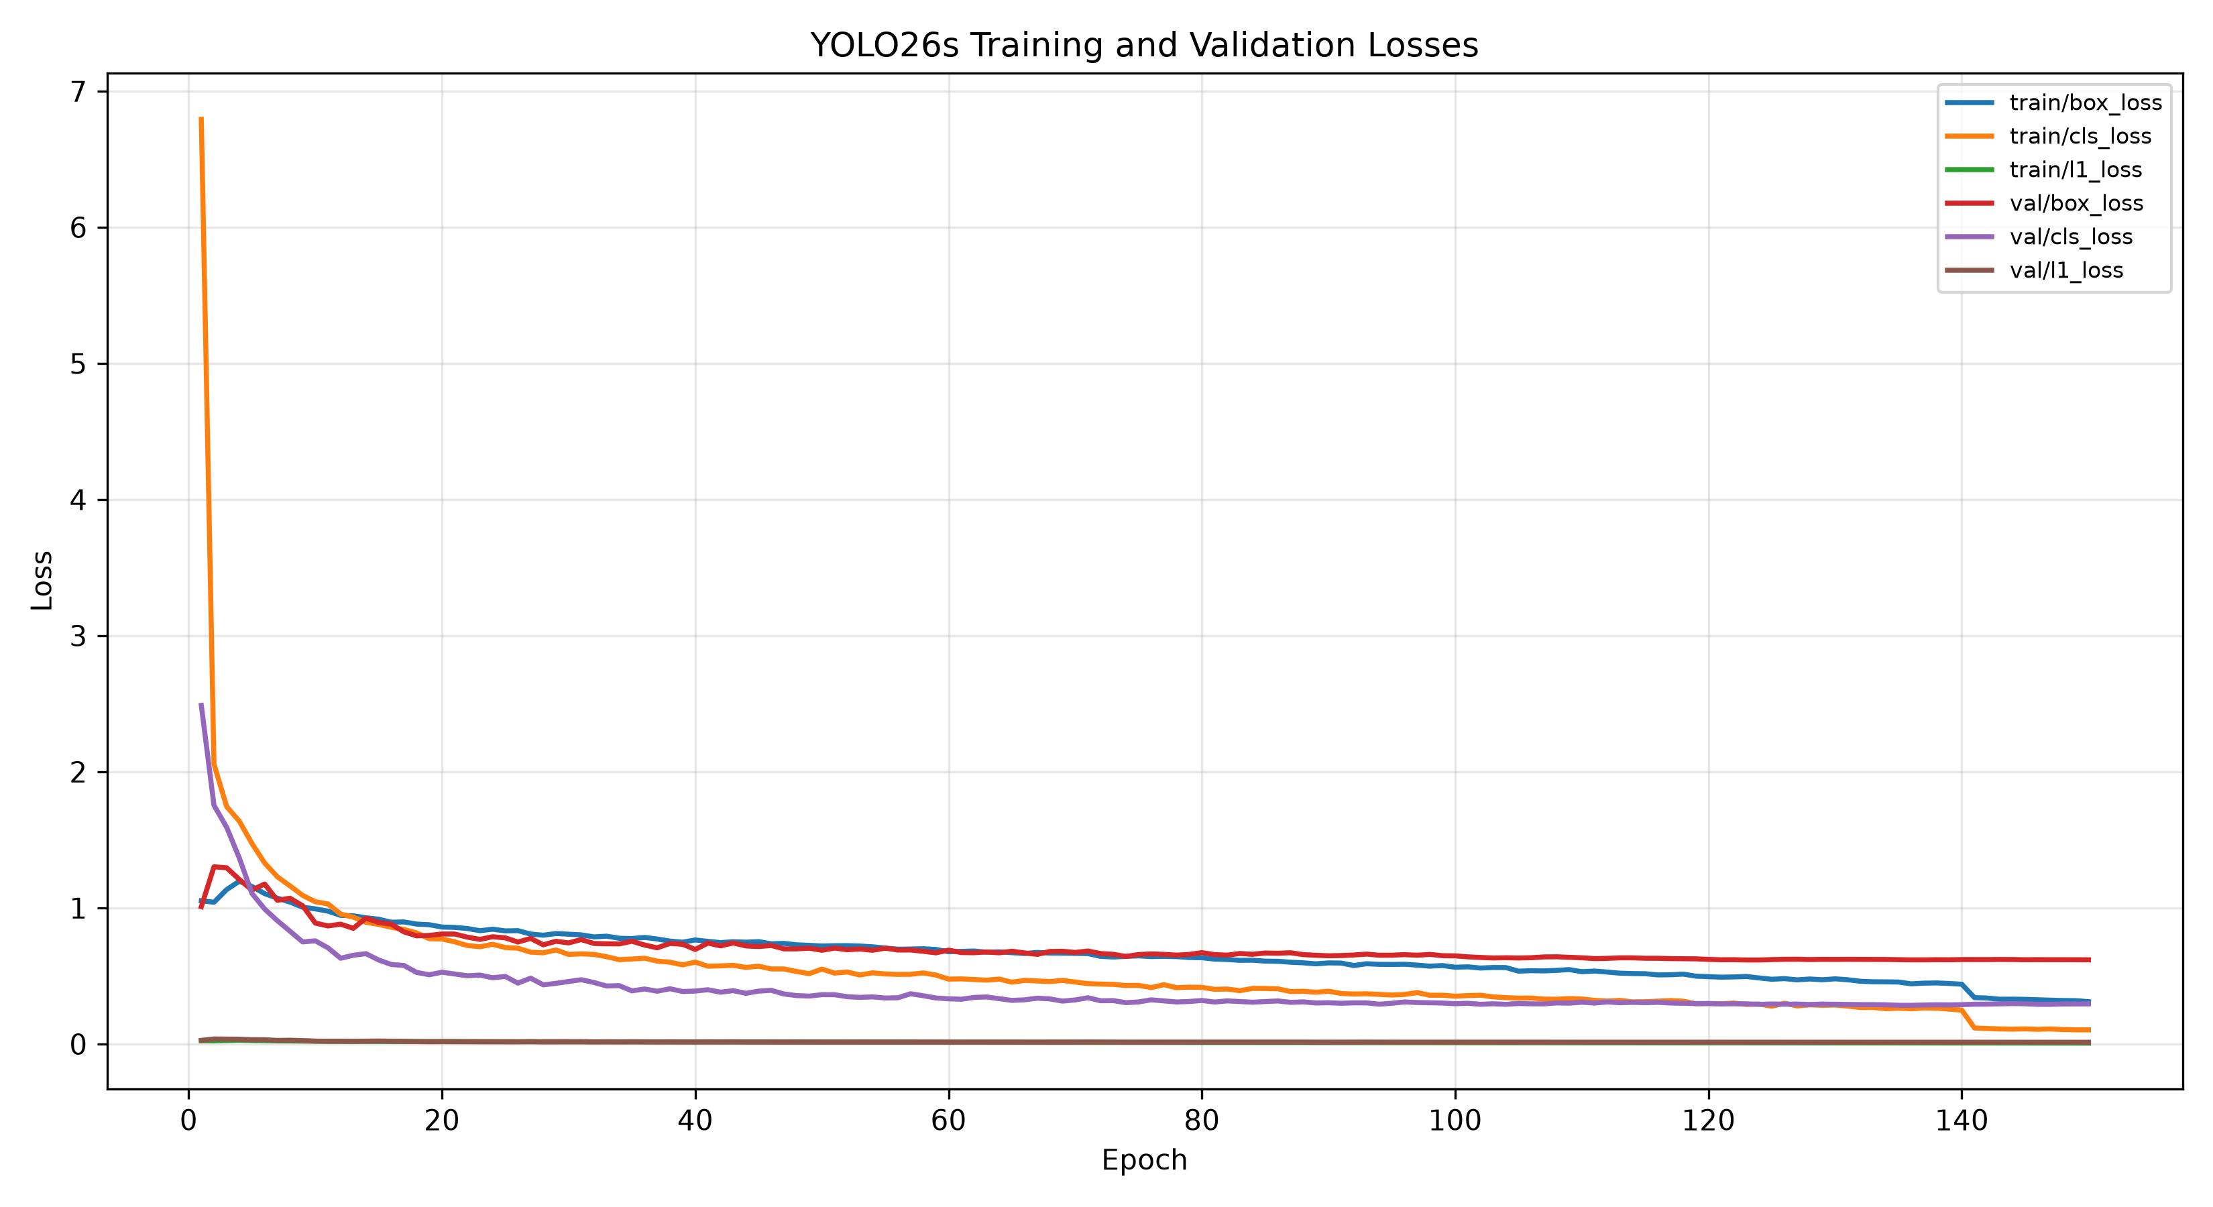
Presented by Kendrew Lim Yan Zhe
BACKUP: VERSION 1 LOSS DETAILS
Version 1 baseline run. Box, classification and L1 losses measure different parts of training.
21
Notes:
Presenter: Kendrew Lim Yan Zhe
Suggested time: Backup / transition
Use only for questions about loss components. These plots are from Version 1, not the final Version 3 tuning run.
Sources:
training/results/final_v1/report_artifacts/baseline_loss_curves.png

Slide 22
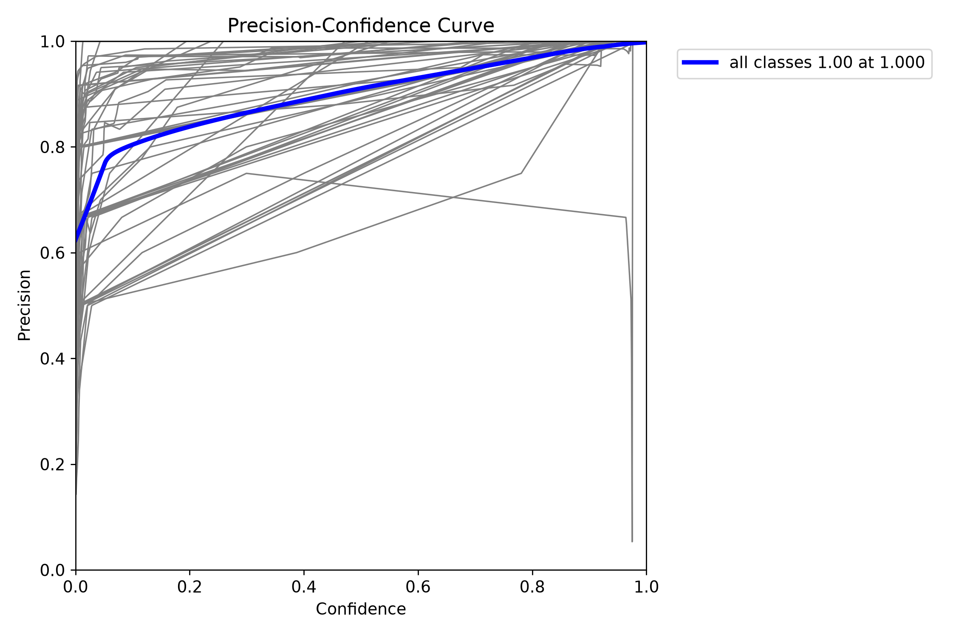
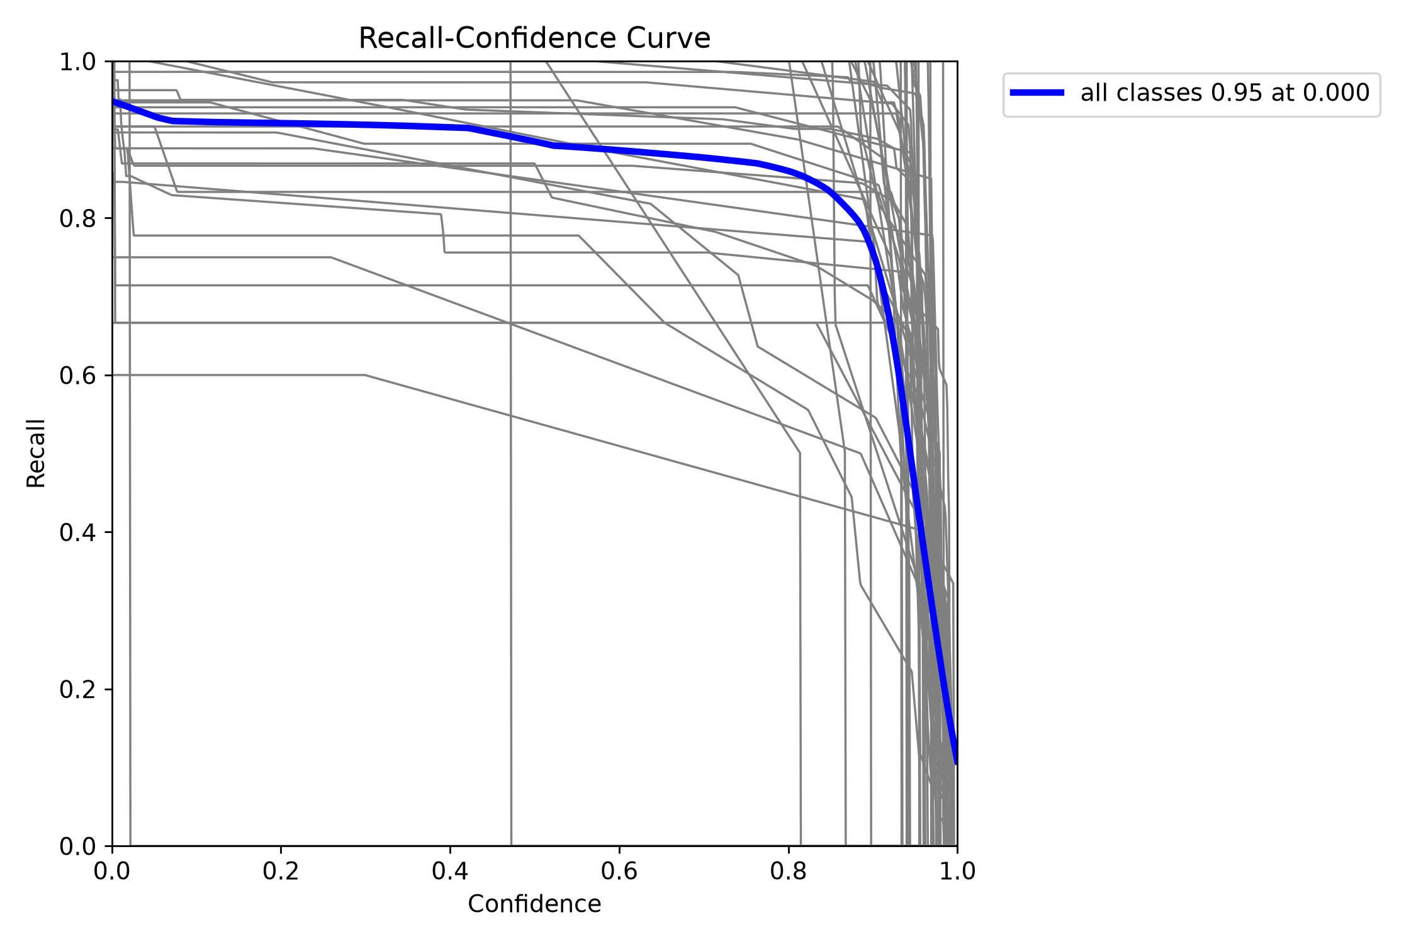
Presented by Kendrew Lim Yan Zhe
BACKUP: VERSION 1 EVALUATION CURVES
Version 1 tuned-model test curves. Raising confidence changes precision and recall in opposite ways.
22
Notes:
Presenter: Kendrew Lim Yan Zhe
Suggested time: Backup / transition
Use only for threshold questions. Explain that a threshold decision depends on the intended tradeoff and operating conditions.
Sources:
training/results/final_v1/report_artifacts/final_test_tuned_cls_pw_025/BoxP_curve.png
training/results/final_v1/report_artifacts/final_test_tuned_cls_pw_025/BoxR_curve.png

Slide 23
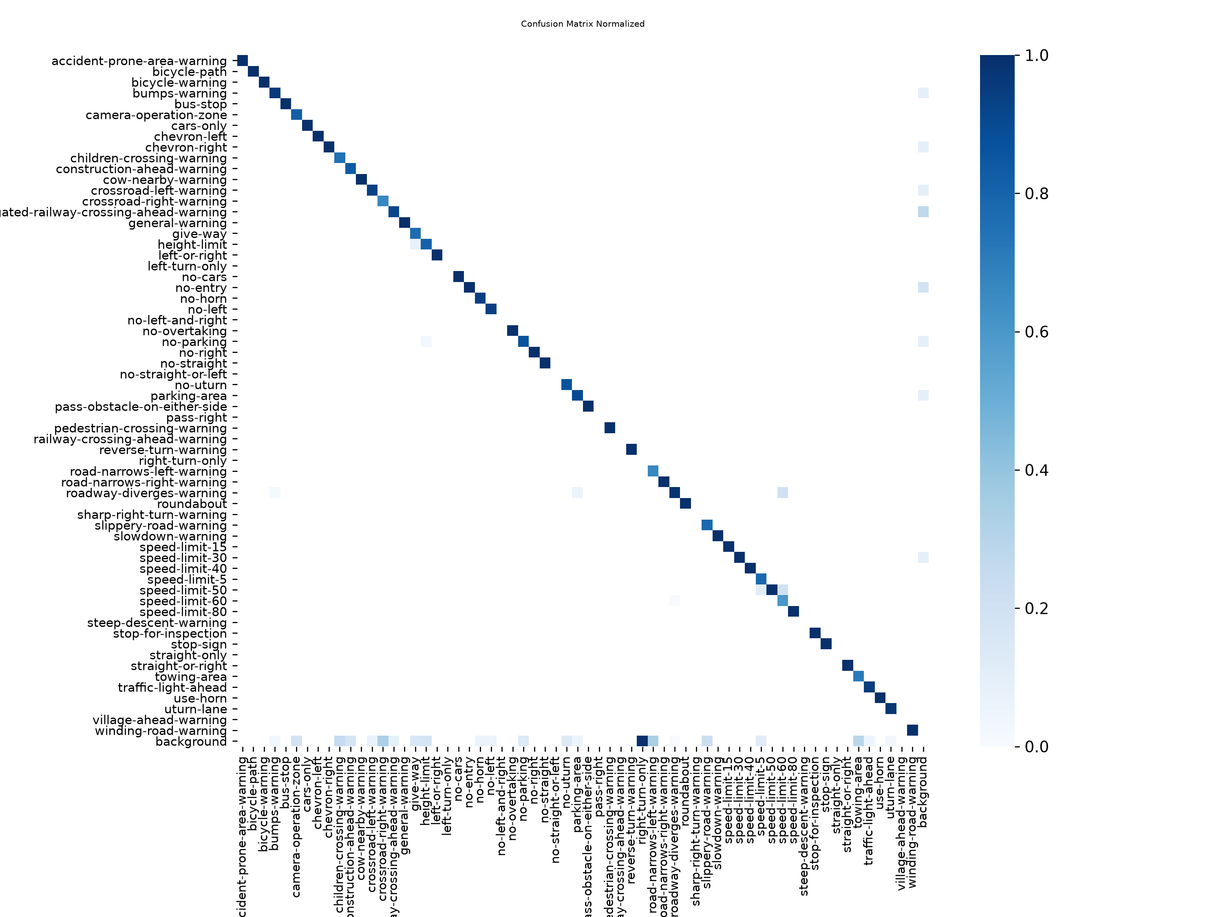
Presented by Kendrew Lim Yan Zhe
BACKUP: VERSION 1 CONFUSION MATRIX
Reading the matrix
Diagonal: correct class
Off diagonal: class confusion
Background: missed or extra detections
Inspect rare classes with their sample counts.
Version 1 tuned-model held-out confusion matrix. Included as a backup because 63 classes make it dense.
23
Notes:
Presenter: Kendrew Lim Yan Zhe
Suggested time: Backup / transition
This is the original Version 1 tuned-model test confusion matrix. Read its axis labels before interpreting a cell. The diagonal shows matches; off-diagonal values show confusion and the background category represents unmatched predictions or ground truth. Do not label this as the Version 3 confusion matrix.
Sources:
training/results/final_v1/report_artifacts/final_test_tuned_cls_pw_025/confusion_matrix_normalized.png

