Slide 1
MCOS
1.6 Application of preventive maintenance

Slide 2
Preventive Maintenance
Preventive maintenance is the act of performing regularly scheduled maintenance activities to help prevent unexpected failures in the future.
simply, it’s about fixing things before they break.

Slide 3
1.6.1PURPOSE OF PREVEVENTIVE MCE
The following are purpose of preventive Maintenance
Extends asset life
Reduces maintenance
Boosts productivity
Reduces unplanned downtime

Slide 4
1.6.2Maintain internal and external components of computer
EXTERNAL COMPONENTS
What is the external component ?
External hardware components, also called peripheral components, are those items that are often externally connected to the computer to control either input or output functions
Examples : mouse, keyboard etc.

Slide 5
Why my mouse is not working?
Causes of a mouse not working are :
Irreparable hardware damage.
Loss of power or connection.
Interference between the mouse and the work surface.
Outdated software
Operating system glitches or misconfigurations.

Slide 6
How to fix a laptop mouse that's not working
Since several factors could be at the root of a mouse failing to work properly, troubleshooting the problem is the best way to make it work once more.
Try these steps, organized in order of most-common and easiest to most intensive.

Slide 7
Continue
1. Inspect the mouse for hardware damage. A cracked housing, a missing ball, sticky or silent clicking of the finger switches, or a failure of the optical sensor to glow suggest that the device is damaged.
2. Clean the mouse. If the pointer moves in jerking motions or is less responsive than usual, clean the mouse to see if it improves the performance.
3. Replace the batteries.
Swap the batteries out for a new set, especially if you're still using the batteries that came with the device. Consider using rechargeable batteries. Likewise, verify the batteries are properly installed.

Slide 8
Continue
Sometimes, closing the panel door before the battery bounces out can be tricky.
4. Try a different USB port.
There might be a problem with the one you're using, so unplug the mouse or the receiver and try an alternate USB port.
5. Connect the mouse directly to the USB port.
6. Use the mouse on an appropriate surface.
Some mice can be used on (almost) any kind of surface. Many can't.
7. Update the driver.
Check the manufacturer's website for available driver updates or use driver updater tools.
8. Release and re-pair a Bluetooth mouse.
9. Disable an integrated trackpad. If your laptop supports an internal trackpad, disable it through your operating system's settings utility. An internal trackpad may conflict with, or override, an external mouse.

Slide 9
Keyboard
A computer keyboard is a peripheral input device modeled after the typewriter keyboard which uses an arrangement of buttons or keys to act as mechanical levers or electronic switches.
How To Fix Windows Keyboard Keys
Which Stop Working A keyboard without working keys may seem like a blow to productivity, but it’s possible to repair. If you’ve been working on your PC and suddenly some or no characters appear on your computer screen, we’re going to show you how to fix it.

Slide 10
If you have a desktop PC, it’s easy to just swap the keyboard and use a different one.
For laptops though, this isn’t possible, which makes it a big problem. It could be that your computer could use some simple hardware or software maintenance, or your keyboard settings are set to use the wrong language or region. Before you visit the repair shop, buy a new keyboard, or chuck your laptop altogether, try some of the quick fixes below.

Slide 11
Tips Fix Keyboard Keys Which Stop Working
Quick checks
• Clean up the keyboard
• Restart your PC
• Use a different keyboard
• Check the region or language settings
• Adjust keyboard input settings
• Run a malware scan
• Reinstall keyboard driver

Slide 12
continue
Visit a service tech/Replace the keyboard Quick Checks
• If you’re using a Bluetooth keyboard, check that it’s powered on and that it’s connected.
• Re-pair the keyboard with your computer (for wireless keyboards).
• Try a different USB port (wired keyboard).
• Check the keyboard’s battery level as it may cause performance problems.
• If the keyboard keys still won’t work after carrying out these basic checks, try the solutions below.

Slide 13
Monitor:
Check the connections: Ensure that all cables connecting the monitor to the computer are securely plugged in. This includes the power cable, video cable (such as HDMI, DisplayPort, or VGA), and any additional cables like USB for peripherals if applicable.
Verify power: Make sure the monitor is receiving power. Check if the power indicator light on the monitor is lit up. If not, ensure that the power cable is plugged in properly and that the outlet is functioning by plugging in another device.
Test with another device: If possible, connect the monitor to another computer or device to see if it works. This helps determine if the issue lies with the monitor or the computer itself.

Slide 14
continue
Adjust monitor settings: Sometimes the monitor settings may be configured incorrectly. Use the physical buttons on the monitor to access the menu and check settings like brightness, contrast, input source, etc.
Restart the computer: Sometimes a simple restart can resolve display issues caused by software glitches or driver conflicts.

Slide 15
continue
Update graphics drivers: Ensure that your computer's graphics drivers are up to date. Outdated or corrupted drivers can cause display problems. You can usually download the latest drivers from the manufacturer's website or use automatic driver update software.
Check for hardware problems: If the monitor still doesn't display anything, there might be a hardware issue with the monitor itself. In this case, it might require professional repair or replacement.
Try a different port or cable: If you're using multiple video ports on your computer (e.g., HDMI, DisplayPort), try switching to a different port. Also, try using a different video cable to rule out any issues with the cable itself

Slide 16
B.INTERNAL COMPONENTS
What is the internal component?
The internal components of a computer system consist of the hardware required to process data and to allow the processor to communicate with other devices such as secondary storage, display screens, and printers.
They are several internal components of computer each play a vital/crucial role in computer system some examples are
Motherboard
processor

Slide 17
Continue
Cooling system
Ram
Power supply
Disk drive
Adapter card and others

Slide 18
To Maintaining the internal components of a computer is crucial for its longevity and optimal performance. Here are some general guidelines for maintaining the internal components
1 Regular cleaning: Dust and debris can accumulate inside the computer case over time, leading to overheating and performance issues. Use compressed air to blow out dust from the internal components, including fans, heat sinks, and vents. Be sure to do this in a well-ventilated area and power off the computer before cleaning.

Slide 19
2 Check for loose connections: Periodically inspect the internal connections of components such as RAM modules, graphics cards, and power cables to ensure they are securely seated in their respective slots or connectors. Loose connections can cause intermittent issues and poor performance.
3 Monitor temperatures: Install temperature monitoring software to keep an eye on the temperatures of the CPU, GPU, and other components. High temperatures can indicate inadequate cooling or airflow, which may require additional cooling solutions such as additional fans or aftermarket CPU coolers.

Slide 20
4 Update drivers and firmware: Regularly update device drivers and firmware for components such as the motherboard, graphics card, and storage drives. Manufacturers often release updates to improve compatibility, performance, and security.
5 Manage cables: Proper cable management not only improves airflow within the case but also makes it easier to access and maintain internal components. Use cable ties, Velcro straps, or cable management channels to organize and secure cables away from fans and other moving parts.
6 Replace thermal paste: Over time, the thermal paste between the CPU and heatsink can degrade, leading to poor heat transfer and higher temperatures. Consider replacing the thermal paste every few years to maintain optimal thermal conductivit

Slide 21
7 .Keep software updated: Regularly update the operating system and software applications to patch security vulnerabilities and improve stability. Outdated software can expose the system to malware and other security threats.
8 .Backup data regularly: Regularly back up important data to an external storage device or cloud storage service. This ensures that valuable files are protected in case of hardware failure or other issues.

Slide 22
9 .Handle components with care: When installing or removing internal components, handle them with care to avoid static discharge and physical damage. Use an anti-static wrist strap or mat when working inside the computer case to prevent damage to sensitive components.
10 .Consult manuals and documentation: Refer to the manuals and documentation provided by the manufacturers for specific maintenance instructions and guidelines for your computer's components.

Slide 23
Common hardware Faults and causes
Computer issues do happen to almost every user of both laptop and desktops.
These issues can be big and small, either a small glitch or a complete system crash. They can happen at any time, and this disruption to your computer experience can seem scary to face. Not to worry, there are a few common computer faults that you can diagnose by yourself without even testing. Understanding why these issues happen and what you can do to fix it can get you prepared before it happens. Sometimes a quick computer restart can fix your problem; it’s as easy as that. So before you repair or replace anything, try restarting your laptop or desktop computer first

Slide 24
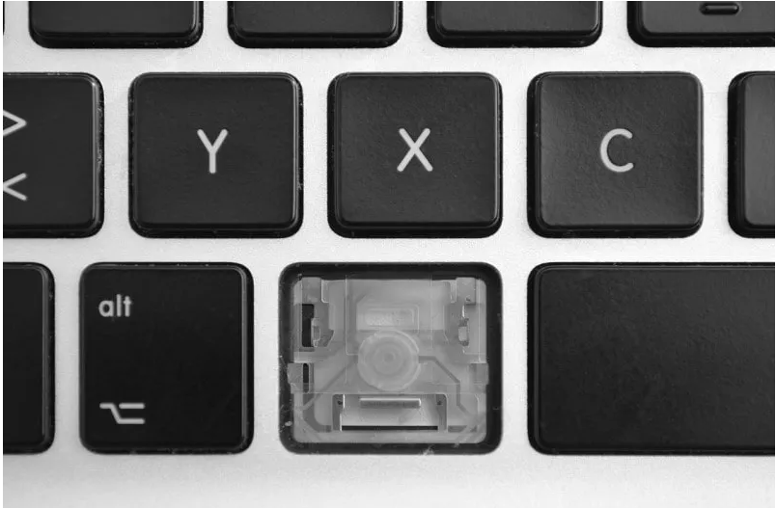
1 key not working on keyboard
Most causes for keyboard failure involve dust and rust buildup and accumulating over the years. Or it could be from a liquid spill or leakage that many computer users might not even be aware of. It is also common that a computer left unused for several months will end up with a faulty keyboard too, if it’s not stored in a cool, dry environment.

Slide 25
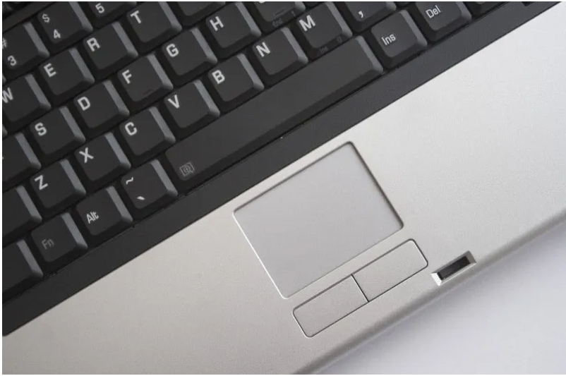
2. Laptop touchpad causing cursor to jump randomly
What causes this failure is quite similar to what causes keyboard failures. The touchpad gets damaged over the years of accumulating dust, rust, and moisture. Liquid spill and leakage is another very common cause. Using excessive force when you press the touchpad button can also cause damage to it over the years.

Slide 26
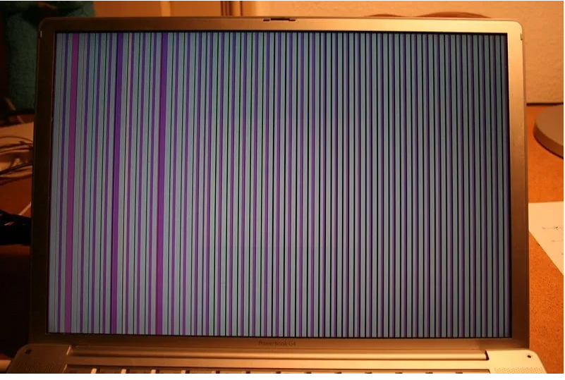
3. Display screen image distortion

Slide 27
Continue
These distortions look like vertical lines across the screen, or a bleeding image. Sometimes an image distortion can mean a video card issue.If you can still get the screen to display on an external monitor, and then you can confirm that you’ve got a screen issue and not a video card issue.The majority of screen damages are physically caused by end-users: dropping the computer, stepping on it, or grabbing the screen by its edge while picking it up instead of carrying the laptop up from the base normally.

Slide 28
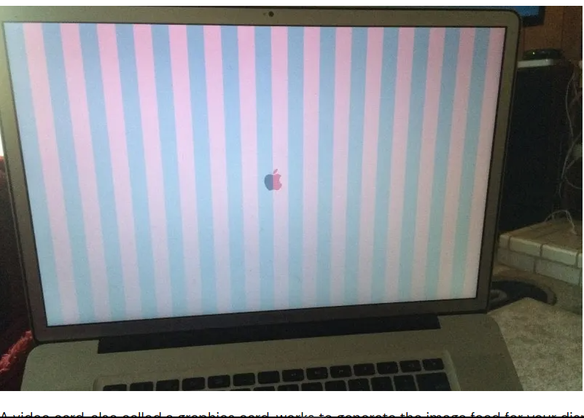
4. Video card faults
Why do video cards fail? Video cards are generally expected to last 2-5 years. Accumulated dust and rust inside the video card leads to overheating problems for the card, and eventually kills it. Heavy gaming, overclocking your computer can also put a lot more pressure on the graphics card and reduce its lifespan

Slide 29
Continue
There are a few distinct ways to tell these apart. Distortion caused by video card faults look more like vertical columns (sometimes horizontal). The keyboard and mouse may also be unresponsive under a video card fault. Connecting to an external display will not work as well.To repair this issue, you will have to replace the video card. Most new laptops have video cards built into the motherboard, so repairing it might be more complicated. You’ll need to replace the entire motherboard to replace the video card. For desktops and some laptops, you’ll be able to replace just the separate video cards

Slide 30
5. Fan noises
Most computers use a fan system to keep it at a regular operating temperature. This prevents overheating that could damage any of the hardware within.
Moving parts like fans almost never operate silently; you’ll always hear a very low whir of the rotors while your computer is on. But when it starts to make abnormal clunking and rattling noises, you’ll know that the fan is wearing down. Getting a replacement would solve this problem. Again, this fan noise is caused by a accumulation of rust and dust inside. This rust causes its motor to wear out. After years of use, your computer collects dust and its fan is clogged. Computing in a clean environment can make a big difference!

Slide 31
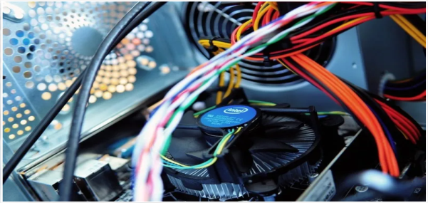
Continue

Slide 32
6. Battery not charging / doesn’t last long
Laptop batteries will deteriorate over a few years. It will either start not lasting long or not hold charge when plugged in. This will also need a replacement.
Batteries usually only last 2-4 years. Once you’ve had your laptop for a while, it’s very likely that the battery is dying if it doesn’t last long or hold a charge. It’s surprising that many people do not expect their laptop batteries to fail!

Slide 33
7. Laptop speaker making static noises
Abnormal sounds made by your speaker are a sign that it is failing. Static noises or distorted noises while playing audio is an example of this failure. This may be caused by water damage or rust formation. Try connecting to external speakers or headphones to verify this failure. It is most likely that speakers are damaged by rust and liquid only. However, speaker problems are too uncommon for us technicians to understand them better. As far as we know, it usually comes after a reported liquid spill, or from finding traces of liquid residue inside the computer. Still, it’s difficult to see what’s wrong inside the

Slide 34
Learning outcome 2:
Maintain Computer System Software

Slide 35
2.1 Introduction to computer software maintenance
Software maintenance is the process of changing, modifying, and updating software to keep up with customer needs.
Software maintenance is done after the product has launched for several reasons including improving the software overall, correcting issues or bugs, to boost performance, and more
Drivers
A Driver, or device driver, is a set of files that tells a piece of hardware how to function by communicating with a computer's operating system.
All pieces of hardware require a driver, from your internal computer components, such as your graphics card, to your external peripherals, like a printer.

Slide 36
Backup and restore
Is the primary backup component of Windows operating system. It can create file and folder backups, as well as system images backups, to be used for recovery in the event of data corruption, hard disk drive failure, or malware infection.
recovery
Describes the process of creating and storing copies of data that can be used to protect organizations against data loss.

Slide 37
Data recovery is the process of retrieving lost, corrupted, or accidentally deleted data from storage devices such as hard drives, solid-state drives (SSDs), USB flash drives, memory cards, and optical media. This data could include files, documents, photos, videos, emails, and more.

Slide 38
Activation
Activation : refers to the process of validating and authorizing software or hardware to ensure that it is genuine and properly licensed for use. Activation is commonly used to prevent software piracy and unauthorized use of proprietary products.
What happens if your PC is not activated?
When it comes to functionality, you won't be able to personalize the desktop background, window title bar, taskbar, and Start color, change the theme, customize Start, and lock screen etc.
Additionally, you might periodically get messages asking to activate your copy of Windows

Slide 39
Update and upgrade
Update
An update is new, improved, or fixed software, which replaces older versions of the same software. For example, updating your operating system brings it up-to-date with the latest drivers, system utilities, and security software.
Upgrade.
An Upgrade means introducing something new or latest version of the previous.

Slide 40
Continue
An update refers to the process of applying changes, improvements, or fixes to software, firmware, or operating systems to enhance functionality, performance, security, or compatibility. Updates are essential for keeping software and systems up-to-date and ensuring they remain stable, secure, and compatible with the latest technologies.

Slide 41
Continue
Updates are typically distributed by software vendors or operating system developers through various channels, such as automatic updates, manual downloads, or online repositories. Users are encouraged to regularly install updates to ensure their software and systems remain secure, reliable, and up-to-date with the latest features and improvements. Additionally, updating software and systems helps mitigate the risk of security breaches, data loss, or system failures caused by known vulnerabilities or software defects

Slide 42
Upgrade
An upgrade in computing refers to the process of replacing or enhancing a hardware component, software application, or system configuration with a newer version or a more advanced alternative. Upgrades are undertaken to improve performance, add new features, enhance compatibility, or extend the lifespan of computing devices and systems.

Slide 43
Comparison between Update and Upgrade
UPDATE | UPGRADE
Providing enhancement of the existing functionalities or features like support to plug-ins or security updates is its objective. | The introduction of new and advanced functionalities or features to the software or applications is the objective of the upgrade
It remains the old software but some functions are changed for different purposes. | It is an entirely new software based on the previous software.
It is a relatively simpler task. | It is a complex task to achieve.
Updating does not take much time as compared to upgrading. | Upgrading is a time-consuming process and requires lots of effort.

Slide 44
2.2 Perform Preventive software maintenance
2.2.1Disk management
Defragmentation: also known as defragging or defrag, is the process of rearranging the data on a storage medium, such as a hard disk drive (HDD), for efficient storage and access.
Defragmenting a hard drive can improve a computer's or laptop's performance and speed. To reduce fragmentation, a disk optimization tool typically uses compaction to free up larger areas of space. Certain disk defragmentation tools might try to keep smaller files together, especially if they're often accessed sequentially.

Slide 45
Disk Clean up: is a computer maintenance utility included in Microsoft Windows designed to free up disk space
Disk partitioning: or disk slicing is the creation of one or more regions on secondary storage, so that each region can be managed separately. These regions are called partitions. It is typically the first step of preparing a newly installed disk, before any file system is created.

Slide 46
Software security
Antimalware: is a type of software program created to protect information technology (IT) systems and individual computers from malicious software, or malware. Antimalware programs scan a computer system to prevent, detect and remove malware.
Ex: bit defender ,Kaspersky, Norton ,Avira
Malware: short for malicious software, refers to any intrusive software developed by cybercriminals (often called hackers) to steal data and damage or destroy computers and computer systems. Examples of common malware include viruses, worms, Trojan viruses, spyware, adware, and ransomware.

Slide 47
Continue
A firewall is a network security device/Software that monitors incoming and outgoing network traffic and decides whether to allow or block specific traffic based on a defined set of security rules. Firewalls have been a first line of defence in network security for over 25 years.

Slide 48
2.3 Troubleshoot software

