Slide 1
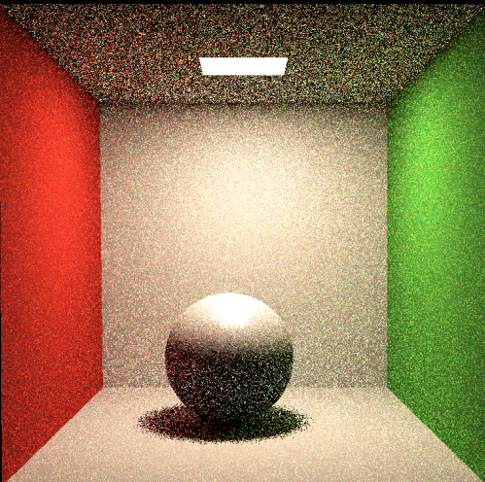
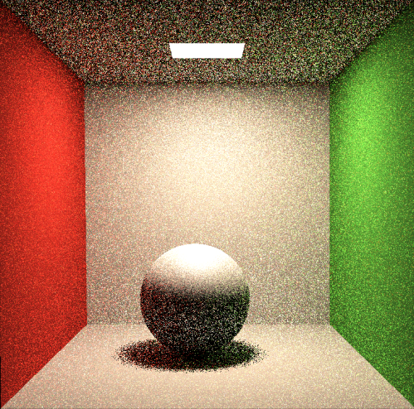
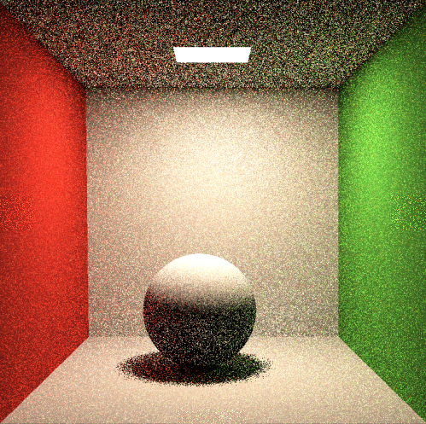
Ssp=1
Ior = 20
Roughness = 0.2
Ssp=1
Ior = 20
Roughness = 0.5
Ssp=1
Ior = 20
Roughness = 1
Return kd * diffuse + (1-kd) * cook_torrance

Slide 2
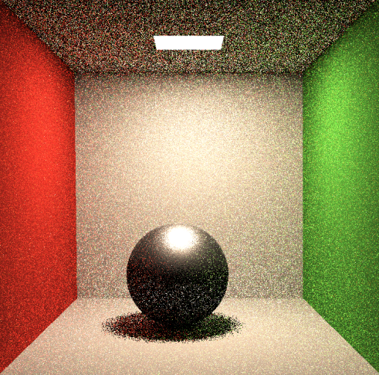
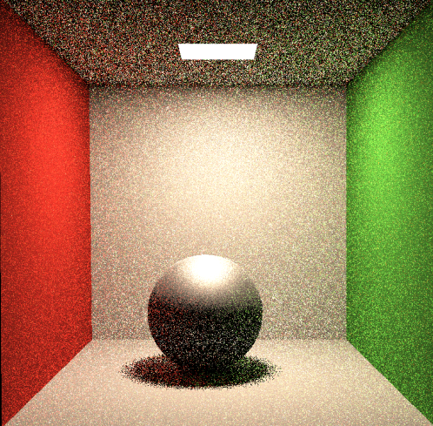
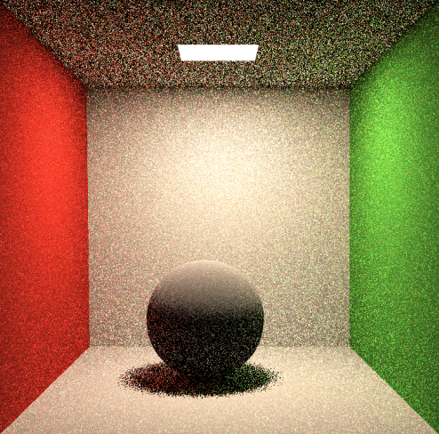
Ssp=1
Ior = 20
Roughness = 0.2
Ssp=1
Ior = 20
Roughness = 0.5
Ssp=1
Ior = 20
Roughness = 1
Return kd * cook_torrance

