Slide 1
Agentic AI Investment Assistant
TEAM FEAF · NAPAI COMPETITION 2026
Turning stock filings into explainable, proactive and verifiable decision support
The AI researches, explains and monitors. The investor makes every decision.
Category B · SYSTEX · Industry & Public-Sector Co-Creation
Agentic Workflow
Domain-Specific Agent
Human-in-the-loop
Notes:
[0:00, 15 s]
SAY: Good morning. We are Team FEAF. We built an investment assistant that researches, explains and monitors Taiwan stocks, and leaves every decision to the investor.
TIP: Pelan dan tenang. Jangan membaca slide. [ISI: nama pembicara 1]

Slide 2
“
I worry that AI might provide recommendations that are incorrect yet sound highly convincing, and that I might lack the expertise to spot the error.
— Respondent R10, from our field survey —
If an AI told you a stock just changed in value… how would you check?
Notes:
[0:15, 35 s]
SAY: One investor in our survey told us: AI may give recommendations that are wrong but sound very convincing, and I may not have the expertise to spot the error. That worry is the whole problem. So a question for you: if an AI told you a stock just changed in value, how would you check? Hold that thought. We will come back to it.
TIP: Jeda 2 detik setelah pertanyaan. Ini pembuka dan penutup, jadi harus diingat juri.

Slide 3



Not short of data. Short of trust
THE PROBLEM
News & social feeds
Filings & statements
Charts & quotes
Analysts & forums
The investor filters & checks it all, alone
Time drain
Shallow reading
Unverifiable
Hours spent gathering before any analysis
Ratios read without context; value traps slip through
AI answers sound right but can’t be checked
8/10
feel overwhelmed
9/10
want to see the AI’s reasoning
8/10
fear inaccurate AI answers
Field survey, n = 10
Notes:
[0:50, 45 s]
SAY: Investors are not short of data. News, filings, charts and forums all compete, and the investor filters everything alone. That costs hours, leads to shallow reading, and AI answers cannot be verified. In our survey of ten investors, eight felt overwhelmed, nine wanted to see the AI's reasoning, and eight feared inaccurate answers. Ten people is a small sample, but it shows the need.
TIP: Sebut 'small sample' sendiri; juri menghargai kejujuran angka. [ISI: pembicara 1]

Slide 4
From a new filing to a verified, explained alert
HOW IT WORKS
1
RULE-BASED
2
RULE-BASED
3
RULE-BASED
4
LLM AGENT
Fetch
Validate
Screen
Triage
Pull new MOPS filings for watched stocks
Reject block pages, fix dates
Drop routine filings
Does it touch valuation?
5
LLM AGENT
6
RULE-BASED
7
RULE-BASED
8
HUMAN
Extract
Recompute
Verify
Decide
Number + exact source sentence
Update valuation, show change
Every number must match the source
Publish alert, or hold for a human
The LLM is used only where language understanding is needed. Code checks every number before anyone sees it.
Notes:
[1:35, 60 s]
SAY: Here is how FEAF works. A new filing arrives from the exchange. Code validates it and screens out routine ones. The language model has one job: read the clause and extract the number with its exact source sentence. From there, code takes over. It checks every number against the source, recomputes the DCF valuation, and decides: publish an alert, or hold it for a person. The model never does arithmetic. We use a DCF because every filing maps to an input we can trace.
TIP: Tunjuk label RULE-BASED / LLM AGENT / HUMAN di slide. Penekanan: model hanya satu langkah. [ISI: pembicara 2]

Slide 5
Why this needs an agent, not a chatbot
AGENT DESIGN
Chatbot / RAG
Fixed workflow
FEAF agent
Answers when asked and quotes text. Never starts, cannot recompute a valuation, no check on its own numbers.
Same steps for every filing. Cannot read free-text clauses or decide when to stop and ask a person.
Decides per filing: publish, hold or archive. Plans steps, uses tools, adjusts on results, stops for a human.
STATE OF ONE FILING
FETCHED
VALIDATED
SCREENED
TRIAGED
EXTRACTED
VERIFIED
VALUED
PUBLISHED
ARCHIVED
HELD
HUMAN REVIEW
Not relevant, or below the threshold
Check failed, low confidence, or no model yet
Approve doubtful cases; invented numbers can only be archived
Decisions are taken by code that can be audited. The model is used in one step only: reading the clause.
Notes:
[2:35, 55 s]
SAY: Why is this an agent and not a chatbot? A chatbot answers when asked. A fixed workflow runs the same steps for every filing. FEAF decides for each filing: publish, hold or archive. It breaks the goal into steps, calls tools, and adapts to results. If the model fails, it switches to a backup and then to rules. If a check fails, it stops and asks a person. Every state is logged.
TIP: Ini menjawab syarat Pasal 3 (state management, tool, kontrol). Tunjuk diagram state di bawah. [ISI: pembicara 2]

Slide 6
Measured on real filings, not promised
RESULTS
0 / 46
41 / 46
Metric | FEAF agent | Without checker
Wrong numbers published | 0 / 46 | 5 / 46
Decision matches expert | 41 / 46 (89%) | 15 / 46 (33%)
Signal level matches expert | 21 / 29 (72%) | 0 / 29
Held for a person | 13 / 46 (28%) | 33 / 46 (72%)
wrong numbers published
decisions match the expert
5 / 46 without the checker
15 / 46 without the checker
25 min → 0.7 s
USD 0.007
per filing: manual vs agent
model cost, 46 filings
Ask FEAF: 52 questions, 3 languages
mean latency with Gemini 3.6 Flash
temperature 0, paid tier
27 / 27 out-of-scope, advice and injected questions refused
0 buy / sell words reached the user
50 / 52 correct (both misses fell back to a sourced answer)
Test set: 46 real MOPS filings of 9 Nov 2026, labelled by a finance team member. Rule path, measured before tuning. “Without checker” = same pipeline that publishes whatever is extracted. Manual baseline 20–30 min per filing (25 used). Source: eval/hasil.
Notes:
[3:30, 70 s]
SAY: We measured it on 46 real filings from 9 November, labelled by a finance member of our team. The agent published zero wrong numbers. The same pipeline without our checker published five. The agent's decision matched the expert in 41 of 46 cases, 89 percent; without the checker, 33 percent. Manual work takes 20 to 30 minutes per filing; the agent takes under a second on average. Model cost for all 46 filings was less than one cent. Limits: these figures were measured before tuning, the labeller is in our team, and accuracy on fresh filings is our next test.
TIP: Jangan menyebut 43/46 atau 42/46 sebagai akurasi (itu di data yang sama dengan penyetelan). Slide ini = kriteria Task Completion 25%. [ISI: pembicara 3]

Slide 7
Built so a wrong number cannot reach an investor
SAFETY, CONTROL AND GOVERNANCE
Risk (Art. 14) | Protection | Evidence
Prompt injection | Pattern scan; every number needs a source sentence | 0 / 72 attacker numbers published
Unauthorised tool use | Closed tool list; no shell, order or email tool | Edit routes: 401 without code
Data leakage | Whitelist of public company fields | TPEx cache fix, 10 Nov
Hallucinated numbers | Code computes; checker matches every number | Failed claim goes to HELD
Sector bias | Financial issuers: “DCF not applicable” | Test in suite
Malicious input | Escaped templates; strict stock-code pattern | Tests in suite
Supply chain | 4 pinned Python libraries; no JS framework | requirements.txt
Service failure | Retry, backup model, rule reasoner, cache | /sehat health page
1
Checker, not trust
Seven checks before publishing: label, quote, digits, currency, unit, conversion, magnitude. The model never does arithmetic.
2
A person decides doubtful cases
Held filings go to a review queue. Invented numbers can only be archived. Severe clauses are always held.
3
Information only
No orders, no broker login, no email, no payment. Edits need an access code. No buy or sell label (FSC).
Open gaps: one shared access code (no roles), no per-IP rate limit, injection patterns are regex-based; the number check is the backstop.
Notes:
[4:40, 65 s]
SAY: Safety has three layers. One: a checker, not trust. Seven checks before anything is published. Two: a person decides doubtful cases, and invented numbers can only be archived. Three: information only. No orders, no broker login, no email, no payment. We ran 72 attack cases built on real filings, including hidden instructions and invented numbers, and none got an attacker's number published. We also found one incident ourselves: a company-profile cache briefly kept officer names and emails. It was never shown to users, and a whitelist now blocks it.
TIP: PASTIKAN insiden cache TPEx sudah dilaporkan ke penyelenggara sebelum menyebutnya (Pasal 14.4). Kalau belum, laporkan dulu. [ISI: pembicara 3]

Slide 8
Evidence from real users and real filings
FIELD VALIDATION
Level | Evidence | Status
1 Needs | Survey of 10 investors, 6–8 Oct 2026, with a PDPA consent notice: 8/10 overwhelmed, 9/10 want to see the reasoning, 8/10 fear wrong AI answers | Done
2 Data / process | 46 real filings of 9 Nov labelled by a finance team member; manual time baseline of 25 minutes per filing; official TWSE / TPEx / MOPS data and documented sources | Done (labeller in team)
3 Prototype trial | 7 users tested the live website with no real money; Ask FEAF the most valued feature | Partly (small sample)
4 Field pilot | Limited deployment with operating records and before/after comparison | Not claimed
The jury scores Field Impact from Level 2 upward. We state exactly what we have and where its limits are.
Notes:
[5:45, 45 s]
SAY: On validation. Level 1: a survey of ten investors with a consent notice. Level 2: 46 real filings labelled by a finance team member, official TWSE, TPEx and MOPS data, and a manual time baseline. Level 3, partly: seven users tried the live website with no real money, and Ask FEAF was the most valued feature. We do not claim a field pilot.
TIP: Sebut field liaison bila sudah ditunjuk [ISI: nama/peran]. Jangan klaim Level 4. [ISI: pembicara 4]

Slide 9
Start focused, then scale with partners
MARKET & BUSINESS MODEL
14.58M
4.29M
~43K
TAM
SAM
SOM
individual TWSE account holders
holders aged 20–40
~1% of SAM, illustrative
Free
Premium
B2B2C (later)
Ask FEAF, watchlist and limited alerts
Full alerts, DCF charts, peer comparison, audit trail · test price NT$600–800 / month
Licensed to brokers and fintech apps
Survey median willingness to pay ≈ US$25 / month. We sell research and alerts, not buy / sell calls (FSC rules).
Deployment: one container (Docker on Dokploy) on open TWSE / TPEx / MOPS data; model cost about USD 0.007 per 46 filings.
Sources for TAM / SAM: [team to fill]
Notes:
[6:30, 30 s]
SAY: Where next? We start with individual investors in Taiwan: about 14.6 million account holders, 4.3 million of them aged 20 to 40. A free tier, a premium tier, and later licensing to brokers. We sell research and alerts, never buy or sell calls. A commercial rollout will also need licensed market data.
TIP: Angka TAM/SAM belum punya sumber di slide: isi sumbernya, atau hapus angkanya sebelum final. [ISI: pembicara 4]

Slide 10
Answers you can ask for. Numbers you can check.
BACK TO OUR OPENING QUESTION
AI researches, explains and monitors. The investor decides.
Don’t take our word for it.
Let’s check it, live.
Notes:
[7:00, 120 s]
SAY: Back to our opening question: if an AI tells you a stock changed in value, how do you check? With FEAF you ask for the source, and you check the number. Let us check it live.
TIP: DEMO LANGSUNG (2 menit):
7:20-8:00 Alerts: buka kasus 2330 yang TERBIT, tunjukkan kalimat sumber dan 8/8 pemeriksaan lolos.
SAY: 'This number comes from this sentence in the filing.'
8:00-8:25 Jejak audit kasus itu. SAY: 'Every step is recorded: state, result, time.'
8:25-8:50 Ask FEAF: satu pertanyaan data bersitasi, lalu 'Should I buy 2330?' (ditolak).
SAY: 'It refuses advice. The investor decides.'
8:50-9:00 SAY: 'AI researches, explains and monitors. The investor decides. Thank you.'
Kasus HELD di Review dilewati demi waktu: ada di slide cadangan.
CADANGAN jika model/koneksi gagal: server turun ke penalar aturan (katakan itu), pakai tangkapan layar atau trace JSON kasus 2330. Latih >= 5 kali.

Slide 11
Backup
Notes:
BACKUP DIVIDER. Do not present. Use the slides after this one only if asked.

Slide 12
Why DCF, not other methods
WHY DCF · TRUSTED DATA
MOPS
Method | Why it falls short
P/E & P/B multiples | Quick, but depends on peers and market mood; can’t show what one filing changes
Technical analysis | Reads price patterns only; ignores cash, debt and earnings
CAPM alone | Gives a required return, not a fair value per share
DCF (our choice) | Values the business from its cash flows; every filing maps to an input we can trace
Official filings and company announcements
TWSE + TPEx
Open data: prices and shares outstanding
0 / 46
wrong numbers published on real filings, each with its source sentence
Financial-sector issuers get no DCF (marked “not applicable”); their filings are held for a person.
Notes:
BACKUP, use only if asked.
Why DCF and not P/E, technical analysis or CAPM alone.
Replaces the old claim '100% of numbers traced'. What we can defend: 0 wrong numbers on 46 real filings and 0 of 72 attacker numbers published. Say 'every published number carries its source sentence'.

Slide 13
Where data comes from, and where it goes
ARCHITECTURE AND DATA FLOW
SOURCES
SERVER · one Docker container
TWSE / TPEx OpenAPI
Daily filings (material information)
Fetcher
Agent pipeline
Gemini 3.6 Flash
Validates the response shape and drops personal fields before saving.
Screen, triage, extract, verify, recompute, publish or hold. The checker and the DCF are plain code; the model only reads the clause.
Reads clause text and calls Ask FEAF tools. Temperature 0. Backup model, then rule reasoner if it fails.
TWSE / TPEx OpenAPI
Prices, P/E, company profile
Sees public filing text only: no personal data, keys or credentials. Never computes a number.
Data store (/data volume)
FinMind
Filings, audit traces, review decisions, thumbs feedback, cache
Income statement, balance sheet, cash flow
MOPS
Ask FEAF
Filing history, via a Taiwan network
Guard (refuses advice, prediction, personal data) → six read-only tools, 5 steps at most → number checker
Web, English / 中文 / Bahasa Indonesia: Watchlist · Alerts · Review · Audit trail · Ask FEAF
Notes:
BACKUP, use only if asked.
Architecture: sources, one server container, Gemini sees public filing text only; edit routes need an access code.
Based on docs/diagram-alur.md part 1. The server holds the only copy of data and traces. The model sees public filing text only. Edit routes (add or remove a stock, change a threshold, approve a review) need an access code; there is no route that trades, sends email or pays. Ask FEAF can only call six read-only tools, at most five steps per question.

Slide 14
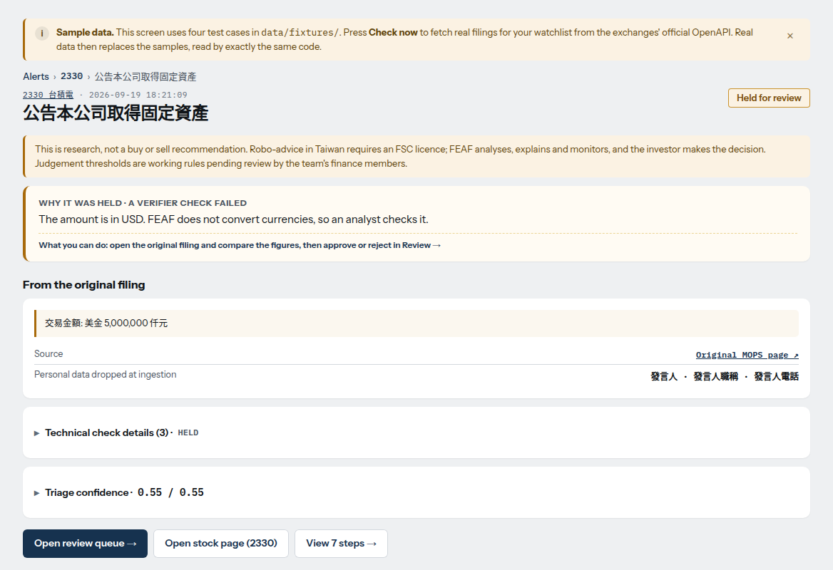
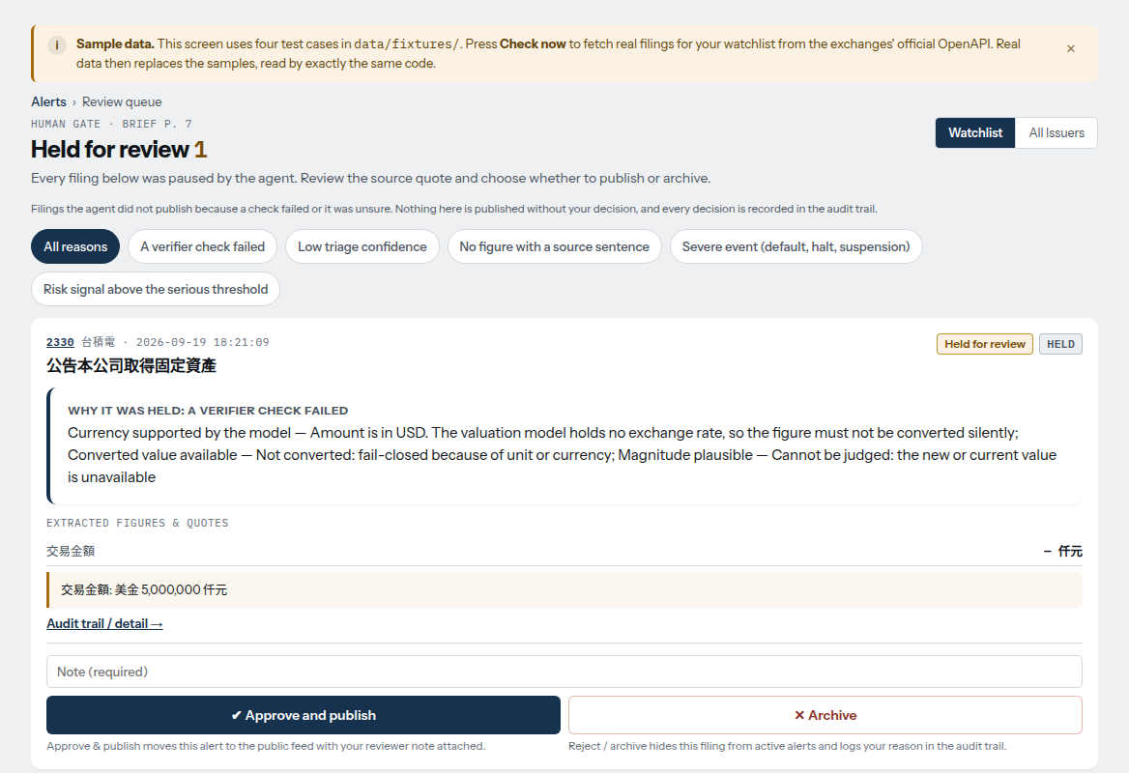
From held alert to a human decision
THE PROTOTYPE
Alert held for review
Review queue
A USD amount cannot be converted silently, so the verifier stops it and says why. The source sentence and the original MOPS link are shown.
Doubtful filings wait here. A person approves and publishes, or archives. A note is required and the decision is recorded.
Screens use the sample data shipped with the app and the rule-based path. Real filings replace the samples after “Check now”.
Notes:
BACKUP, use only if asked.
Prototype: a held alert (USD amount, no silent conversion) and the review queue. Sample data, rule-based path.
Real screens of the running app (QA-6 captures, 12 Nov). They use the four sample cases shipped in data/fixtures (the amber banner says so) and the rule-based path (no API key on that run). TODO(team): recapture from the live server with Gemini active before the final, so the screens match the model path described in the deck.

Slide 15
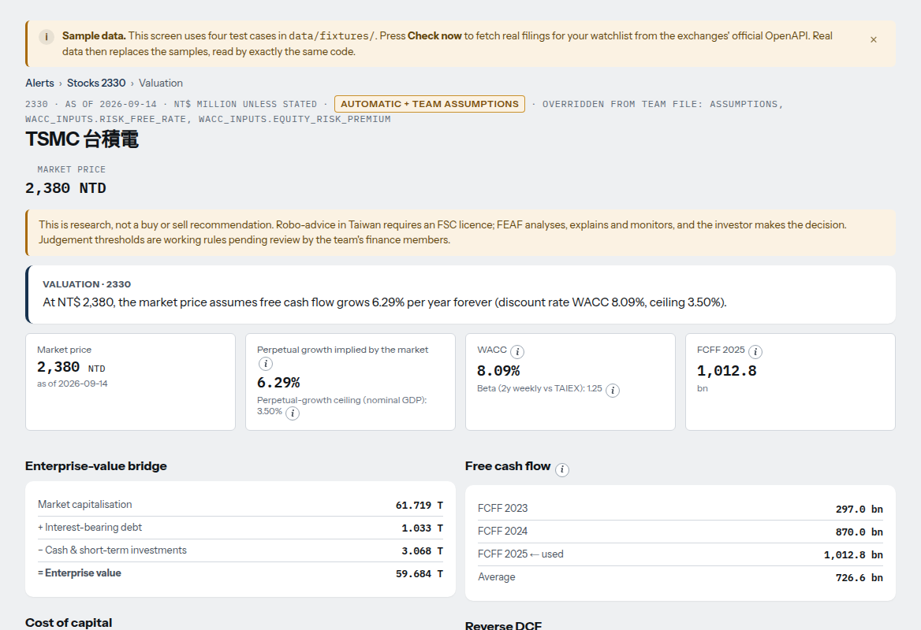
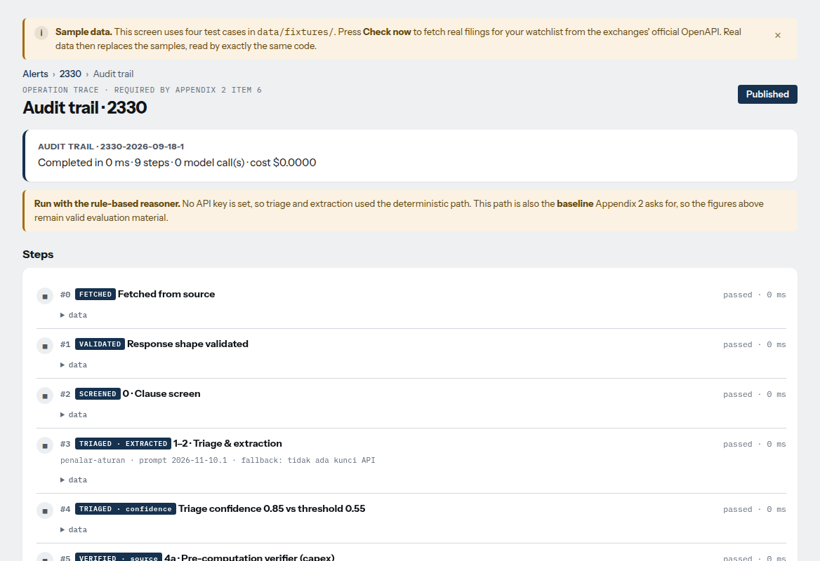
Every number shows how it was made
THE PROTOTYPE
Valuation, TSMC 2330
Audit trail, one filing
Enterprise-value bridge, cost of capital, reverse DCF and a sensitivity table. Below the fold: the source of each input.
Each state with its result and timing, from FETCHED to PUBLISHED. This run used the rule-based reasoner, so it shows 0 model calls.
Screens use the sample data shipped with the app and the rule-based path. Real filings replace the samples after “Check now”.
Notes:
BACKUP, use only if asked.
Prototype: valuation page and the audit trail (the operation trace Appendix 2 asks for).
Valuation page: the DCF is computed by plain code (scripts/dcf.py), with sensitivity table and the source of every input. Audit trail: nine states from FETCHED to PUBLISHED, with the prompt version and fallback reason recorded; this is the operation trace Appendix 2 asks for. Same caveat as the previous slide: sample data, rule-based path.

Slide 16
What users valued
USER TESTING · FEAF WEBSITE
7
4/6
#1
DCF
users tested the live website
valid answers: purpose very or mostly clear
most valued feature: Ask FEAF
output seen as a core strength
What they actually used it for
Checking prices, comparing companies (e.g., TSMC 2330 vs Hon Hai 2317) and understanding fundamentals. Beginners also used it to learn investment terms. Watchlist and alerts were valued for monitoring.
Sandbox use: no real money, no trading.
Notes:
BACKUP, use only if asked.
User testing: 7 users, no real money. Small sample; say so.
Small sample, no real money, no trading. 4/6 means six valid answers on this question. TODO(team): add task metrics (time, success) and before/after time from respondents if available.

Slide 17
What FEAF does not do, and how it fails safely
LIMITS AND RECOVERY
Known limits
Worst case | What happens | Recovery
Model returns an invented or injected number | Checker fails it; nothing published | Held, failing check named in the trace
Model down, rate-limited or out of credit | Retry, then backup model, then rule reasoner | Shown on /sehat; next cycle retries
Run takes too long | Cap of 90 s and 40 calls per run | Rest answered next cycle
Server restart | Data and traces live in the /data volume | /sehat shows the code version
Accuracy is measured on 46 filings labelled in-team; a blind set is next
No currency conversion: USD and other foreign amounts are held
Financial-sector issuers get no DCF
The exchange feed lags about one day; older history needs a Taiwan network
Beta is 1.0 (flagged) when price history is short
Notes:
BACKUP, use only if asked.
Limits and worst cases: no currency conversion, no DCF for financial issuers, one-day feed lag, accuracy on fresh filings not yet measured.
Appendix 2 asks for known limits, worst case and recovery. Out-of-sample accuracy is not measured yet. DCF constants (risk-free 1.94%, ERP 5.01%) are fixed inputs.

Slide 18
Open sources, tools and who did what
RESOURCES AND TEAM (ART. 13)
Type | What | Used for
Market data | TWSE / TPEx OpenAPI, MOPS | Filings, prices, shares, profiles
Statements | FinMind | Quarterly statements (cached 12 h)
Model | Google Gemini 3.6 Flash (backup 3.5 Flash) | Reads clause text, Ask FEAF; public text only
Reference | Damodaran (ERP 5.01%); Taiwan 10-year bond (1.94%) | WACC inputs
Dev tools | Claude Code, Antigravity | Pair programming; not part of the product
Libraries | FastAPI, uvicorn, Jinja2, httpx (MIT / BSD) | Web app and tests
Team division of labour
Part | Done by | AI tools’ role
[fill] | [name] | [fill]
[fill] | [name] | [fill]
[fill] | [name] | [fill]
[fill] | [name] | [fill]
Advisers guide only: they do not do core design, code, evaluation or presentation.
Only public filings are sent to the model. No personal data, keys or credentials.
Notes:
BACKUP, use only if asked.
Third-party resources and team roles. Fill the division-of-labour table before the final.
TODO(team): fill the division-of-labour table with real names and roles. Advisers and technical consultants may only guide; they must not do core design, code, evaluation or presentation. Full list of third parties: docs/pengungkapan-pihak-ketiga.md.

Slide 19
Is this investment advice?
BACKUP · Q&A
No.
Never says buy or sell; no recommendation label on any analysis
Never trades; no broker login, no payment, no email
A disclaimer appears on every stock and valuation page (FSC)
Scope: research and alerts, as the tender asks
FEAF shows research, valuation and alerts. The investor decides.
27 / 27
advice, prediction, personal-data and injected questions refused by Ask FEAF; 0 buy / sell words reached the user
Notes:
BACKUP, use only if asked.
Is this investment advice? No: research and alerts only, never buy/sell, never trades.

Slide 20
A real trace: held, not published
BACKUP · Q&A
Step | What happened
Fetch | TSMC board approval of a capital budget (clause 20), pulled from TWSE OpenAPI; no personal field present
Clause screen | Clause 20 → valuation lane; possible inputs: capex, cash
Triage and extract | gemini-3.6-flash, prompt 2026-11-10.1: 4 amounts found, all in US$, unit million
Confidence | 0.55: no amount convertible to NTD
Checker | Currency check failed: USD amount, no exchange rate in the model, not converted silently
End | HELD FOR REVIEW. Nothing published.
Audit it: /jejak/2330-2026-11-10-211853
Notes:
BACKUP, use only if asked.
A real trace: USD amount found, currency check failed, held for review, nothing published.
Saved trace: eval/hasil/jejak-contoh-2330-2026-11-10-211853.json, live at /jejak/2330-2026-11-10-211853. TSMC board approval of a capital budget, clause 20. Pulled from TWSE OpenAPI on 11 Nov 02:35 UTC.

Slide 21
Live demo plan and fallback
BACKUP · DEMO
1
Alerts
If something fails
Case 2330: published, all checks passed
No model or no connection: the server falls back to the rule reasoner. Say so.
Prepare screenshots of each step before the final.
Saved trace JSON for case 2330 can be shown offline.
Practise at least five times.
2
Audit trace
Open its trace: steps and the source sentence
3
Ask FEAF
One data question with sources; then “should I buy 2330?”, refused
4
Review
One held case; the human decision is recorded
Notes:
BACKUP, use only if asked.
Demo plan and fallback.

