Slide 1
Agentic AI Investment Assistant
TEAM FEAF · NAPAI COMPETITION 2026
Turning stock filings into explainable, proactive and verifiable decision support
The AI researches, explains and monitors. The investor makes every decision.
Category B · SYSTEX · Industry & Public-Sector Co-Creation
Agentic Workflow
Domain-Specific Agent
Human-in-the-loop
Notes:
Cover. Category, track and technology tags added so the jury sees the scope at once. Only tags we really use: no Multi-Agent, no RAG.

Slide 2
“
I worry that AI might provide recommendations that are incorrect yet sound highly convincing, and that I might lack the expertise to spot the error.
— Respondent R10, from our field survey —
If an AI told you a stock just changed in value… how would you check?

Slide 3



Not short of data. Short of trust
THE PROBLEM
News & social feeds
Filings & statements
Charts & quotes
Analysts & forums
The investor filters & checks it all, alone
Time drain
Shallow reading
Unverifiable
Hours spent gathering before any analysis
Ratios read without context; value traps slip through
AI answers sound right but can’t be checked
8/10
feel overwhelmed
9/10
want to see the AI’s reasoning
8/10
fear inaccurate AI answers
Field survey, n = 10
Notes:
Survey of 10 investors, 6-8 Oct 2026, PDPA consent notice. Small sample: say so. The numbers show the need, they do not prove it for the whole market.

Slide 4
We value each company with a DCF model
HOW WE ANALYSE A STOCK
FCF
WACC
Debt
Shares
Free cash flow
Discount rate
Net debt
Shares outstanding
Free cash flow the business generates after reinvestment
Cost of equity estimated with CAPM
Debt minus cash, from the balance sheet
To get value per share
Value per share = (present value of future cash flows − net debt) ÷ shares outstanding, then compared with the market price.
Fixed inputs: risk-free 1.94% (Taiwan 10-year bond) · equity risk premium 5.01% (Damodaran) · beta from two years of weekly returns vs TAIEX, 1.0 when data is short.
Notes:
Inputs not on the slide: risk-free 1.94% (Taiwan 10-year government bond), equity risk premium 5.01% (Damodaran), beta from two years of weekly returns vs TAIEX, 1.0 when data is short. All arithmetic runs in plain code, never in the model.

Slide 5
Why DCF, not other methods
WHY DCF · TRUSTED DATA
MOPS
Method | Why it falls short
P/E & P/B multiples | Quick, but depends on peers and market mood; can’t show what one filing changes
Technical analysis | Reads price patterns only; ignores cash, debt and earnings
CAPM alone | Gives a required return, not a fair value per share
DCF (our choice) | Values the business from its cash flows; every filing maps to an input we can trace
Official filings and company announcements
TWSE + TPEx
Open data: prices and shares outstanding
0 / 46
wrong numbers published on real filings, each with its source sentence
Financial-sector issuers get no DCF (marked “not applicable”); their filings are held for a person.
Notes:
Replaces the old claim '100% of numbers traced'. What we can defend: 0 wrong numbers on 46 real filings and 0 of 72 attacker numbers published. Say 'every published number carries its source sentence'.

Slide 6
From a new filing to a verified, explained alert
HOW IT WORKS
1
RULE-BASED
2
RULE-BASED
3
RULE-BASED
4
LLM AGENT
Fetch
Validate
Screen
Triage
Pull new MOPS filings for watched stocks
Reject block pages, fix dates
Drop routine filings
Does it touch valuation?
5
LLM AGENT
6
RULE-BASED
7
RULE-BASED
8
HUMAN
Extract
Recompute
Verify
Decide
Number + exact source sentence
Update valuation, show change
Every number must match the source
Publish alert, or hold for a human
The LLM is used only where language understanding is needed. Code checks every number before anyone sees it.
Notes:
Only clause-20 filings (valuation lane) call the model in the 46-filing test: 5 model calls. Risk, capital, report, severe and governance clauses are parsed by code.

Slide 7
Where data comes from, and where it goes
ARCHITECTURE AND DATA FLOW
SOURCES
SERVER · one Docker container
TWSE / TPEx OpenAPI
Daily filings (material information)
Fetcher
Agent pipeline
Gemini 3.6 Flash
Validates the response shape and drops personal fields before saving.
Screen, triage, extract, verify, recompute, publish or hold. The checker and the DCF are plain code; the model only reads the clause.
Reads clause text and calls Ask FEAF tools. Temperature 0. Backup model, then rule reasoner if it fails.
TWSE / TPEx OpenAPI
Prices, P/E, company profile
Sees public filing text only: no personal data, keys or credentials. Never computes a number.
Data store (/data volume)
FinMind
Filings, audit traces, review decisions, thumbs feedback, cache
Income statement, balance sheet, cash flow
MOPS
Ask FEAF
Filing history, via a Taiwan network
Guard (refuses advice, prediction, personal data) → six read-only tools, 5 steps at most → number checker
Web, English / 中文 / Bahasa Indonesia: Watchlist · Alerts · Review · Audit trail · Ask FEAF
Notes:
Based on docs/diagram-alur.md part 1. The server holds the only copy of data and traces. The model sees public filing text only. Edit routes (add or remove a stock, change a threshold, approve a review) need an access code; there is no route that trades, sends email or pays. Ask FEAF can only call six read-only tools, at most five steps per question.

Slide 8
Why this needs an agent, not a chatbot
AGENT DESIGN
Chatbot / RAG
Fixed workflow
FEAF agent
Answers when asked and quotes text. Never starts, cannot recompute a valuation, no check on its own numbers.
Same steps for every filing. Cannot read free-text clauses or decide when to stop and ask a person.
Decides per filing: publish, hold or archive. Plans steps, uses tools, adjusts on results, stops for a human.
STATE OF ONE FILING
FETCHED
VALIDATED
SCREENED
TRIAGED
EXTRACTED
VERIFIED
VALUED
PUBLISHED
ARCHIVED
HELD
HUMAN REVIEW
Not relevant, or below the threshold
Check failed, low confidence, or no model yet
Approve doubtful cases; invented numbers can only be archived
Decisions are taken by code that can be audited. The model is used in one step only: reading the clause.
Notes:
The agent breaks one goal into dependent steps, calls tools (TWSE/TPEx OpenAPI, FinMind, DCF calculator, language model), adjusts on results (model fails -> backup model -> rule reasoner; checker fails -> HELD) and stops for a person when unsure. Decisions are taken by code that can be audited; the model reads the clause in one step only.

Slide 9




Four stages, one closed loop
AGENT DESIGN
1 Personalised
2 Proactive
3 Feedback
4 Optimised
Risk profile (conservative, moderate, aggressive) sets thresholds, DCF class, strengths and watch-outs
The server checks filings every 10 minutes and raises an alert without being asked
Thumbs up or down on each alert tells the agent what was useful
Each thumbs-down raises that clause’s threshold by 0.05, each thumbs-up lowers it by 0.02, within 0.40–0.90
The loop closes:
two thumbs-down on the same clause, and the next similar alert is archived with its score and threshold as the reason. Thresholds are kept per server.
Notes:
The tender asks for personalised intelligence, proactive delivery, behavioural feedback and continuous optimisation. Show one example live: two thumbs-down on the same clause make the next similar alert archived with its score and threshold as the reason. Thresholds are per server (one investor per server); do not claim per-user personalisation.

Slide 10




The FEAF website: four parts, one goal
WHAT WE BUILT
DCF valuation
Watchlist & alerts
Value per share with WACC, cost of debt and cost of equity, built from verified numbers
Follow your stocks; get an alert when a filing changes a valuation input
Safe by design
Ask FEAF
Every number traced to its source; no trading, no broker login
Ask about any Taiwan stock: prices, fundamentals, company comparisons, in English, Chinese or Bahasa Indonesia

Slide 11
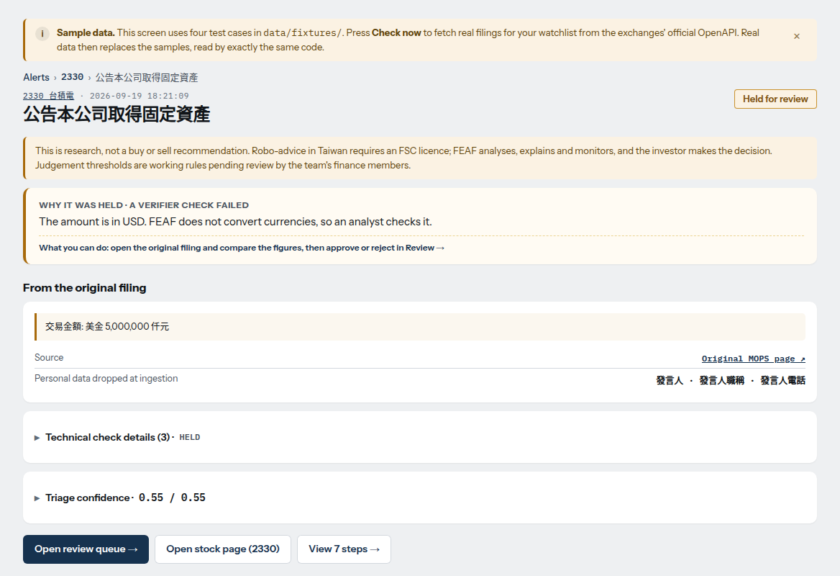
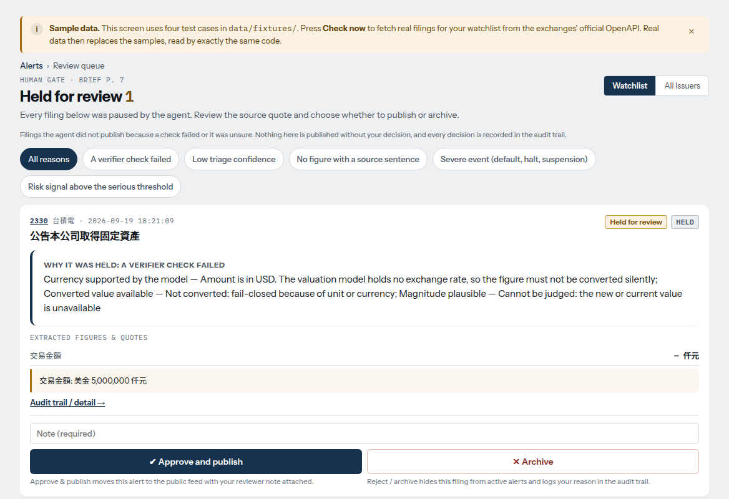
From held alert to a human decision
THE PROTOTYPE
Alert held for review
Review queue
A USD amount cannot be converted silently, so the verifier stops it and says why. The source sentence and the original MOPS link are shown.
Doubtful filings wait here. A person approves and publishes, or archives. A note is required and the decision is recorded.
Screens use the sample data shipped with the app and the rule-based path. Real filings replace the samples after “Check now”.
Notes:
Real screens of the running app (QA-6 captures, 12 Nov). They use the four sample cases shipped in data/fixtures (the amber banner says so) and the rule-based path (no API key on that run). TODO(team): recapture from the live server with Gemini active before the final, so the screens match the model path described in the deck.

Slide 12
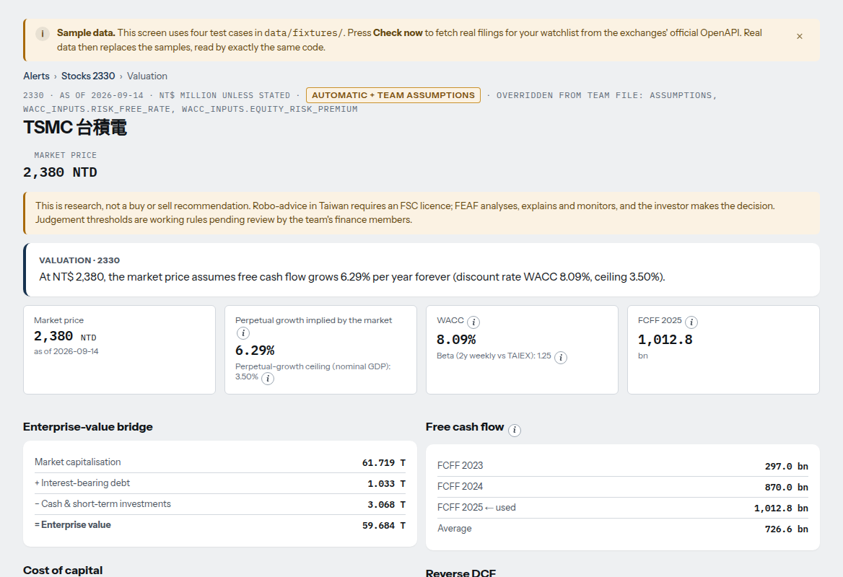
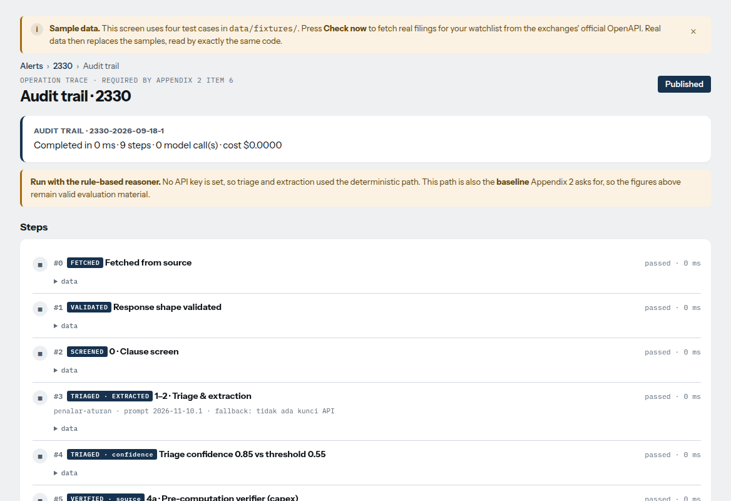
Every number shows how it was made
THE PROTOTYPE
Valuation, TSMC 2330
Audit trail, one filing
Enterprise-value bridge, cost of capital, reverse DCF and a sensitivity table. Below the fold: the source of each input.
Each state with its result and timing, from FETCHED to PUBLISHED. This run used the rule-based reasoner, so it shows 0 model calls.
Screens use the sample data shipped with the app and the rule-based path. Real filings replace the samples after “Check now”.
Notes:
Valuation page: the DCF is computed by plain code (scripts/dcf.py), with sensitivity table and the source of every input. Audit trail: nine states from FETCHED to PUBLISHED, with the prompt version and fallback reason recorded; this is the operation trace Appendix 2 asks for. Same caveat as the previous slide: sample data, rule-based path.

Slide 13
Measured on real filings, not promised
RESULTS
0 / 46
41 / 46
Metric | FEAF agent | Without checker
Wrong numbers published | 0 / 46 | 5 / 46
Decision matches expert | 41 / 46 (89%) | 15 / 46 (33%)
Signal level matches expert | 21 / 29 (72%) | 0 / 29
Held for a person | 13 / 46 (28%) | 33 / 46 (72%)
wrong numbers published
decisions match the expert
5 / 46 without the checker
15 / 46 without the checker
25 min → 0.7 s
USD 0.007
per filing: manual vs agent
model cost, 46 filings
Ask FEAF: 52 questions, 3 languages
mean latency with Gemini 3.6 Flash
temperature 0, paid tier
27 / 27 out-of-scope, advice and injected questions refused
0 buy / sell words reached the user
50 / 52 correct (both misses fell back to a sourced answer)
Test set: 46 real MOPS filings of 9 Nov 2026, labelled by a finance team member. Rule path, measured before tuning. “Without checker” = same pipeline that publishes whatever is extracted. Manual baseline 20–30 min per filing (25 used). Source: eval/hasil.
Notes:
Official numbers are the rule path measured BEFORE any tuning (eval/hasil/evaluasi-20261111T084547Z.md). After tuning the figures are in-sample (43/46 rules, 42/46 model): do not call them accuracy. Out-of-sample accuracy is not yet measured; a blind set of 15-20 fresh filings is the next step. The labeller is a team member. Ask FEAF 50/52 was measured before the 11 Nov checker fix and has not been re-run with Gemini. TODO(team): re-run scripts/evaluasi.py --chat before the final.

Slide 14
Built so a wrong number cannot reach an investor
SAFETY, CONTROL AND GOVERNANCE
Risk (Art. 14) | Protection | Evidence
Prompt injection | Pattern scan; every number needs a source sentence | 0 / 72 attacker numbers published
Unauthorised tool use | Closed tool list; no shell, order or email tool | Edit routes: 401 without code
Data leakage | Whitelist of public company fields | TPEx cache fix, 10 Nov
Hallucinated numbers | Code computes; checker matches every number | Failed claim goes to HELD
Sector bias | Financial issuers: “DCF not applicable” | Test in suite
Malicious input | Escaped templates; strict stock-code pattern | Tests in suite
Supply chain | 4 pinned Python libraries; no JS framework | requirements.txt
Service failure | Retry, backup model, rule reasoner, cache | /sehat health page
1
Checker, not trust
Seven checks before publishing: label, quote, digits, currency, unit, conversion, magnitude. The model never does arithmetic.
2
A person decides doubtful cases
Held filings go to a review queue. Invented numbers can only be archived. Severe clauses are always held.
3
Information only
No orders, no broker login, no email, no payment. Edits need an access code. No buy or sell label (FSC).
Open gaps: one shared access code (no roles), no per-IP rate limit, injection patterns are regex-based; the number check is the backstop.
Notes:
Open gaps, say them plainly: one shared access code (no roles), no per-IP rate limit, injection patterns are regex-based so the number check is the backstop. Incident: the TPEx company-profile cache briefly kept officer names and contact emails until 10 Nov (commit e4572d6); never shown to users; fixed with a whitelist and an automated test. Rules forbid keys and personal data in the deck.

Slide 15
What users valued
USER TESTING · FEAF WEBSITE
7
4/6
#1
DCF
users tested the live website
valid answers: purpose very or mostly clear
most valued feature: Ask FEAF
output seen as a core strength
What they actually used it for
Checking prices, comparing companies (e.g., TSMC 2330 vs Hon Hai 2317) and understanding fundamentals. Beginners also used it to learn investment terms. Watchlist and alerts were valued for monitoring.
Sandbox use: no real money, no trading.
Notes:
Small sample, no real money, no trading. 4/6 means six valid answers on this question. TODO(team): add task metrics (time, success) and before/after time from respondents if available.

Slide 16
Evidence from real users and real filings
FIELD VALIDATION
Level | Evidence | Status
1 Needs | Survey of 10 investors, 6–8 Oct 2026, with a PDPA consent notice: 8/10 overwhelmed, 9/10 want to see the reasoning, 8/10 fear wrong AI answers | Done
2 Data / process | 46 real filings of 9 Nov labelled by a finance team member; manual time baseline of 25 minutes per filing; official TWSE / TPEx / MOPS data and documented sources | Done (labeller in team)
3 Prototype trial | 7 users tested the live website with no real money; Ask FEAF the most valued feature | Partly (small sample)
4 Field pilot | Limited deployment with operating records and before/after comparison | Not claimed
The jury scores Field Impact from Level 2 upward. We state exactly what we have and where its limits are.
Notes:
Claim: Level 2 reached, Level 3 partly (7 users). Do not claim Level 4. The gold-set labeller is in the team, say so. TODO(team): name the field liaison and contacts (Art. 6.2 requires one when field validation is done), say who was interviewed, add a before/after time from respondents.

Slide 17
What we will improve next
WHAT USERS ASKED FOR
1
2
3
4
Charts
Onboarding
Clean sources
Mobile layout
Visual DCF, WACC and company comparisons
Tooltips and a guided tour for Alerts, Review, Thresholds
Readable citations instead of raw JSON
Less scrolling on data-heavy pages
Next phase
Peer benchmarking and supply-chain data (suppliers, commodity prices) for deeper analysis; a blind test set of fresh filings to measure out-of-sample accuracy.

Slide 18
What FEAF does not do, and how it fails safely
LIMITS AND RECOVERY
Known limits
Worst case | What happens | Recovery
Model returns an invented or injected number | Checker fails it; nothing published | Held, failing check named in the trace
Model down, rate-limited or out of credit | Retry, then backup model, then rule reasoner | Shown on /sehat; next cycle retries
Run takes too long | Cap of 90 s and 40 calls per run | Rest answered next cycle
Server restart | Data and traces live in the /data volume | /sehat shows the code version
Accuracy is measured on 46 filings labelled in-team; a blind set is next
No currency conversion: USD and other foreign amounts are held
Financial-sector issuers get no DCF
The exchange feed lags about one day; older history needs a Taiwan network
Beta is 1.0 (flagged) when price history is short
Notes:
Appendix 2 asks for known limits, worst case and recovery. Out-of-sample accuracy is not measured yet. DCF constants (risk-free 1.94%, ERP 5.01%) are fixed inputs.

Slide 19
Start focused, then scale with partners
MARKET & BUSINESS MODEL
14.58M
4.29M
~43K
TAM
SAM
SOM
individual TWSE account holders
holders aged 20–40
~1% of SAM, illustrative
Free
Premium
B2B2C (later)
Ask FEAF, watchlist and limited alerts
Full alerts, DCF charts, peer comparison, audit trail · test price NT$600–800 / month
Licensed to brokers and fintech apps
Survey median willingness to pay ≈ US$25 / month. We sell research and alerts, not buy / sell calls (FSC rules).
Deployment: one container (Docker on Dokploy) on open TWSE / TPEx / MOPS data; model cost about USD 0.007 per 46 filings.
Sources for TAM / SAM: [team to fill]
Notes:
TODO(team): fill the sources for TAM and SAM (e.g. TDCC / TWSE account statistics and year). Premium price is a test price from the survey.

Slide 20
Open sources, tools and who did what
RESOURCES AND TEAM (ART. 13)
Type | What | Used for
Market data | TWSE / TPEx OpenAPI, MOPS | Filings, prices, shares, profiles
Statements | FinMind | Quarterly statements (cached 12 h)
Model | Google Gemini 3.6 Flash (backup 3.5 Flash) | Reads clause text, Ask FEAF; public text only
Reference | Damodaran (ERP 5.01%); Taiwan 10-year bond (1.94%) | WACC inputs
Dev tools | Claude Code, Antigravity | Pair programming; not part of the product
Libraries | FastAPI, uvicorn, Jinja2, httpx (MIT / BSD) | Web app and tests
Team division of labour
Part | Done by | AI tools’ role
[fill] | [name] | [fill]
[fill] | [name] | [fill]
[fill] | [name] | [fill]
[fill] | [name] | [fill]
Advisers guide only: they do not do core design, code, evaluation or presentation.
Only public filings are sent to the model. No personal data, keys or credentials.
Notes:
TODO(team): fill the division-of-labour table with real names and roles. Advisers and technical consultants may only guide; they must not do core design, code, evaluation or presentation. Full list of third parties: docs/pengungkapan-pihak-ketiga.md.

Slide 21
Answers you can ask for. Numbers you can check.
BACK TO OUR OPENING QUESTION
AI researches, explains and monitors. The investor decides.
Don’t take our word for it.
Let’s check it, live.
Notes:
Demo plan is on the last backup slide (plan, not yet rehearsed): Alerts (2330, published, all checks passed) -> audit trace -> Ask FEAF (data question, then 'should I buy 2330?' refused) -> Review (one held case). If the connection or model fails, the server falls back to the rule reasoner: say so, and use the saved trace.

Slide 22
Is this investment advice?
BACKUP · Q&A
No.
Never says buy or sell; no recommendation label on any analysis
Never trades; no broker login, no payment, no email
A disclaimer appears on every stock and valuation page (FSC)
Scope: research and alerts, as the tender asks
FEAF shows research, valuation and alerts. The investor decides.
27 / 27
advice, prediction, personal-data and injected questions refused by Ask FEAF; 0 buy / sell words reached the user

Slide 23
A real trace: held, not published
BACKUP · Q&A
Step | What happened
Fetch | TSMC board approval of a capital budget (clause 20), pulled from TWSE OpenAPI; no personal field present
Clause screen | Clause 20 → valuation lane; possible inputs: capex, cash
Triage and extract | gemini-3.6-flash, prompt 2026-11-10.1: 4 amounts found, all in US$, unit million
Confidence | 0.55: no amount convertible to NTD
Checker | Currency check failed: USD amount, no exchange rate in the model, not converted silently
End | HELD FOR REVIEW. Nothing published.
Audit it: /jejak/2330-2026-11-10-211853
Notes:
Saved trace: eval/hasil/jejak-contoh-2330-2026-11-10-211853.json, live at /jejak/2330-2026-11-10-211853. TSMC board approval of a capital budget, clause 20. Pulled from TWSE OpenAPI on 11 Nov 02:35 UTC.

Slide 24
Live demo plan and fallback
BACKUP · DEMO
1
Alerts
If something fails
Case 2330: published, all checks passed
No model or no connection: the server falls back to the rule reasoner. Say so.
Prepare screenshots of each step before the final.
Saved trace JSON for case 2330 can be shown offline.
Practise at least five times.
2
Audit trace
Open its trace: steps and the source sentence
3
Ask FEAF
One data question with sources; then “should I buy 2330?”, refused
4
Review
One held case; the human decision is recorded

