Slide 1
Applying DAX
Fundamentals in Power BI: From Measures to
Contextual Analysis
Kenneth A. Camasura
Instructor: Joseph A. Vistal
IS 107 - Business Intelligence

Slide 2
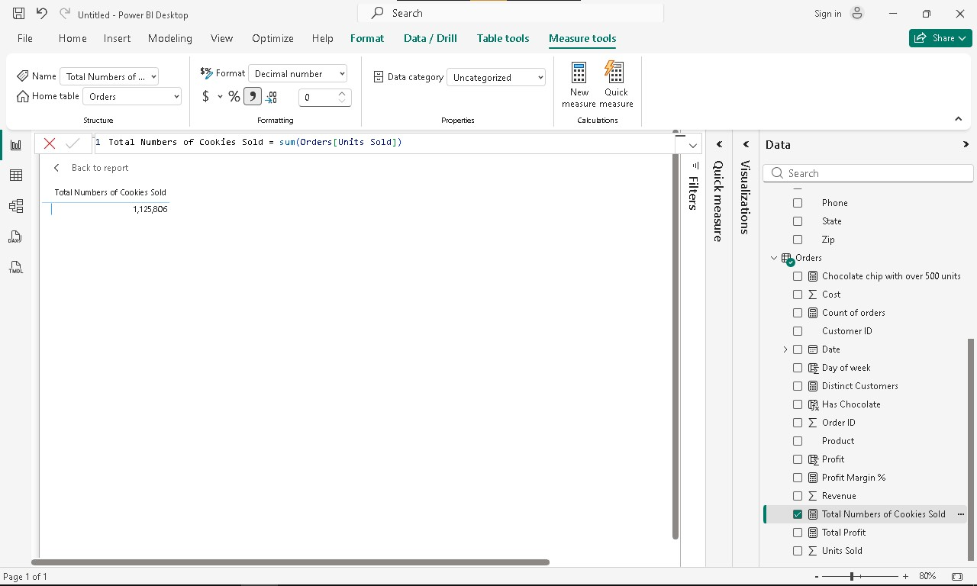
Formula:Total Numbers of Cookies Sold = sum(Orders[Units Sold])

Slide 3
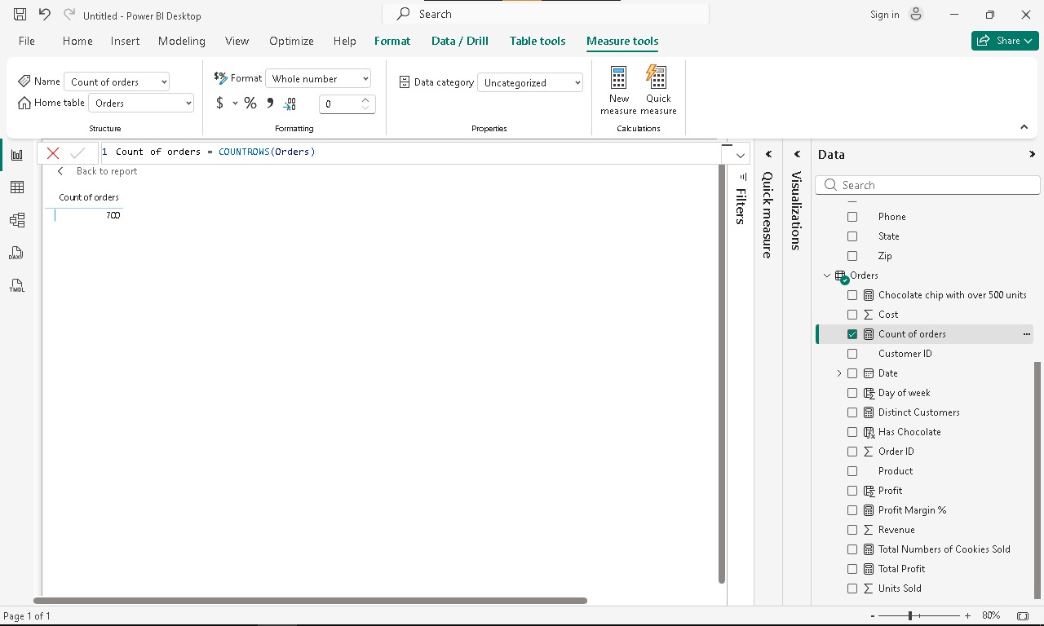
Formula: Count of orders = COUNTROWS(Orders)

Slide 4
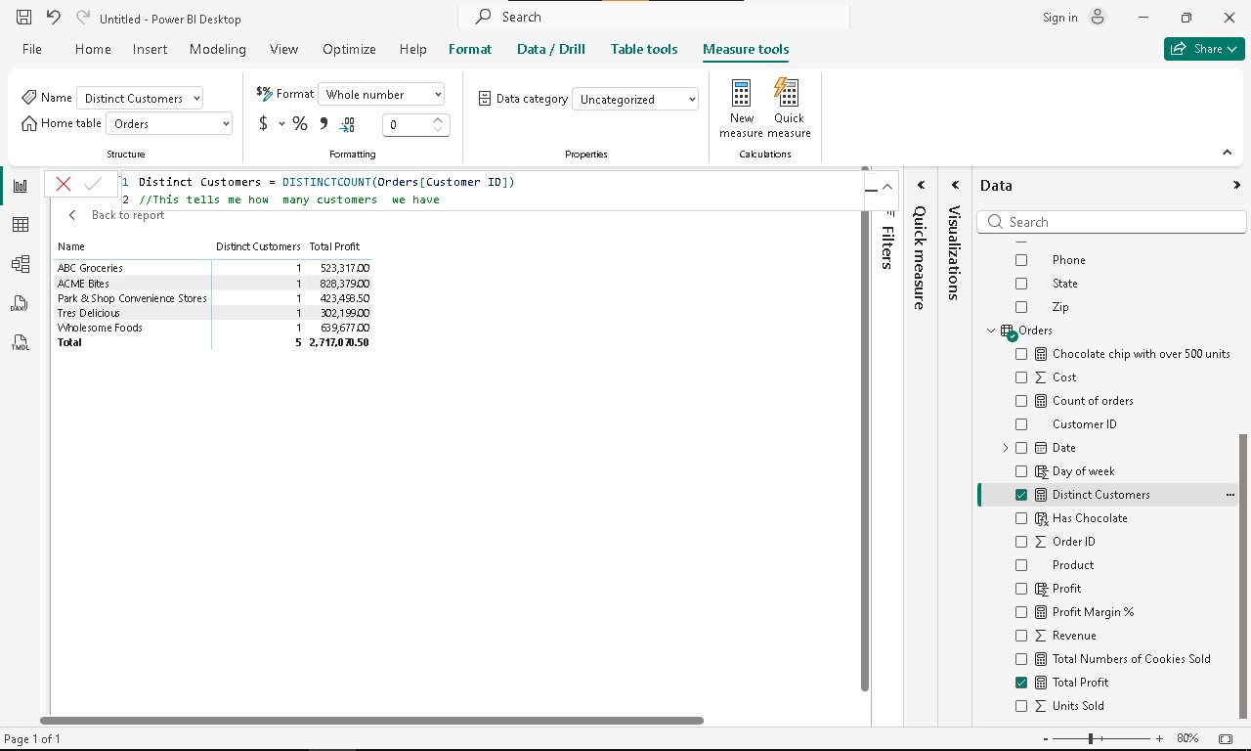
Formula:Distinct Customers = DISTINCTCOUNT(Orders[Customer ID])
//This tells me how many customers we have

Slide 5
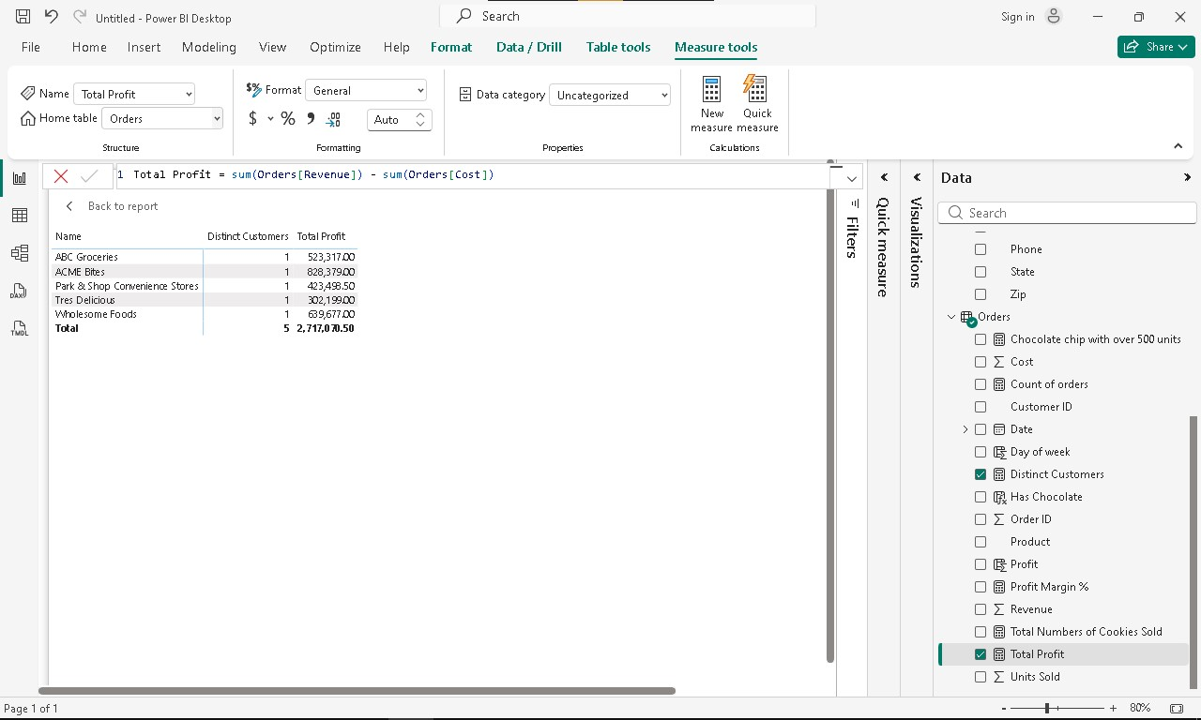
Formula: Total Profit = sum(Orders[Revenue]) - sum(Orders[Cost])

Slide 6
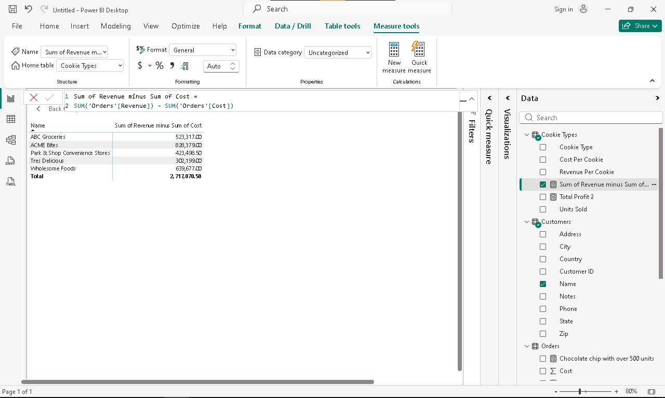
Formula: Sum of Revenue minus Sum of Cost = SUM('Orders'[Revenue]) - SUM('Orders'[Cost])

Slide 7
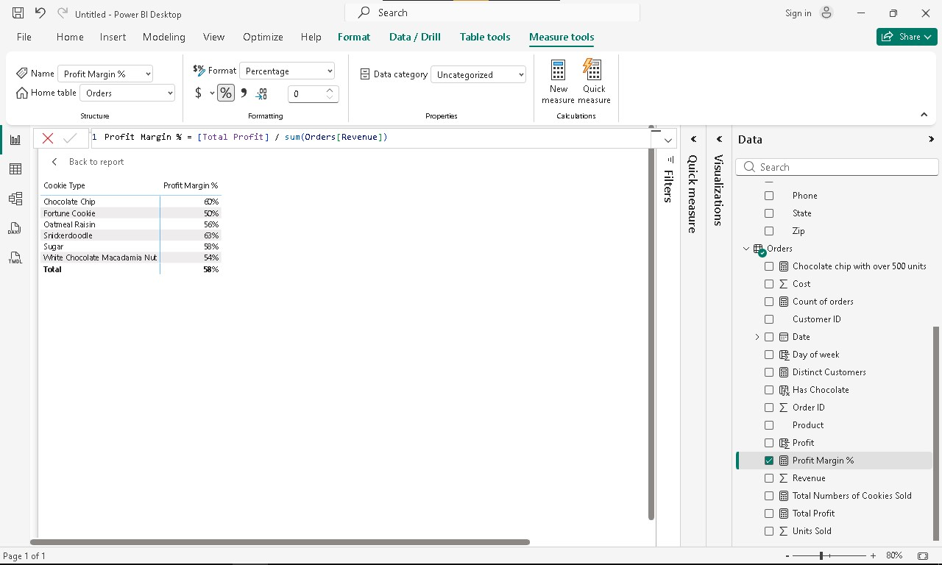
Formula: Profit Margin % = [Total Profit] / sum(Orders[Revenue])

Slide 8
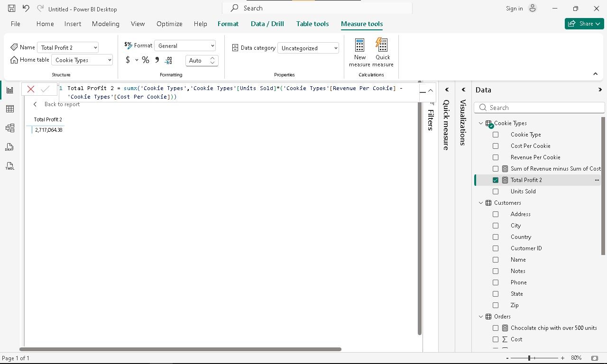
Formula: Total Profit 2 = sumx('Cookie Types','Cookie Types'[Units Sold]*('Cookie Types'[Revenue Per Cookie] - 'Cookie Types'[Cost Per Cookie]))

Slide 9
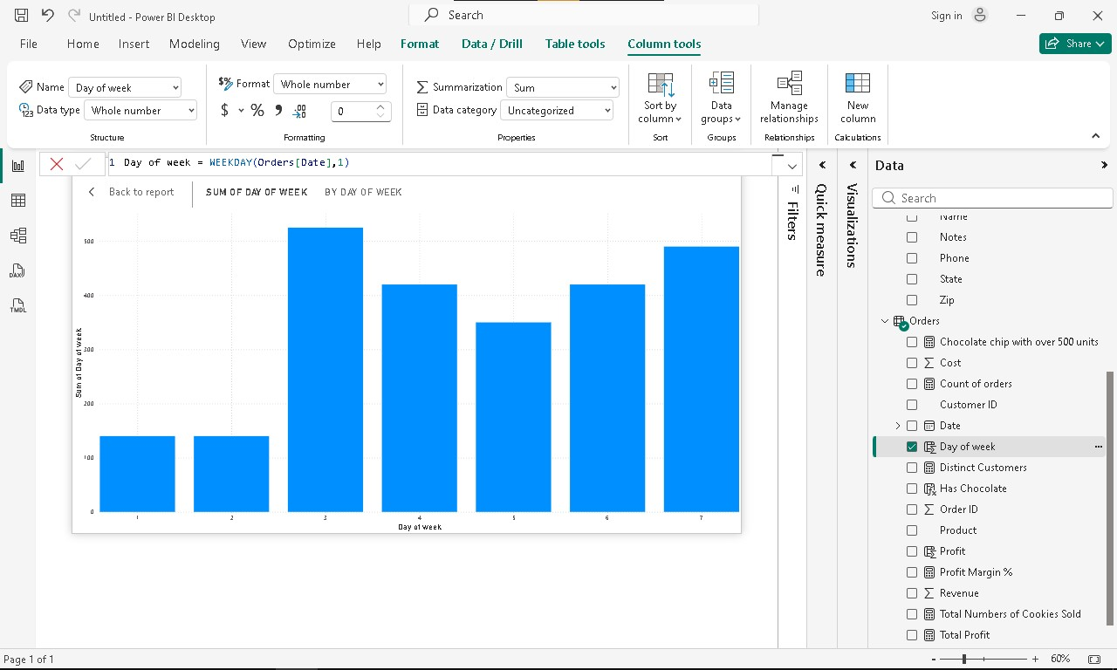
Formula: Day of week = WEEKDAY(Orders[Date],1)

Slide 10
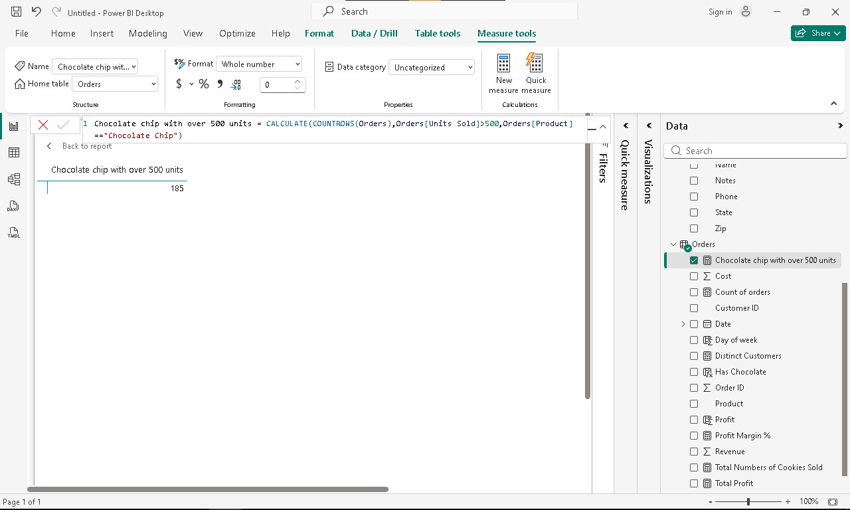
Formula: Chocolate chip with over 500 units = CALCULATE(COUNTROWS(Orders),Orders[Units Sold]>500,Orders[Product]=="Chocolate Chip")

Slide 11
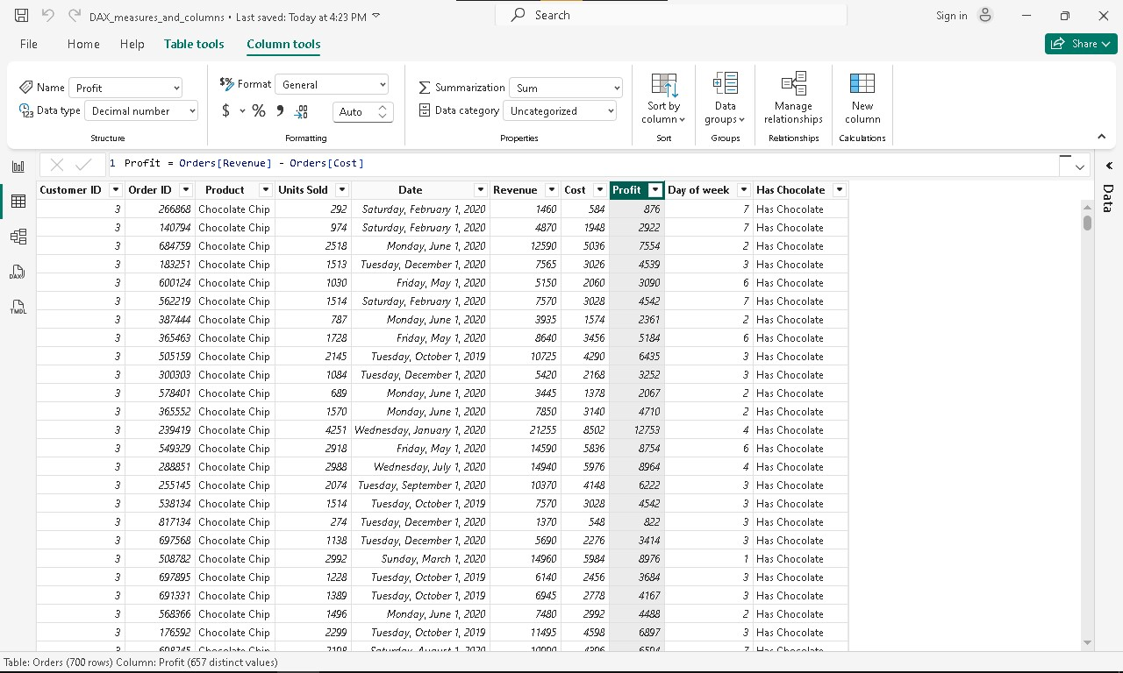
Formula: Profit = Orders[Revenue] - Orders[Cost]

Slide 12
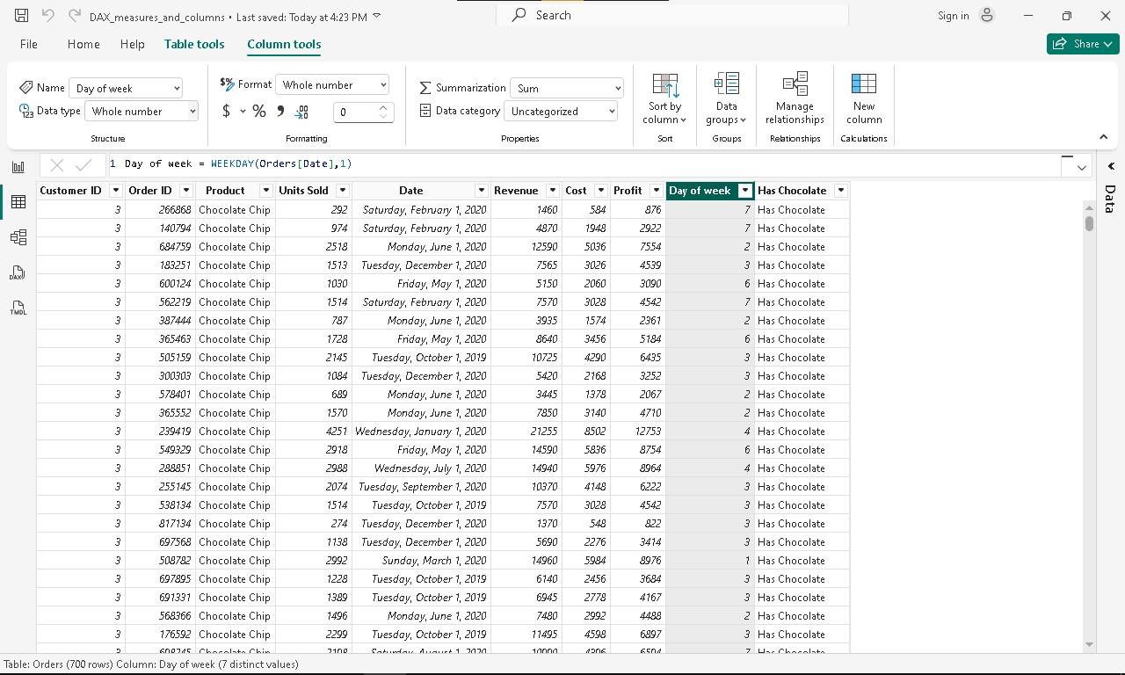
Formula: Day of week = WEEKDAY(Orders[Date],1)

Slide 13
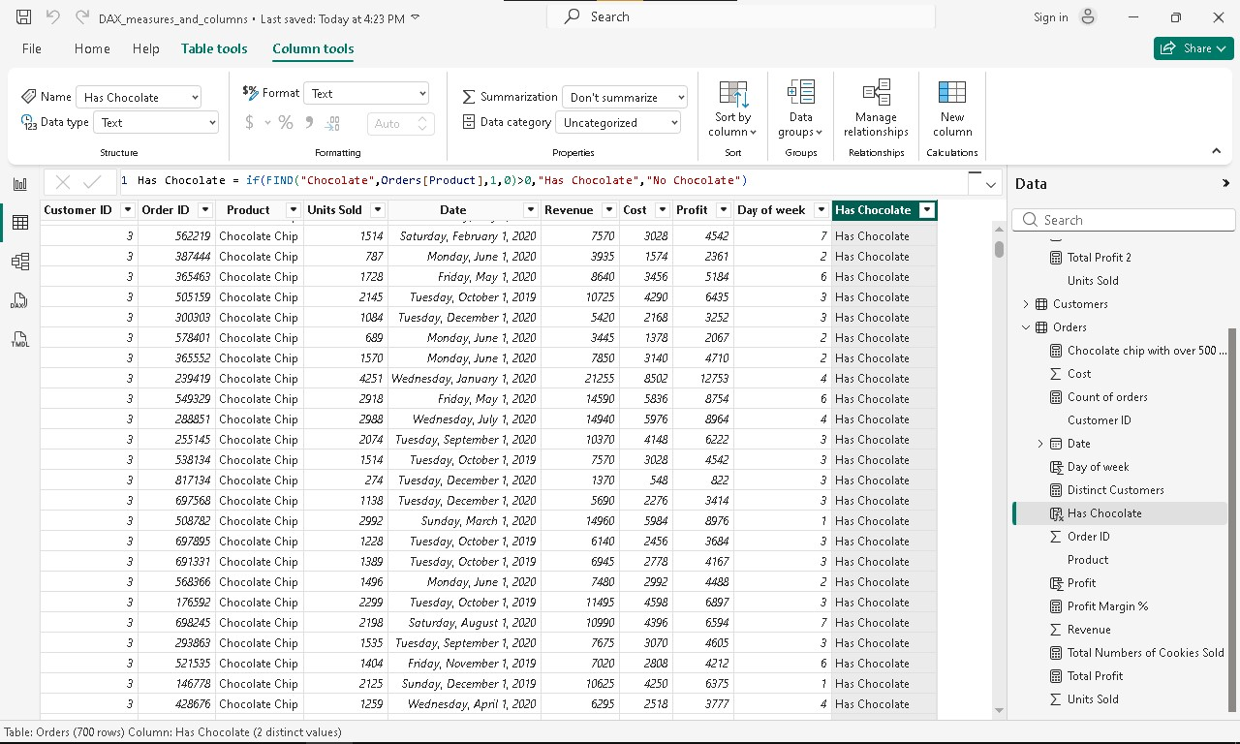
Formula: Has Chocolate = if(FIND("Chocolate",Orders[Product],1,0)>0,"Has Chocolate","No Chocolate")

Slide 14
Guided Questions:
I. Foundational Concepts
1. Defining DAX: In your own words, how would you explain the difference between a standard Excel formula and a Data Analysis Expression (DAX) based on the tutorial?
Answer: A standard Excel formula works on a fixed cell or range it's static and tied to a specific location in a spreadsheet. DAX, on the other hand, is designed to work with relational data models and entire columns or tables. Instead of referencing "cell B2," DAX references "the Sales Amount column in the Sales table." It's also dynamic it responds to filters, slicers, and visuals automatically, something Excel formulas can't do natively in the same way.

Slide 15
Guided Questions:
I. Foundational Concepts
2. The "Why" of DAX: Why can’t we just use the raw numbers from our imported dataset to create complex reports? What is the specific "gap" that DAX fills in Power BI?
Answer: Raw numbers from an imported dataset are just stored values they can't adapt to context. The gap DAX fills is dynamic calculation. For example, raw data might have individual sales rows, but to get "Total Sales only for a specific region when a slicer is clicked," you need DAX. It allows you to create calculations that respond to user interaction and filter context in real time, which raw data simply cannot do.

Slide 16
Guided Questions:
II. Calculated Columns vs. Measures
3. The Storage Difference: The video demonstrates creating both Calculated Columns and Measures. Which one actually increases the file size of your Power BI model, and why is this an important consideration for large datasets?
Answer: Calculated Columns increase the file size because they are computed row-by-row at data refresh time and stored physically inside the data model. Every new row gets a new computed value saved to memory. Measures, by contrast, are calculated on the fly only when a visual needs them nothing is stored. For large datasets with millions of rows, using Calculated Columns unnecessarily can dramatically bloat your .pbix file.

Slide 17
Guided Questions:
II. Calculated Columns vs. Measures
4. Context Clues: * When you created a Calculated Column, the calculation happened row-by-row.
○ When you created a Measure, the result changed depending on which filters or visuals you clicked.
○ Question: Explain how "Filter Context" affects the result of a Measure in your final dashboard.
Answer:Filter Context is the set of filters currently active in a report from slicers, visual filters, row/column headers in a matrix, or cross-filtering from other visuals. A Measure's result automatically adjusts based on whatever Filter Context surrounds it. For example, a Total Sales measure will return the overall total on an empty canvas, but if you place it inside a chart broken down by Region, it will return the sales per region the same formula, different results, because the Filter Context changed. This makes Measures incredibly powerful and flexible.

Slide 18
Guided Questions:
III. Function Application & Syntax
5. The RELATED Function: In the tutorial, the RELATED function is used. Why is this function necessary when working with multiple tables, and what must be established in the Model View for this function to work correctly?
Answer:RELATED is necessary when you need to pull a value from a different table into a Calculated Column. Since Power BI works with relational tables (not one big flat sheet), columns from other tables aren't directly accessible in a formula. For RELATED to work, a relationship must be established in Model View between the two tables specifically, a one-to-many relationship where the table you're pulling from is on the "one" side. Without that relationship, RELATED has no path to follow and will throw an error.

Slide 19
Guided Questions:
III. Function Application & Syntax
6. Deconstructing the Formula: Look at the following formula from the video: Total Sales = SUM(Sales[Sales Amount]) Identify the Measure Name, the Function, the Table, and the Column. Why is it "best practice" to include the table name in the reference?
Answer: Total Sales = SUM(Sales[Sales Amount])
Component | Value
Measure Name | Total Sales
Function | SUM()
Table | Sales
Column | Sales Amount

Slide 20
Guided Questions:
III. Function Application & Syntax
6. Deconstructing the Formula: Look at the following formula from the video: Total Sales = SUM(Sales[Sales Amount]) Identify the Measure Name, the Function, the Table, and the Column. Why is it "best practice" to include the table name in the reference?
Answer: Including the table name (Sales[Sales Amount] instead of just [Sales Amount]) is best practice because it removes ambiguity if multiple tables have a column named "Sales Amount," DAX knows exactly which one you mean. It also makes formulas easier to read, debug, and maintain.

Slide 21
Guided Questions:
IV. Analysis & Troubleshooting
7. Data Interpretation: Look at the visual you created using your DAX measures. If the "Total Profit" measure shows a negative number for a specific category, does that mean the DAX formula is "broken," or is it telling you something about the business data? How can you verify which it is?
Answer: A negative "Total Profit" does not mean the formula is broken it's most likely telling you something real about the business: that category is operating at a loss (costs exceed revenue). To verify, you should:
Check the underlying data for that category (are the cost values higher than the sales values?)
Simplify the measure temporarily to display just Total Revenue and Total Cost separately to see both sides
Cross-check with the source dataset to confirm the raw numbers match

Slide 22
Guided Questions:
IV. Analysis & Troubleshooting
8. Optimization: If you were tasked with calculating Profit Margin Percentage, would it be more efficient to create a Calculated Column for every row or a single Measure? Justify your answer based on what you learned about DAX efficiency.
Answer: A single Measure is far more efficient. Here's why:
A Calculated Column would compute and store the profit margin for every single row in the table, consuming memory and increasing file size even for rows you may never display.
A Measure calculates the profit margin only when needed, and it automatically adapts to whatever filter context is active (e.g., per product, per region, per month).
Profit Margin is an aggregated insight, so it makes far more sense as a Measure: Profit Margin % = DIVIDE([Total Profit], [Total Sales], 0) clean, dynamic, and storage-efficient.

