Slide 1
Hybrid Scheduling & Dual Queue Scheduling
Kevin & Scott
S. N. M. Shah, A. K. B. Mahmood and A. Oxley, 2009 IEE

Slide 2
MOTIVATION & PROBLEM STATEMENT
Why CPU scheduling
Room to improve
Research goal
The CPU is the most important resource in an OS with scheduling being a fundamental function of a CPU. Efficient scheduling is essential to system throughput and user experience.
Classic algorithms we previously learned trade off either starvation, fairness, and/or response time. No single algorithm perfectly handles each metric simultaneously.
Create new algorithms that optimize waiting time, turnaround time, and response time

Slide 3
CLASSIC ALGORITHM FCFS
Key Idea:
First Come, First Served: processes execute in order of arrival
Advantages:
Minimal overhead (less context switches)
Easy to implement, best used for batch jobs with similar size
Disadvantages:
Suffers from the Convoy Effect
Worst TAT of all algorithms
Non-preemptive, no fairness for late jobs

Slide 4
CLASSIC ALGORITHM SJF
Key Idea:
Shortest Job First: jobs queue by CPU burst length, shortest first
Advantages:
Optimal for minimizing TAT and WT compared to other non-preemptive algorithms
Disadvantages:
Starvation Risk
Requires knowing burst lengths
Non-preemptive, mid RESP

Slide 5
CLASSIC ALGORITHM STCF
Key Idea:
Shortest Time-to-Completion: preemptive version of SJF; new arrivals preempt if they have shorter remaining times
Advantages:
Best TAT of all algorithms with late arrivals
Strong WT
Disadvantages:
Starvation Risk
Requires knowing burst lengths
High overhead if preemptions are frequent, mid RESP

Slide 6
CLASSIC ALGORITHM RR
Key Idea:
Round Robin: FIFO queue with quantum; preempts on expiry, moves to tail
Advantages:
Fair CPU sharing, no starvation
Best RESP
Disadvantages:
Poor TAT
Quantum size affects performance
Too large = similar to FCFS, Too small = context switch overhead

Slide 7
NEW ALGORITHM HYBRID (H)
Key Idea:
Combines RR + SJF, runs processes in a SJF queue with a quantum
Periodically forces the largest job a turn, then re-sorts the queue back to SJF
Advantages:
Best WT of all algorithms
Strong TAT
No starvation
Disadvantages:
More complex than classic algorithms
Jobs need to arrive at the same time, needs an oracle
Sorting overhead at each reset cycle

Slide 8

H – A Deeper Look
The Two Key Variables:
$t_{large}=$ burst length of the longest process currently in the queue
$t_{exec}=$ CPU time elapsed since last reset, starts at 0
Execution Flow
Start the process at the head of the queue
After each quantum expires, update $t_{exec} \left(t_{exec}=t_{exec}+q\right)$
Compare $t_{exec} \& t_{large}$:
If $t_{exec}<t_{large}→$ normal operation, current process goes to the back of the queue. Start the next process in queue
If $t_{exec}≥t_{large}→$ triggers reset, largest job immediately gets a turn. Queue is resorted to SJF. $t_{exec}$ resets to 0. $t_{large}$ updates to current largest process. Start next process in queue

Slide 9
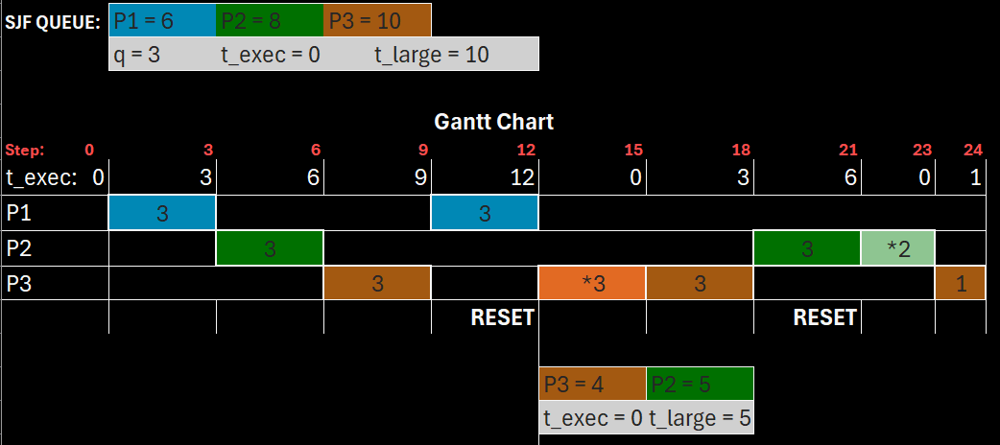
H – A Simple Example
*made by us in excel

Slide 10
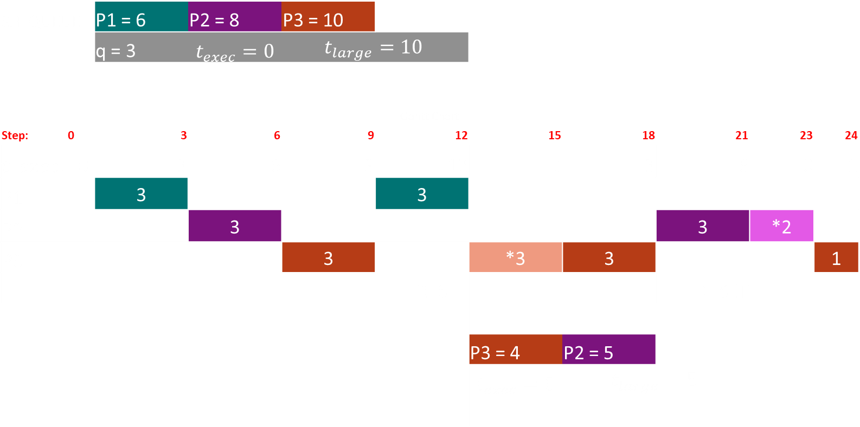
H – A Simple Example
SJF QUEUE: | P1 = 6 | P2 = 8 | P3 = 10
 | q = 3 | $$t_{exec}=0$$ | $$t_{large}=10$$
Gantt Chart
Step: 0 | 3 | 6 | 9 | 12 | 15 | 18 | 21 | 23 | 24
$t_exec$: 0 | 3 | 6 | 9 | 12 | 0 | 3 | 6 | 0 | 1
P1 | 3 |  |  | 3
P2 |  | 3 |  |  |  |  | 3 | *2
P3 |  |  | 3 |  | *3 | 3 |  |  | 1
 |  |  |  | RESET |  |  | RESET
 |  |  |  |  | P3 = 4 | P2 = 5
 |  |  |  |  | $$t_{exec}=0$$ | $$t_{large}=5$$
*made by us in excel

Slide 11
NEW ALGORITHM DUAL QUEUE (DQ)
Key Idea:
Expands on H but with 2 queues (FIFO waiting queue + SJF execution queue)
New arrivals are batched into the waiting queue and get flushed into the execution queue on reset
Advantages:
Best RT of all algorithms
Lower overhead than H
No starvation
Disadvantages:
Even more complex logic than other algorithms
Sorting overhead at each reset cycle

Slide 12

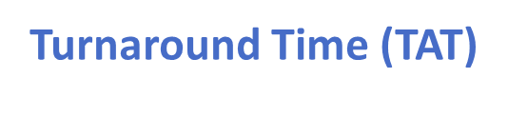
EXPERIMENT SETUP & METRICS
20
Process Sets
10
Process Each
8
Algorithms Compared
Turnaround Time (TAT)
$$t_{completion}−t_{arrival}$$
Response Time (RESP)
$$t_{first run}−t_{arrival}$$
Waiting Time (WT)
Total time spend idle in the ready queue

Slide 13
EXPERIMENT RESULTS
H Wins
Waiting Time
3,136
DQ Wins
Response Time
1937
Both Have Low
Turnaround Times
5517(H) / 7125 (DQ)
Both
No Starvation

Slide 14
CONNECTION TO CORE OS CONCEPTS

Slide 15
CRITICAL REFLECTION

Slide 16
REFERENCES

