Slide 1
Behind the data: population and sampling
Dr Moses Ngari

Slide 2
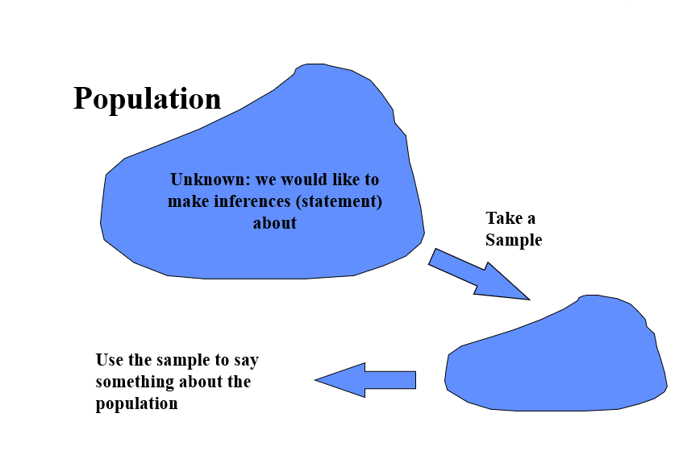

Slide 3
Example
A survey of haemoglobin status in children under-five years in Kilifi county
Impossible to interview everyone, so select a random sample of 30
From the sample we find that the mean Hb is 10g/dl
What does this tell us about the population?

Slide 4
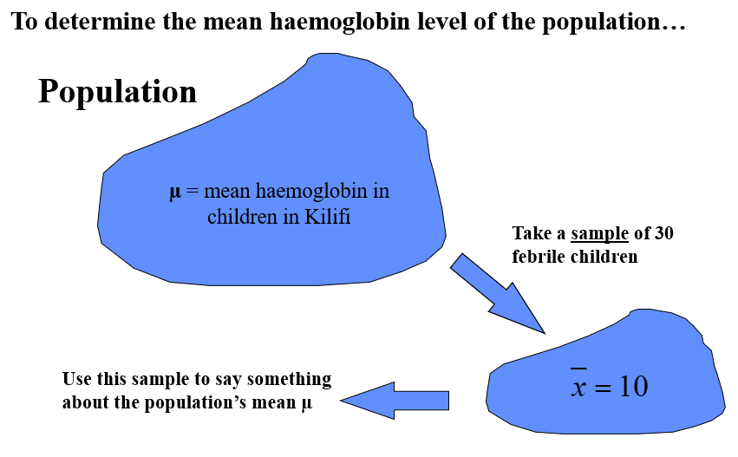

Slide 5
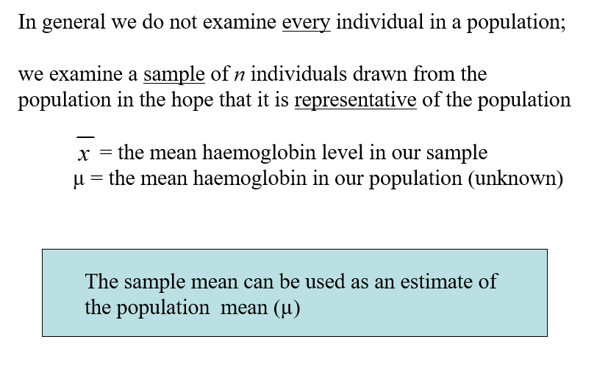

Slide 6
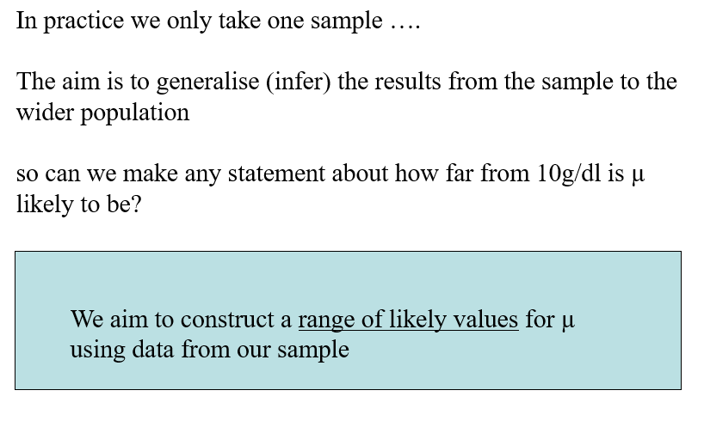

Slide 7
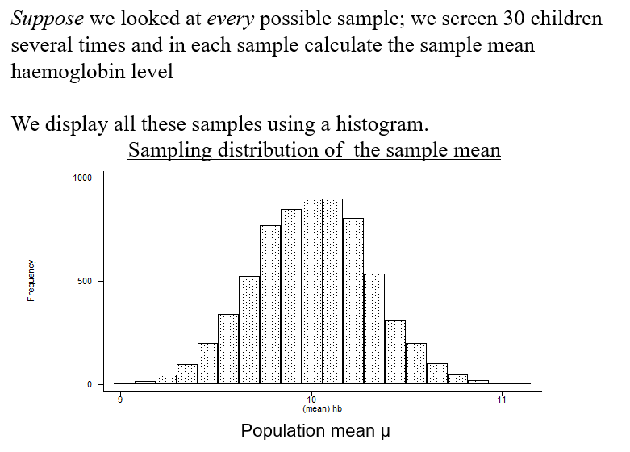

Slide 8
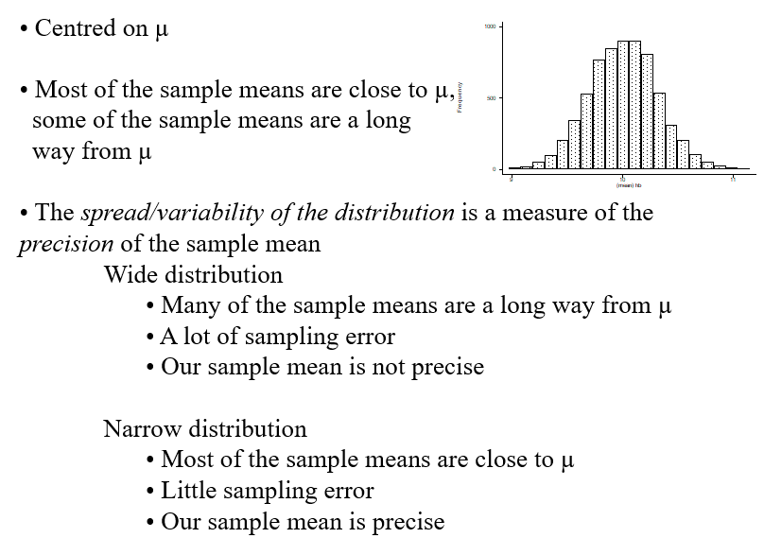
Sampling distribution of the sample mean

Slide 9
For the sample of data that we collect
The sample mean estimates the most likely value for the population mean
The standard deviation (s) shows the variability of the data in our sample
The standard error (s/√n) shows the uncertainty of the parameter we have estimated from our sample
Standard error can be used to:
Calculate confidence intervals around the sample mean (express statistical uncertainty)
~ range of likely values for µ
Test hypotheses (assess the strength of evidence) about the sample mean we have observed

Slide 10
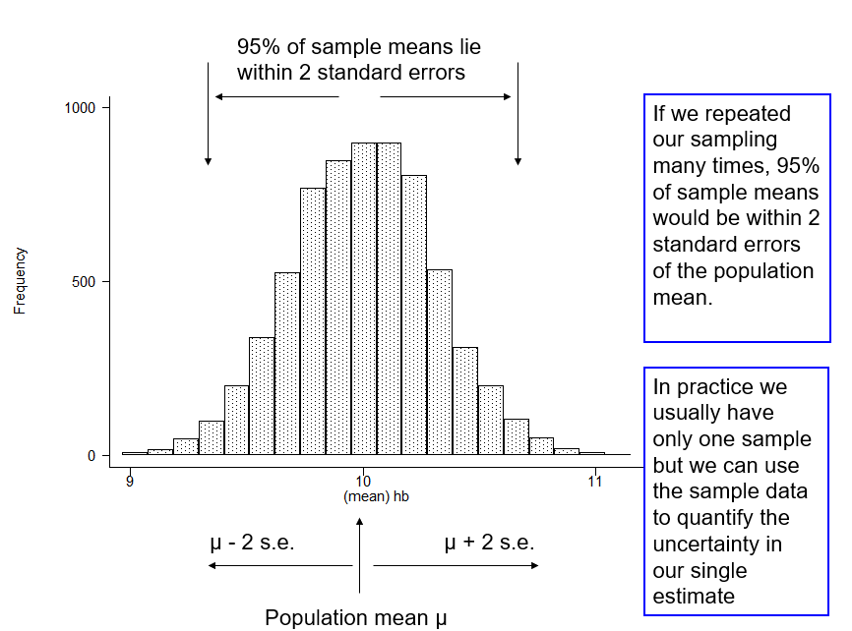

Slide 11
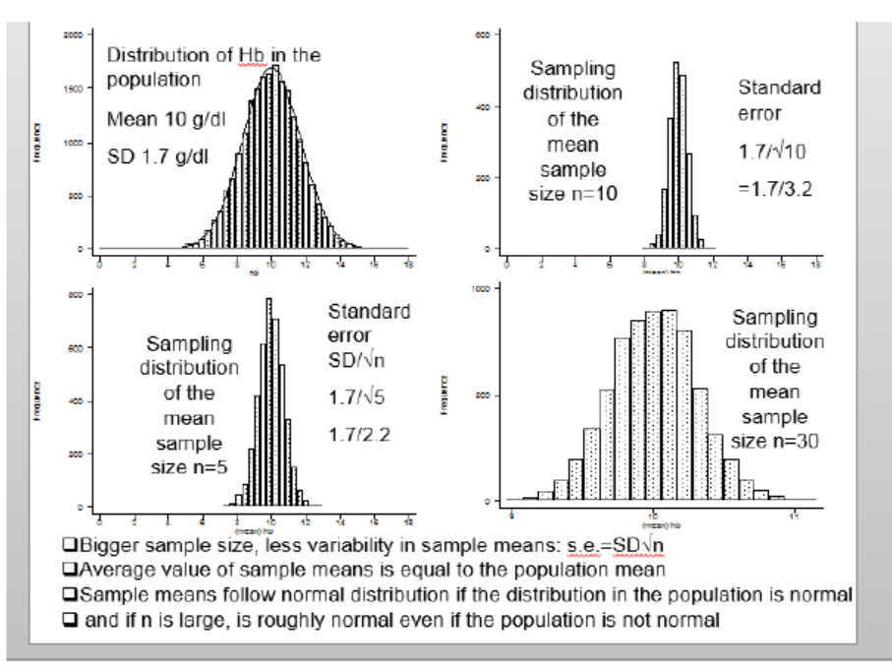

Slide 12
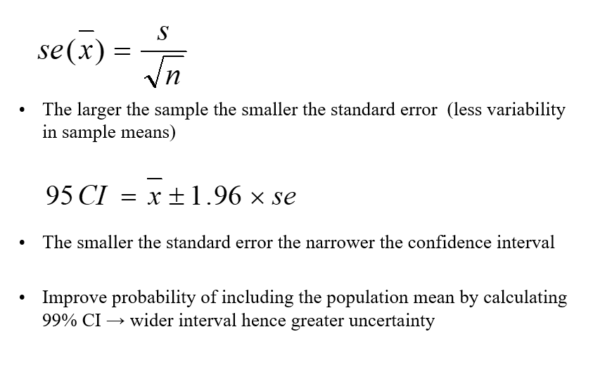

Slide 13
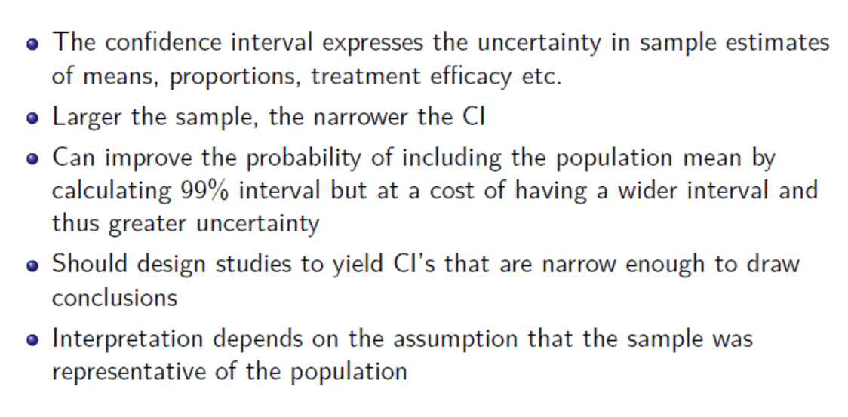
Summary

Slide 14
Exercise
Suppose we’ve collected a random sample of 10 recently graduated students and asked them what their annual salary is. Imagine that this is the data we see, 44617,7066, 17594, 2726, 1178, 18898, 5033, 37151, 4514, and 4000.
Goal: Estimate the mean salary of the graduated children.
Find a 95 % confidence interval for the mean.
Setting 1: Assume that incomes are normally distributed with unknown mean and SD = ksh15,000.

