Slide 1
Test of hypothesis: t-test
Dr Moses Ngari

Slide 2
Procedures for statistical inference
Point estimation
Confidence intervals
Hypothesis testing

Slide 3
Hypothesis Testing
Allows us to use sample data to test a claim about a population, such as testing whether a population proportion or population mean equals some number.
Example: Is the true average amount that students spent weekly on alcohol $20?

Slide 4
Hypothesis Testing
Defn: Its an assertion (claim/conjecture) about the values of a population parameter
Elements
Define hypothesis (null & alternative)
Test statistic
Rejection region

Slide 5
Definitions
Null hypothesis, H₀ - always represents the status quo, i.e. the hypothesis that requires no change in current behavior
Alternative hypothesis, H₁ - is the conclusion that the researcher is trying to make.
Test statistic – Quantity used to test between null and alternative hypotheses
Rejection region - Values of the test statistic for which we reject the null in favor of the alternative hypothesis and vice versa

Slide 6
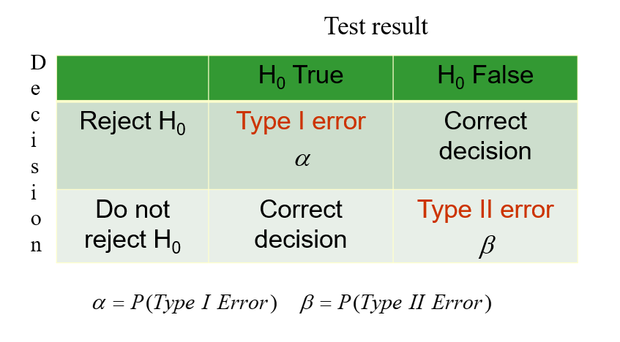
Type I & II errors

Slide 7
Inference from a Sample Mean
One-sample tests are appropriate when a sample is being compared to the population from a hypothesis. The population characteristics are known from theory or are calculated from the population (eg H0 μ=3 or H0 μ<3).
Two-sample tests are appropriate for comparing two samples, typically experimental and control samples from a scientifically controlled experiment.
Paired tests are appropriate for comparing two samples where it is impossible to control important variables. Members are paired between samples so the difference between the members becomes the sample.

Slide 8
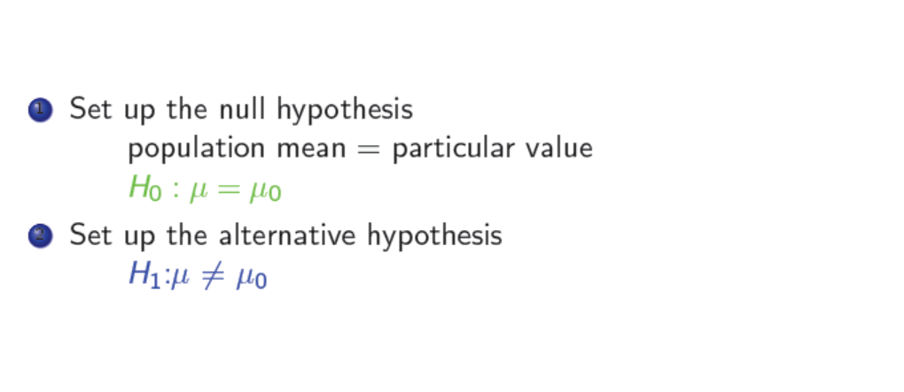
One sample ttest

Slide 9
Example
Sample mean birth weight in 141 babies was 3.01 with s.e. 0.04.Suppose prior to the study it was thought population mean was 3.25 kg. What are the null and the alternative hypothesis?

Slide 10
Example
Sample mean birth weight in 141 babies was 3.01 with s.e. 0.04.Suppose prior to the study it was thought population mean was 3.25 kg. What are the null and the alternative hypothesis?
H0 : = 3:25 VS H1: ̸= 3:25

Slide 11
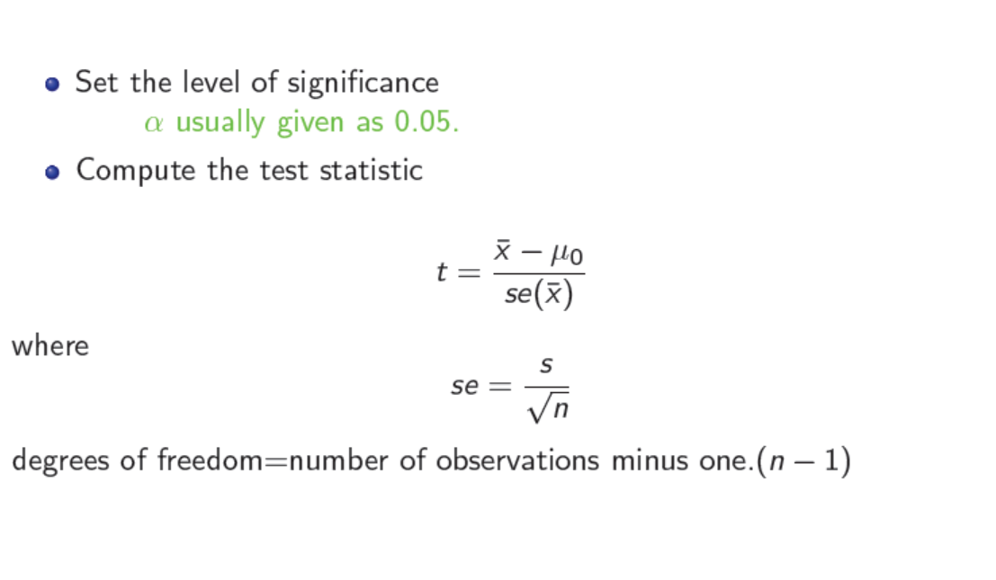

Slide 12
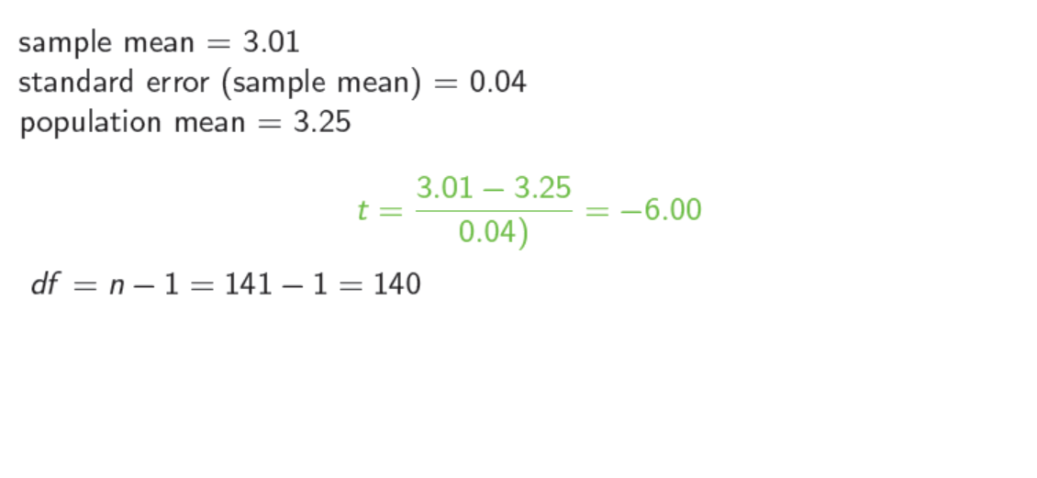

Slide 13
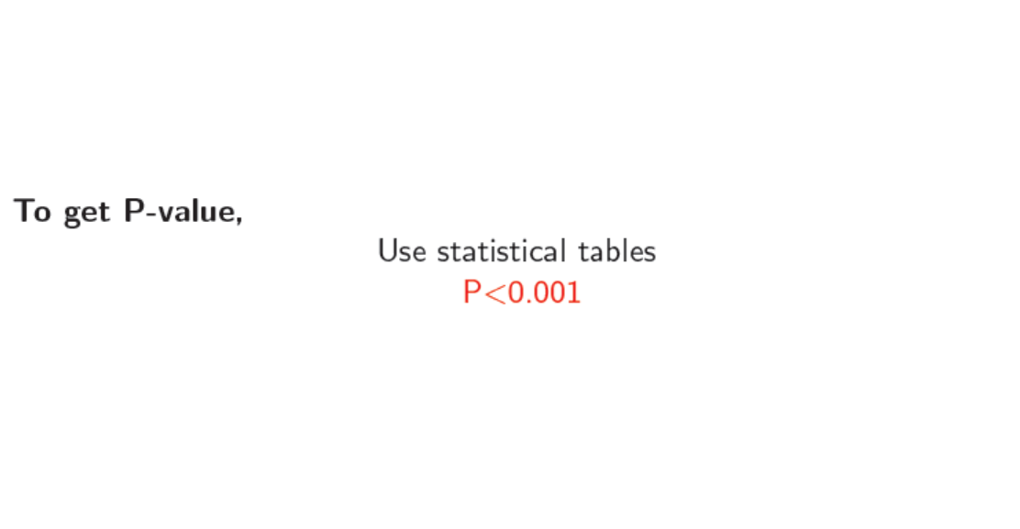
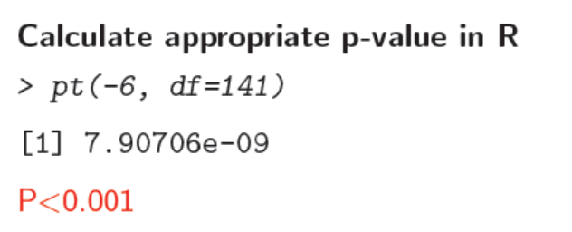
Calculate appropriate p-value

Slide 14
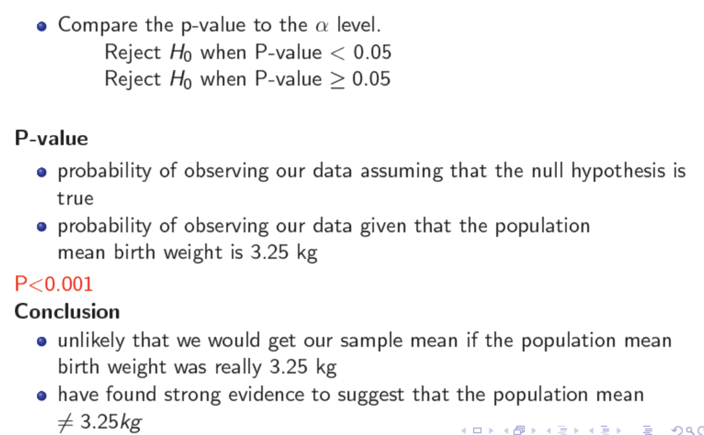
Interpretation

Slide 15
Paired comparisons
Weight measured in same babies
at birth
prior to leaving clinic
Q: mean weight at birth = mean weight on leaving clinic?
Birth
mean birthweight in 122 babies = 3.03 kg
Leaving clinic
mean birthweight in 122 babies = 3.07 kg

Slide 16
Paired Data
What do we think looking at those 2 mean values?
Are the 2 sets of weights comparable?
What is our null hypothesis?
H₀: mean at birth = mean on leaving
Equivalent to:
H₀: mean difference in weights = 0

Slide 17
Paired data
include 122 babies with 2 weight measurements
mean difference = difference between means
= - 0.04
calculate s.e. of the differences in the weights (se=0.01)
test statistic = mean difference / s.e.(mean difference)
t = - 0.04 / 0.01 = - 4.00
d.f. = 122 – 1 = 121

Slide 18
Paired data
p < 0.001 : strong evidence to suggest mean weight at birth was different to mean weight on leaving clinic

Slide 19
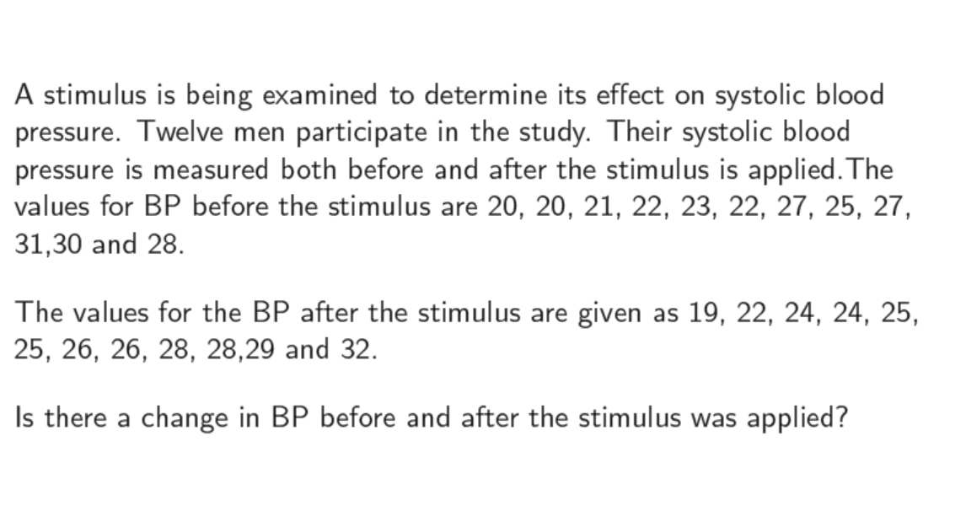
Example2

Slide 20
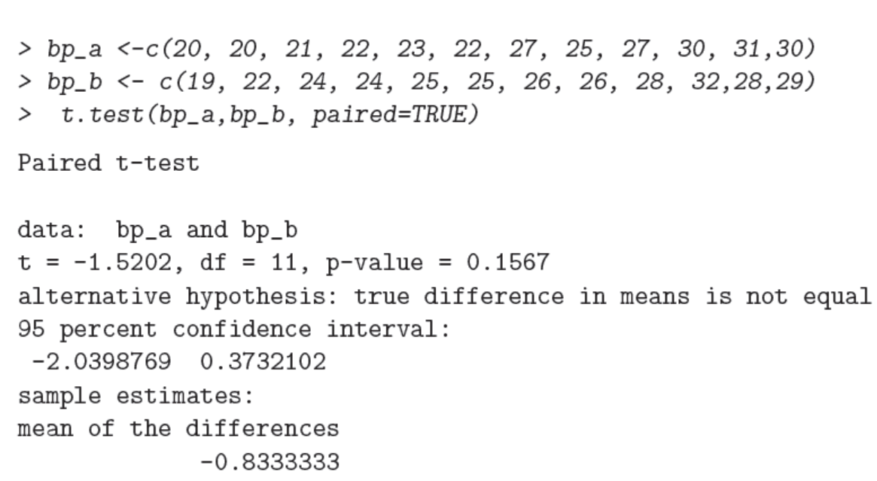

Slide 21
What can we conclude?
The t test is not significant (t=-1.09, p=0.1567), indicating that the stimuli did not significantly affect systolic blood pressure.

Slide 22
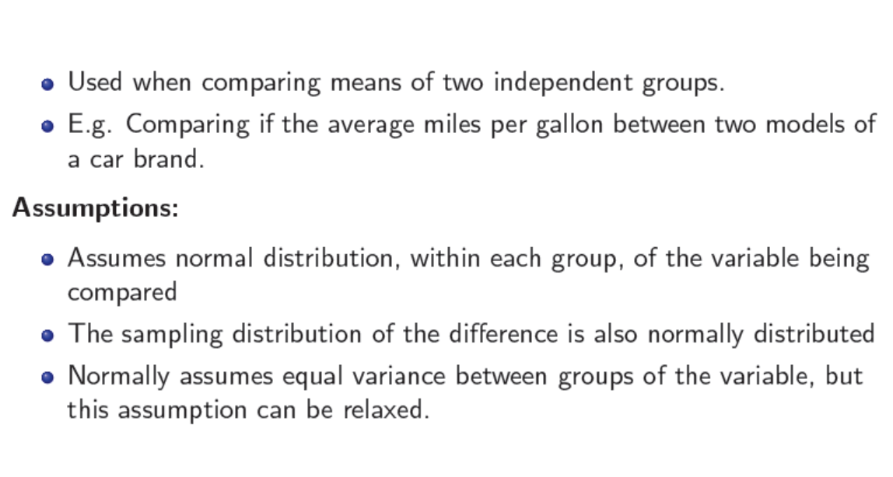
Comparing group means: Two sample T-test

Slide 23
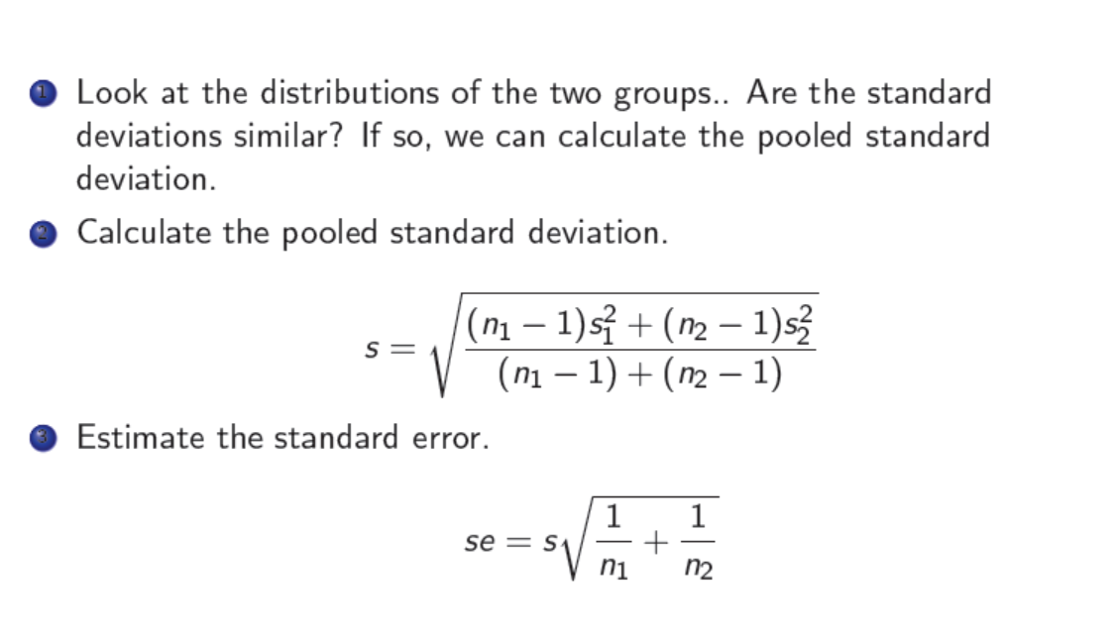
Calculating the standard error of the difference in means

Slide 24
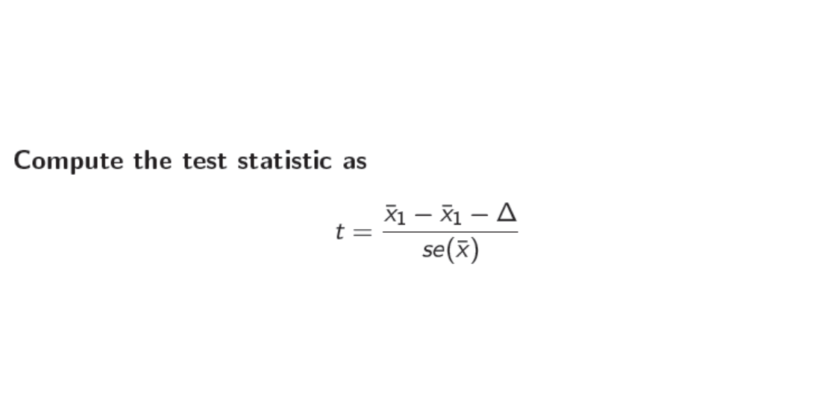

Slide 25
Example3
Suppose that we have measured the weight of 18 individuals:
9 women (group A) and 9 men (group B).
We want to know if the mean weight of women are different.
The weights have been provided:
Women: 38.9, 61.2, 73.3, 21.8, 63.4, 64.6, 48.4, 48.8, 48.5
Men: 67.8, 60.0, 63.4, 76.0, 89.4, 73.3, 67.3, 61.3, 62.4

Slide 26
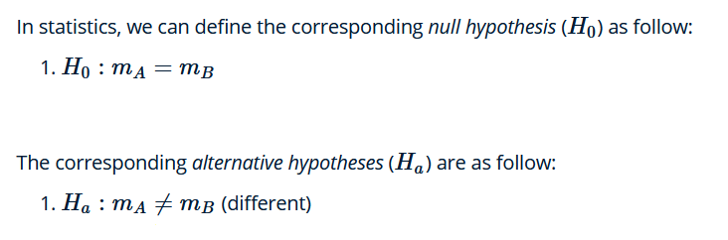
Example3
Suppose that we have measured the weight of 18 individuals:
9 women (group A) and 9 men (group B).
We want to know if the mean weight of women are different.
The weights have been provided:
Women: 38.9, 61.2, 73.3, 21.8, 63.4, 64.6, 48.4, 48.8, 48.5
Men: 67.8, 60.0, 63.4, 76.0, 89.4, 73.3, 67.3, 61.3, 62.4

Slide 27
Example 3
#read the weights in R as two vectors
women_weight <- c(38.9, 61.2, 73.3, 21.8, 63.4, 64.6, 48.4, 48.8, 48.5)
men_weight <- c(67.8, 60, 63.4, 76, 89.4, 73.3, 67.3, 61.3, 62.4)
#Run the t-test
t.test(women_weight,men_weight, var.equal = TRUE)

Slide 28
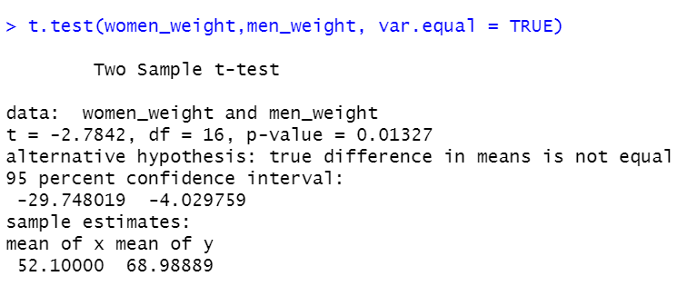
Example 3

Slide 29
Interpretation of the result
The P-value of the test is 0.01327, which is less than the significance level alpha=0.05. We can conclude that men’s average weight is significantly different from women’s average weight with a P-value=0.01327.

Slide 30
Summary
Use one sample t-test
Test if population mean = particular value
Based on prior assumption about population mean
Test if sample means measured on 2 occasions are equal
More common than previous example
Based on set of complete measurements

Slide 31
Summary
The t-test/z-test compares two means only.
In presence of >2 groups, use ANOVA (not covered)
The t-test/z-test assumes data are normally distributed.
For skewed data, use non-parametric tests (not covered).

