Slide 1
ANOVA Using R
Moses Ngari

Slide 2
ANOVA
Comparison of means form several groups: The basic ANOVA situation
When the exposure variable has more than two categories, we often wish to compare the mean outcomes from each of the groups defined by these categories.
Example, - Wish to examine how the systolic blood pressure measurements collected as part of the routine hospital visits vary with age groups (3 categories) or sex or ethnic groups or socioeconomic classes.

Slide 3
ANOVA
Main Question: Do the means of the quantitative variables depend on which group the individual is in?
If categorical variable has only 2 values: 2-sample t-test
ANOVA allows for 3 or more groups

Slide 4
ANOVA
Exploratory Data analysis
Graphical investigation:
1 Side-by-side box plots
2 Multiple histograms

Slide 5
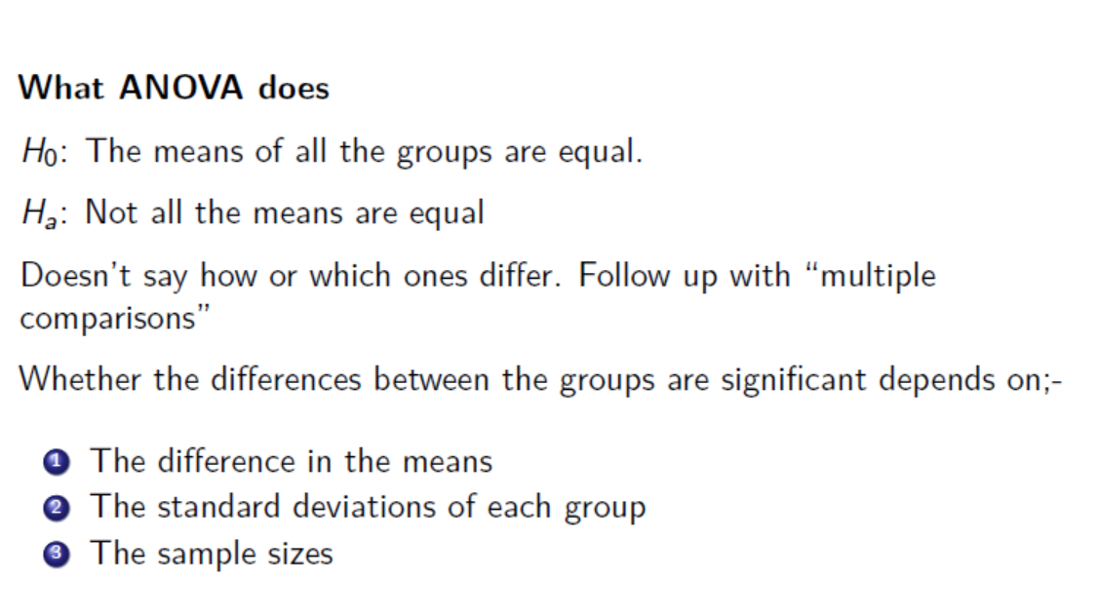

Slide 6
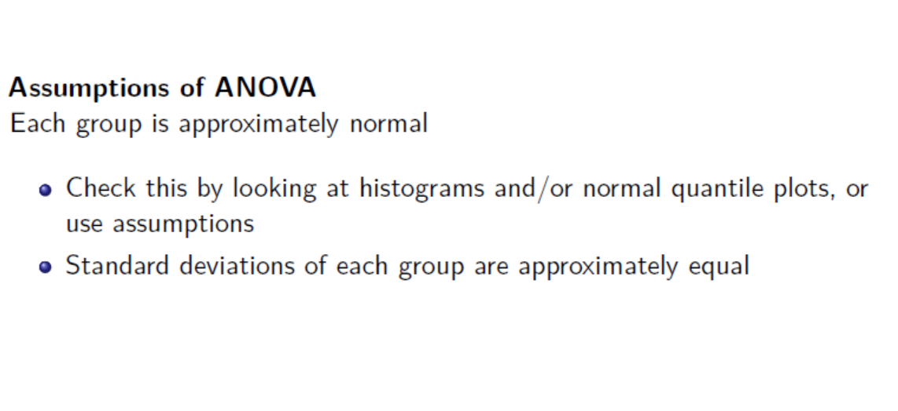

Slide 7
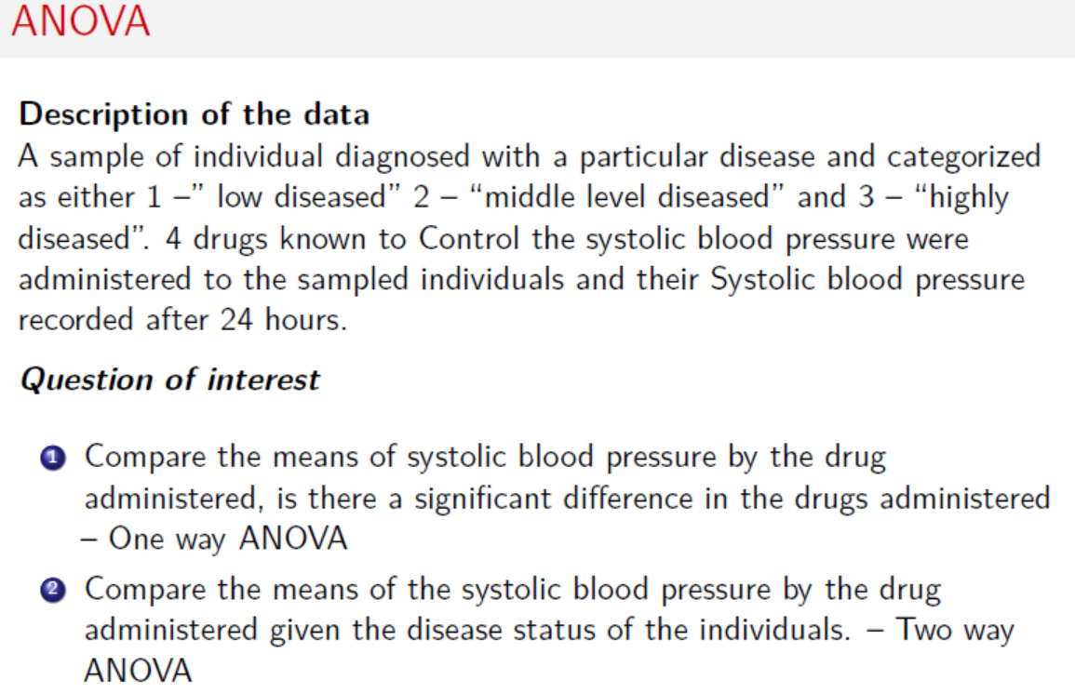

Slide 8


Slide 9


Slide 11
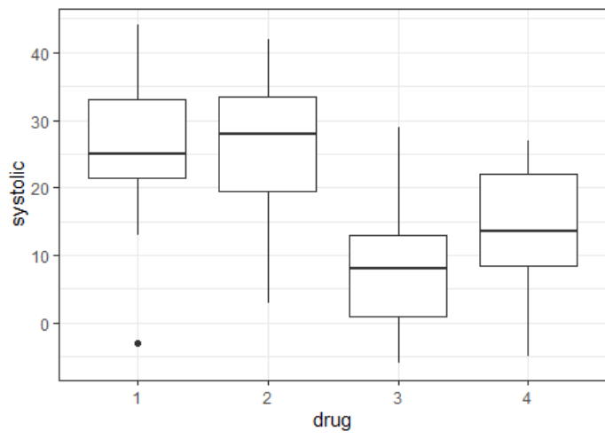

Slide 12
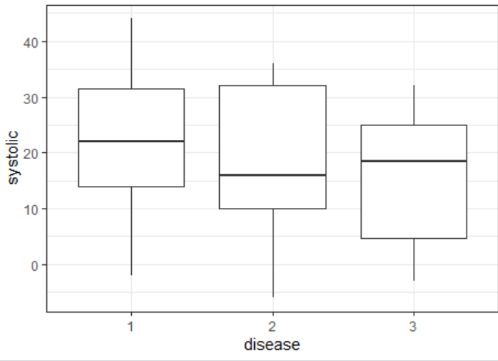

Slide 13
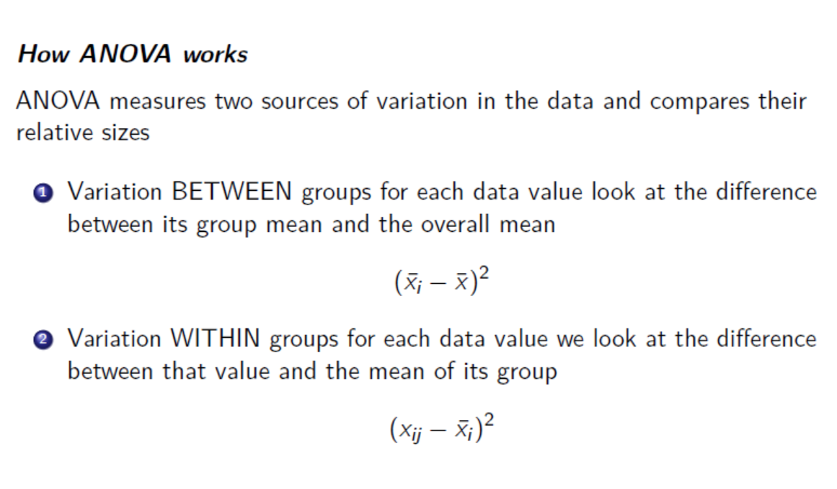

Slide 14
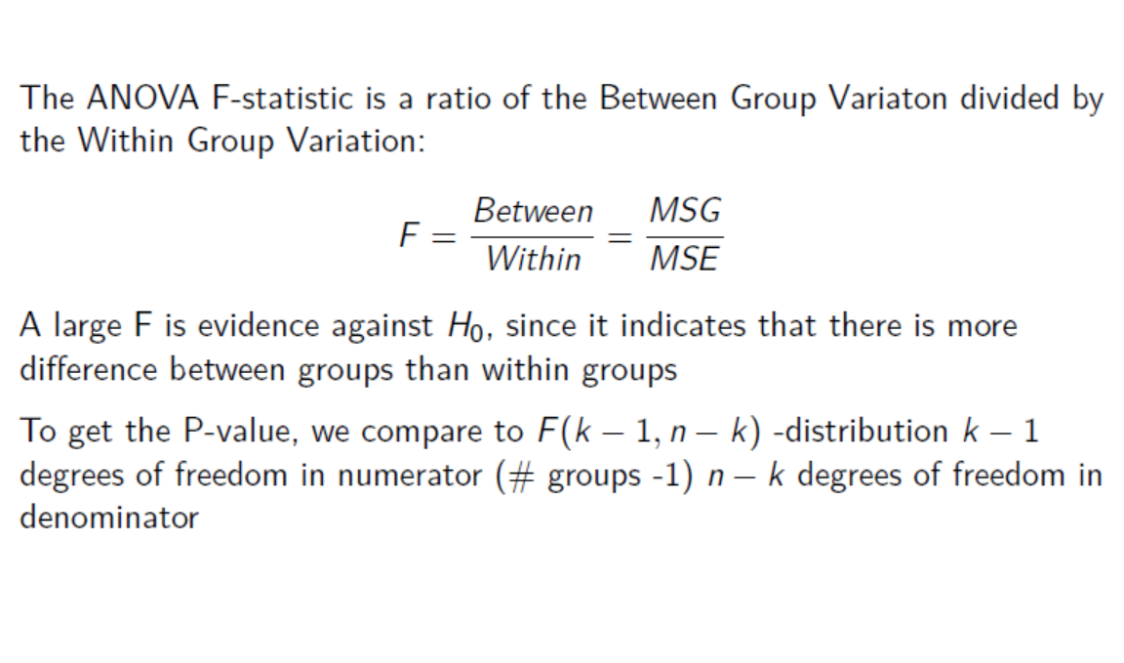

Slide 15
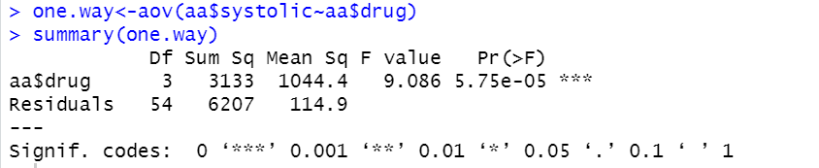

Slide 16
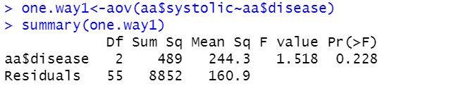

Slide 17
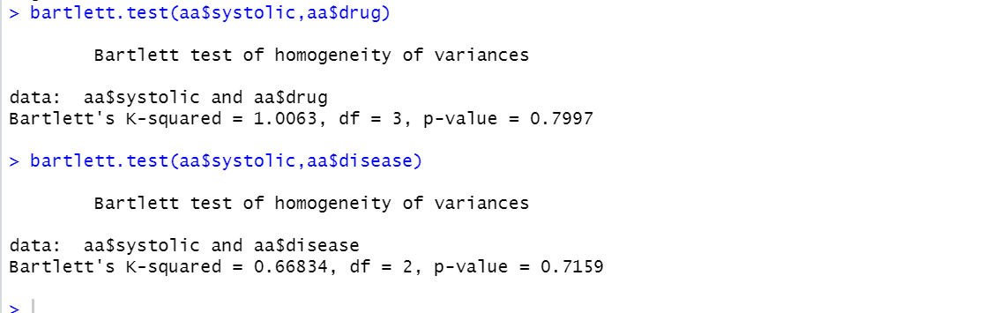
Normality and Variance Homogeneity test

Slide 18
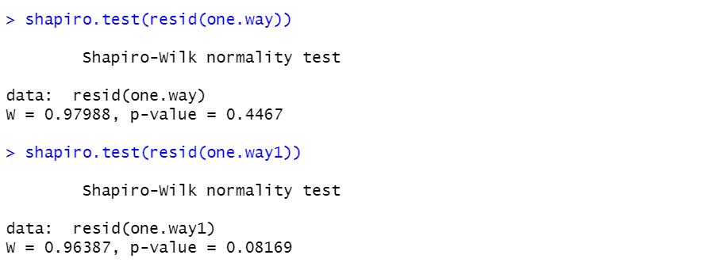

Slide 19
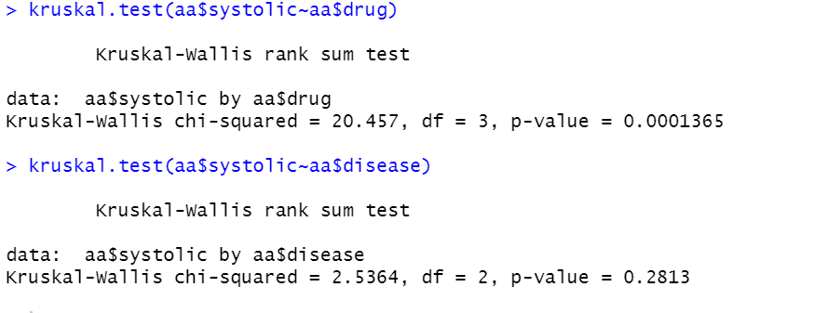
Assumption violated
Use non-parametric methods: Kruskal-Wallis rank sum test

