Slide 1
REGRESSION
By:
Dr. Rose Kigathi

Slide 2
Basics
Scientific method
Identify a question or problem.
Collect relevant data on the topic.
Analyze the data.
Form a conclusion.
Statistics = methods of :
Collecting
Analyzing
Drawing conclusions from Data (2,3,4)

Slide 3
The red line/ Heart of research...
The questions you are asking need to be clear. (Specific objectives).
Materials and Methods, Experimental design, data analysis all grow from this point.

Slide 4
Data analysis: “Gabbage in gabbage out”
Data Analysis method:
Will it answer the questions you are asking?
Is it appropriate for the type of data you have?
Are there any aspects of the data collection/design that may limit data analysis?
Response variables vs. Explanatory variables
Response variables: you measured
What you are varied

Slide 5
Model
“A representation of the essential aspects of an existing system,
or system to be constructed which represents knowledge of that system in a usable form” (Eykhoff, 1974)
Analysis is about fitting models to data
know the nature of your data
Know the nature of the response variable and explanatory variable
question you are trying to answer

Slide 6
RESPONSE VARIABLE | EXPLANATORY VARIABLE
 | Continuous | Categorical | Continuous and categorical
Continuous | Regression | ANOVA | ANCOVA
Count | Squareroot transformation GLM-Log-linear models (Poisson errors) | Contingency table GLM, | Squareroot transformation GLM poisson error
Proportion | Arcsine transformation GLM Logistic model (binomial errors) | Arcsine transformation GLM binomial | Arcsine transformation GLM with binomial error
Binary data | Binary logistic
Time at death | Time series analysis

Slide 7
Linear Models
Linear model is relatively simple:
y= a + bx (Y_{i} = β₀ + β₁x_{i})
With :
a or β₀ = intercept
b or β₁ = slope
R uses
son~father
Response ~ Explanatory variable

Slide 8
Response and Explanatory
Model specification:
Linear model
y= a+bx
This has 2 variables (y and x) and 2 parameters (a and b, the intercept and the slope respectively).
Variables = those elements of the model that are changing and whose behavior is to be predicted by the model; e.g. x, y
Parameters = usually constants in the model, e.g. a, b

Slide 9
Model
y=a + bx => Type of model: two-parameter linear model

Slide 10
Assumptions of Linear Models
Random Sampling
Constant Variance
Normal errors
Additive effects
Independence of errors

Slide 11
Non-constant variance
Plant
Size
Plant
Size
1/y
Plant density
Plant density
Survivors
Ln y
Age
Age

Slide 12
Independence of errors
Spatial pseudo-replication
E.g Plants are close together
Use of blocks/stratified sampling
Repeated measures
Do each seperately
Average for each plant or animal
Time Series
Mixed effect models

Slide 13
Additive effects
Effects are assumed to be additive
Fertilizer- 2kg/m²
Pesticide – 1 kg/m²
Both – 3 kg/m²
+Pesticide
+Pesticide
Yield
Fertilizer
Fertilizer

Slide 14
Simple Linear regression
y= a + bx
Estimate a , b and variance
Y_{i} = β₀ + β₁x_{i} +ε_{i},
ε_{i} ε _{1, . . . ,} εn are unobserved random variables.
Each ε_{i} Will have N(0,σ²) distribution
Regression will estimate β₀ , β₁ , σ²
σ² will determine the clustering of your data around the line Y_{i} = β₀ + β₁x_{i}

Slide 15
Variance (of the sample s²)
Most important quantity in statistics
The greater the variability the greater your uncertainity in values of parameters estimated
The lower the ability to differentiate competing hypothesis

Slide 16
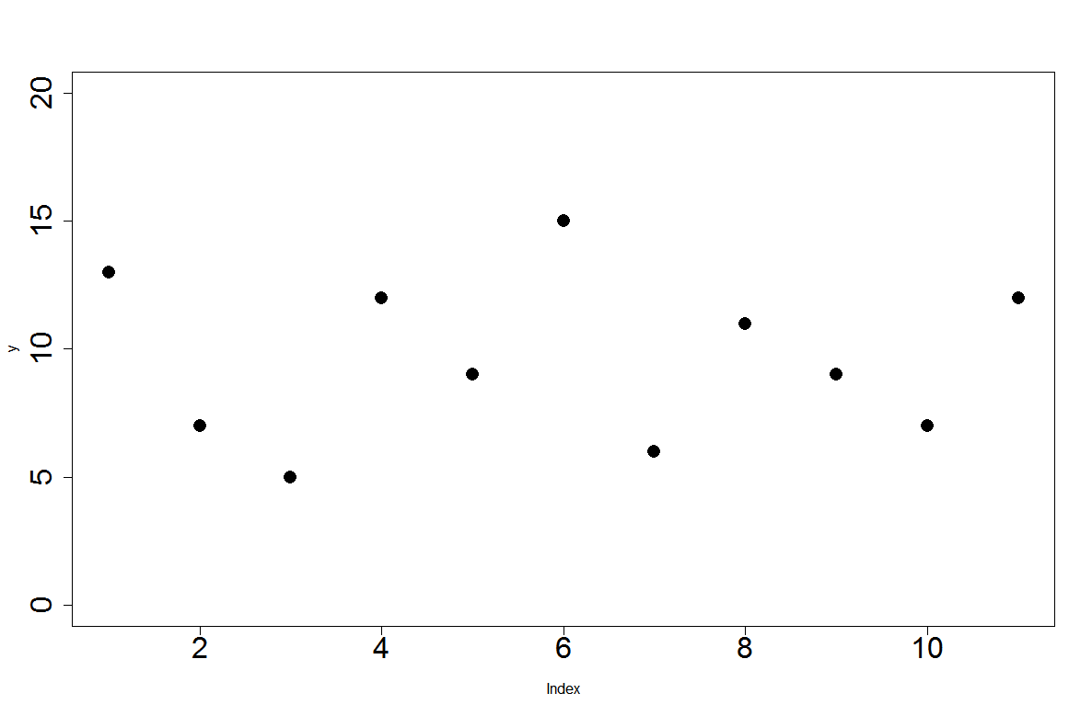
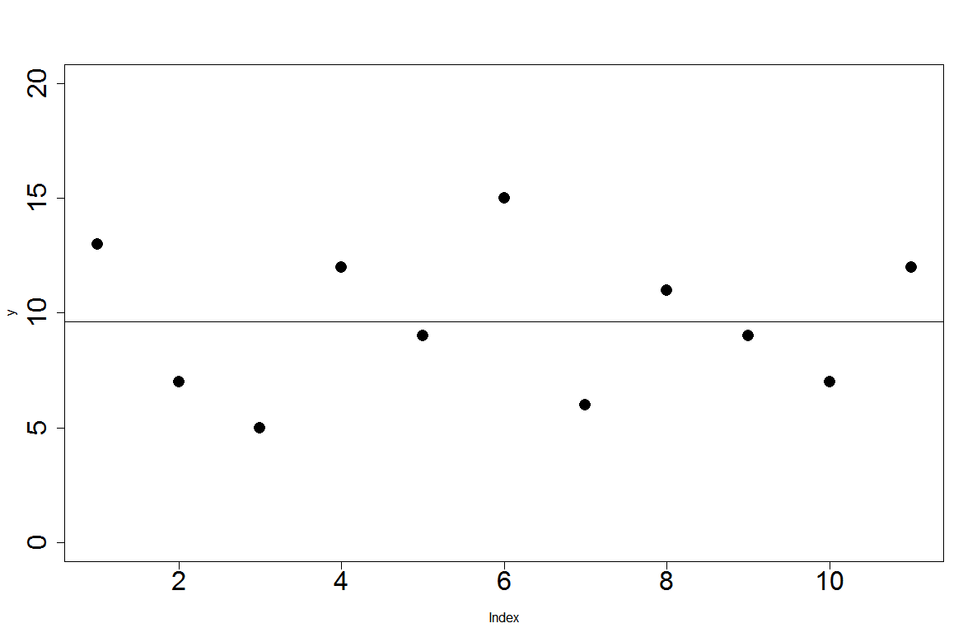
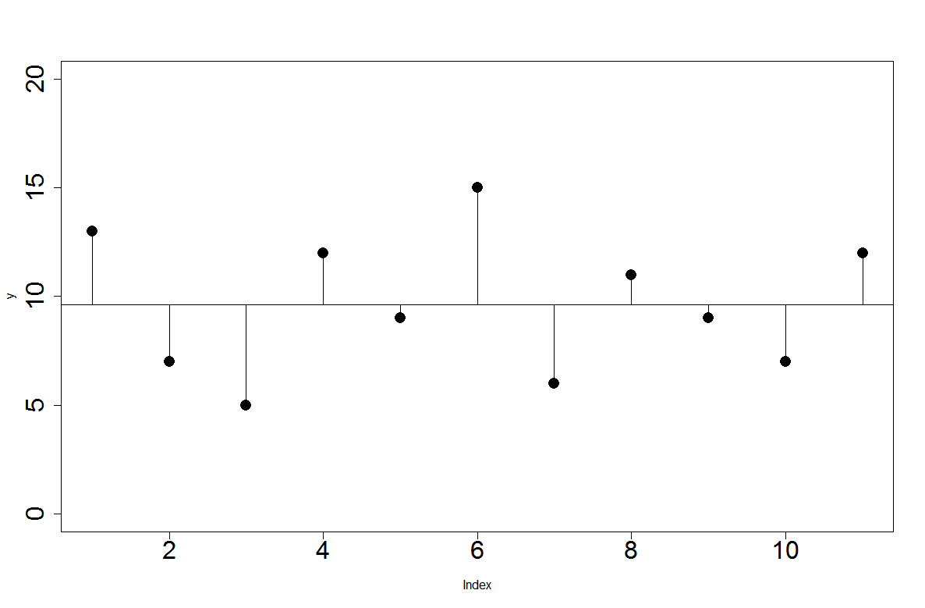
Variance (of the sample s²)
d = y-ӯ

Slide 17
Variance (of the sample s²)
Σd=Σ(y-ӯ)= 0
ΣІdІ=ΣІ y-ӯ І
Σd²=Σ(y-ӯ)² -Sum of squares
Problem:Sum of squares will always get bigger everytime a data point is added

Slide 18
Degrees of Freedom
4
4 | 7
4 | 7 | 2
4 | 7 | 2 | 0
4 | 7 | 2 | 0 | 7

Slide 19
Degrees of Freedom
The sample size n, minus the number of parameters p estimated from the data
Since in variance you estimate only one variable the mean (ӯ), then df= n-1 thus,
Variance= Sum of squares
Degrees of freedom
S²=Σ(y-ӯ)²
n-1

Slide 20
Sum of Squares in Regression
tannin<-read.table("tannin.txt",header=T)
attach (tannin)
plot(tannin~growth,pch=16)
##No attach
plot(tannin~growth,pch=16, tannin)
plot(tannin$tannin~growth$tannin,pch=16)

Slide 21
Sum of Squares in Regression
SST=Σ(y-ӯ)²
SSR
SST
SSE
Σd²=Σ(y-ӯ)² -Sum of squares

Slide 22
Sum of Squares in Regression
SSE=Σ(y-ŷ)²
Residuals
ŷ =a+bx
SSE=Σ(y-a-bx)²

Slide 23
Sum of Squares in Regression
SSR=SST-SSE
SSR

Slide 24
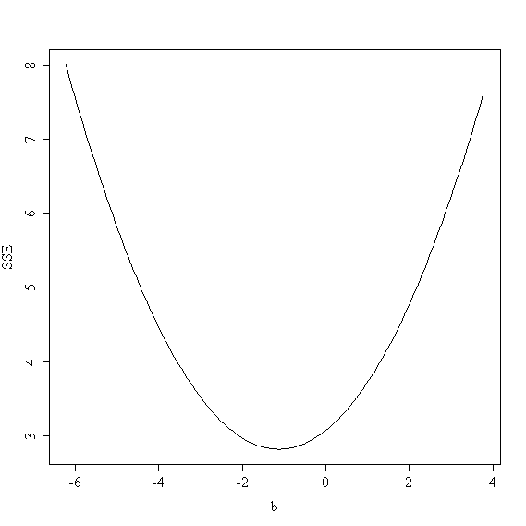
best fit line minimises SSE
maximum likelihood estimate of the slope solves for b=0
ӯ =a+bx
The value that minimizes SS
b=SSXY
SSX
We define the best fit line as the one that minimises SSE

Slide 25
DESK WORK

Slide 26
Linear regression on R
model1<-lm(growth~tannin)
summary(model1)
Call:
lm(formula = growth ~ tannin)
Residuals:
Min 1Q Median 3Q Max
-2.4556 -0.8889 -0.2389 0.9778 2.8944
Coefficients:
Estimate Std. Error t value Pr(>|t|)
(Intercept) 11.7556 1.0408 11.295 9.54e-06 ***
tannin -1.2167 0.2186 -5.565 0.000846 ***
---
Signif. codes: 0 ‘***’ 0.001 ‘**’ 0.01 ‘*’ 0.05 ‘.’ 0.1 ‘ ’ 1
Residual standard error: 1.693 on 7 degrees of freedom
Multiple R-squared: 0.8157, Adjusted R-squared: 0.7893
F-statistic: 30.97 on 1 and 7 DF, p-value: 0.0008461

Slide 27
Linear regression on R
summary(model)
Coefficients:
Estimate Std. Error t value Pr(>|t|)
(Intercept) 11.7556 1.0408 11.295 9.54e-06 ***
tannin -1.2167 0.2186 -5.565 0.000846 ***
---
Residual standard error: 1.693 on 7 degrees of freedom
Multiple R-squared: 0.8157, Adjusted R-squared: 0.7893
F-statistic: 30.97 on 1 and 7 DF, p-value: 0.000846
SSR/SST
Last two columns of ANOVA

Slide 28
Linear regression on R
summary.aov(model1)
Df Sum Sq Mean Sq F value Pr(>F)
tannin 1 88.82 88.82 30.97 0.000846 ***
Residuals 7 20.07 2.87
---
Signif. codes: 0 ‘***’ 0.001 ‘**’ 0.01 ‘*’ 0.05 ‘.’ 0.1 ‘ ’ 1

Slide 29
Diagnostics
Expectation= No pattern

Slide 30
Diagnostics
Expectation= Fit closely to the dotted staight line

Slide 31
Diagnostics
Expectation= No pattern

Slide 32
Diagnostics
Shows which outliers are expected to have the largest effect on
parameters

Slide 33
decay <- read.delim("I:/R course material/Crawley data/decay.TXT")
attach (decay)
names (decay)
plot(y~x)
abline(lm(y~x))
model2<-lm(y~x)
summary(model2

Slide 34
Non-linear data
Coefficients:
Estimate Std. Error t value Pr(>|t|)
(Intercept) 84.5534 5.0277 16.82 < 2e-16 ***
x -2.8272 0.2879 -9.82 9.94e-11 ***
---
Signif. codes: 0 ‘***’ 0.001 ‘**’ 0.01 ‘*’ 0.05 ‘.’ 0.1 ‘ ’ 1
Residual standard error: 14.34 on 29 degrees of freedom
Multiple R-squared: 0.7688, Adjusted R-squared: 0.7608
F-statistic: 96.44 on 1 and 29 DF, p-value: 9.939e-11

Slide 37
model3<-lm(log(y)~x)
summary(model3)
plot(model3)
Heteroscedasticity

Slide 39
Steps in regression analysis
Data inspection
Model specification
Model fitting
Model criticism
Occam razor:
Given a set of explantions
Which account equally well for your data
The correct explanation is the simplest explanation

Slide 40
PRACTICAL

