Slide 1

CSCI E-25 Computer Vision
Building Blocks of Deep Learning
Steve Elston
Copyright 2021, Stephen F Elston. All rights reserved.

Slide 2
Building Blocks of Deep Learning
Key points for this lecture
Deep neural networks have revolutionized some areas of machine learning
Object classification
Object detection
Segmentation
Generative models
…
Many types of deep neural networks used in CV
Fully connected NNs – our focus this week
Convolutional NNs for feature extraction – next week
Many others …

Slide 3
Building Blocks of Deep Learning
Key points for this lesson
Forward propagation and linear networks
Deep architectures; depth vs. breath
Nonlinearity and activation functions
Learning weights with backpropagation
Loss functions
Computing gradients with the chain rule

Slide 4
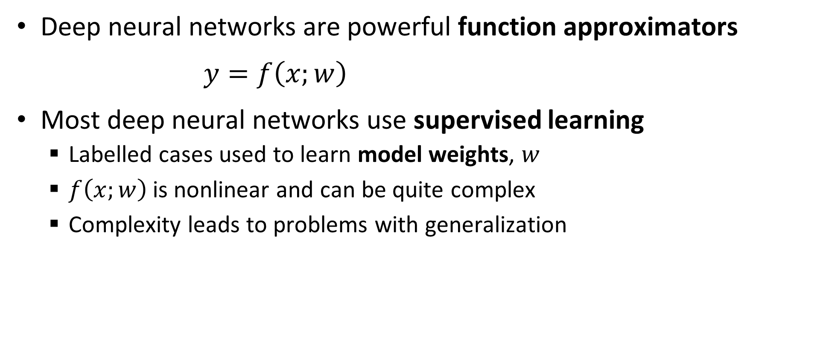
Function Approximation with Deep Neural Networks
Deep neural networks are powerful function approximators
$y=f\left(x;w\right)$
Most deep neural networks use supervised learning
Labelled cases used to learn model weights, $w$
$f\left(x;w\right)$is nonlinear and can be quite complex
Complexity leads to problems with generalization

Slide 5
Essential Elements of Deep Learning
Representation
Inference
Input = X
Output = Y
Learning

Slide 6
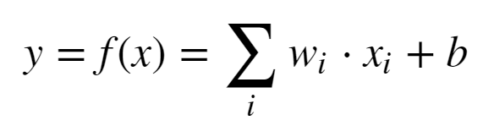
Representation: Linear Neural Network
Proposed by McCulloch and Pitts (1943)
X₁
w₁
w₂
X₂
Σ + b
Y
w₃
X₃

Slide 7

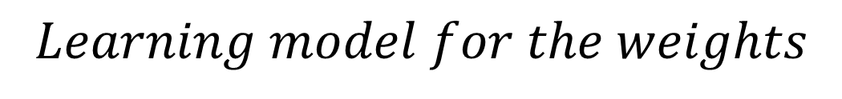


Representation: Linear Neural Network
Early learning model for a neural network - Heeb (1949)
X₁
$$Learning model for the weights$$
w₁
$$w_{ij}=x_{i}x_{j}$$
w₂
Σ + b
$$Δw_{ij}=ηx_{i}x_{j}$$
X₂
Y
w₃
$$Where, η is the learning rate$$
X₃
But, this is just linear regression!

Slide 8
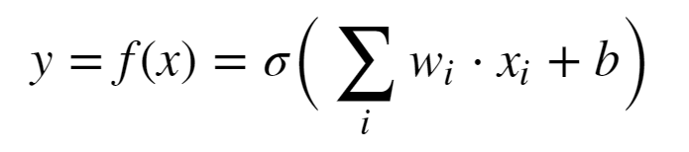
Representation: Perceptron
Use of nonlinear activation proposed by Rosenblatt (1962)
X₁
w₁
w₂
X₂
σ(Σ + b)
Y
w₃
X₃
Minsky and Papert (1969) showed the perceptron cannot represent an exclusive or (XOR)
This is just logistic regression!

Slide 9
We Need a Better Deep Representation
By mid-1980s need for architecture with hidden layers for greater model capacity was recognized
Input layer
Multiple hidden layers
Output layer
Apply nonlinear activations in hidden units
Can fully connect between layers
Learn weights for complex function approximation
Can solve XOR problem and much more

Slide 10
We Need a Better Deep Representation
w¹₁₁
X₁
S₁ = σ_{h}(Σ )
w²₁
w¹₁₂
w¹₂₁
S₃ = Σ
X₂
w²₂
w¹₂₂
S₂ = σ_{h}(Σ )
_{Input Layer}
_{Hidden Layer}
_{Output Layer}

Slide 11
We Need a Better Deep Representation
What is the output of the simple network?
Process called forward propagation
Start with the output of the hidden layer:
S₁ = σ(Σ_{i} x_{i} * W¹_{1i})
S₂ = σ(Σ_{i} x_{i} * W¹_{2i})
Next, compute the output of the output layer
S₃ = Σ_{j} W²_{j} * σ(Σ_{i} x_{i} * W¹_{ji})

Slide 12
Model Capacity
The universal approximation theorem, Hornik (1991), tells us that an infinitely wide hidden layer can represent any function
Usefulness limited:
It’s nice to know we can represent complex functions
But, completely infeasible in practice
What can we do?
Trade depth for breath

Slide 13
Model Capacity
Model capacity is fundamentally related to the bias-variance trade-off of machine learning
Low capacity models have high bias but low variance
High capacity models have low bias but high variance
High capacity models have a tendency to be overfit
We have more to say about this problem in another lesson

Slide 14
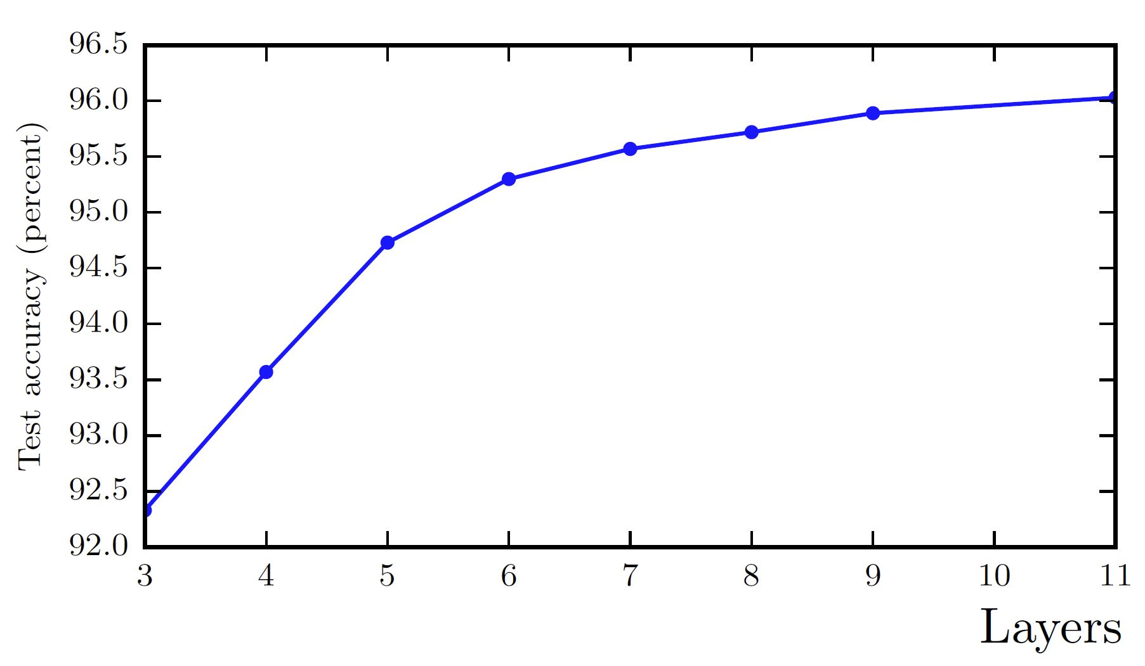
Model Capacity
Model capacity with increasing depth. From Goodfellow et. al. 2014.

Slide 15
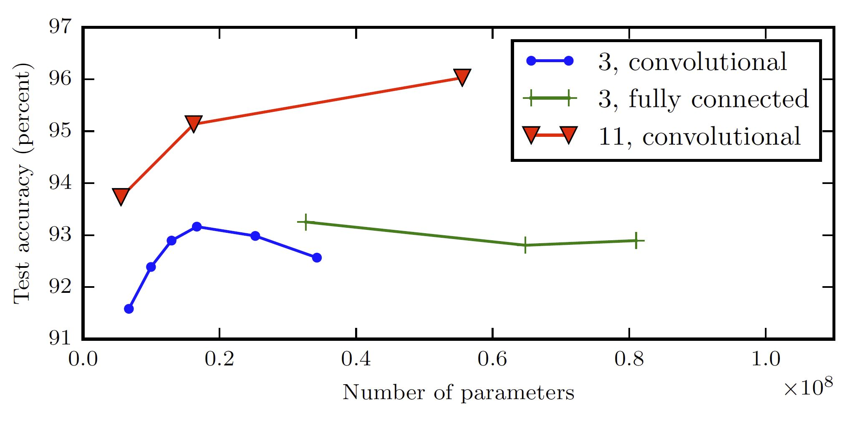
Model Capacity
Model capacity vs. number of parameters. From Goodfellow et. al. 2014.

Slide 16
Activation functions
Nonlinear activation is key to achieving good function approximation.
Many activation functions have been tried, here are a few:
Function | How Used? | Comments
Sigmoid | Binary classifier output layer | Historically the most used
Softmax | Multi-class output layer | For categorical distribution
Linear | Numeric output layer | Regression models
Rectilinear | Hidden layers | Widely used to avoid vanishing gradient
Leak Rectilinear | Hidden layers | Widely used to avoid vanishing gradient
Tanh | Binary classifier output layers Other specialized applications | Better gradient properties than sigmoid

Slide 17
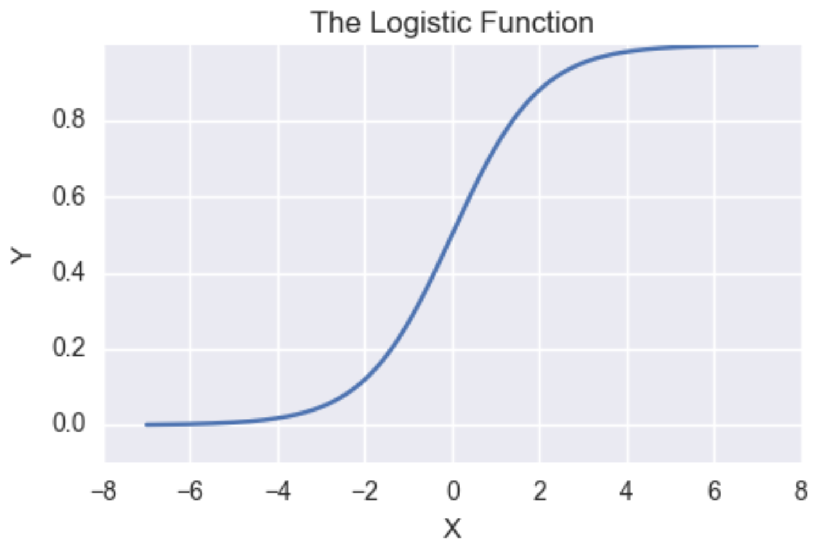
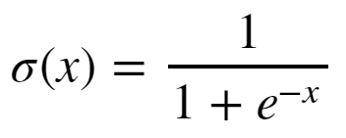
Activation functions
Sigmoid has vanishing gradients
Near-0 gradient
Near-0 gradient

Slide 18
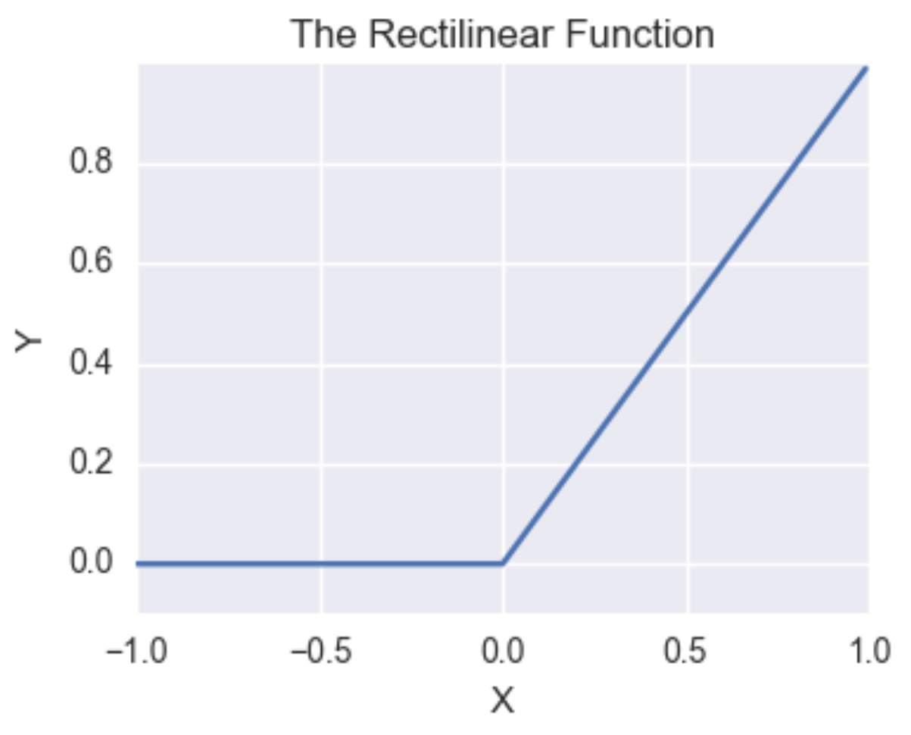

Activation functions
Rectilinear function has constant gradient for positive values
Constant gradient
Gradient of Leaky ReLU < 0

Slide 19
The Backpropagation Algorithm
To find function approximation, f(x), we need to learn model weights
The primary algorithm we use to learn model weights is known as backpropagation
Backpropagation was applied to learning (system identification) for control problems as early as 1960 by Henry Kelly and 1961 by Arthur Bryson for dynamic programming
First applied to neural networks by Paul Werbos in 1974
In 1986 by Rumelhart, Hinton and Williams showed that backpropagation was effective for learning the weights of hidden layers

Slide 20
The Backpropagation Algorithm
w¹₁₁
X₁
S₁ = σ_{h}(Σ )
w²₁
w¹₁₂
w¹₂₁
S₃ = Σ
J(W)
X₂
w²₂
w¹₂₂
S₂ = σ_{h}(Σ )
Y
_{Input Layer}
_{Hidden Layer}
_{Output Layer}
_{Loss Function}

Slide 21

The Backpropagation Algorithm
To learn model weight tensor we must minimize the loss function using the gradient:
Where:

Slide 22

The Back Propagation Algorithm
Backpropagation is a gradient decent algorithm
Weight updates are taken as small steps in the direction of the gradient of the loss function
Backpropagation converges when the gradient is approximately 0

Slide 23

Loss Functions for Training Neural Networks
What are some choices for a loss function, , given the weight tensor?
For regression problems use MSE
Which loss function should we use for classification problems?
Cross entropy is a good choice, but is a bit abstract

Slide 24

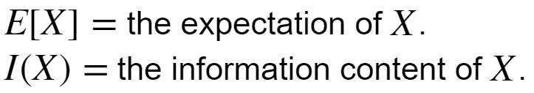
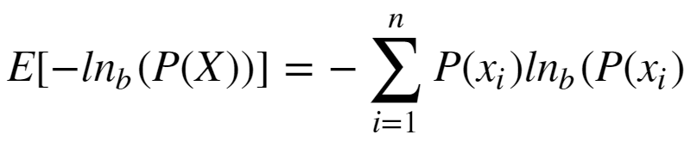
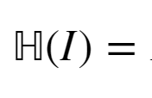
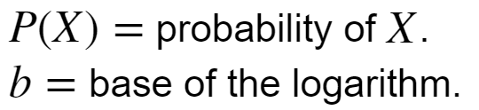
Loss Functions for Training Neural Networks
What is Shannon Entropy?
Where:
We are working with probability distributions, so:
Where:

Slide 25
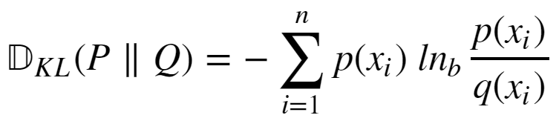
Loss Functions for Training Neural Networks
We need to measure the difference between the distribution of our function approximation and the distribution of the data
The Kullback-Leibler divergence between two distributions P(X) and Q(X) is such a measure:

Slide 26
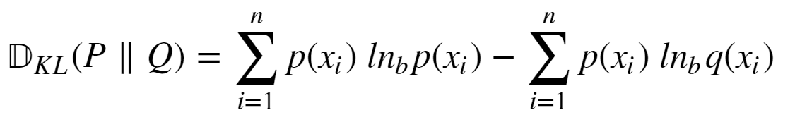
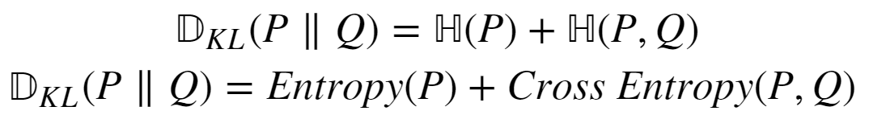
Loss Functions for Training Neural Networks
How do we compute KL divergence?
If we knew P(X) we would not need to compute KL divergence
We can expand KL divergence as:

Slide 27


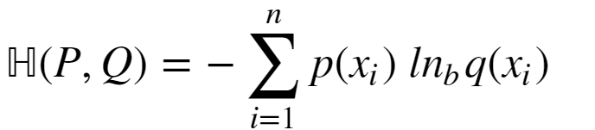
Loss Functions for Training Neural Networks
Given:
The term is constant
So, we only need the cross entropy term:

Slide 28
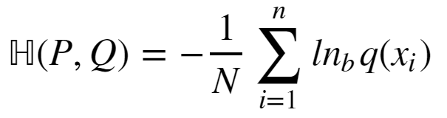
Loss Functions for Training Neural Networks
How can we compute cross entropy when we don’t know P(X):
Since we don’t know P(X), use the approximation:

Slide 29
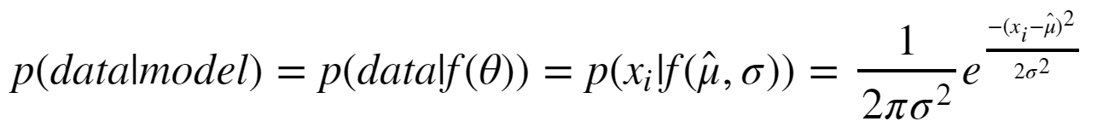
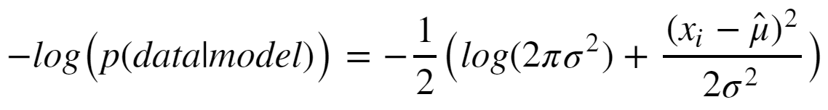
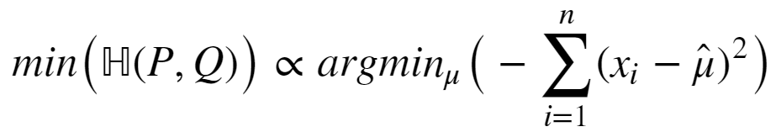
Loss Functions for Training Neural Networks
Consider the special case of Gaussian likelihood:
Taking the negative logarithm:
Ignoring the constant terms, the minimum of cross entropy is:

Slide 30
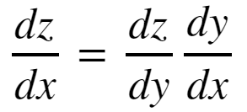
The Chain Rule of Calculus
In order to compute the gradients of the loss function though the layers of a deep neural network we need to apply the chain rule of calculus
To consider a function z = f(y), where y = g(x); then z = f(g(x)). Then the derivative of z with respect to x is:

Slide 31
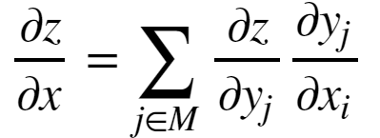
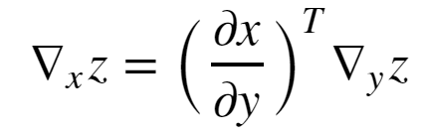


The Chain Rule of Calculus
We need the gradient of real-valued loss function, J, given a M dimensional weight tensor, W
This leads to the general form of the chain rule:
Or,
Where, = is the nxm Jacobian matrix of partial derivatives
= the gradient of z with respect to y

Slide 32
Example: Computing a Gradient
w¹₁₁
X₁
S₁ = σ_{h}(Σ )
w²₁
w¹₁₂
w¹₂₁
S₃ = Σ
J(W)
X₂
w²₂
w¹₂₂
S₂ = σ_{h}(Σ )
Y
_{Input Layer}
_{Hidden Layer}
_{Output Layer}
_{Loss Function}

Slide 33
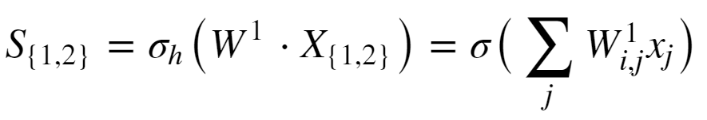
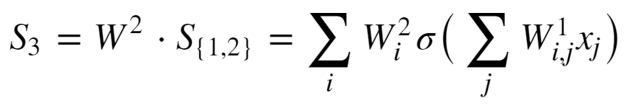
Example: Computing a Gradient
Start with forward propagation relationships
The output of the hidden units are computed as:
The output unit relation is:

Slide 34
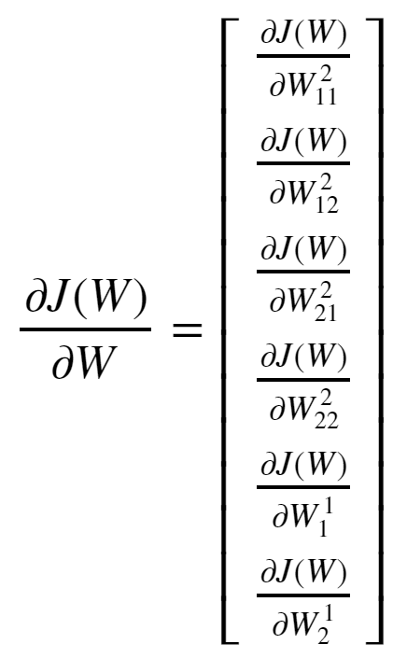
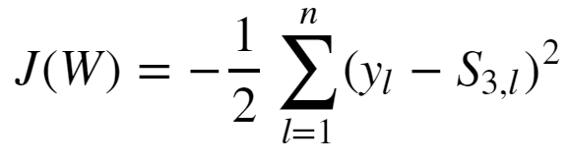
Example: Computing a Gradient
Goal is to compute the gradient:
The loss function is:

Slide 35
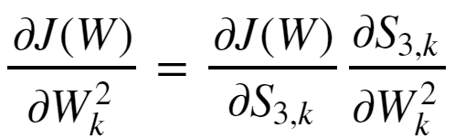
Example: Computing a Gradient
Start with the easier case of the gradient with respect to the output tensor.
Applying the chain rule yields:

Slide 36
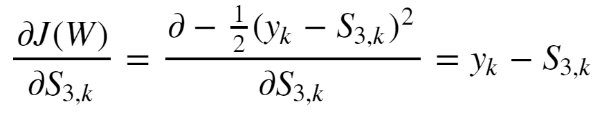
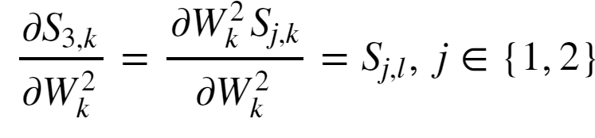
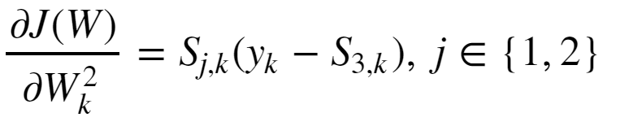
Example: Computing a Gradient
The first partial derivative is:
The second partial derivative is:
And the gradient with respect to the output tensor is then:

Slide 37
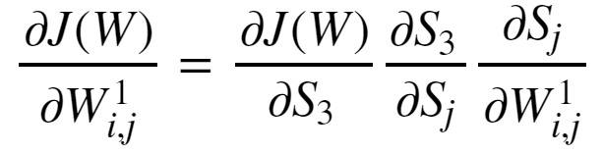
Example: Computing a Gradient
The gradient with respect to the input tensor is a bit more complicated
Apply the chain rule twice to get:

Slide 38
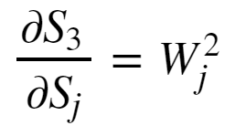
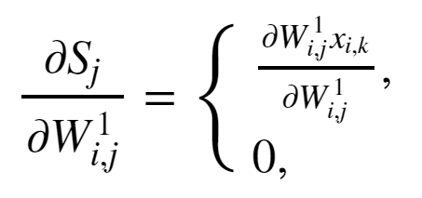
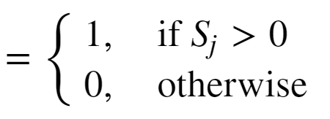
Example: Computing a Gradient
The output layer has linear activation so the left most partial derivative is just 1.
The middle partial derivative :
The right most partial derivative, given ReLU activation:

Slide 39
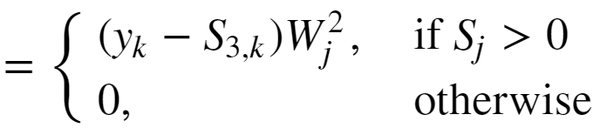
Example: Computing a Gradient
The gradient with respect to the input weights is then:

Slide 40
Efficient Computation for Deep Networks
b²
σ_{ο}
Y
W²
+
U⁵
b¹
U⁴
W¹
dot
σ_{h}
U³
+
U²
Mat
Mult
U¹
X

Slide 41
Example: Computing a Gradient
U⁹
U¹⁰
J
U⁷
sum
+
mult
+
U⁵
λ
sqr
U⁶
sum
U⁸
sqr
J_{MLE}
W¹
W²
Y_{est}
Cross-
entropy
dot
σ_{ο}
U⁴
σ_{h}
Mat
Mult
U¹
U³
Y
X

Slide 42
Performance Metrics for Deep NNs
How can we measure the performance of deep neural networks?
Use the same metrics used for other machine learning algorithms
RMSE, R^2, etc for regression
Accuracy, precision, recall, etc. for classification

