Slide 1

CSCI E-25 Computer Vision
Convolution and Image Filtering
Steve Elston
Copyright 2022, 2023 Stephen F Elston. All rights reserved.

Slide 2
Image Filtering
Almost all computer vision pipelines require filtering
Without good image data preparation even the most state of the art CV algorithms will not produce good results
Classical filters apply the mathematical operation of convolution
Noise suppression
Edge and corner enhancement
Anti-aliasing
We can understand the effects of filtering through spectral analysis
Filter changes power spectrum of image
Typical filters reduce high-frequency energy – noise
Higher frequency components include sharp edges and corners – typically blurred by filtering

Slide 3
Image Filtering
Key points for this lesson
How convolution works in 1-d, 2-d and higher dimension
How to apply padding, stride and tiling for convolution
Constructing convolutional filter kernels
The Fourier transform and frequency components of images
The relationship between filtering and the spectrum of images

Slide 4
Convolution

Slide 5
Convolution
Convolution operations are a computationally efficient method of applying filters
Convolutional kernel weights determine characteristics of filters
Filtering noise
Creating and enhancing features
Convolutional filtering computationally efficient
High volume applications
Real-time CV

Slide 6
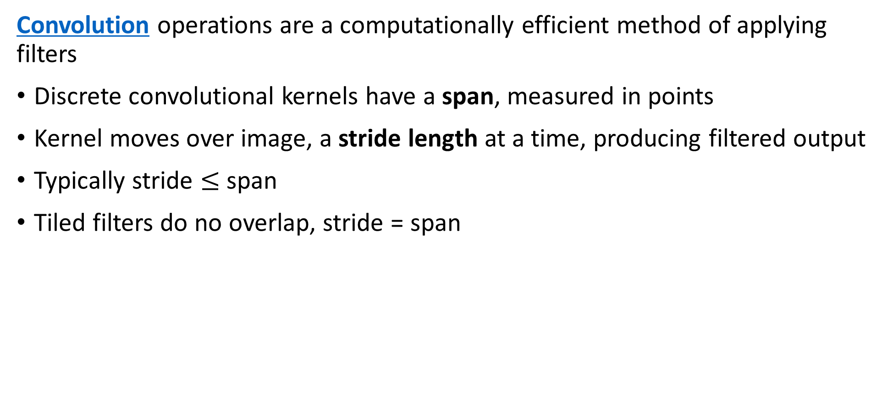
Convolution
Convolution operations are a computationally efficient method of applying filters
Discrete convolutional kernels have a span, measured in points
Kernel moves over image, a stride length at a time, producing filtered output
Typically stride $≤$ span
Tiled filters do no overlap, stride = span

Slide 7
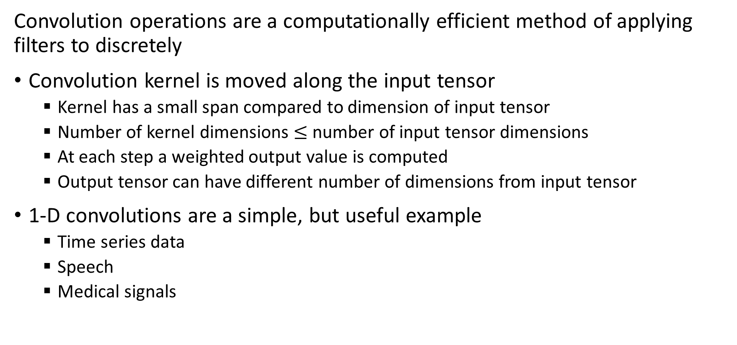
Convolution
Convolution operations are a computationally efficient method of applying filters to discretely
Convolution kernel is moved along the input tensor
Kernel has a small span compared to dimension of input tensor
Number of kernel dimensions $≤$ number of input tensor dimensions
At each step a weighted output value is computed
Output tensor can have different number of dimensions from input tensor
1-D convolutions are a simple, but useful example
Time series data
Speech
Medical signals

Slide 8
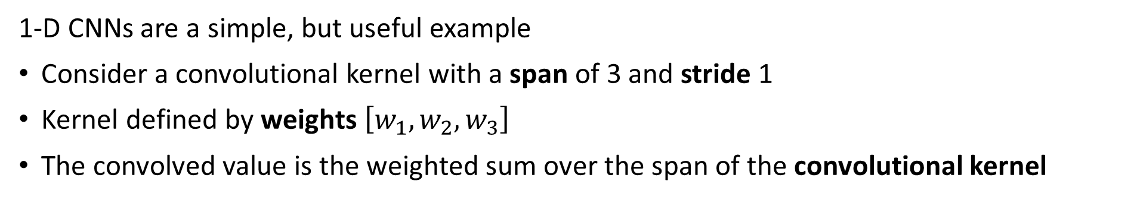
1-D Convolution
1-D CNNs are a simple, but useful example
Consider a convolutional kernel with a span of 3 and stride 1
Kernel defined by weights $\left[w_{1},w_{2},w_{3}\right]$
The convolved value is the weighted sum over the span of the convolutional kernel
t = 3
W₁
W₂
W₃
Kernel Span
or
Receptive Field

Slide 9
1-D Convolution
1-D CNNs are a simple, but useful example
Move kernel by stride 1
The convolutional kernel moves one sample per step
t = 4
W₁
W₂
W₃
Kernel Span
or
Receptive Field

Slide 10
1-D Convolution
1-D CNNs are a simple, but useful example
Continue to produce one output value per time step
t = 5
W₁
W₃
W₂
Kernel Span
or
Receptive Field

Slide 11
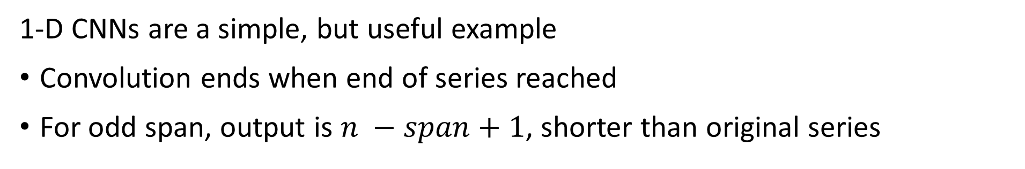
1-D Convolution
1-D CNNs are a simple, but useful example
Convolution ends when end of series reached
For odd span, output is $n −span+1$, shorter than original series
t = n
W₁
W₃
W₂
Kernel Span
or
Receptive Field

Slide 12
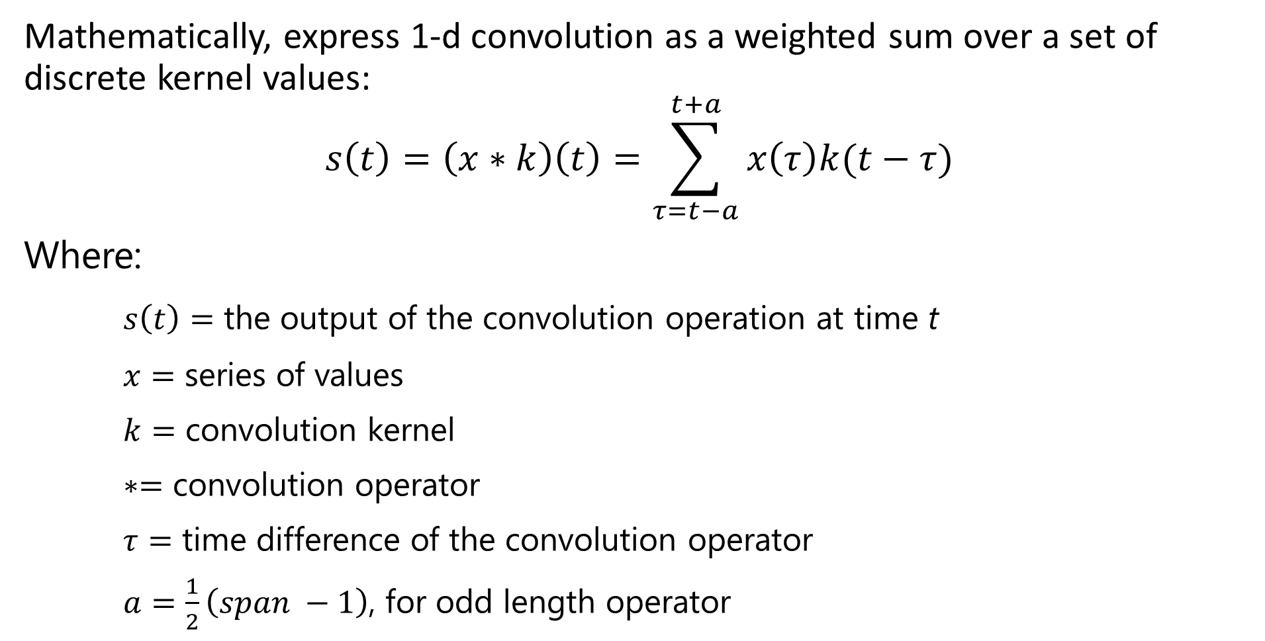
1-D Convolution
Mathematically, express 1-d convolution as a weighted sum over a set of discrete kernel values:
$$s\left(t\right)=\left(x∗k\right)\left(t\right)=\sum_{τ=t−a}^{t+a}{x\left(τ\right)k(t−τ)}$$
Where:
$s\left(t\right)=$ the output of the convolution operation at time t
$x=$ series of values
$k=$ convolution kernel
$∗=$ convolution operator
$τ=$ time difference of the convolution operator
$a=\frac{1}{2}\left(span −1\right)$, for odd length operator

Slide 13
2-D Convolution
4 x 4 input tensor
3 x 3 convolution operator
2 x 2 output tensor
Input
Output

Slide 14
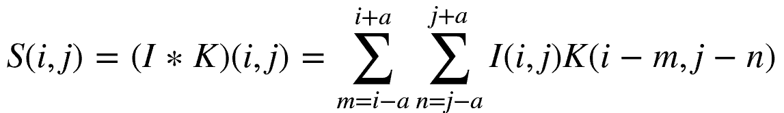
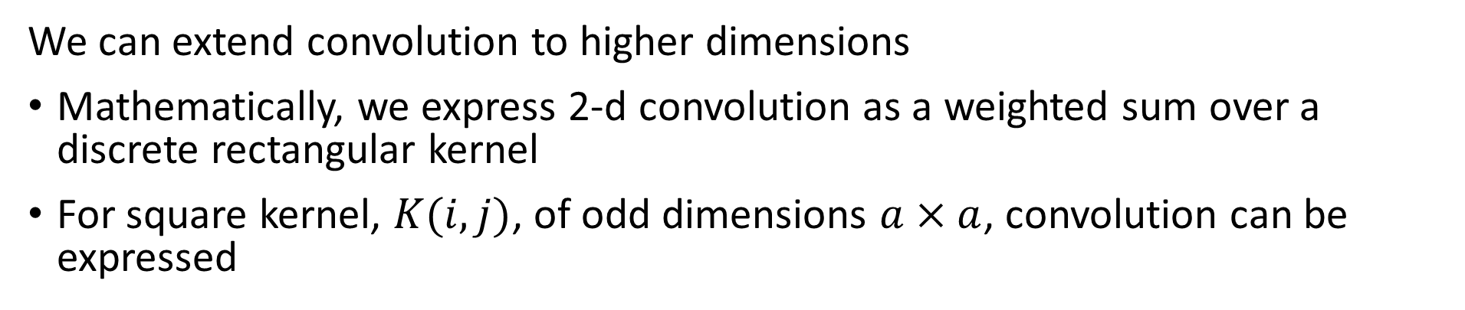
2-D Convolution
We can extend convolution to higher dimensions
Mathematically, we express 2-d convolution as a weighted sum over a discrete rectangular kernel
For square kernel, $K(i,j)$, of odd dimensions $a×a$, convolution can be expressed
Where S, I and K are now 2-dimensional tensors

Slide 15
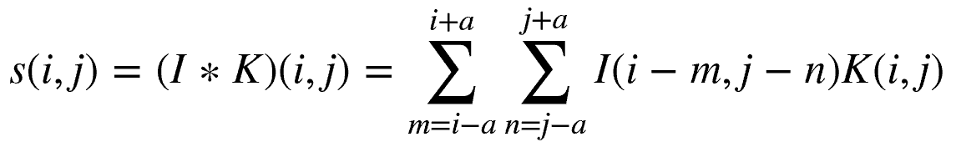
2-D Convolution
How can we extend convolution to higher dimensions
The image and kernel tensors are commutative in the convolution relationship
This allows an operation known as kernel flipping with the following alternative result:

Slide 16
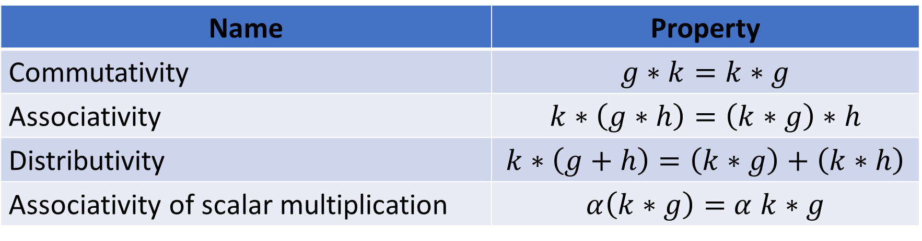
Algebraic Properties of Convolution
Convolution operations have useful algebraic properties
Notice that these properties are identical to the familiar algebraic properties of multiplication
Name | Property
Commutativity | $$g∗k=k∗g$$
Associativity | $$k∗\left(g∗h\right)=\left(k∗g\right)∗h$$
Distributivity | $$k∗\left(g+h\right)=\left(k∗g\right)+\left(k∗h\right)$$
Associativity of scalar multiplication | $α\left(k∗g\right)=$ $α$ $k∗g$

Slide 17
Stride, Tiling and Padding for Convolution

Slide 18
Stride and Tiling
Do we always move the convolution kernel by 1 data value?
No!
May not need the full resolution of the input
Or, change the dimension of the input tensor
Stride > 1 down-samples the data
Output of lower resolution
Stride < 1 up-samples the data
Output of higher resolution
Stride can be fractional to create the required output dimension

Slide 19
Stride and Tiling
Tiling is a special case when stride = span:
Stride
Stride
Input
Output
Stride >1 reduces dimensionality

Slide 20
Padding for Convolution
How can we best deal with edges of the input tensor when performing convolution?
A valid convolution confines the kernel to the input tensor dimensions
For odd kernel shape, output dimension is (span + 1)/2 less than input dimension
After many convolution layers, dimension is reduced further
We can zero pad the input tensor
Dimensionality is maintained

Slide 21
Padding for Convolution
Example: 4x4 input tensor with 3x3 kernel
0
0
0
0
0
0
Convolution
Operations
0
0
0
0
0
0
0
0
0
0
0
0
0
0
Input
Output
Dimension of output tensor = dimension of input tensor
0 values have little effect with max pooling

Slide 22
Commonly Used Convolution Kernels

Slide 23
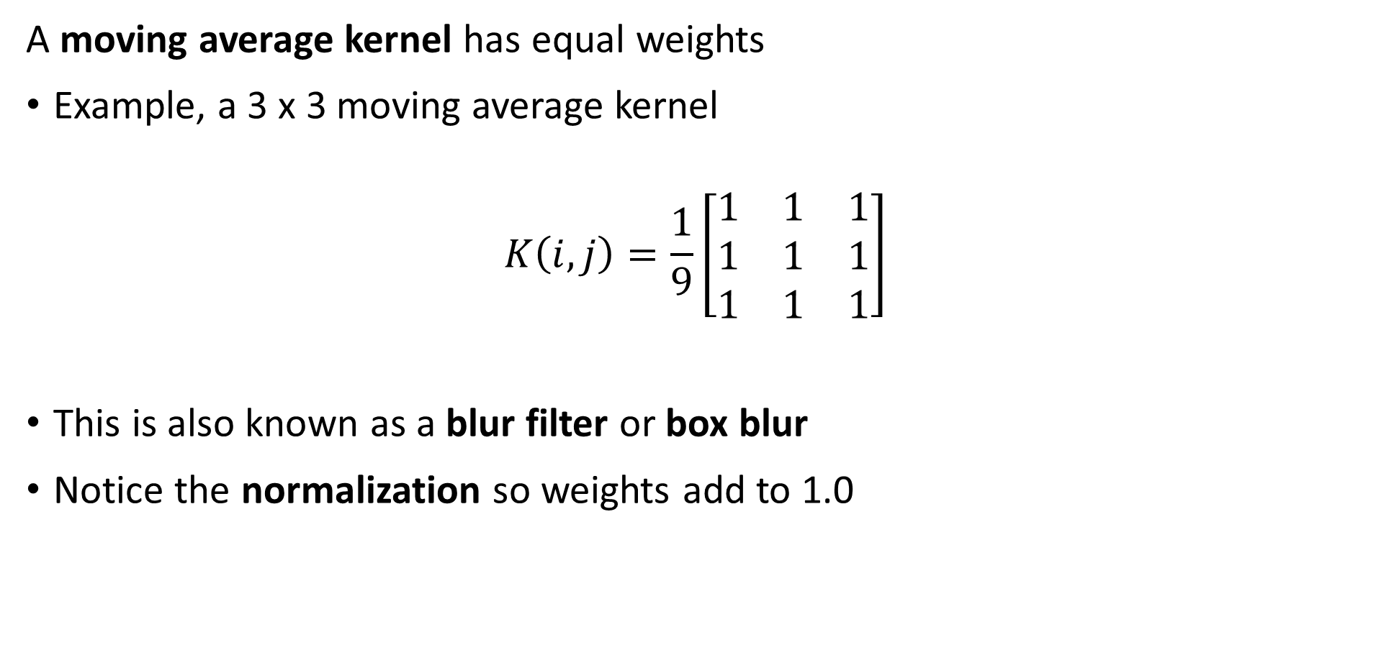
Common Convolution Kernels
A moving average kernel has equal weights
Example, a 3 x 3 moving average kernel
$$K\left(i,j\right)=\frac{1}{9}\left[\begin{matrix}1 & 1 & 1 \\ 1 & 1 & 1 \\ 1 & 1 & 1\end{matrix}\right]$$
This is also known as a blur filter or box blur
Notice the normalization so weights add to 1.0

Slide 24
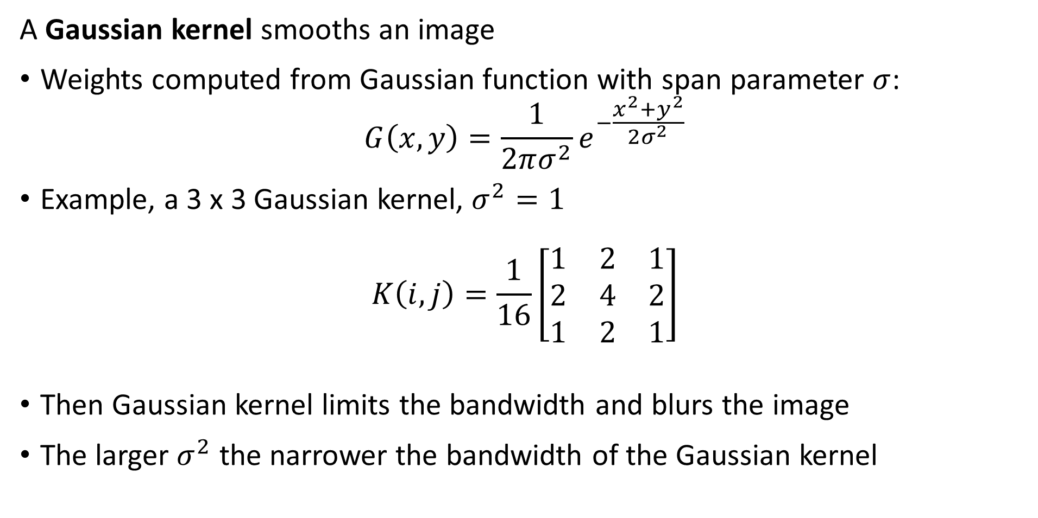
Common Convolution Kernels
A Gaussian kernel smooths an image
Weights computed from Gaussian function with span parameter $σ$:
$$G\left(x,y\right)=\frac{1}{2πσ^{2}}e^{−\frac{x^{2}+y^{2}}{2σ^{2}}}$$
Example, a 3 x 3 Gaussian kernel, $σ^{2}=1$
$$K\left(i,j\right)=\frac{1}{16}\left[\begin{matrix}1 & 2 & 1 \\ 2 & 4 & 2 \\ 1 & 2 & 1\end{matrix}\right]$$
Then Gaussian kernel limits the bandwidth and blurs the image
The larger $σ^{2}$ the narrower the bandwidth of the Gaussian kernel

Slide 25
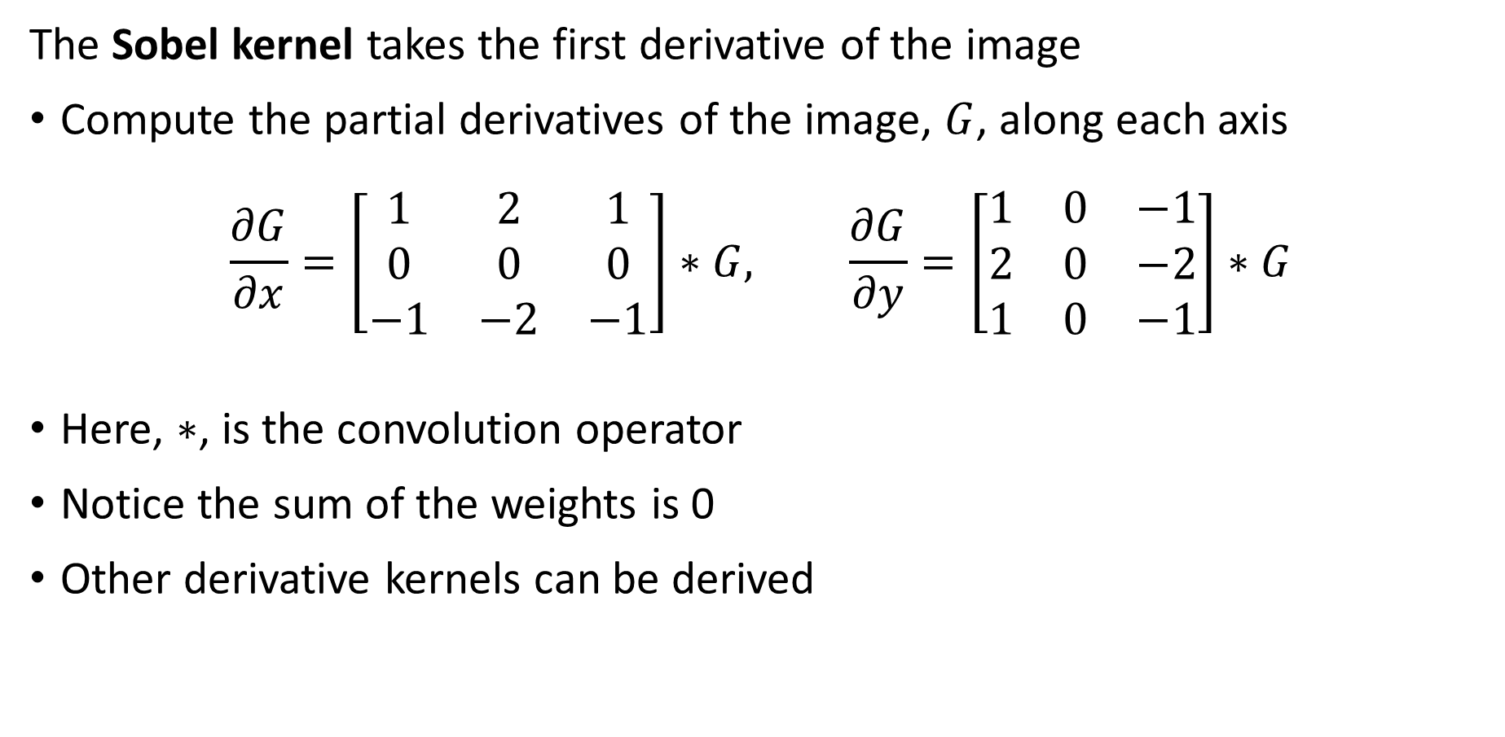
Common Convolution Kernels
The Sobel kernel takes the first derivative of the image
Compute the partial derivatives of the image, $G$, along each axis
$$\frac{∂G}{∂x}=\left[\begin{matrix}1 & 2 & 1 \\ 0 & 0 & 0 \\ −1 & −2 & −1\end{matrix}\right]∗G, \frac{∂G}{∂y}=\left[\begin{matrix}1 & 0 & −1 \\ 2 & 0 & −2 \\ 1 & 0 & −1\end{matrix}\right]∗G$$
Here, $∗$, is the convolution operator
Notice the sum of the weights is 0
Other derivative kernels can be derived

Slide 26
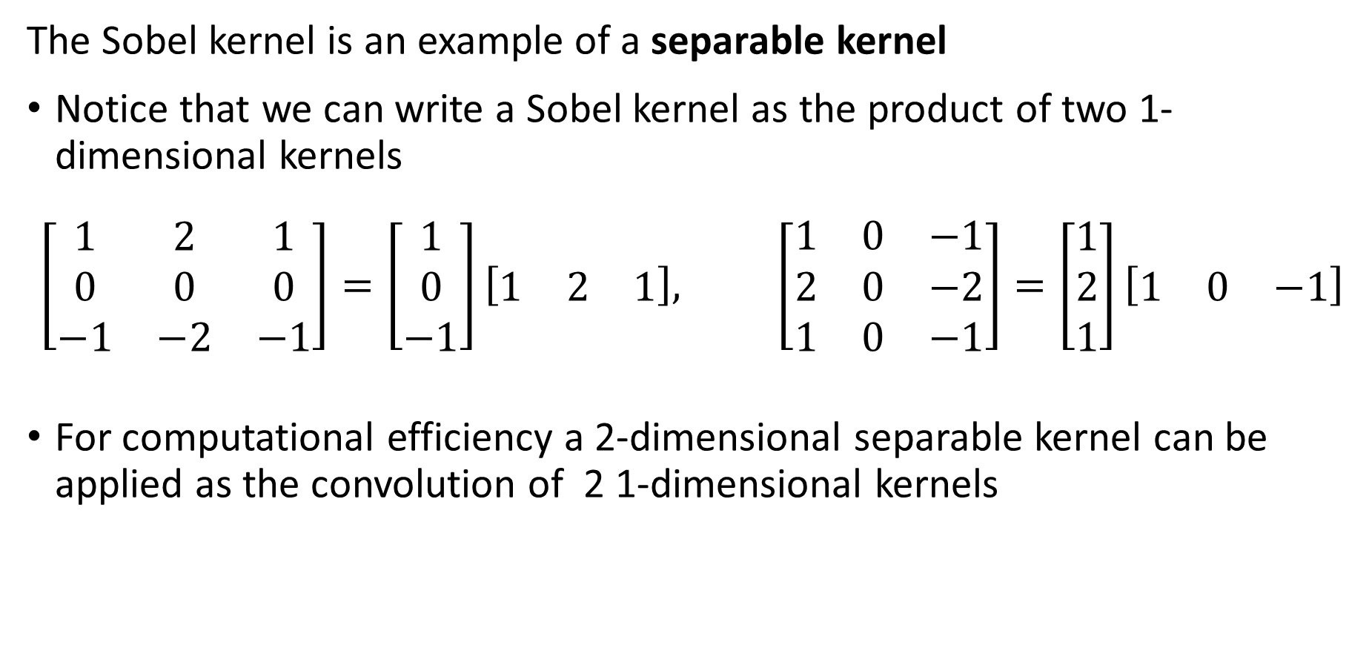
Common Convolution Kernels
The Sobel kernel is an example of a separable kernel
Notice that we can write a Sobel kernel as the product of two 1-dimensional kernels
$$\left[\begin{matrix}1 & 2 & 1 \\ 0 & 0 & 0 \\ −1 & −2 & −1\end{matrix}\right]=\left[\begin{matrix}1 \\ 0 \\ −1\end{matrix}\right]\left[\begin{matrix}1 & 2 & 1\end{matrix}\right], \left[\begin{matrix}1 & 0 & −1 \\ 2 & 0 & −2 \\ 1 & 0 & −1\end{matrix}\right]=\left[\begin{matrix}1 \\ 2 \\ 1\end{matrix}\right]\left[\begin{matrix}1 & 0 & −1\end{matrix}\right]$$
For computational efficiency a 2-dimensional separable kernel can be applied as the convolution of 2 1-dimensional kernels

Slide 27
Median Filter
Median filter is a special case
Median filter outputs median value of the pixel values within patch
Typically use odd patch sizes – e.g., 3 x 3, 5 x 5, 7 x 7
Median filter is not easily formulated using convolution
Use an incremental update algorithm for computational efficiency
Median filter has interesting properties
Suppresses noise
Sharpens edges and corners
Median filter can alter image
Response is not isotropic – not same along diagonals of image
Can move edges and corners

Slide 28
Filtering and Spectral Properties of Images

Slide 29
Spectral Properties of Images
The power spectrum of an image reveals fundamental properties
Power spectrum reveals the vertical and horizontal frequency components of the image
Low frequency components of an image represent regions with slowly changing properties
High frequency components of an image arise from local features with rapid changes
Edges
Corners
Texture
Filtering changes the power spectrum of an image

Slide 30
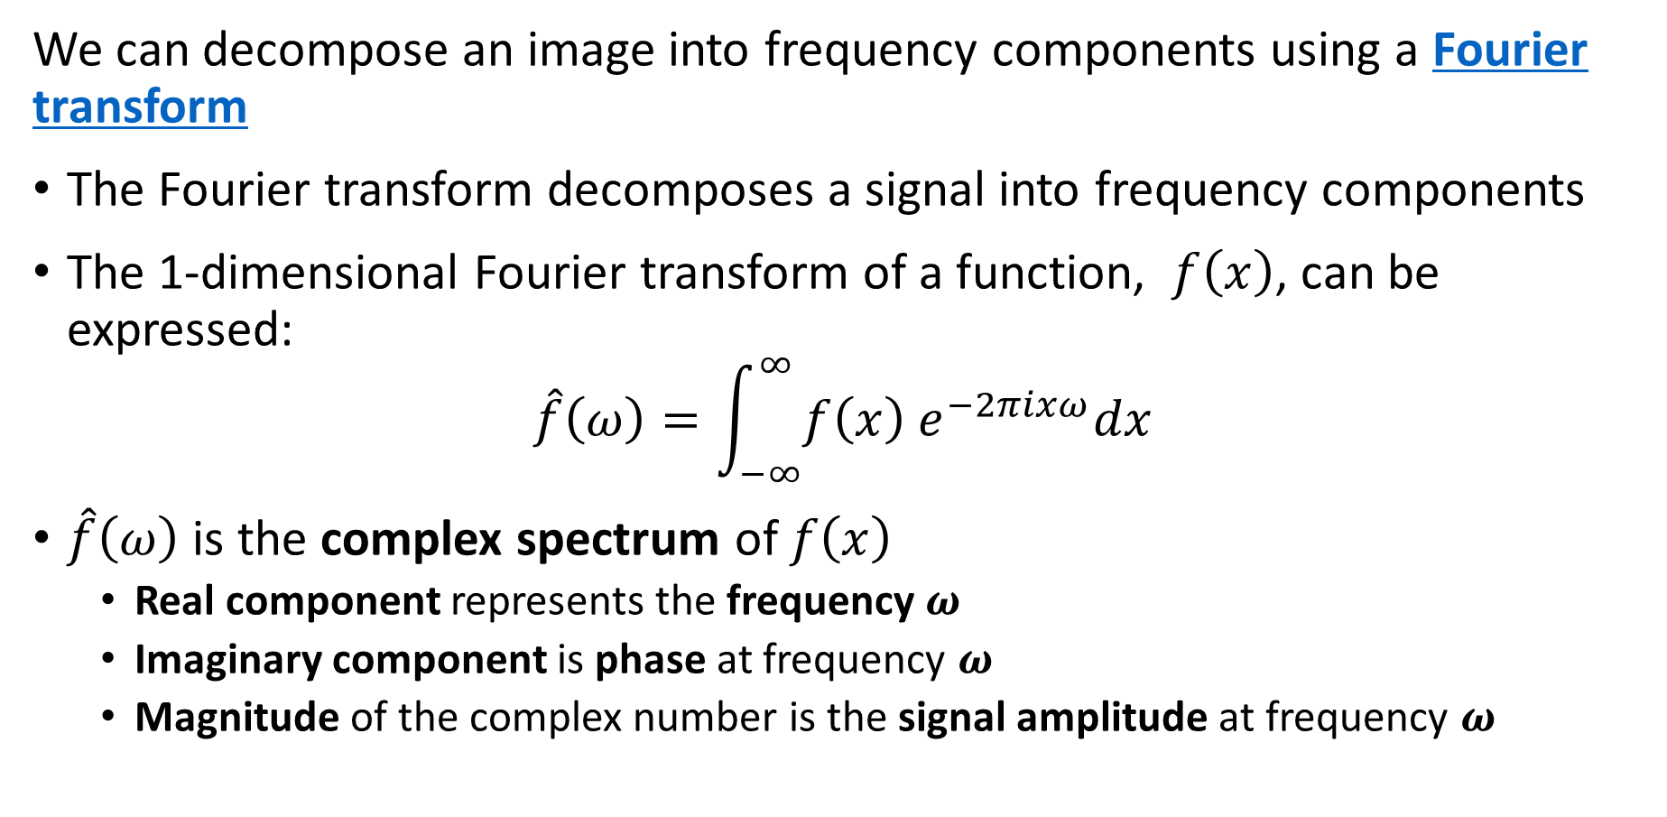
Spectral Properties of Images
We can decompose an image into frequency components using a Fourier transform
The Fourier transform decomposes a signal into frequency components
The 1-dimensional Fourier transform of a function, $f\left(x\right)$, can be expressed:
$$\hat{f}\left(ω\right)=\int_{−∞}^{∞}{f\left(x\right) e^{−2πixω}dx}$$
$\hat{f}\left(ω\right)$ is the complex spectrum of $f\left(x\right)$
Real component represents the frequency $ω$
Imaginary component is phase at frequency $ω$
Magnitude of the complex number is the signal amplitude at frequency $ω$

Slide 31
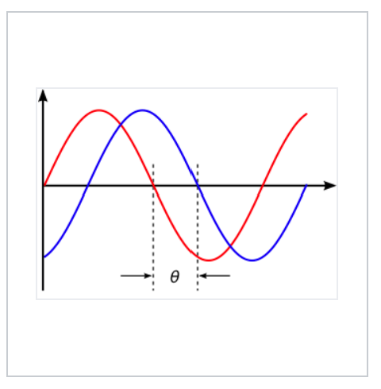
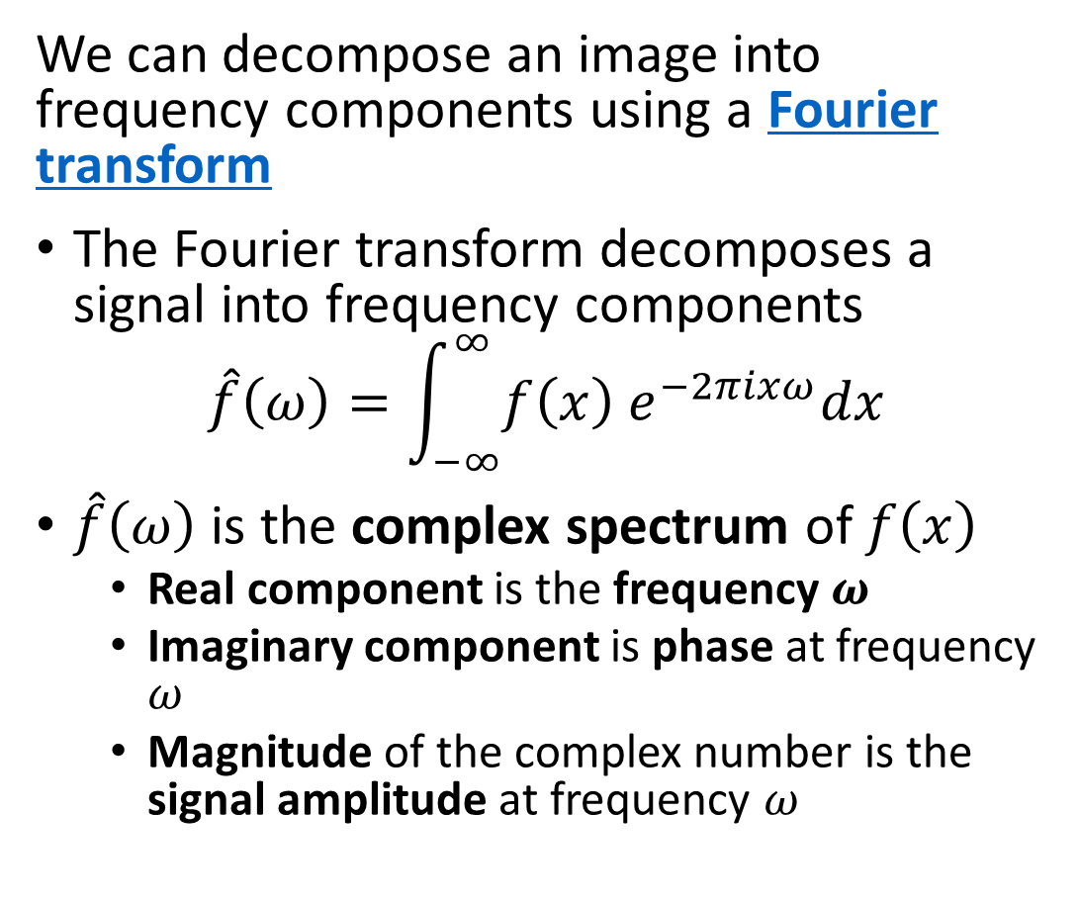
Spectral Properties of Images
We can decompose an image into frequency components using a Fourier transform
The Fourier transform decomposes a signal into frequency components
$$\hat{f}\left(ω\right)=\int_{−∞}^{∞}{f\left(x\right) e^{−2πixω}dx}$$
$\hat{f}\left(ω\right)$ is the complex spectrum of $f\left(x\right)$
Real component is the frequency $ω$
Imaginary component is phase at frequency $ω$
Magnitude of the complex number is the signal amplitude at frequency $ω$
Amplitude
Two sinusoidal signals with identical frequency and amplitude, phase shifted by θ
Credit, Wikipedia commons

Slide 32
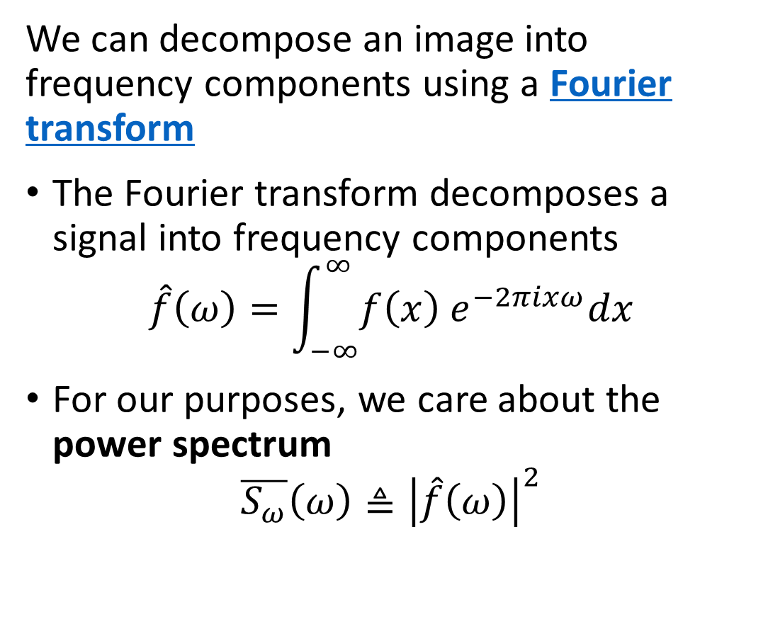
Spectral Properties of Images
We can decompose an image into frequency components using a Fourier transform
The Fourier transform decomposes a signal into frequency components
$$\hat{f}\left(ω\right)=\int_{−∞}^{∞}{f\left(x\right) e^{−2πixω}dx}$$
For our purposes, we care about the power spectrum
$$\overline{S_{ω}}\left(ω\right)≜{\left|\hat{f}\left(ω\right)\right|}^{2}$$
Amplitude
Two sinusoidal signals with identical frequency and amplitude, phase shifted by θ
Credit, Wikipedia commons

Slide 33
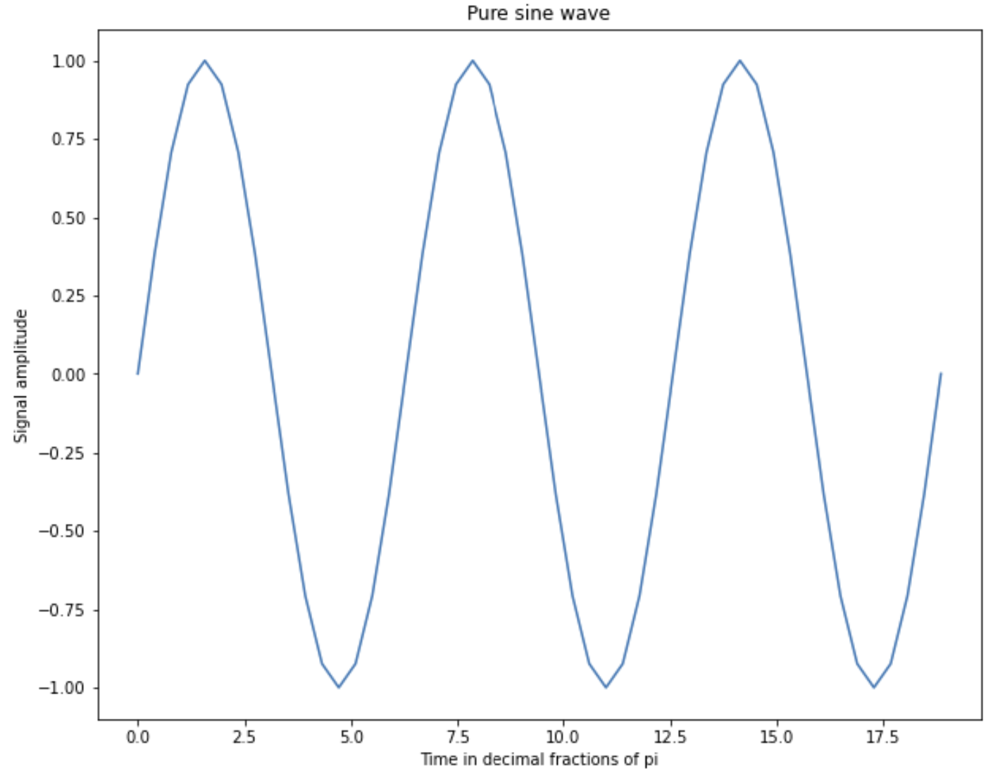
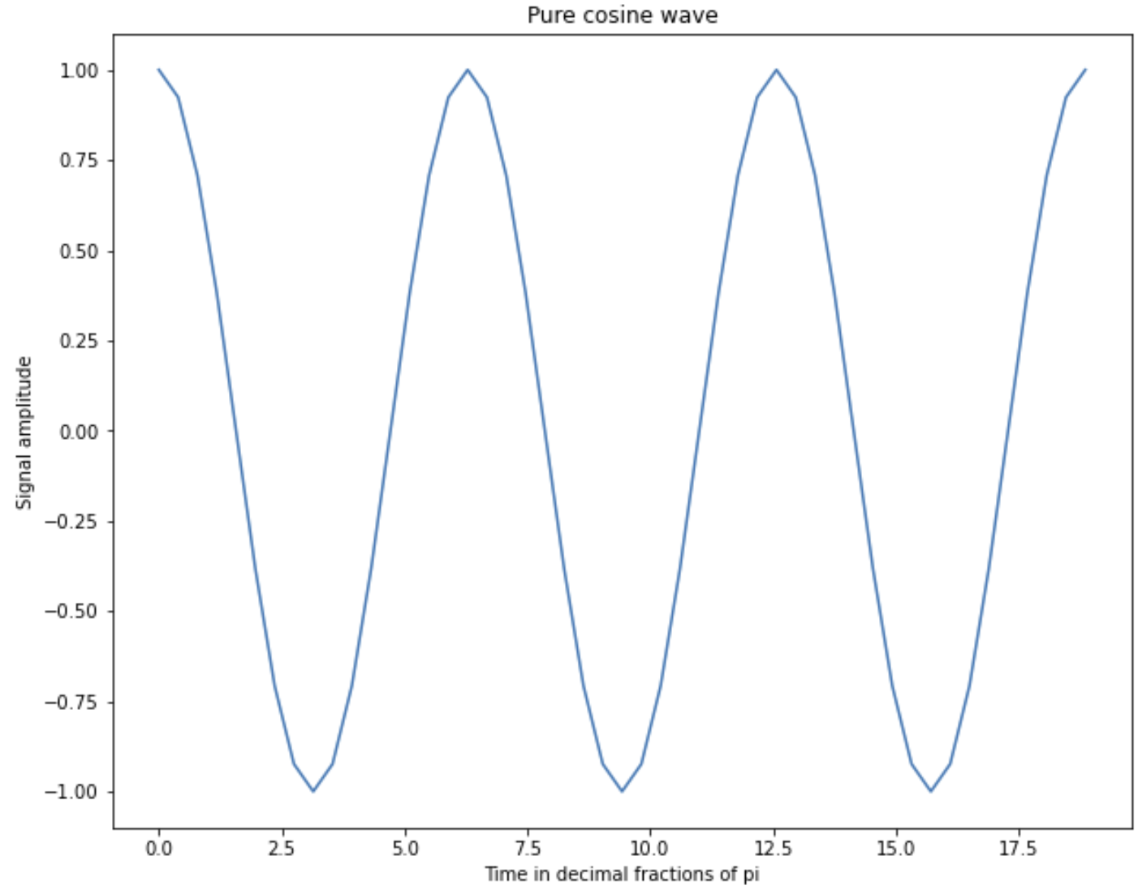
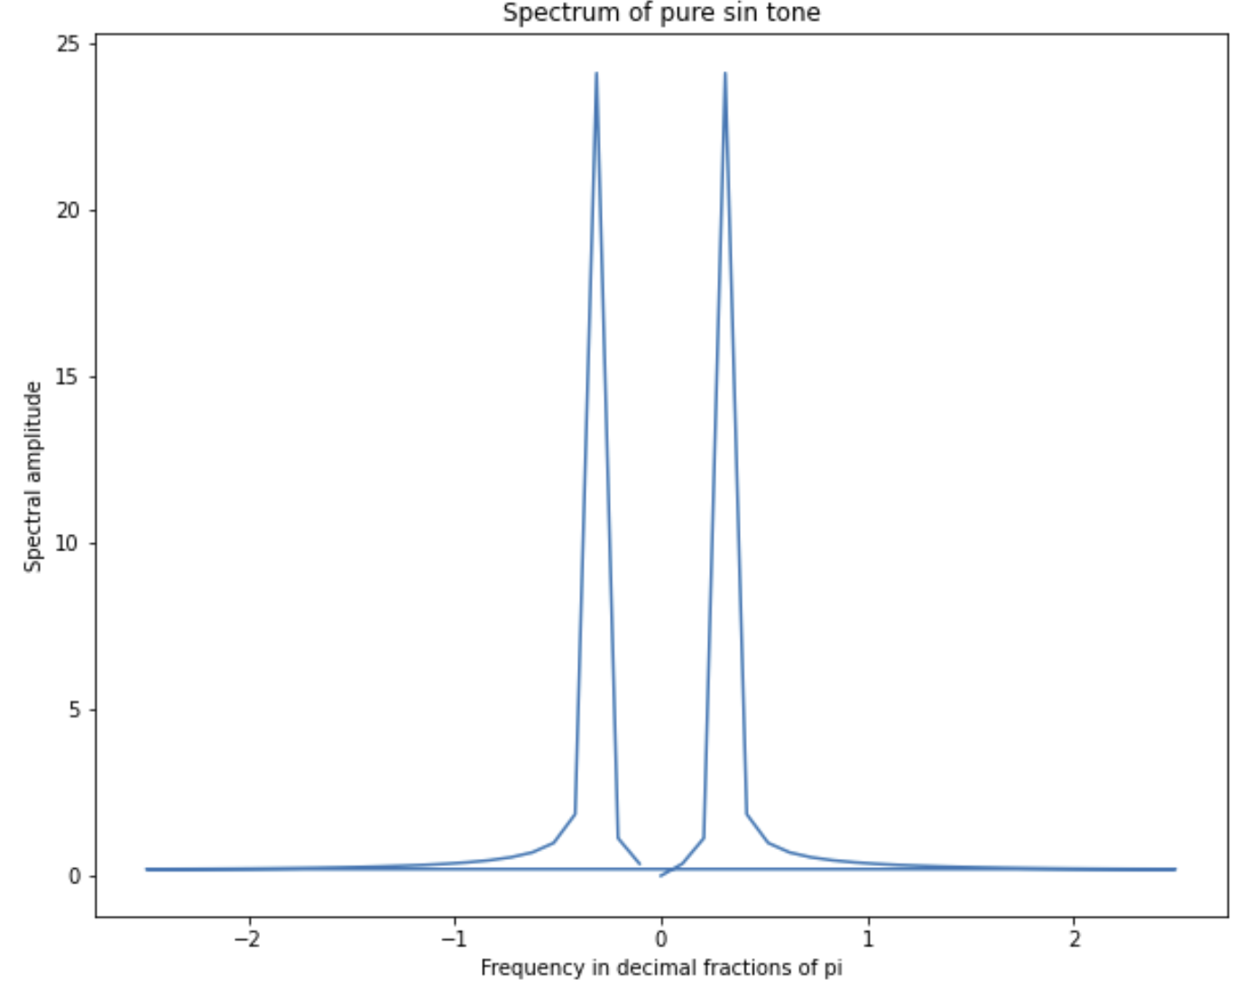
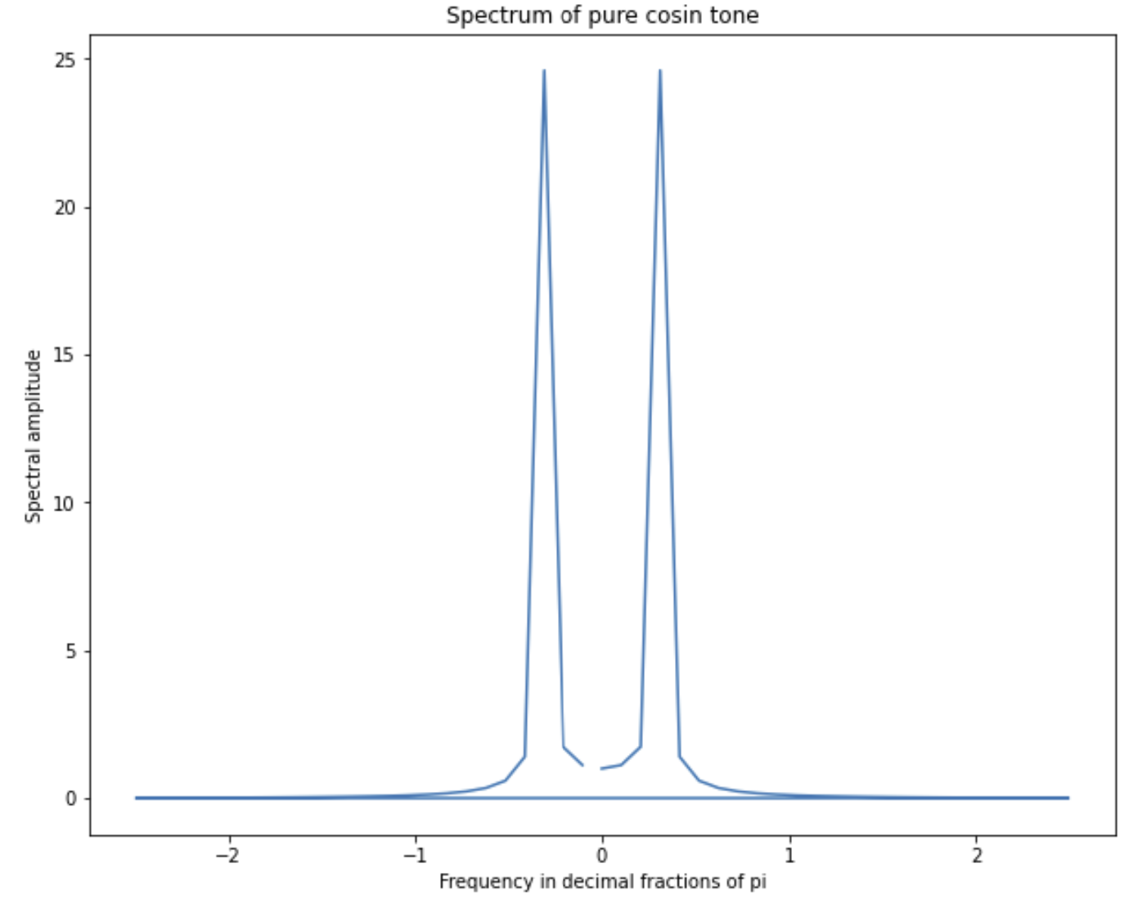
Spectral Properties of Images
Example of single frequency signals and their power spectrum

Slide 34
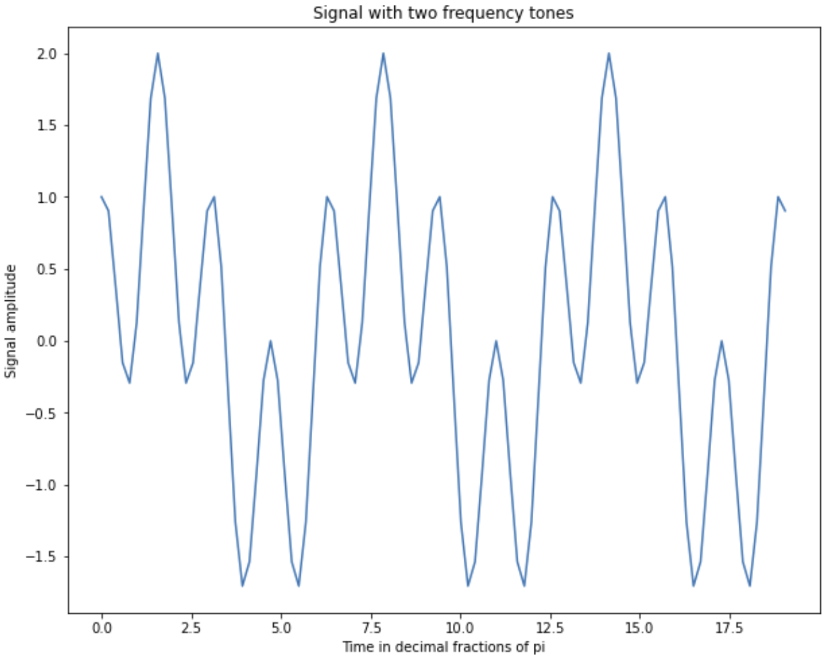
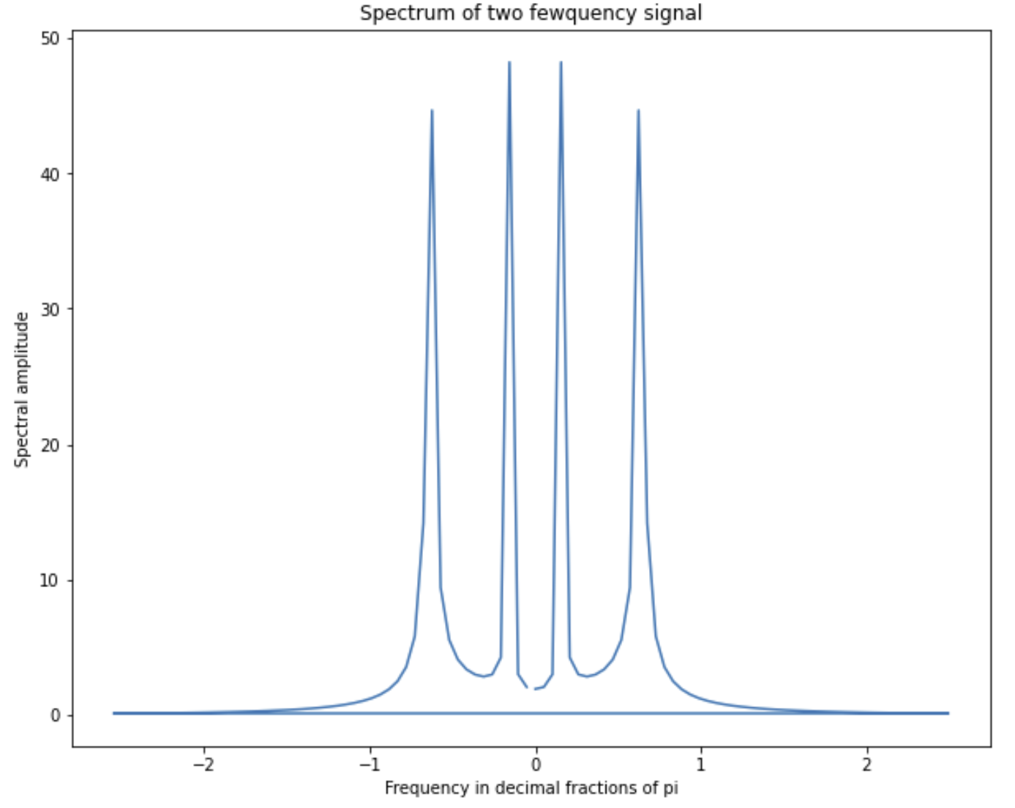
Spectral Properties of Images
Example of signal with two frequencies and the power spectrum

Slide 35
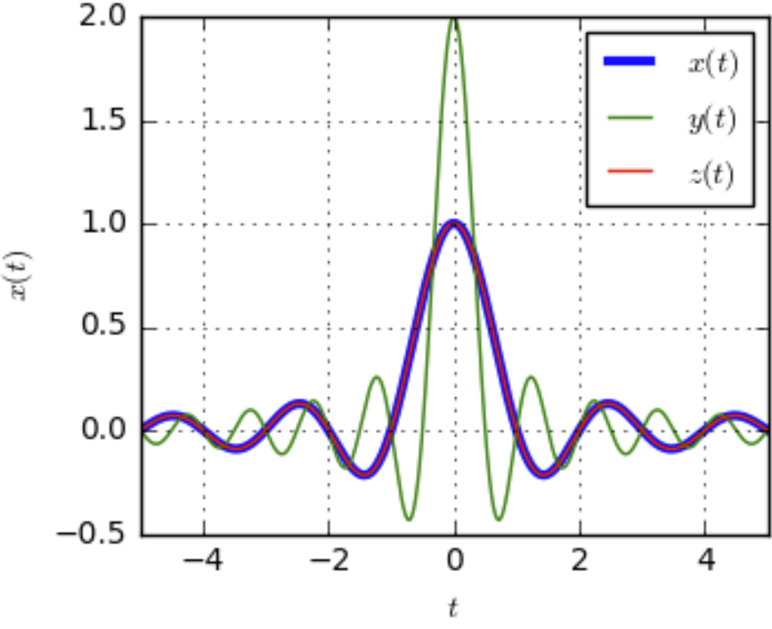
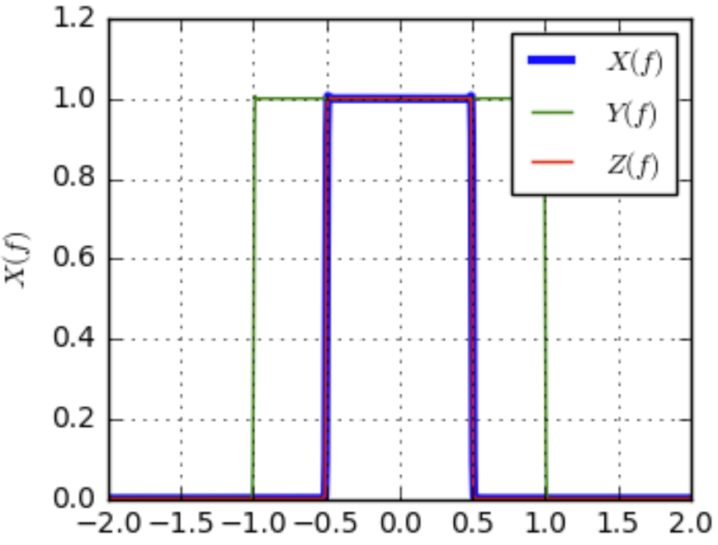
Spectral Properties of Images
Impulse response of convolutional a filter is the Fourier transform in the frequency domain
Fourier Transform
Filter in time domain
Filter in frequency domain
Credit, DSP Illustrations
Relationship is reversable (inverse Fourier transform) and commutable – exchange time and frequency domain

Slide 36
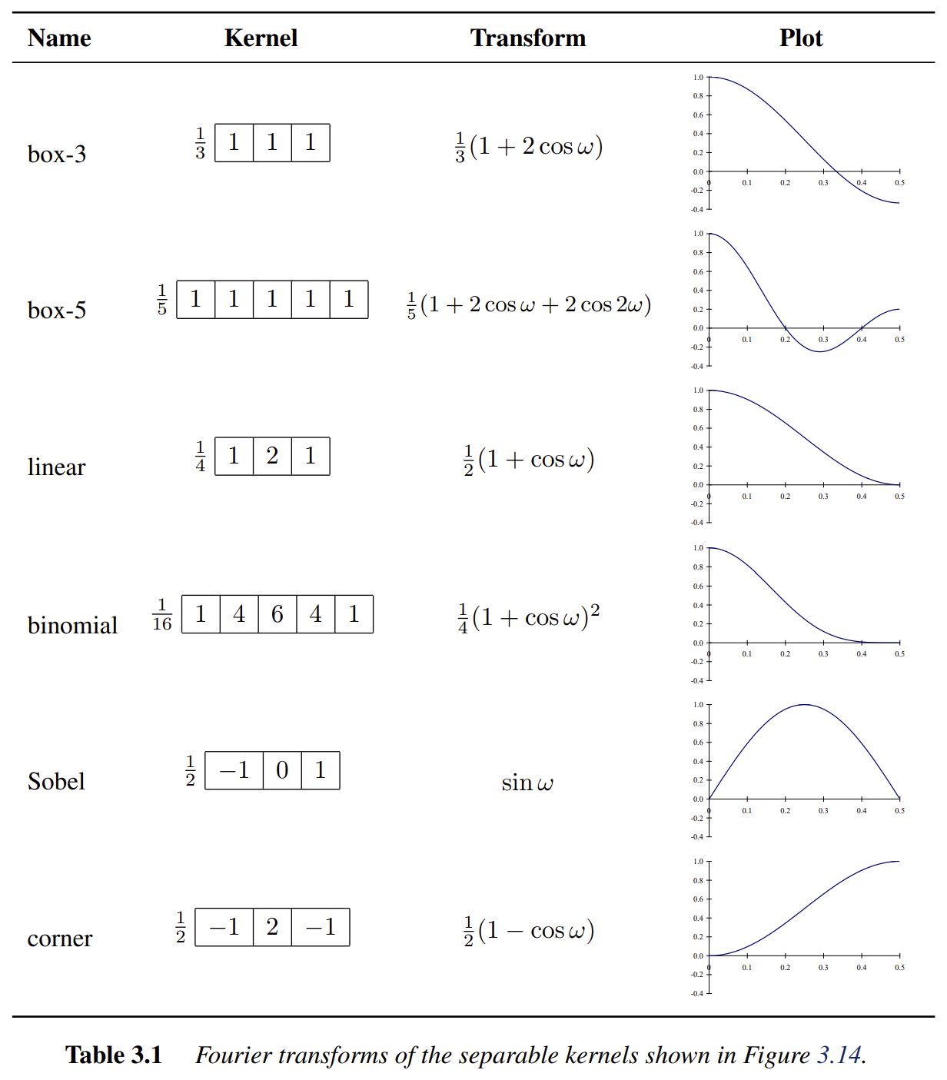
Spectral Properties of Images
Impulse response of some commonly used convolutional filters
Name of the filter
Values of the kernel operator
Analytical representation of the Fourier transform
Graph of the Fourier transform or impulse response
Credit: Szeliski, 2nd Edition

Slide 37
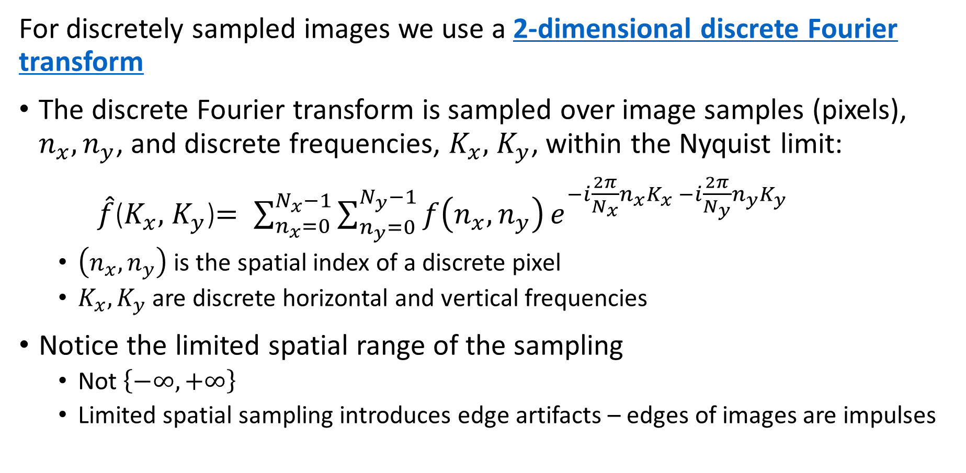
Spectral Properties of Images
For discretely sampled images we use a 2-dimensional discrete Fourier transform
The discrete Fourier transform is sampled over image samples (pixels), $n_{x},n_{y}$, and discrete frequencies, $K_{x},$ $K_{y}$, within the Nyquist limit:
$\hat{f}$($K_{x},$ $K_{y}$)$= \sum_{n_{x}=0}^{N_{x}−1}{\sum_{n_{y}=0}^{N_{y}−1}{f\left(n_{x},n_{y}\right)}}e^{−i\frac{2π}{N_{x}}n_{x}K_{x} −i\frac{2π}{N_{y}}n_{y}K_{y}}$
$\left(n_{x},n_{y}\right)$ is the spatial index of a discrete pixel
$K_{x},K_{y}$ are discrete horizontal and vertical frequencies
Notice the limited spatial range of the sampling
Not $\left\{−∞, +∞\right\}$
Limited spatial sampling introduces edge artifacts – edges of images are impulses

Slide 38
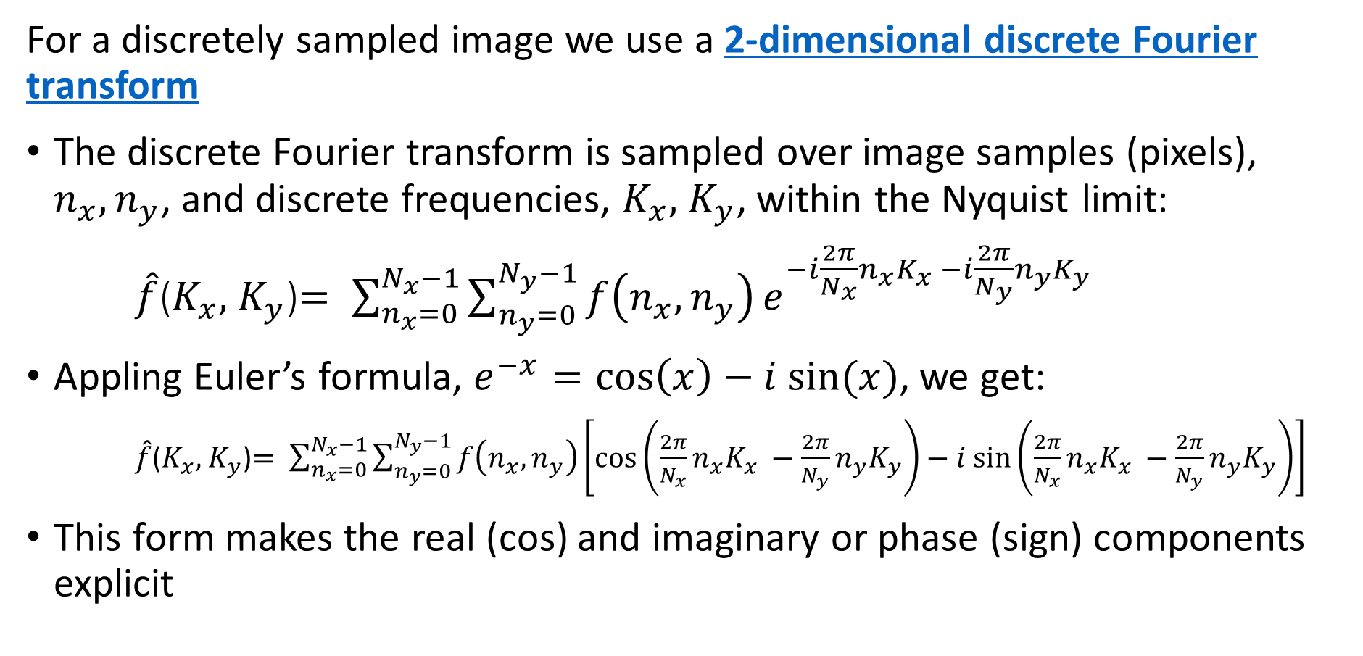
Spectral Properties of Images
For a discretely sampled image we use a 2-dimensional discrete Fourier transform
The discrete Fourier transform is sampled over image samples (pixels), $n_{x},n_{y}$, and discrete frequencies, $K_{x},$ $K_{y}$, within the Nyquist limit:
$\hat{f}$($K_{x},$ $K_{y}$)$= \sum_{n_{x}=0}^{N_{x}−1}{\sum_{n_{y}=0}^{N_{y}−1}{f\left(n_{x},n_{y}\right)}}e^{−i\frac{2π}{N_{x}}n_{x}K_{x} −i\frac{2π}{N_{y}}n_{y}K_{y}}$
Appling Euler’s formula, $e^{−x}=\cos\left(x\right)−i sin⁡(x)$, we get:
$\hat{f}$($K_{x},$ $K_{y}$)$= \sum_{n_{x}=0}^{N_{x}−1}{\sum_{n_{y}=0}^{N_{y}−1}{f\left(n_{x},n_{y}\right)}}\left[\cos\left(\frac{2π}{N_{x}}n_{x}K_{x} −\frac{2π}{N_{y}}n_{y}K_{y}\right)−i sin⁡\left(\frac{2π}{N_{x}}n_{x}K_{x} −\frac{2π}{N_{y}}n_{y}K_{y}\right)\right]$
This form makes the real (cos) and imaginary or phase (sign) components explicit

Slide 39
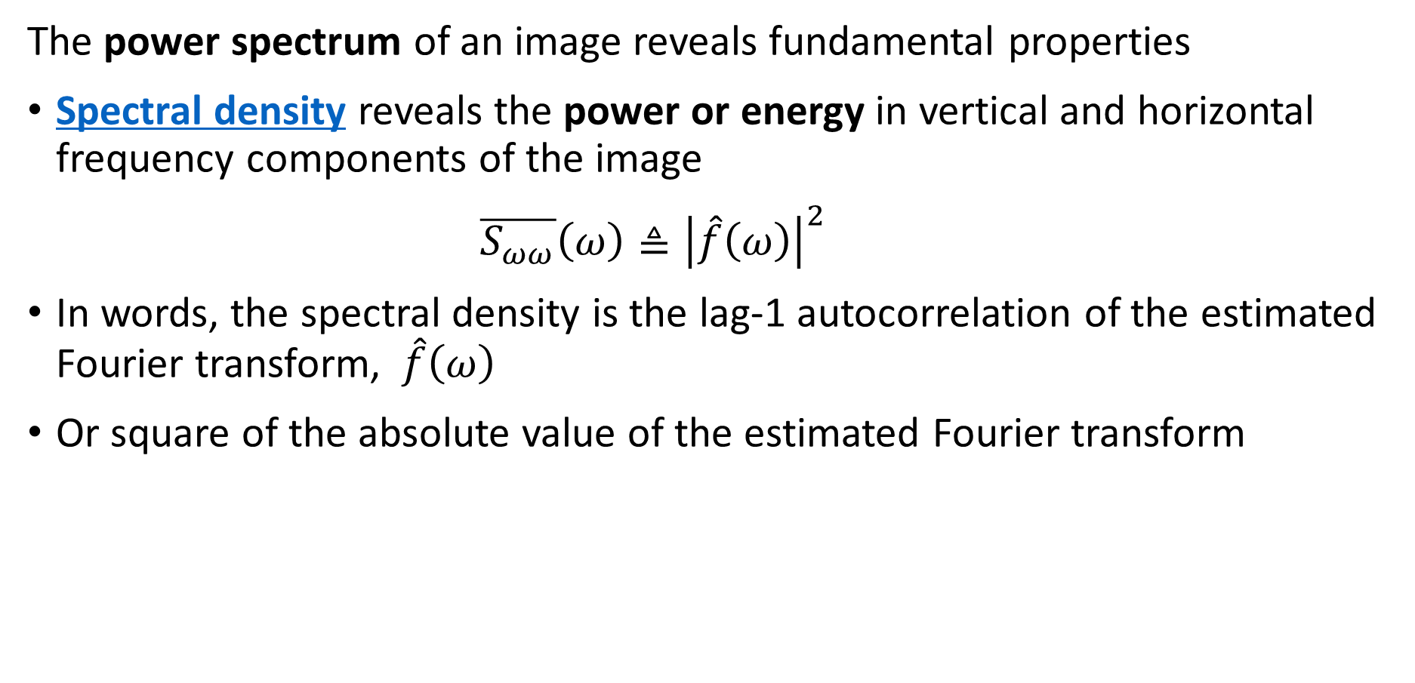
Spectral Properties of Images
The power spectrum of an image reveals fundamental properties
Spectral density reveals the power or energy in vertical and horizontal frequency components of the image
$\overline{S_{ωω}}\left(ω\right)≜{\left|\hat{f}\left(ω\right)\right|}^{2}$
In words, the spectral density is the lag-1 autocorrelation of the estimated Fourier transform, $\hat{f}\left(ω\right)$
Or square of the absolute value of the estimated Fourier transform

Slide 40
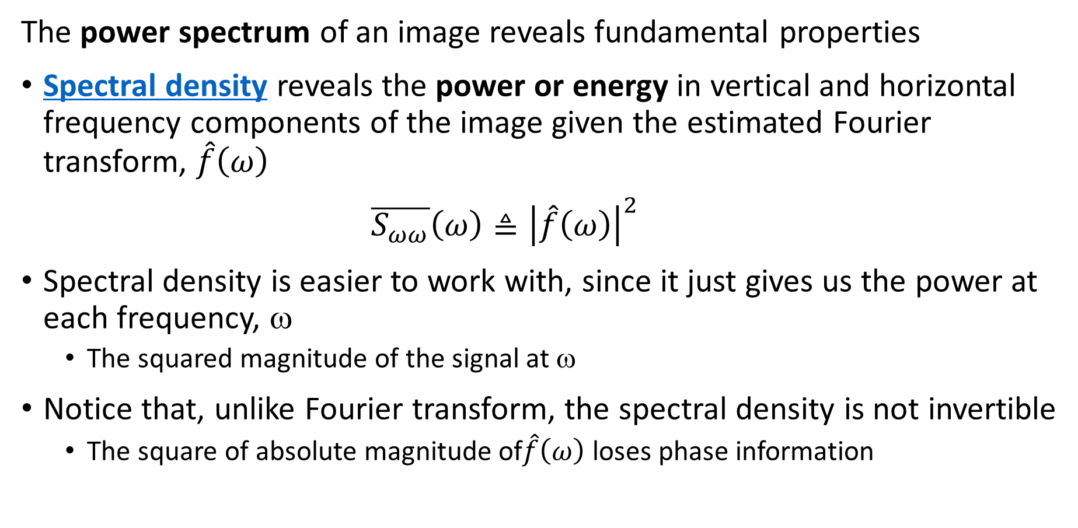
Spectral Properties of Images
The power spectrum of an image reveals fundamental properties
Spectral density reveals the power or energy in vertical and horizontal frequency components of the image given the estimated Fourier transform, $\hat{f}\left(ω\right)$
$\overline{S_{ωω}}\left(ω\right)≜{\left|\hat{f}\left(ω\right)\right|}^{2}$
Spectral density is easier to work with, since it just gives us the power at each frequency, ω
The squared magnitude of the signal at ω
Notice that, unlike Fourier transform, the spectral density is not invertible
The square of absolute magnitude of$\hat{f}\left(ω\right)$ loses phase information

Slide 41
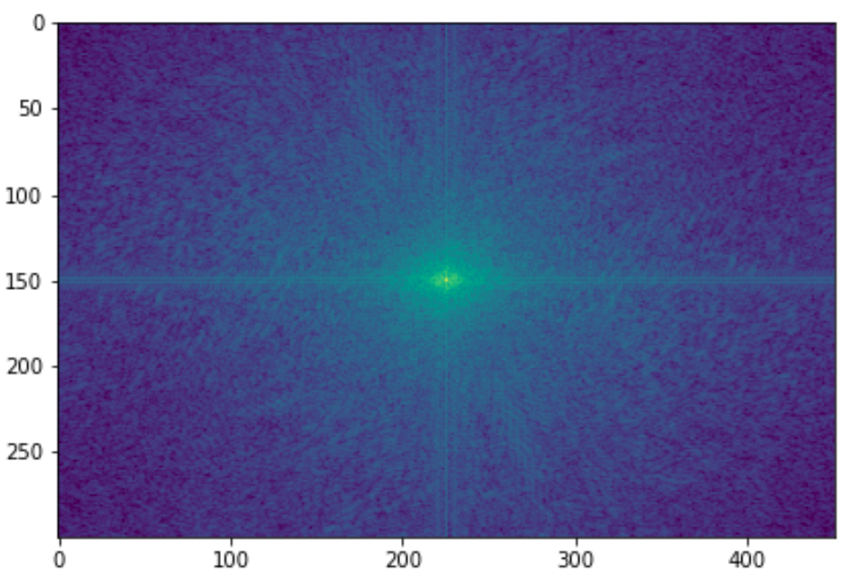
Spectral Properties of Images
Spectral density reveals the power or energy in vertical and horizontal frequency components of the image
Increasing Horizontal frequency
Increasing Horizontal frequency
For real-valued image, spectral density is symmetric about zero frequency
Rapid changes (e.g. edges, corners) have high frequency components
Increasing vertical frequency
Vertical frequency = 0
Increasing vertical frequency
Horizontal frequency = 0

Slide 42
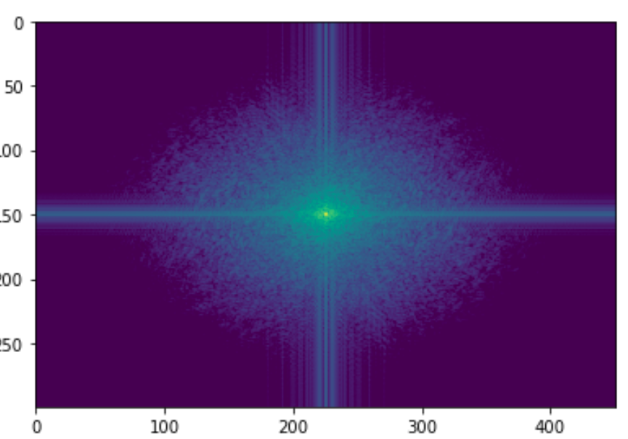
Spectral Properties of Images
Changes in spectral density show the effect of filtering
Filters change the spectral characteristics of images
Filters can suppress unwanted high frequency noise
Filtering reduces aliasing
Lower frequency image is blurred – edges and corners less sharp
Gaussian Filter
σ = 1.0

Slide 43
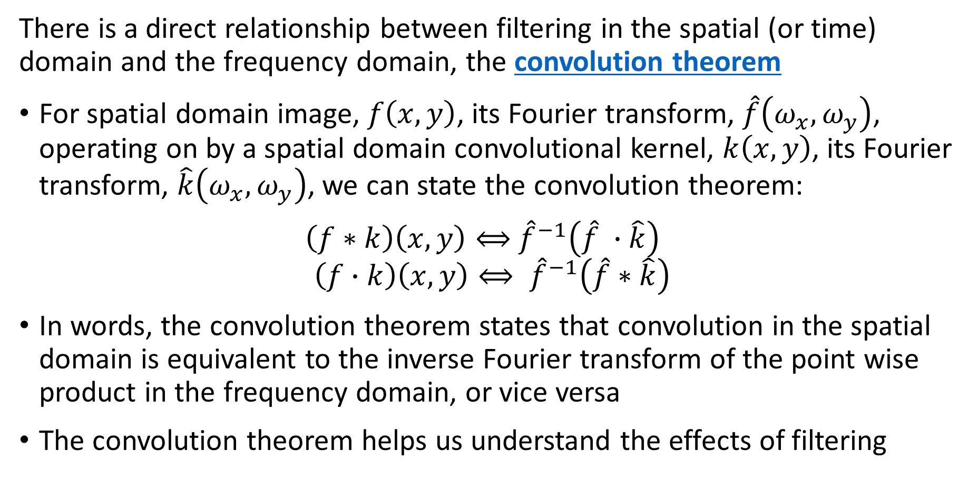
The Convolution Theorem
There is a direct relationship between filtering in the spatial (or time) domain and the frequency domain, the convolution theorem
For spatial domain image, $f\left(x,y\right)$, its Fourier transform, $\hat{f}\left(ω_{x},ω_{y}\right)$, operating on by a spatial domain convolutional kernel, $k\left(x,y\right)$, its Fourier transform, $\hat{k}\left(ω_{x},ω_{y}\right)$, we can state the convolution theorem:
$\left(f∗k\right)\left(x,y\right)⟺$ ${\hat{f}}^{−1}\left(\hat{f} ∙\hat{k}\right)$
$$\left(f∙k\right)\left(x,y\right)⟺ {\hat{f}}^{−1}\left(\hat{f}∗\hat{k}\right)$$
In words, the convolution theorem states that convolution in the spatial domain is equivalent to the inverse Fourier transform of the point wise product in the frequency domain, or vice versa
The convolution theorem helps us understand the effects of filtering

Slide 44
Summary
Key points for this lesson
How convolutional works in 1-d, 2-d and higher dimension
How to apply padding, stride and tiling for convolution
Constructing convolutional filter kernels
The relationship between filtering and the spectrum of images

