Slide 1

CSCI E-25 Computer Vision
Machine Learning for Vision
Steve Elston
Copyright 2021, Stephen F Elston. All rights reserved.

Slide 2
Machine Learning and Computer Vision
How is machine learning applied in computer vision?
Machine learning has had a dramatic impact on CV starting in the 1980s
Many CV applications of machine learning:
Object recognition
Object detection
Image stitching
Motion models
Generative models
…

Slide 3
Machine Learning and Computer Vision
Many ML algorithms are applied to CV problems
Linear models
Widely used and flexible class of models
Our focus for today
K-nearest neighbours
Support vector machines
Tree models and tree ensembles
Naïve Bayes models
Deep neural networks – more on these starting next week!
…

Slide 4
Machine Learning and Computer Vision
Key points for this lesson
The formulation of linear machine learning models
Basic machine learning workflow
Formulation of CV features for machine learning
The relationship between bias, variance and model capacity
Theory of binary classifiers
Theory of multi-class classifiers

Slide 5
Review of Linear Models

Slide 6
Why linear models?
Understandable and interpretable
Generalize well, if properly fit
Highly scalable – computationally efficient
Can approximate fairly complex functions
Applied widely to CV problems
A basis of understanding complex models
Many non-linear models are locally linear at convergence
e.g. we can learn a lot about the convergence of DL and RL models from linear approximations

Slide 7

Review of Linear Models
Given a feature matrix, A, we wish to compute a linear model to predict some labels x
Let A be n x p.
Then, the model has a vector of p coefficients or weights, b
We want to compute b so that we minimize errors, ε
The predictive model is then:

Slide 8


Review of Linear Models
How can we compute b so that we minimize errors, ε, for the model?
Minimize the sum of the squared error, Σ ε²
A straight-forward solution is to find the inverse of $A, A^{−1}$:

Slide 9
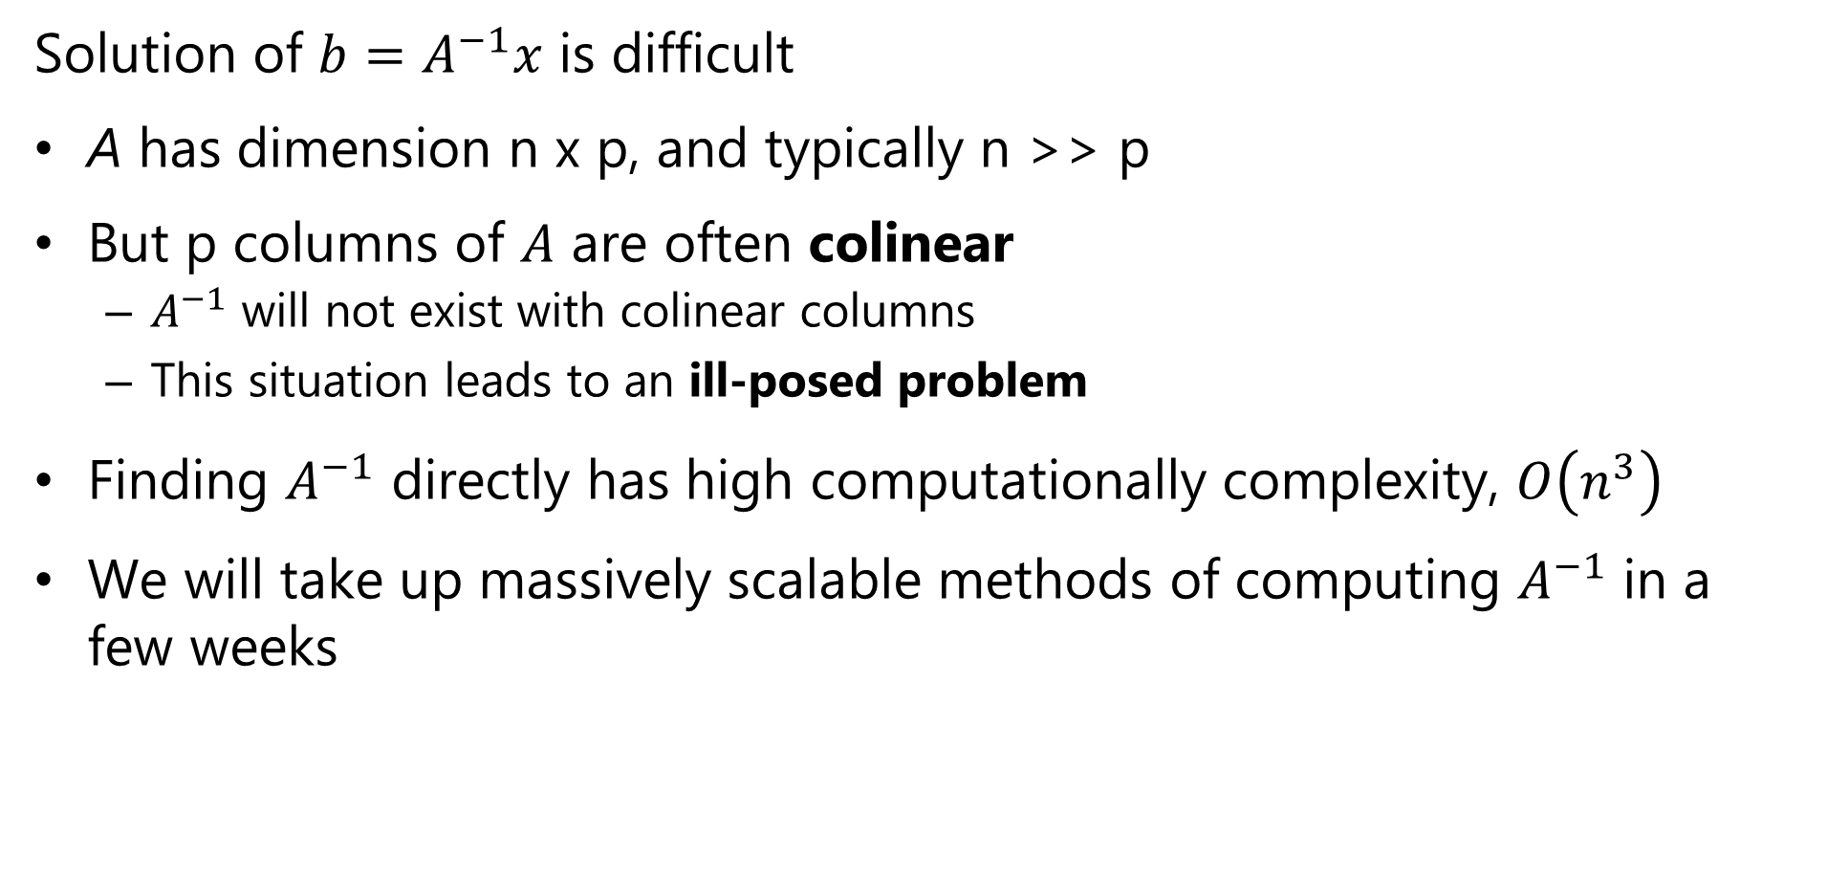
Review of Linear Models
Solution of $b=A^{−1}x$ is difficult
A has dimension n x p, and typically n >> p
But p columns of $A$ are often colinear
$A^{−1}$ will not exist with colinear columns
This situation leads to an ill-posed problem
Finding $A^{−1}$ directly has high computationally complexity, $O\left(n^{3}\right)$
We will take up massively scalable methods of computing $A^{−1}$ in a few weeks

Slide 10

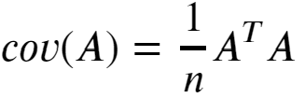
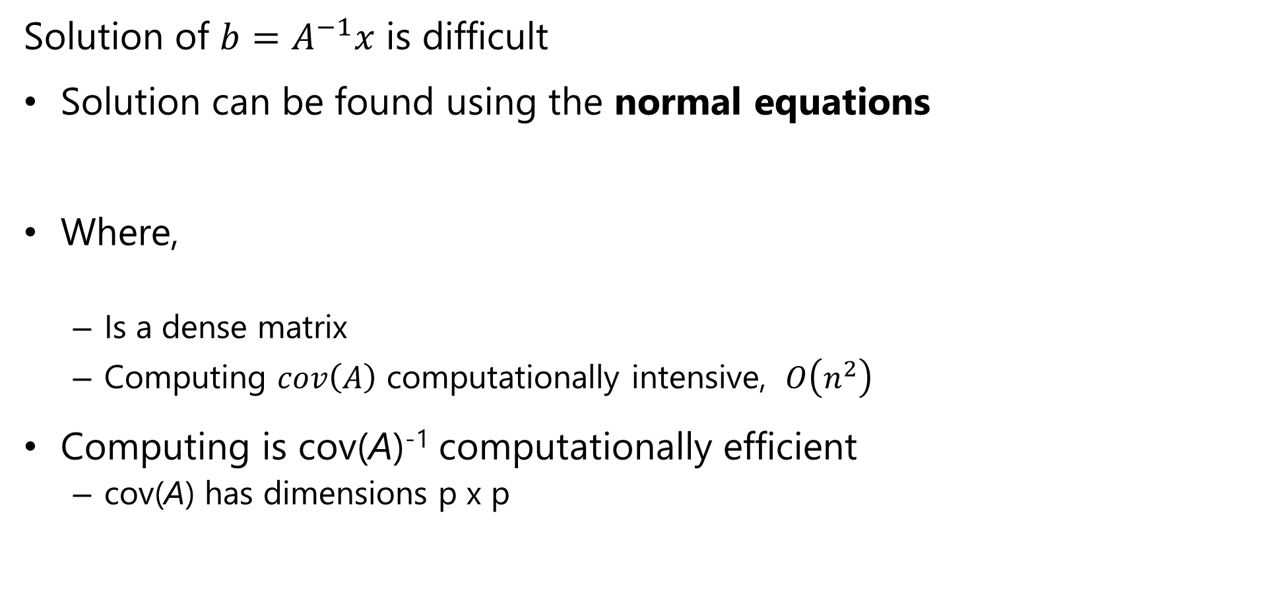
Review of Linear Regression Problem
Solution of $b=A^{−1}x$ is difficult
Solution can be found using the normal equations
Where,
Is a dense matrix
Computing $cov\left(A\right)$ computationally intensive, $O\left(n^{2}\right)$
Computing is cov(A)⁻¹ computationally efficient
cov(A) has dimensions p x p

Slide 11
What could possibly go wrong?
It is typically the case that A has colinear features
With colinear features cov(A) is not invertible
Some features many be statistically independent of the label
Noninformative
Add noise to model
Inverse of cov(A) is unstable
We say the solution is ill-posed!
We must solve a biased approximation
This process is known as regularization
We will take up this topic in a few weeks

Slide 12
The L2 Regularization Method

Slide 13
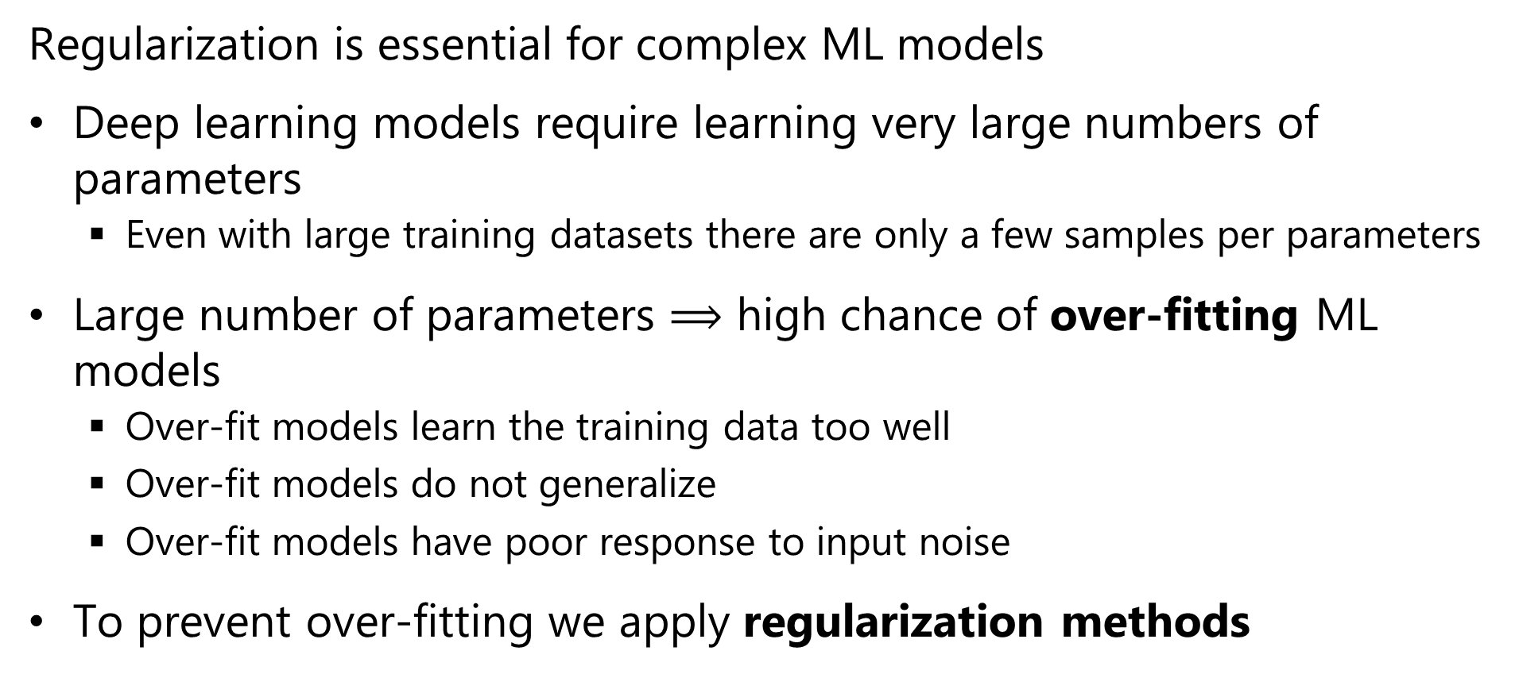
Regularization for Machine Learning
Regularization is essential for complex ML models
Deep learning models require learning very large numbers of parameters
Even with large training datasets there are only a few samples per parameters
Large number of parameters $⟹$ high chance of over-fitting ML models
Over-fit models learn the training data too well
Over-fit models do not generalize
Over-fit models have poor response to input noise
To prevent over-fitting we apply regularization methods

Slide 14
l2 Regularization
L2 or Euclidean norm regularization is a widely used method
Over-fit models tend to have parameters (weights) with extreme values
One way to regularize models is to limit the values of the parameters
Limit the L2 norm of the model parameter vector
We add a small bias term to (greatly) reduce the variance

Slide 15
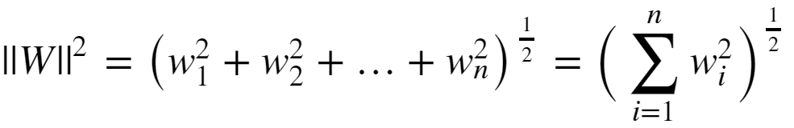

l2 Regularization
Limit the size of the model parameters is to constrain the l2 or Euclidian norm:
The regularized loss function is then:
Where λ is the regularization hyperparameter
Large λ increases bias but reduces variance
Small λ decreases bias and increases variance

Slide 16
l2 Regularization
How can you gain some intuition about l2 regularization?
X2
Β1 ~ 0
Β1 large
Β2 small
-Β1 = Β2
X1
Β2 ~ 0
Constant ||Β||²
l2 regularization is considered a soft constraint

Slide 17
L2 Regularization
How can you gain some intuition about l2 regularization?
Contours of J(W)_{MLE}
Min_{W} (J(W)_{MLE})
Constraint on model parameters binds
Initial W
Domain of Overfitting
Contours of ||W||²

Slide 18
l2 Regularization
l2 regularization goes by many names
Euclidian norm regularization
First published by Andrey Tikonov in late 1940s
Only published in English in 1977
Is known as Tikhonov regularization
In the statistics literature often called ridge regression
In the engineering literature is referred to as pre-whitening

Slide 19
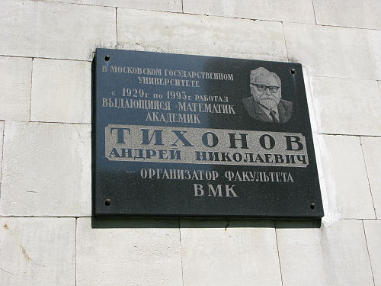
l2 Regularization
Plaque commemorating Andrey Tikhonov at Moscow Institute of Mathematics

Slide 20
L1 Regularization Methods

Slide 21
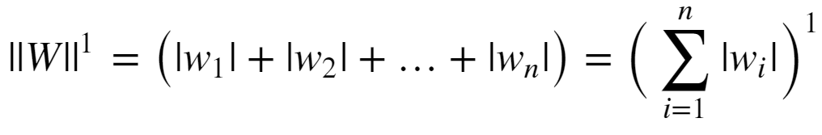
l1 Regularization
Regularization can be performed with other norms
The l1 (min-max) norm is another common choice
Conceptually, l1 norm limits the sum of the absolute values of the weights:
The l1 norm is also known as the Manhattan distance or taxi cab distance, since it is the distance traveled on a grid between two points.

Slide 22

l1 Regularization
Given the l1 norm of the weights, the loss function becomes:
Where α is the regularization hyperparameter
Large α increases bias but reduces variance
Small α decreases bias and increases variance
The l1 constraint drives some weights to exactly 0
This behavior leads to the term lasso regularization
L1 regularization provides a hard constraint on parameters
In contrast L2 provides soft constraints

Slide 23
l1 Regularization
A diagram helps develop some intuition on l1 regularization:
X2
Β1 = 0
X1
Β2 = 0
Constant ||Β||
L1 regularization is a hard constraint on the weights

Slide 24
L1 Regularization
A diagram helps develop some intuition on l1 regularization:
Contours of J(W)_{MLE}
Min_{W} (J(W)_{MLE})
Nonzero parameter
value
Initial W
Domain of Overfitting
Contours of ||W||¹

Slide 25
Bias, Variance and Model Capacity

Slide 26
The Bias-Variance Trade-Off
Machine learning algorithms learn a function approximation:
f(X, w) = y, where X is the feature vector, w is the parameter vector and y is the label
We say that a complex function has high capacity
High capacity model can approximate complex functions
High capacity model has large number of parameters or weights
But, may not generalize well
May learn the training data too well!

Slide 27
The Bias-Variance Trade-Off
High capacity models fit training data well
Overfit models exhibit high variance
Do not generalize well; exhibit brittle behavior
Error_{training} << Error_{test}
Low capacity models have high bias
Generalize well -> low variance
Do not fit data well
Regularization adds bias
Strong regularization adds significant bias
Weak regularization leads to high variance

Slide 28

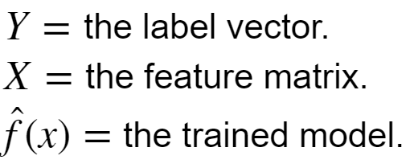
The Bias-Variance Trade-Off
How can we understand the bias-variance trade-off?
We start with the error:
Where:

Slide 29
The Bias-Variance Trade-Off
We can expand the error term
Increasing bias decreases variance
Increasing variance decreases bias
Notice that even if the bias and variance are 0 there is still irreducible error

Slide 30
The Bias-Variance Trade-Off
Variance
Bias
Test Error
Increasing bias
Increasing variance

Slide 31
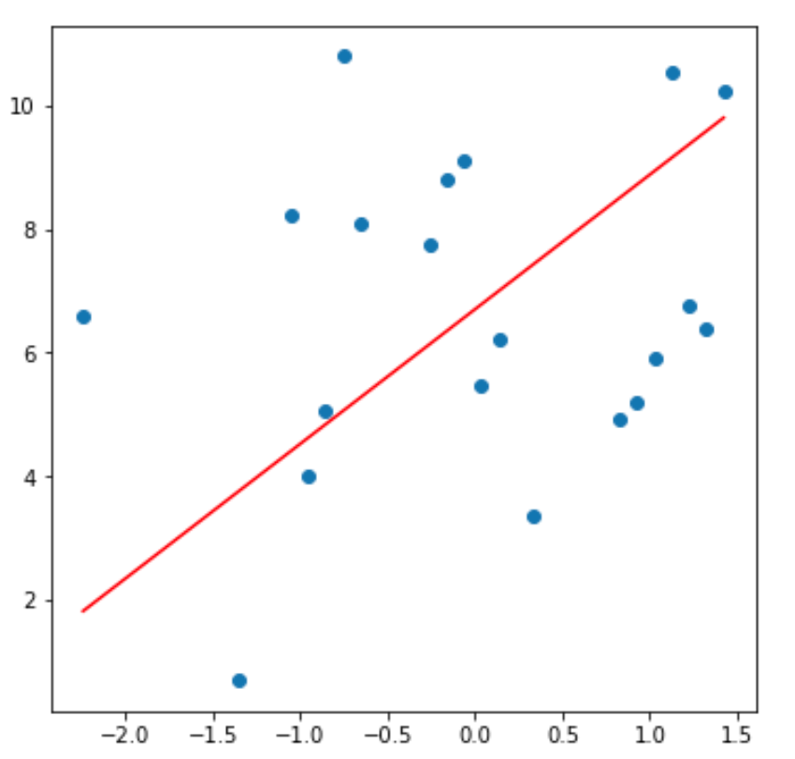
Model Capacity, Bias and Variance
Example: capacity, bias and variance for a polynomial model linear in coefficients
For a set of data values fit a strait line mode, with 2 parameters
This model has high bias, since does not fit the training data well
Variance is limited since low capacity model produces consistent predictions

Slide 32
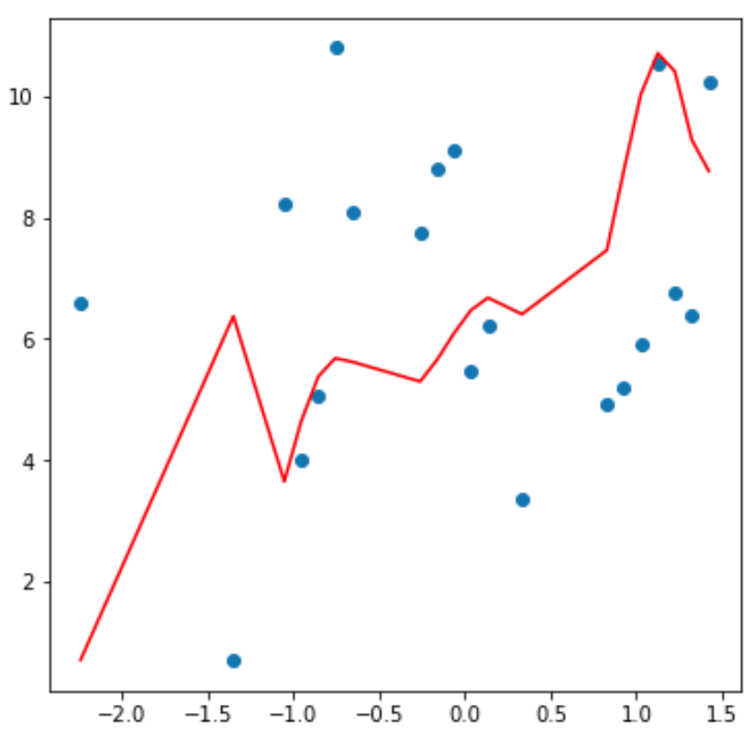
Model Capacity, Bias and Variance
Example: capacity, bias and variance for a polynomial model linear in coefficients
Fit same data with 12th order polynomial model with 13 parameters
The model has low bias, since it fits the training data fairly well
But the model will have high variance since predictions will be erratic
v

Slide 33
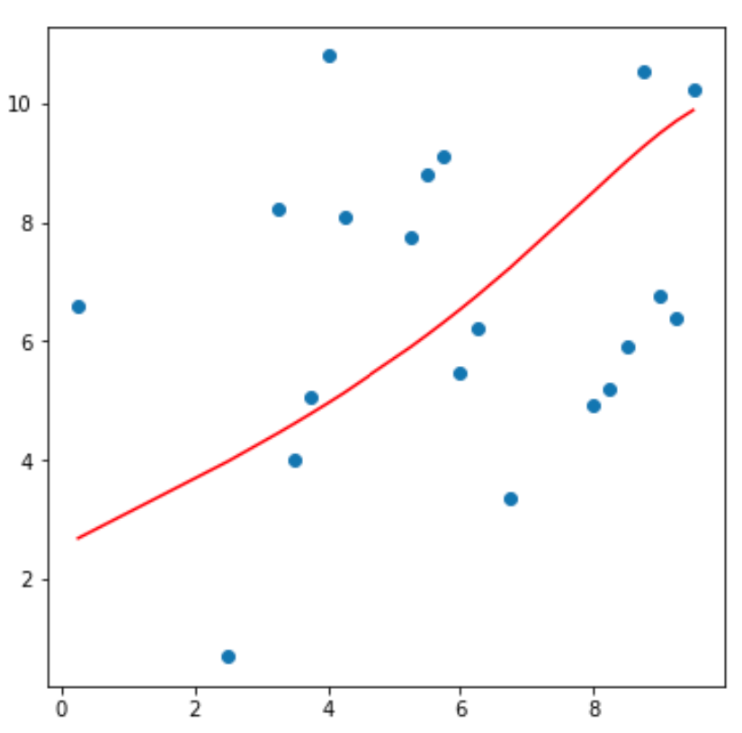
Model Capacity, Bias and Variance
Example: capacity, bias and variance for a polynomial model linear in coefficients
Models of many different capacities possible between the extremes
Need to find an optimal trade-off point between bias and variance

Slide 34
Machine Learning Workflow

Slide 35
Machine Learning Workflow
Which types of machine learning models do we use for computer vision problems?
Unsupervised: Models applied when ground-truth is unknown
Supervised: Models trained with known outcomes, or labels
Regression for predicting numeric values
Classifiers for predicting categories
Initially, we focus on supervised classification

Slide 36
Machine Learning Workflow
How do we organize a machine learning workflow?
Define model and hyperparameters
Database
Split data to
Train
Test
Evaluate
Train Model
Test Model

Slide 37
Machine Learning Workflow
Supervised learning of model parameters using features with know labels
Define model and hyperparameters
Training features
Model training by minimizing errors with for known labels
Trained model
With
Learned model parameters
Training labels

Slide 38
Machine Learning Workflow
Supervised learning of model parameters using features with know labels
Test
features
Trained model
With
Learned model parameters
Evaluate model performance
Test
labels

Slide 39
Machine Learning Workflow
How do we evaluate classification models?
Classifiers perform an hypothesis test with possible outcomes:
True positive (TP): Positive cases are correctly classified
True negative (TN): Negative cases are correctly classified
False positive (FP): Negative case erroneously classified as positive
False negative (FN): Positive case erroneously classified as negative
These quantities can be organised into a confusion matrix:
 | Actual Positive | Actual Negative
Classified Positive | TP | FP
Classified Negative | FN | TN

Slide 40
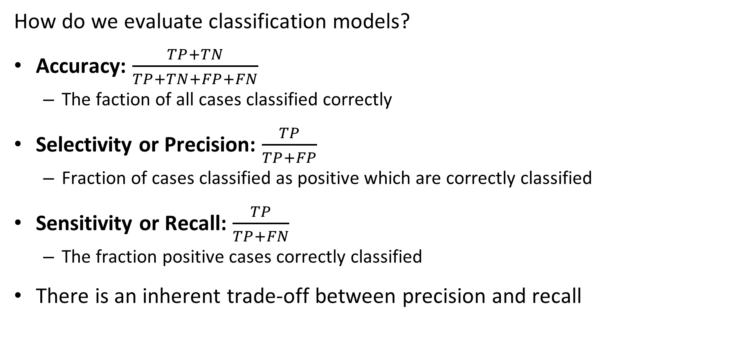
Machine Learning Workflow
How do we evaluate classification models?
Accuracy: $\frac{TP+TN}{TP+TN+FP+FN}$
The faction of all cases classified correctly
Selectivity or Precision: $\frac{TP}{TP+FP}$
Fraction of cases classified as positive which are correctly classified
Sensitivity or Recall: $\frac{TP}{TP+FN}$
The fraction positive cases correctly classified
There is an inherent trade-off between precision and recall

Slide 41
Machine Learning with Image Data

Slide 42
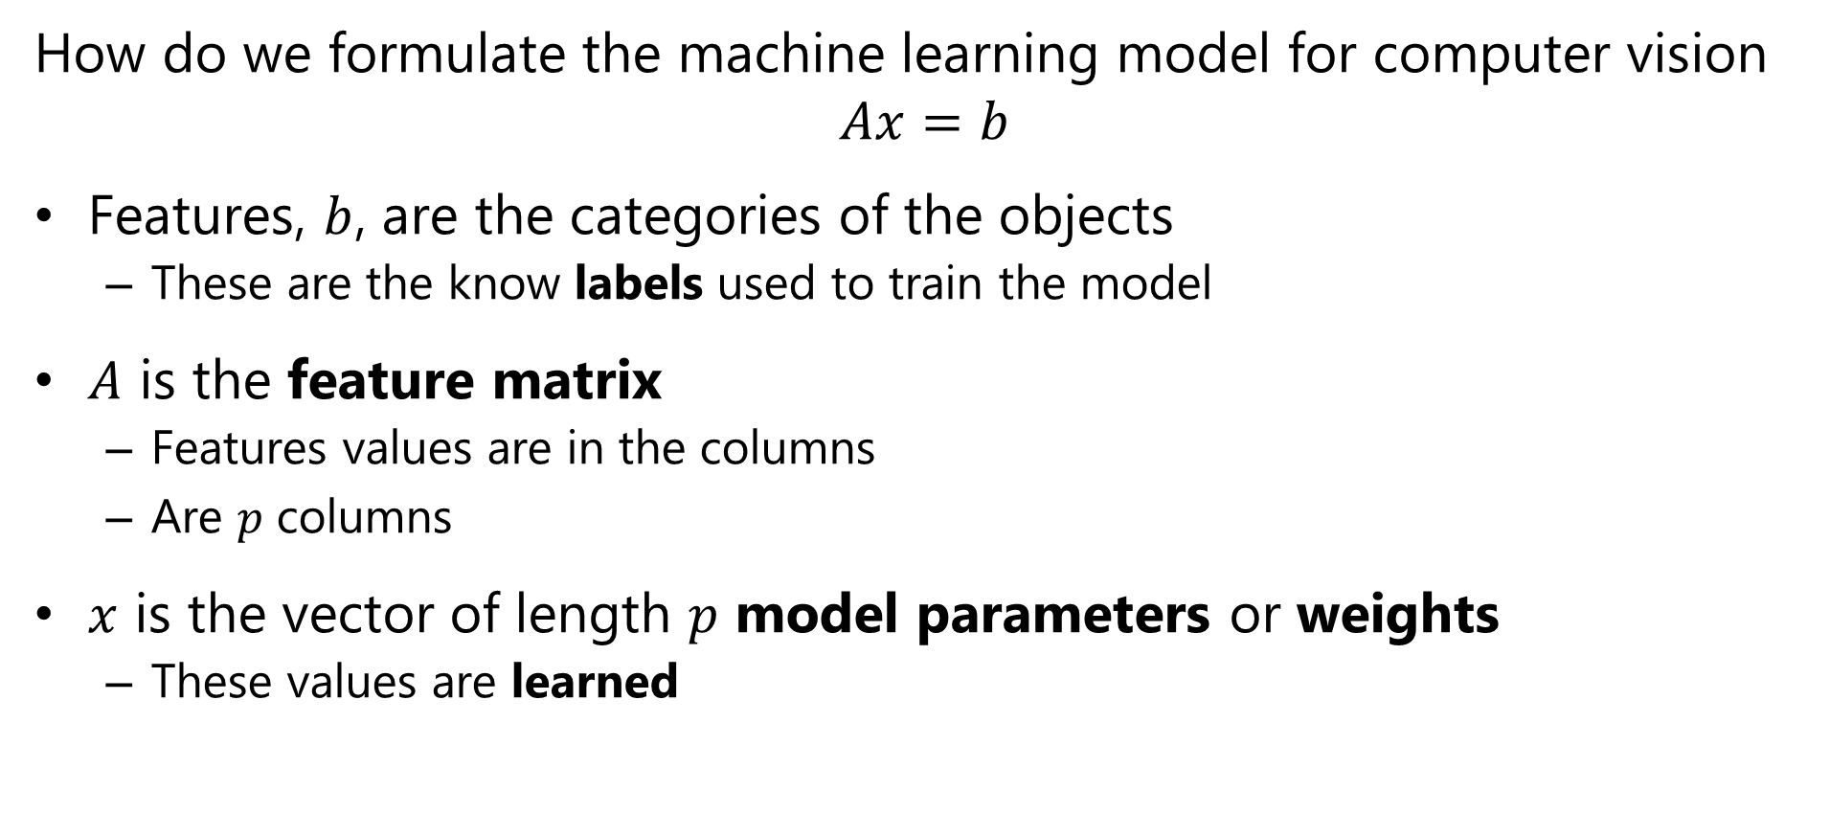
Formulating a Computer Vision Machine Learning Model
How do we formulate the machine learning model for computer vision
$$Ax=b$$
Features, $b$, are the categories of the objects
These are the know labels used to train the model
$A$ is the feature matrix
Features values are in the columns
Are $p$ columns
$x$ is the vector of length $p$ model parameters or weights
These values are learned

Slide 43
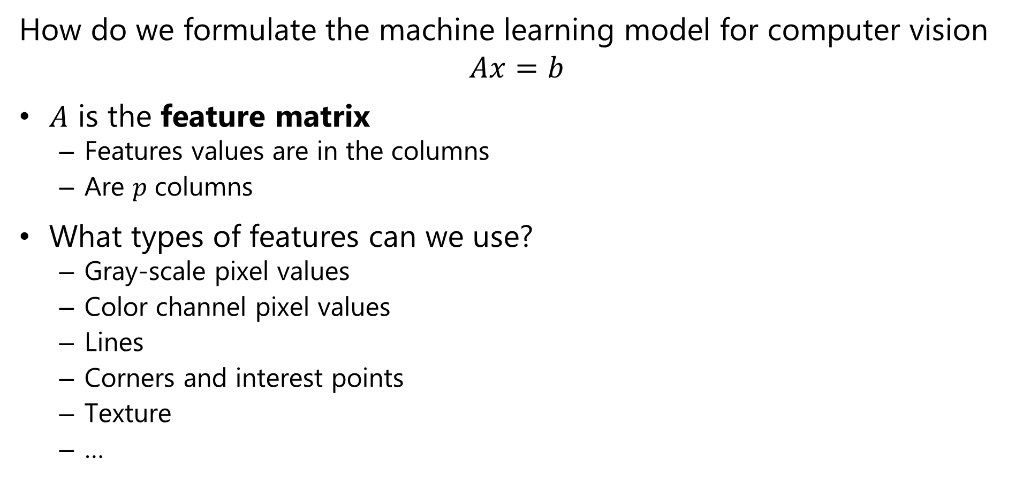
Formulating a Computer Vision Machine Learning Model
How do we formulate the machine learning model for computer vision
$$Ax=b$$
$A$ is the feature matrix
Features values are in the columns
Are $p$ columns
What types of features can we use?
Gray-scale pixel values
Color channel pixel values
Lines
Corners and interest points
Texture
…

Slide 44
How Can We Work With Image Data?
How to prepare image pixel values for machine learning?
0,0
1,0
Must flatten the image into a feature vector
Example: start with a d-2 gray-scale image
Flatten to a 1-d feature vector
For color image concatenate channel feature vectors
.
.
.
0 ,0
0 ,1
. . .
0 ,M-1
1 ,0
1 ,1
. . .
1 ,M-1
N-2,0
2 ,0
2 ,1
. . .
2 ,M-1
N-1,0
Flatten
3 ,0
3 ,1
. . .
3 ,M-1
.
.
.
.
.
.
.
.
.
0,M-1
N-2 ,0
N-2 ,1
. . .
N-2 ,M-1
1,M-1
N-1,0
N-1,1
. . .
N-1,M-1
.
.
.
N-2,M-1
N-1,M-1

Slide 45
How Can We Work With Image Data?
Images yield high-dimensional feature space
A single 28x28 gray scale image -> 784 features
A single 1024x1024x3 color image -> 3 million features!
Large numbers of features cause convergence problems with machine learning models
Its hard to work with high-dimensional spaces
Details are beyond the scope of our course
There are more efficient ways to represent images, including:
Principle component compression
Extract higher level features; edges, corners, textures, etc.

Slide 46
How Can We Work With Image Data?
Images yield high-dimensional feature space
Deep neural networks are machine learning models
Deep neural networks learn features
Under right conditions improve performance over hand engineered features
Much more on this topic!

Slide 47
Review Binary Classification

Slide 48
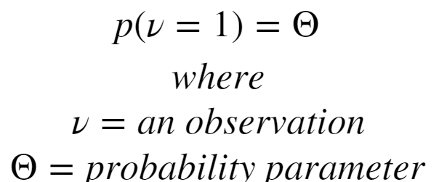
Review of Binary Classification
Binary classification selects most probable category from set {0,1}
Binary classification is based on the Bernoulli distribution
Binary Bernoulli distribution for probability of success or probability of observation: ν = 1:

Slide 49
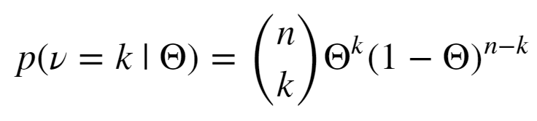

Review of Binary Classification
We extend the Bernoulli distribution for multiple trials with the Binomial distribution for k successes in n trials:
Were the Binomial coefficient, pronounced n choose k is:
The Binomial coefficient tells us the number of ways we can choose k values from n possibilities

Slide 50
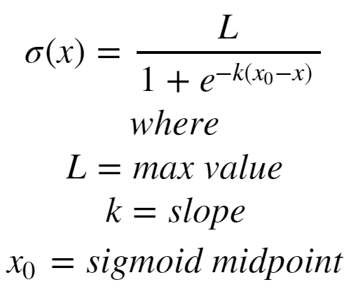
Review of Binary Classification
How do perform classification with the Bernoulli distribution?
Must transform a numeric value to the set {0,1}
Use the logistic or sigmoid function to squash the model output value

Slide 51
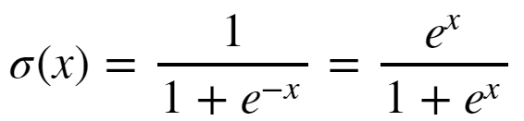
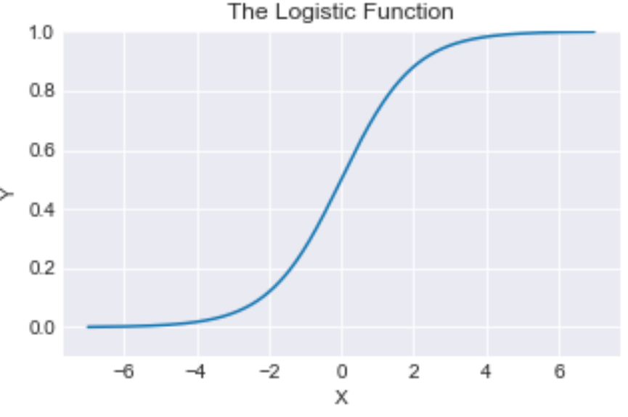
Review of Binary Classification
Simplify the logistic function if k = 1, L = 1 and x_{o} = 0:

Slide 52
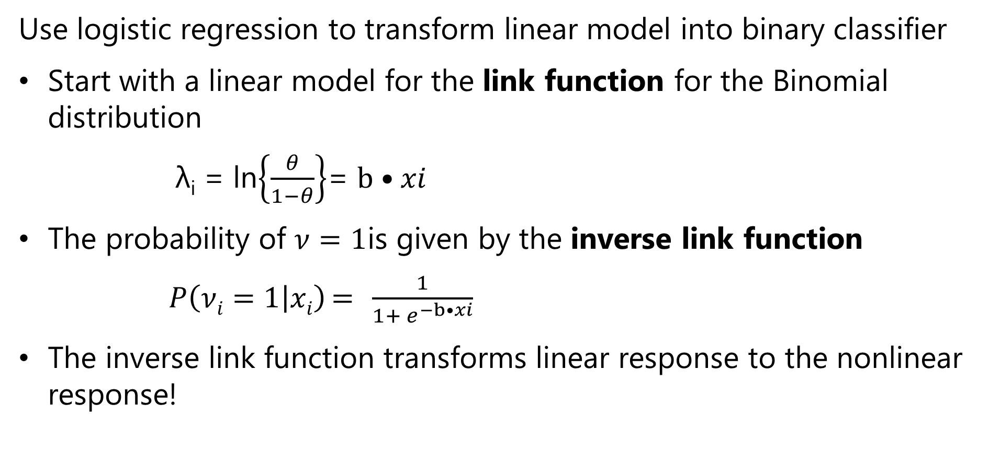
Review of Binary Classification
Use logistic regression to transform linear model into binary classifier
Start with a linear model for the link function for the Binomial distribution
λ_{i} = ln$\left\{\frac{θ}{1−θ}\right\}$= $b•xi$
The probability of $ν=1$is given by the inverse link function
$P\left(νi=1 | xi\right)={ ^{ }\frac{1}{1+ e^{−b•xi}}}$
The inverse link function transforms linear response to the nonlinear response!

Slide 53
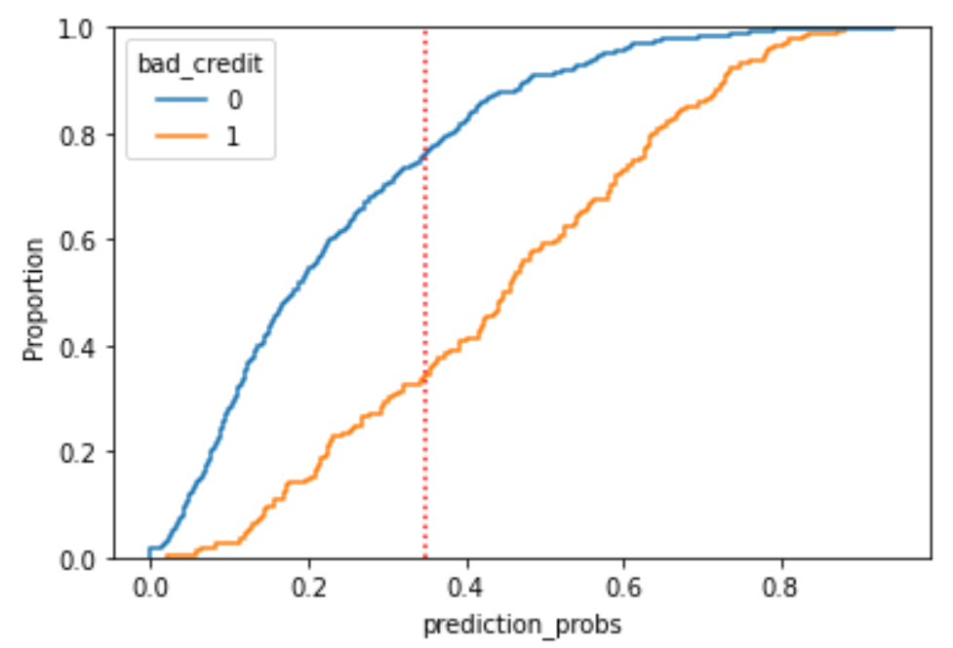
Review of Binary Classification
Example: Cut off for binary classification
Cut off applied to the cumulative distribution function for the positive and negative cases

Slide 54
Multi-Class Classification

Slide 55
Multi-Class Classifiers
Many applications of multi-class classifiers
Images can contain many types of objects
A binary classifier is not useful for object classification
We need a multi-class classifier

Slide 56
Multi-Class Classifiers
How can we create multi-class classifiers?
Approach
A hierarchy of binary classifiers
Use a multi-class distribution
Hierarchical binary classifiers
One vs. many
One vs. one

Slide 57
Multi-Class Classifiers
Classify using possible binary splits
Several possible approaches
One class vs. all others
Continue until all classes identified
Every class vs. every other class
Apply to all possible pairs

Slide 58


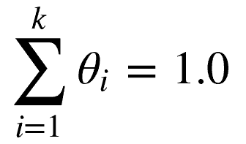
Classification with the Categorical Distribution
What is the distribution for multi-class problems?
Use the Categorical distribution for k categories with probability mass function:
Where probability mass for each category is :
And the normalization of the probability distribution :

Slide 59
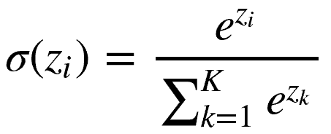

Classification with the Categorical Distribution
How do we create a categorical classifier?
Use a softmax function for K classes:
The normalization, , ensures the probabilities sum to 1.0
Softmax squashes the response of the linear models to a probability
Softmax used for response layer in deep learning models

Slide 60
Classification with the Categorical Distribution
What is the output of softmax?
One value for each category, K
For example, if we have 10 categories, there are 10 softmax output values
Take the max as the most probable category
Label must be one-hot encoded
Binary value for each possible category
Only one 1, others 0

Slide 61
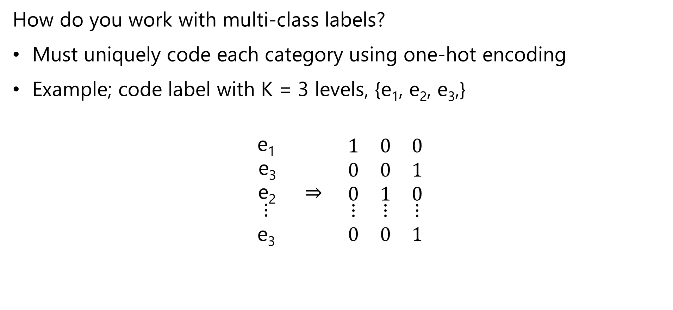
Coding Multi-Class Labels
How do you work with multi-class labels?
Must uniquely code each category using one-hot encoding
Example; code label with K = 3 levels, {e₁, e₂, e₃,}
$$\begin{matrix}\text{e}\text{1} & & \\ \text{e}\text{3} & & \\ \text{e}\text{2} & ⇒ & \end{matrix}\begin{matrix}1 & 0 & 0 \\ 0 & 0 & 1 \\ 0 & 1 & 0\end{matrix}$$
$$\begin{matrix}⋮ & & \\ \text{e}\text{3} & & \end{matrix}\begin{matrix}⋮ & ⋮ & ⋮ \\ 0 & 0 & 1\end{matrix}$$
Label One-hot encoding

Slide 62
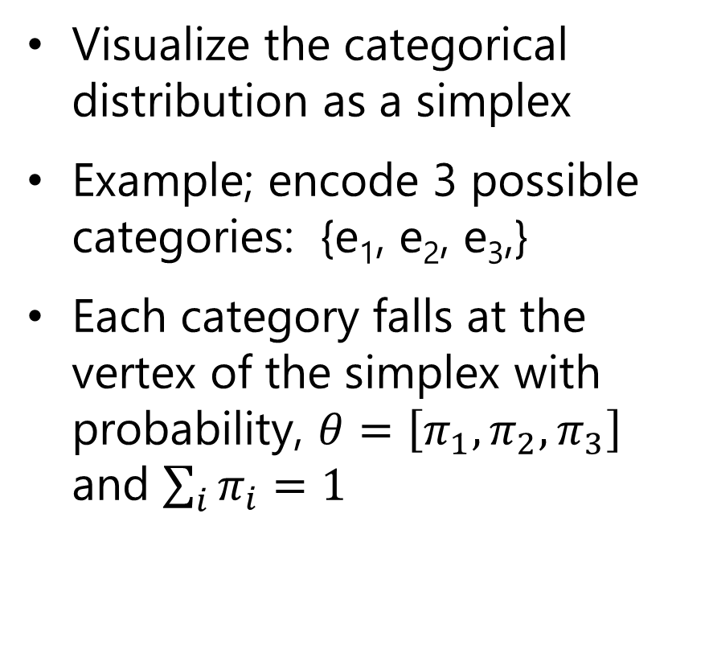
Classification with the Categorical Distribution
Visualize the categorical distribution as a simplex
Example; encode 3 possible categories: {e₁, e₂, e₃,}
Each category falls at the vertex of the simplex with probability, $θ=\left[π_{1},π_{2},π_{3}\right]$ and $\sum_{i}{π_{i}=1}$
(0,0, e₃)
(0,e₂,0)
(e₁,0,0)

Slide 63
(0,0,4)
(1,0,3)
(0,3,1)
(1,1,2)
(2,0,2)
C
(0,2,2)
(2,1,1)
(1,2,1)
(3,0,1)
(0,3,1)
B
A
(4,0,0)
(0,4,0)
(3,1,0)
(2,2,0)
(1,3,0)

Slide 64
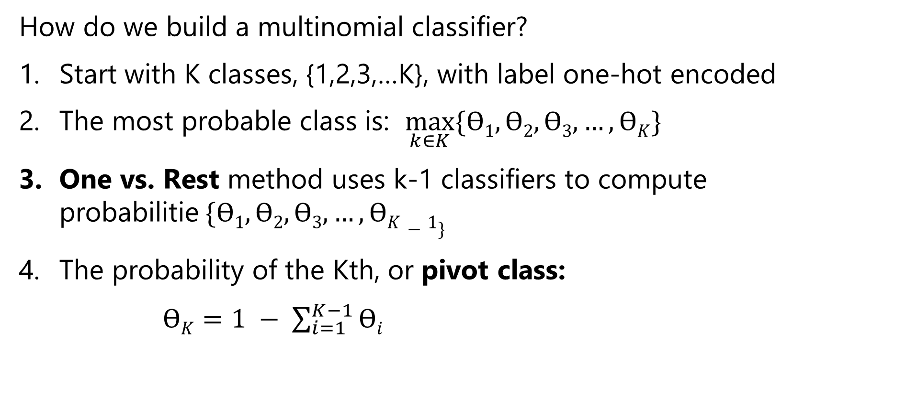
Multi-Class Logistic Regression
How do we build a multinomial classifier?
Start with K classes, {1,2,3,…K}, with label one-hot encoded
The most probable class is: $\max_{k∈K}{\{ϴ1,ϴ2,ϴ3,…,ϴK\}}$
One vs. Rest method uses k-1 classifiers to compute probabilitie$\underset{ }{}{\{ϴ1,ϴ2,ϴ3,…,ϴK−1\}}$
The probability of the Kth, or pivot class:
$ϴK=1 − \sum_{i=1}^{K−1}{ϴi}$

Slide 65
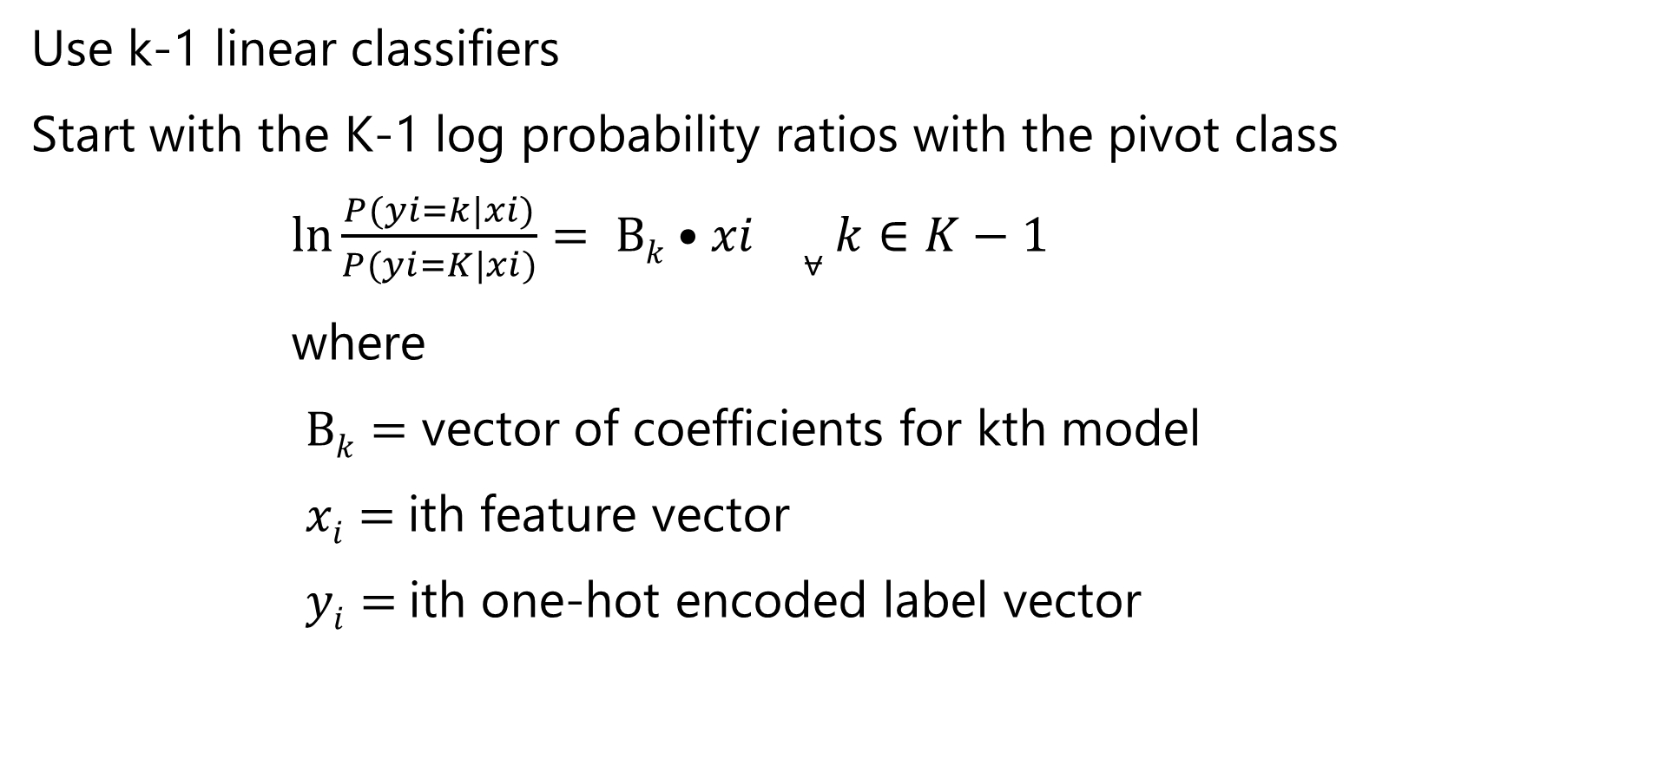
Multi-Class Logistic Regression
Use k-1 linear classifiers
Start with the K-1 log probability ratios with the pivot class
$\ln{\frac{P(yi=k|xi)}{P(yi=K|xi)}}= Вk•xi ⩝k∈K−1$
where
$Вk=$ vector of coefficients for kth model
$xi=$ith feature vector
$yi=$ith one-hot encoded label vector

Slide 66
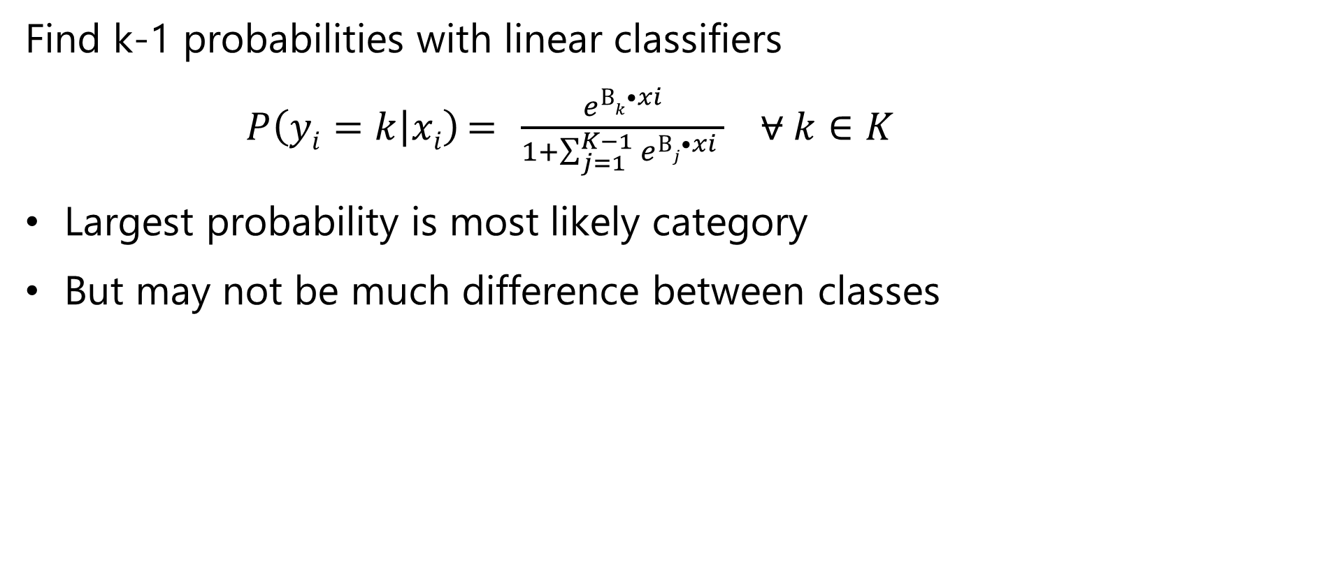
Multi-Class Logistic Regression
Find k-1 probabilities with linear classifiers
$P\left(yi=k | xi\right)={ ^{ }\frac{e^{Вk•xi}}{1+\sum_{j=1}^{K−1}{e^{Вj•xi}} }} ⩝k∈K$
Largest probability is most likely category
But may not be much difference between classes

Slide 67
Multi-Class Logistic Regression
What could possibly go wrong?
Probability differences between classes can be small
Sometimes better to consider top few classes
Example; most probable 5 classes of 1,000 of objects in image
Assumption of well-separated classes
But class characteristics can overlap – be nonunique
Assumption of balance in class samples in training data
Imbalance common – some objects are rare
Model learning biased to more frequent cases

Slide 68
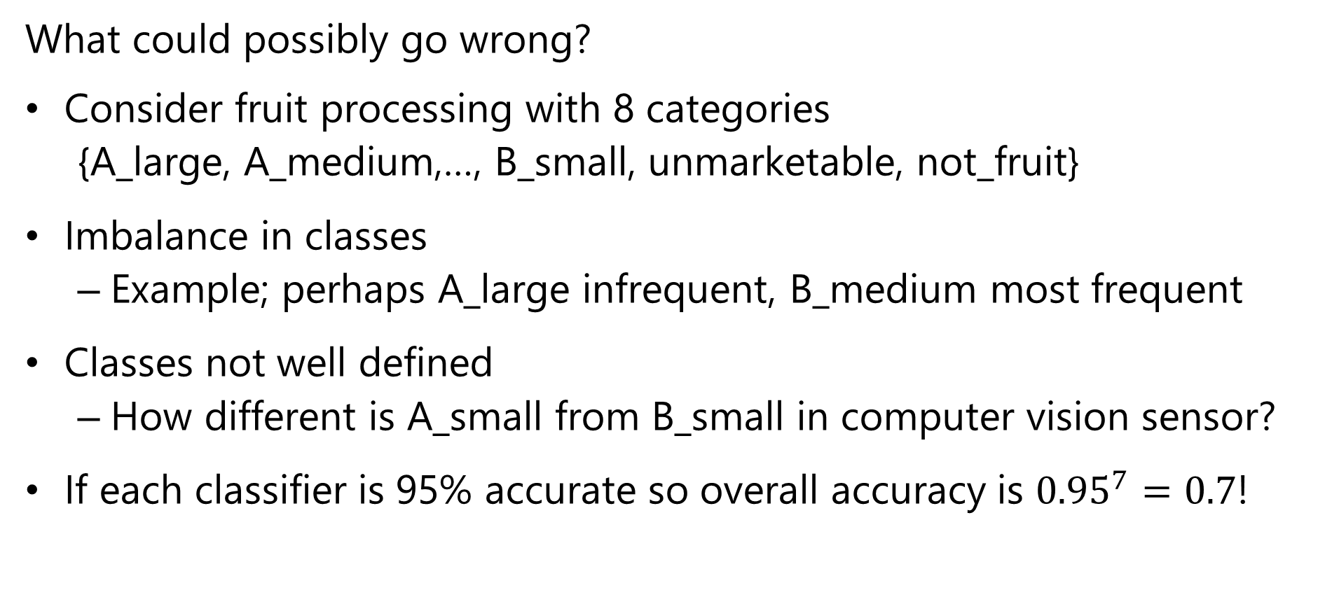
Multi-Class Logistic Regression
What could possibly go wrong?
Consider fruit processing with 8 categories
{A_large, A_medium,…, B_small, unmarketable, not_fruit}
Imbalance in classes
Example; perhaps A_large infrequent, B_medium most frequent
Classes not well defined
How different is A_small from B_small in computer vision sensor?
If each classifier is 95% accurate so overall accuracy is ${0.95}^{7}=0.7$!

Slide 69
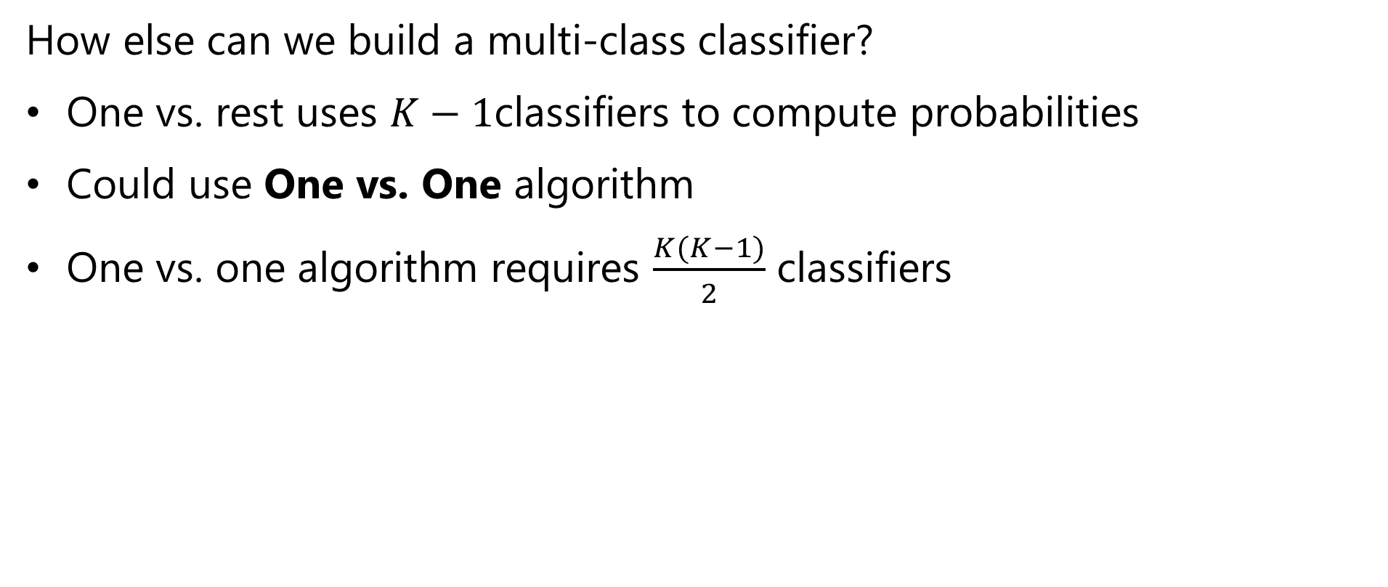
Multi-Class Logistic Regression
How else can we build a multi-class classifier?
One vs. rest uses $K−1$classifiers to compute probabilities
Could use One vs. One algorithm
One vs. one algorithm requires $\frac{K(K−1)}{2}$ classifiers

Slide 70
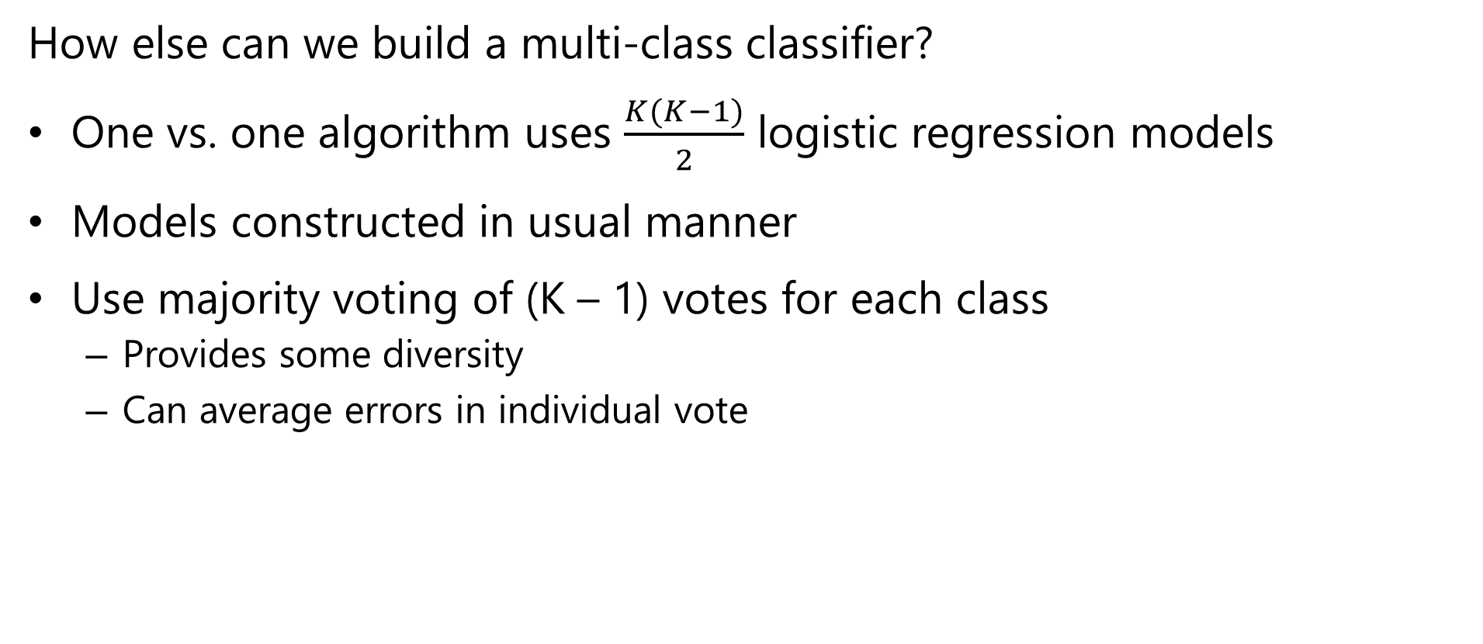
Multi-Class Logistic Regression
How else can we build a multi-class classifier?
One vs. one algorithm uses $\frac{K(K−1)}{2}$ logistic regression models
Models constructed in usual manner
Use majority voting of (K – 1) votes for each class
Provides some diversity
Can average errors in individual vote

Slide 71
Multi-Class Logistic Regression
How else can we build a multi-class classifier?
How many classifiers does each approach require?
Number of classes | One vs. rest classifiers |  | One vs. one classifiers
 | Number of classifiers | Accuracy at 1% error rate | Number of classifiers | Accuracy at 1% error rate – no diversity | Accuracy at 1% error rate – Normally distributed errors
2 | 1 | 0.99 | 1 | 0.99 | 0.99
3 | 2 | 0.98 | 3 | 0.97 | 0.98
4 | 3 | 0.97 | 6 | 0.94 | 0.98
10 | 9 | 0.91 | 45 | 0.64 | 0.93
100 | 99 | 0.37 | 4950 | 0.00 | 0.30
1000 | 999 | 0.00 | 499500 | 0.00 | 0.00

Slide 72
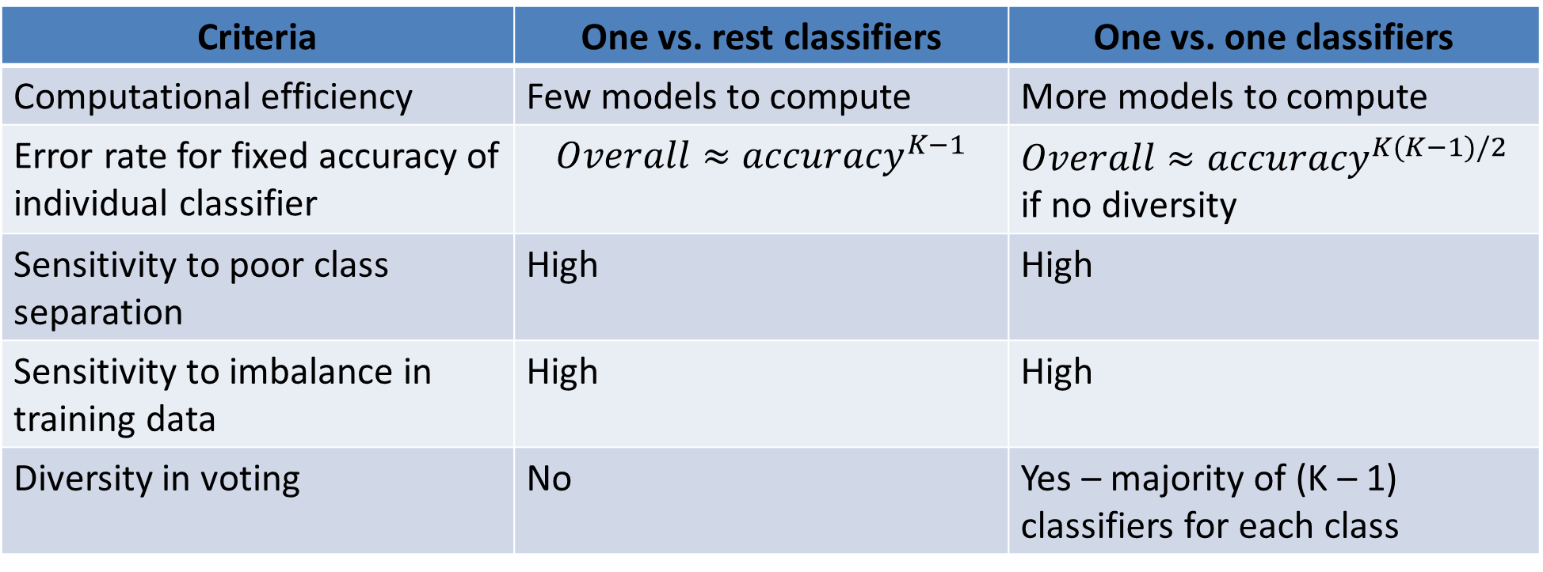
Multi-Class Logistic Regression
Compare one vs. rest and one vs. one classifiers
Criteria | One vs. rest classifiers | One vs. one classifiers
Computational efficiency | Few models to compute | More models to compute
Error rate for fixed accuracy of individual classifier | $$Overall≈{accuracy}^{K−1}$$ | $Overall≈{accuracy}^{K(K−1)/2}$ if no diversity
Sensitivity to poor class separation | High | High
Sensitivity to imbalance in training data | High | High
Diversity in voting | No | Yes – majority of (K – 1) classifiers for each class

Slide 73
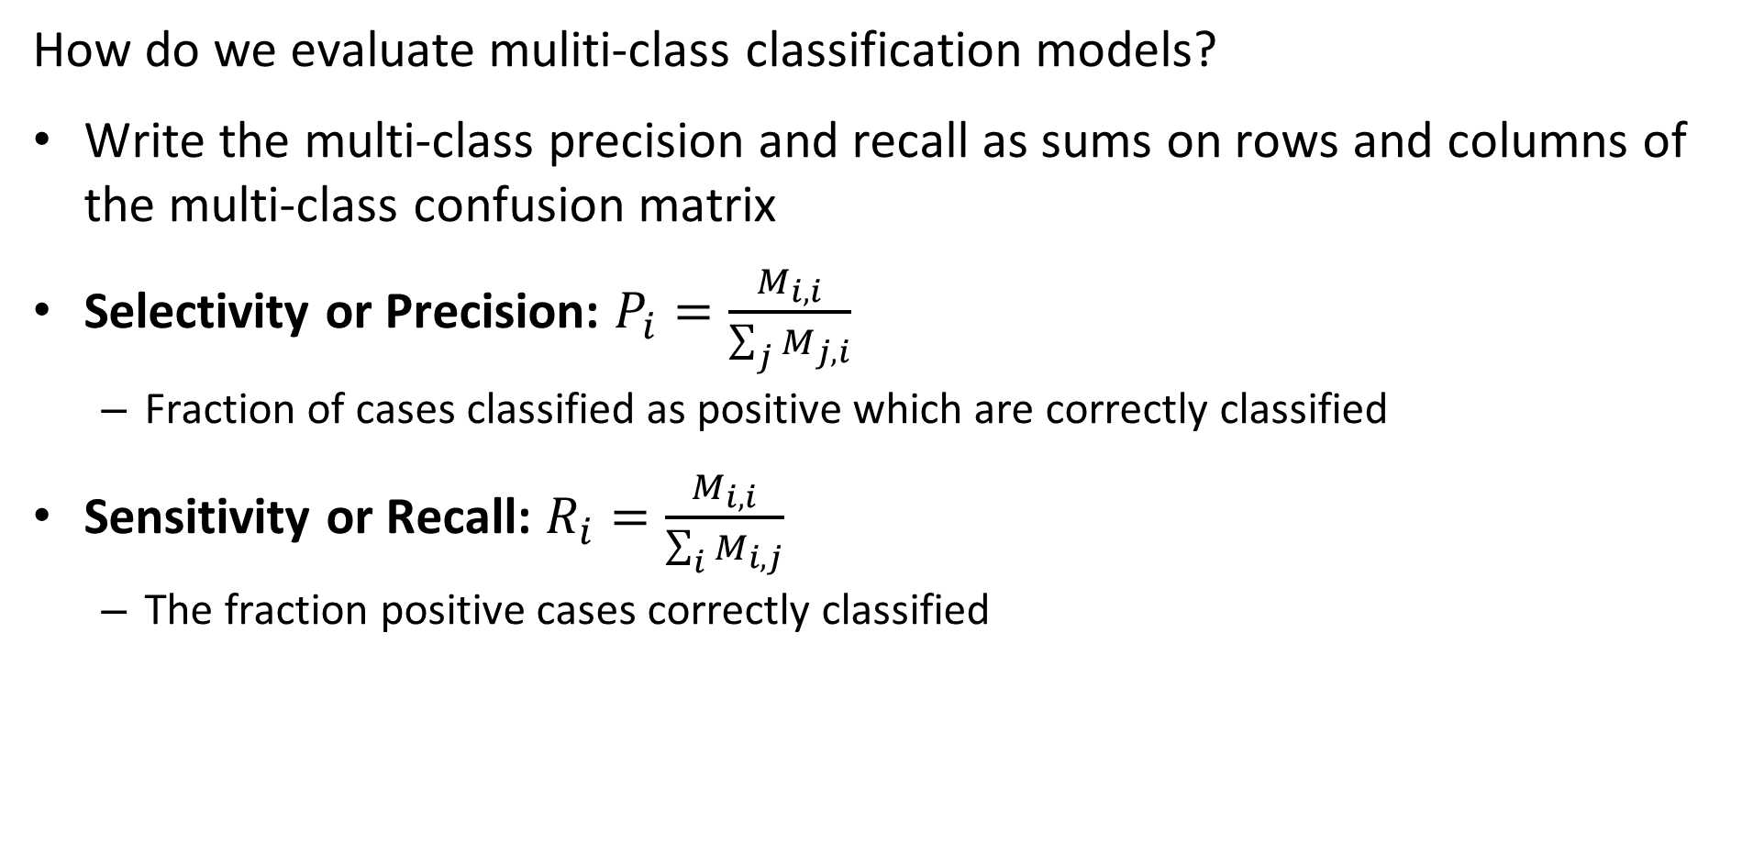
Evaluation of Multi-Class Classifiers
How do we evaluate muliti-class classification models?
Write the multi-class precision and recall as sums on rows and columns of the multi-class confusion matrix
Selectivity or Precision: $P_{i}=\frac{M_{i,i}}{\sum_{j}{M_{j,i}}}$
Fraction of cases classified as positive which are correctly classified
Sensitivity or Recall: $R_{i}=\frac{M_{i,i}}{\sum_{i}{M_{i,j}}}$
The fraction positive cases correctly classified

Slide 74
Summary
Key points for this lesson
The formulation of linear machine learning models
Basic machine learning workflow
Formulation of CV features for machine learning
The relationship between bias, variance and model capacity
Theory of binary classifiers
Theory of multi-class classifiers

