Slide 1

CSCI E-25 Computer Vision
Introduction to Computer Vision
Steve Elston
Copyright 2022, 2023, Stephen F Elston. All rights reserved.

Slide 2
What is Computer Vision?
Computer vision is a collections of algorithms enabling computers to perform tasks with images
Image enhancement, filtering, and projection
Object detection
Object identification
Scene interpretation and labeling
Segmentation
3D scene reconstruction
Similarity search
..….

Slide 3
What is Computer Vision?
Computer vision is a dynamic and fast moving area of AI
Major technical advances mean tasks that were impossible or impractical 10 years ago are now routine
Impact of deep learning
Methods and algorithms advancing rapidly
Landmark paper, Krizhevsky et.al., 2012
With rapidly growing capability the number of applications is exploding
New ideas appear constantly
Economics of CV has improved rapidly
Low power system on a chip
IOT deployments

Slide 4
What is Computer Vision?
Many applications of computer vision
Industrial inspection
Robotics and autonomous vehicles
Scientific analysis – e.g. remote sensing, seismology, astrophysics, etc.
Medical image interpretation
Digital photography
Wildlife monitoring
Security
Image search
…..

Slide 5
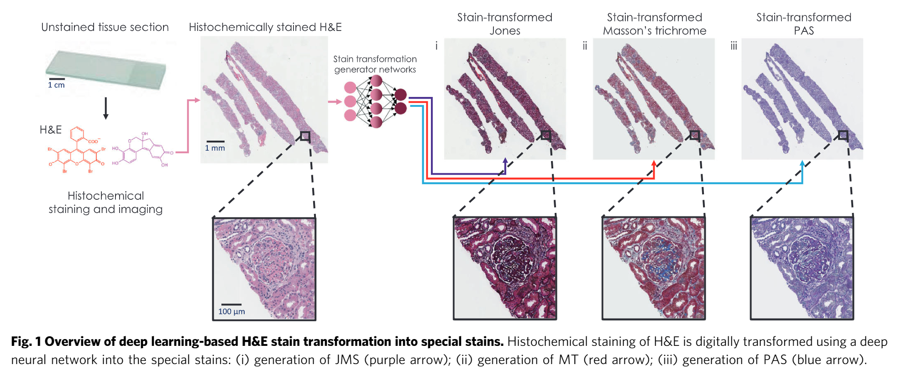
Medical Application of Computer Vision
Learning to virtually stain histological samples to simplify pathology diagnoses
Hnna, et. al., Deep learning-based transformation of H&E stained tissues into special stains, Nature Communications, 2021.

Slide 6
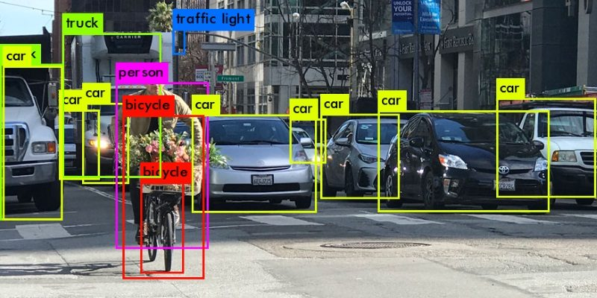
Autonomous Vehicle CV Application
Learning to track and identify moving objects in the environment
https://heartbeat.comet.ml/introduction-to-basic-object-detection-algorithms-b77295a95a63

Slide 7
About This Couse

Slide 8
About your Instructor: Steve Elston
Instructor for Harvard since 2017
Data science consultant with several decades of experience
Lead team that commercialized Bell Labs S, now open source R
Company co-founder and held executive positions in several industries
Creator of multiple edX courses, author of books and articles
Inventor on 5 patents
BS, physics and math (minor), University of New Mexico
MS and PhD, geophysics, Princeton University – John von Neuman Supercomputing Fellow

Slide 9
Teaching Assistant: Moustafa Saleh
Principal data scientist at Oracle Cloud
Received PhD in computer science from University of Texas at San Antonio
Worked previously at Microsoft’s Advanced Threats Protection team developing ML solutions for malware detection
Research mainly focused on applying machine learning solutions to cyber-security challenges

Slide 10
Teaching Assistant: Tatyana Boland
MBA in Finance from Texas A&M
MLA from Harvard Extension School in Sustainability & Environmental Management
BA in Political Science from University of Washington
Program manager at Air Liquid
Worked previously at Oracle OCI as Principal Technical Program Manager in Physical Networking team

Slide 11
About this course
We will survey the fast moving and exciting subject of computer vision
Computer vision is a vast subject with a long history
Large and growing list of applications
Many possible algorithms for each task
Computer vision has changed radically in the past 10 years
Deep learning continues to radically change the theory and practice of CV
As CV capabilities improve new algorithms and applications emerge constantly

Slide 12
About this Course
Focus on fundamental concepts rather than the very latest applications
We are time limited to one semester
Focus on building your broad foundation of theory and practical understanding of fundamentals
Building on this foundation you can explore rapidly changing algorithms and applications during your career
Hands-on components must adhere to limits of computational capacity and your time
Work with smaller datasets
Limit complexity of algorithms
Suggest using Google Colab Pro (or Pro+) for some assignments
We will explore some fun applications!

Slide 13
About this course
Understanding theory essential to successful computer vision
Without understanding theory one is just turning knobs on a black box and hoping for the best
Selection and proper application of best algorithms requires understanding of theory
Goal is for you to gain enough understanding of theory for algorithms you apply

Slide 14
About this course
Computer vision is a highly emperical subject
Learning to work with image data is a core skill for CV
Hands on application of CV is at the intersection of theory and coding
But, there are often deviations from ideal behavior
Understanding theory is essential to understanding and resolving problems
Try many solutions and see what works best
Try lots of ideas, fail fast, keep what works!!
The assignments for this course help you build the aforementioned skills

Slide 15
Where can you find the course materials?
Read and understand the Syllabus in Canvas!
Material specific to this course are in the Github repository
Slides
Notebooks
Data
Supplementary materials
Assignment due dates, submissions, and grading in Canvas
Class assignments
Graduate independent projects
Recommended reading primarily from these texts:
Computer Vision: Algorithms and Applications, 2nd ed, Richard Szeliski, 2021, download here
Computer Vision, Principles, Algorithms, Applications, Learning, Fifth Edition, E.R. Davies, Academic press, 2018
Deep Learning for Vision Systems, Mohamed Elgendy, Manning, 2020: Available at Harvard Coop or publishers web site with discounts

Slide 16
Communication
Ed Discussion is the primary means of communication for this course
Use Ed for help with assignments and projects
It’s okay to post small amounts of code!
Post complete exception messages if you are dealing with an error
Graded online class discussions take place in Ed
Private communications regarding matters such as grades
Use Ed private messages for fastest reponse
Or, stephen_elston@g.harvard.edu, tatyanaboland@gmail.com and msaleh83@gmail.com
Do not use Canvas messages, unless you want a delayed response!

Slide 17
Late Assignment Policy
Timely release of assignment solutions is an important part of the learning process
This is a fast-moving survey course
Do not fall behind! With approximately 12 assignments and a project, there is very little time to “catch-up”
Late assignment policy:
Up to one day late - no penalty
Up to 6 days late - less 20%
More than 6 days late - no credit
Make sure you turn in work on time!

Slide 18
Setting up for Assignments
Install the Anaconda scientific Python distribution
Install Git
Clone the course GitHub repository
Copy assignment notebook to a working directory
Complete exercises
Submit assignments by uploading to Canvas

Slide 19
The Nature of Images

Slide 20
Working with Digital Images
Key points for this lesson
The nature of image formation
How digital images data are represented
How digital images data are sampled and the effects of aliasing
Steps in basic image filtering and adjustment

Slide 21
The Nature of Images
Images can come in many forms
Still images
Video
Volumetric – CAT, MRI, seismic
Multi-spectral – remote sensing, material handling, agriculture
Specialized – industrial and scientific imaging
RADAR, LIDAR – earth science, autonomous vehicles
Acoustic - medical, seismic
……

Slide 22
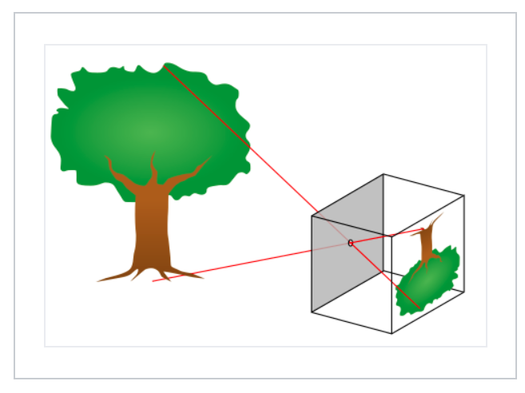
The Nature of Images
Basic image camera image formation
A camera forms an image from scattered light from an object
A pinhole camera or camera obscura forms an image by projecting light rays back to their source
Credit, Wikipedia commons

Slide 23
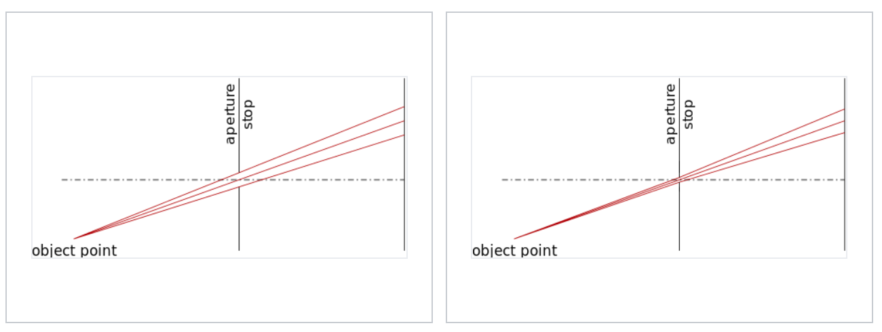
The Nature of Images
Basic image camera image formation
The smaller the aperture of the pinhole the light is focused to a point and the image is sharper, but less light passes
Aperture is parameterized by f-stops or f-number
Credit, Wikipedia commons

Slide 24
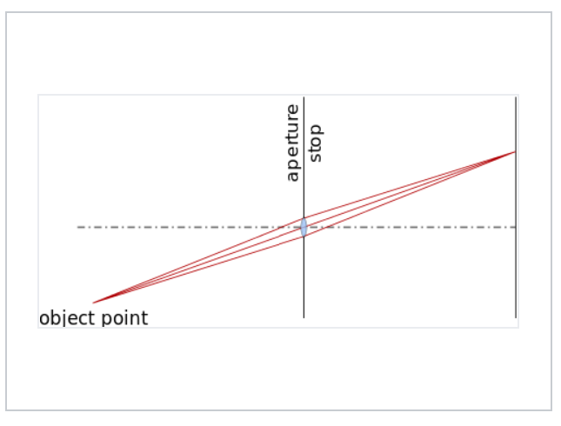
The Nature of Images
Basic image camera image formation
Adding a lens to the camera allows capturing more light with larger f-stop
Credit, Wikipedia commons

Slide 25
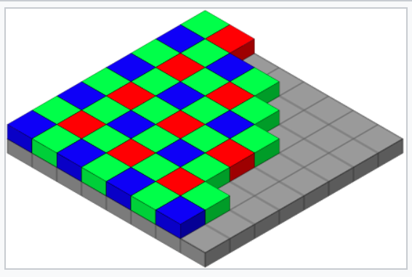
The Nature of Images
Basic image camera image formation
Digital cameras use a photo-sensitive device placed on the image plane
The Bayer-arrangement is an example of a photo-sensitive device arrangement that captures the red, green blue, primary colors into discrete pixels on the image plane
Photo-sensitive device on image plane
Credit, Wikipedia commons

Slide 26
Working With and Representation of Digital Image Data

Slide 27
Working with Image Data
A grey scale image is represented as a two dimensional tensor of pixel values
0 ,0
0 ,1
. . .
0 ,M-1
1 ,0
1 ,1
. . .
1 ,M-1
2 ,0
2 ,1
. . .
2 ,M-1
3 ,0
3 ,1
. . .
3 ,M-1
.
.
.
.
.
.
.
.
.
N-2 ,0
N-2 ,1
. . .
N-2 ,M-1
N-1,0
N-1,1
. . .
N-1,M-1
Unsigned integer pixel values have range {0,255}; black to white
Floating point pixel values I the range {0,1}; black to white

Slide 28
Working with Multi-Spectral Data
Multi-spectral images are represented as 3-dimensional tensors
2 spatial dimensions
3rd dimension of frame are the color channels
Ordinary color images have 3 channels – most usually red, green and blue
Spectrum of colors created by mixing primary colors with correct intensity
Scientific images can have many spectral channels
Example: multi-spectral remote sensing
Multi-spectral astrophysical images

Slide 29
Working with Image Data
A color image is a 3-dimensional tensor representing the three color channels
Mix (sum) primary RGB color channels to create spectrum of colors
Red
0 ,0,0
0 ,1,0
. . .
0 ,M-1,0
Green
1 ,0,0
1 ,1,0
. . .
1 ,M-1,0
0 ,0,0
0 ,1,0
. . .
0 ,M-1,1
Blue
2 ,0,0
2 1,0
. . .
2 ,M-1,0
1 ,0,0
1 ,1,0
. . .
1 ,M-1,1
0 ,M-1,2
3 ,0,0
3 ,1,0
. . .
3 ,M-1,0
2 ,0,0
2 1,0
. . .
2 ,M-1,1
1 ,M-1,2
.
.
.
.
.
.
.
.
.
. . .
3 ,0,0
3 ,1,0
3 ,M-1,1
2 ,M-1,2
.
.
.
.
.
.
.
.
.
3 ,M-1,2
N-2 ,0,0
N-2 ,1,0
. . .
N-2 ,M-1,0
.
.
.
N-1,0,0
N-1,1,0
. . .
N-1,M-1,0
N-2 ,0,0
N-2 ,1,0
. . .
N-2 ,M-1,1
N-1,0,1
N-1,1,1
. . .
N-2 ,0,0
N-2 ,1,0
N-1,M-1,1
N-2 ,M-1,2
N-1,0,2
N-1,1,2
. . .
N-1,M-1,2
Intensity of each color channel is on a scale of {0,255} or {0,1}

Slide 30
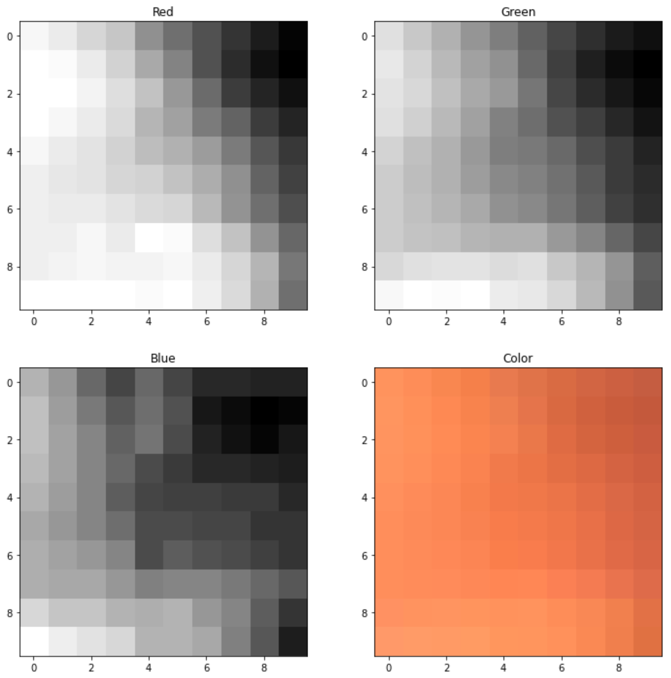
Working with Image Data
A color image is a 3-dimensional tensor representing the RGB color channels
Intensity of color is the pixel value in the channel on a scale of {0,255} or {0,1}
Mix (sum) primary color channels to create spectrum of colors

Slide 31
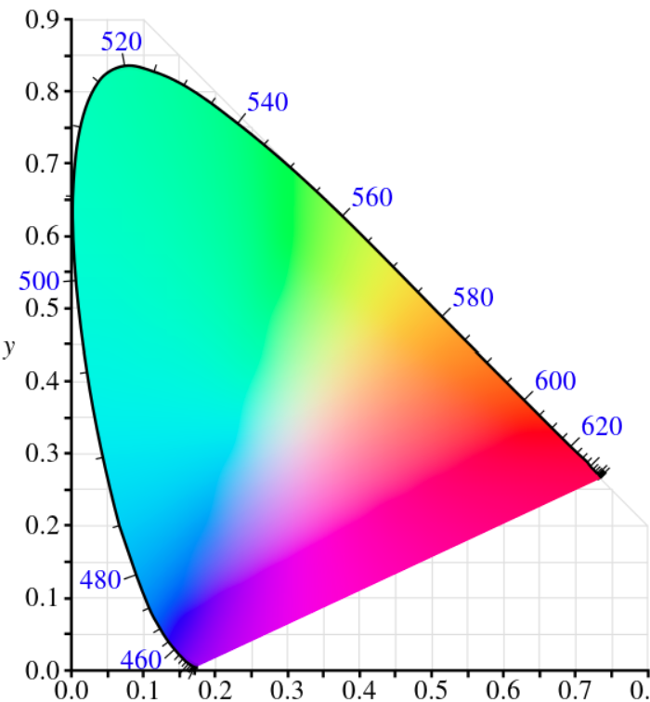
Working with Image Data
Many color schemes used in image representation
RGB is simple and most widely used
CIE 1931 (aka XYZ) uses wavelength and luminance to create a rich spectrum of color optimized for human vision
Can convert between schemes – e.g. skimage
But conversion may not be exact!
Credit, Wikipedia commons

Slide 32
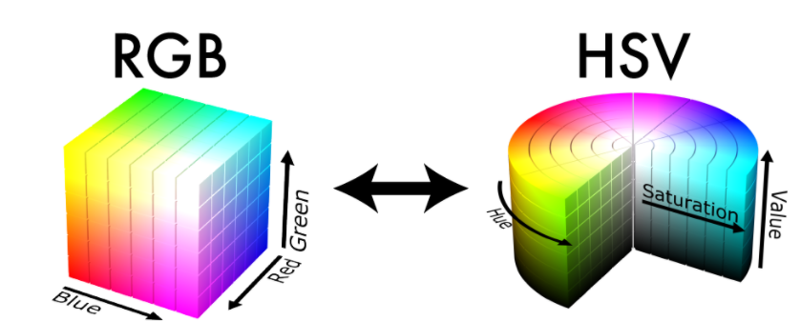
Working with Image Data
Many color schemes used in image representation
Hue, Saturation and Value (HSV) another alternative
Can convert between schemes – e.g. skimage
But conversion may not be exact!
Credit, Wikipedia commons

Slide 33
Working with Image Data
Video is represented as a 4-dimensional tensor
2 spatial dimensions per RGB color channel
3rd dimension are 3 color channels
4th dimension is the time sequence of images (frames)
Or, 3rd dimension can be depth; e.g. medical images

Slide 34
Working with Image Data
0,0
Machine learning algorithms use one data sample, as feature vector, at a time
1,0
.
.
.
0 ,0
0 ,1
. . .
0 ,M-1
1 ,0
1 ,1
. . .
1 ,M-1
N-2,0
For image data, we must flatten the image to create features:
. . .
N-1,0
2 ,0
2 ,1
2 ,M-1
Flatten
3 ,0
3 ,1
. . .
3 ,M-1
.
.
.
.
.
.
.
.
.
0,M-1
N-2 ,0
N-2 ,1
. . .
N-2 ,M-1
1,M-1
N-1,0
N-1,1
. . .
N-1,M-1
.
.
.
N-2,M-1
N-1,M-1

Slide 35
Sampling and Aliasing

Slide 36
Sampling and Aliasing
Digital images are spatially sampled into pixels
The value of the pixel represents the intensity of the illumination in the pixel area
Limit of spatial resolution is determined by the vertical and horizontal pixel sampling density
Aliasing results if we try to sample an image with too low a pixel density
In volumetric imaging the samples are voxels – volumetric pixels
Example, medical MRI

Slide 37
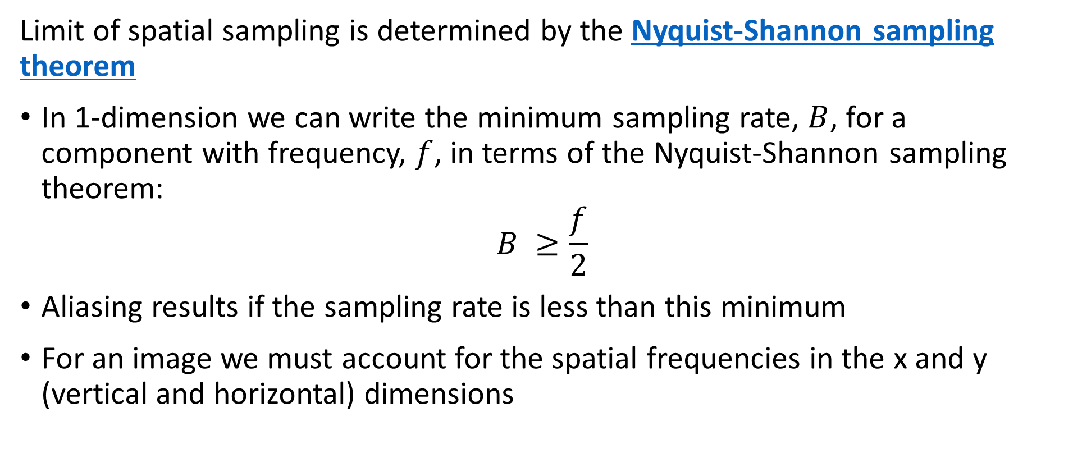
Sampling and Aliasing
Limit of spatial sampling is determined by the Nyquist-Shannon sampling theorem
In 1-dimension we can write the minimum sampling rate, $B$, for a component with frequency, $f$, in terms of the Nyquist-Shannon sampling theorem:
$$B ≥\frac{f}{2}$$
Aliasing results if the sampling rate is less than this minimum
For an image we must account for the spatial frequencies in the x and y (vertical and horizontal) dimensions

Slide 38
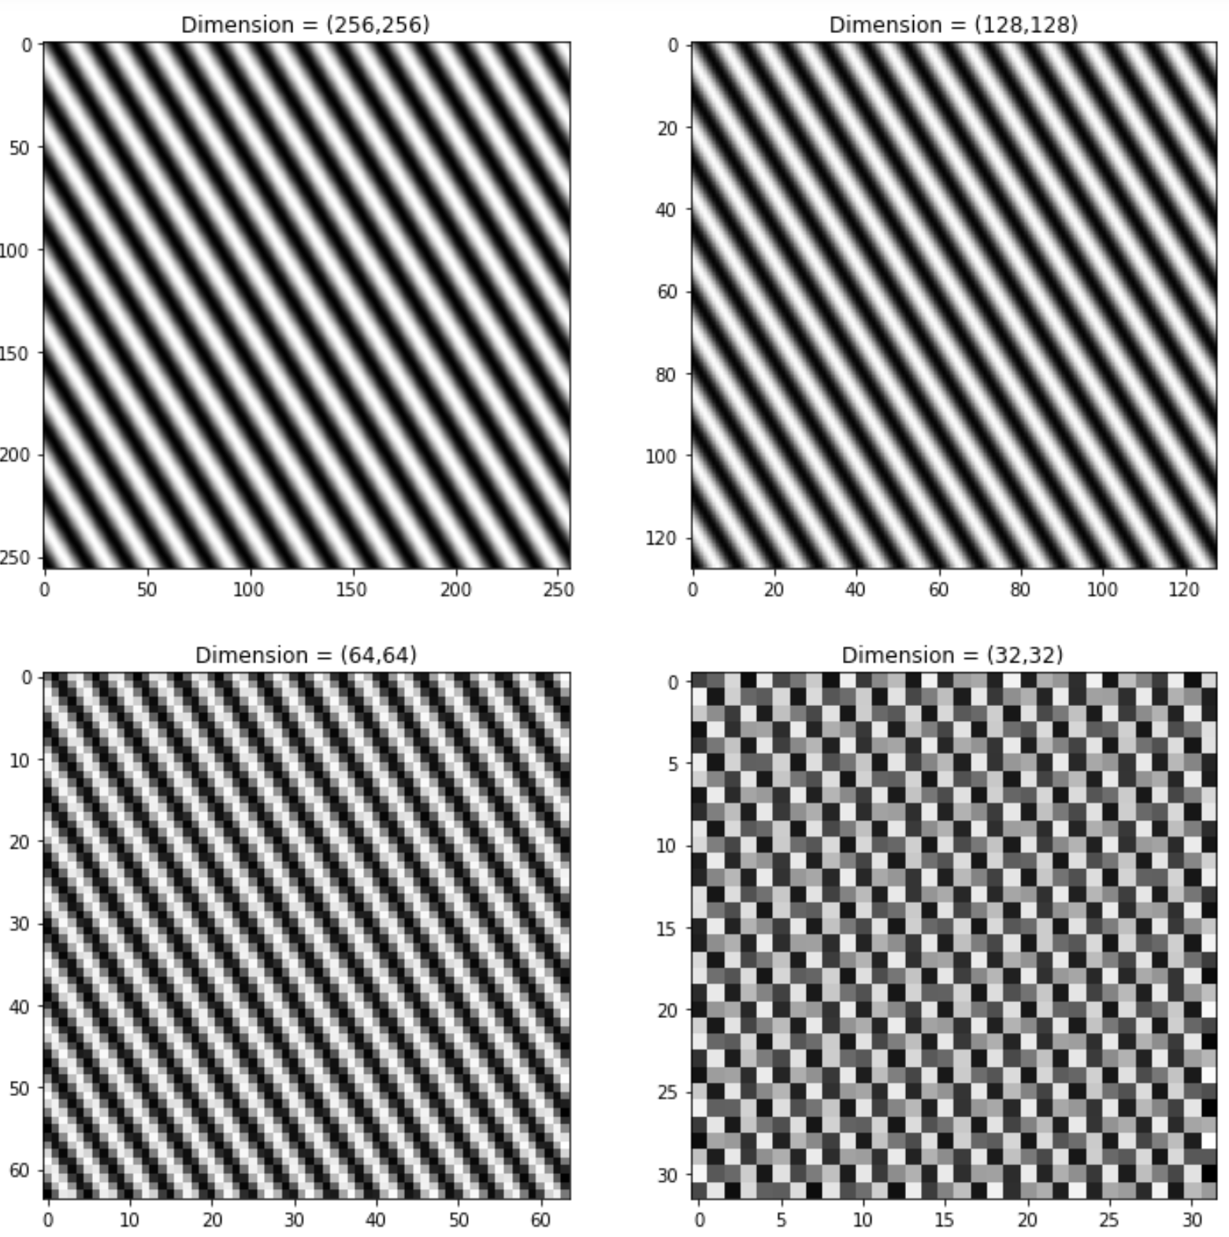
Sampling and Aliasing
Simple example of spatial aliasing
Down sample the image until sampling frequency is less than Nyquist rate
The aliased image exhibits significant sampling artifacts!

Slide 39

Sampling and Aliasing
Limit bandwidth of image to reduce aliasing
Filter out high frequency components to stay within Nyquist limit:
$$B ≥\frac{f}{2}$$
More on filtering next week!

Slide 40
Preprocessing Image Data Basics

Slide 41
Resizing Images
Resizing an image is a common pre-processing step in computer vision
Recall, pixel values represent the average illumination in a rectangular patch of the image area
Up sample – increase number of pixels
Down sample – reduce number of pixels
Use interpolation for pixel centre values
We investigate filter-based methods next week

Slide 42
Resizing Images
Resizing algorithms use interpolated values for pixel centres
For even factors of 2 resizing use mean interpolations
Use averages of adjacent pixel values
Arbitrary resizing can use spline interpolation or bilinear interpolation
Interpolate from original image pixel centre values to resized image pixel values
Many other interpolation methods are used
PCA/SVD and other generative models
Gaussian convolutional filters
Super-resolution deep convolutional neural networks
More on these later

Slide 43
Contrast and Illumination
Performance of computer vision algorithms can never be better than the input image
If the features required for the task are not clear and well-defined in the image, no algorithm can reliably perform the task
Common problems with images:
Poor illumination
Low contrast
Correction of images is often the first pre-processing step in a CV pipeline

Slide 44
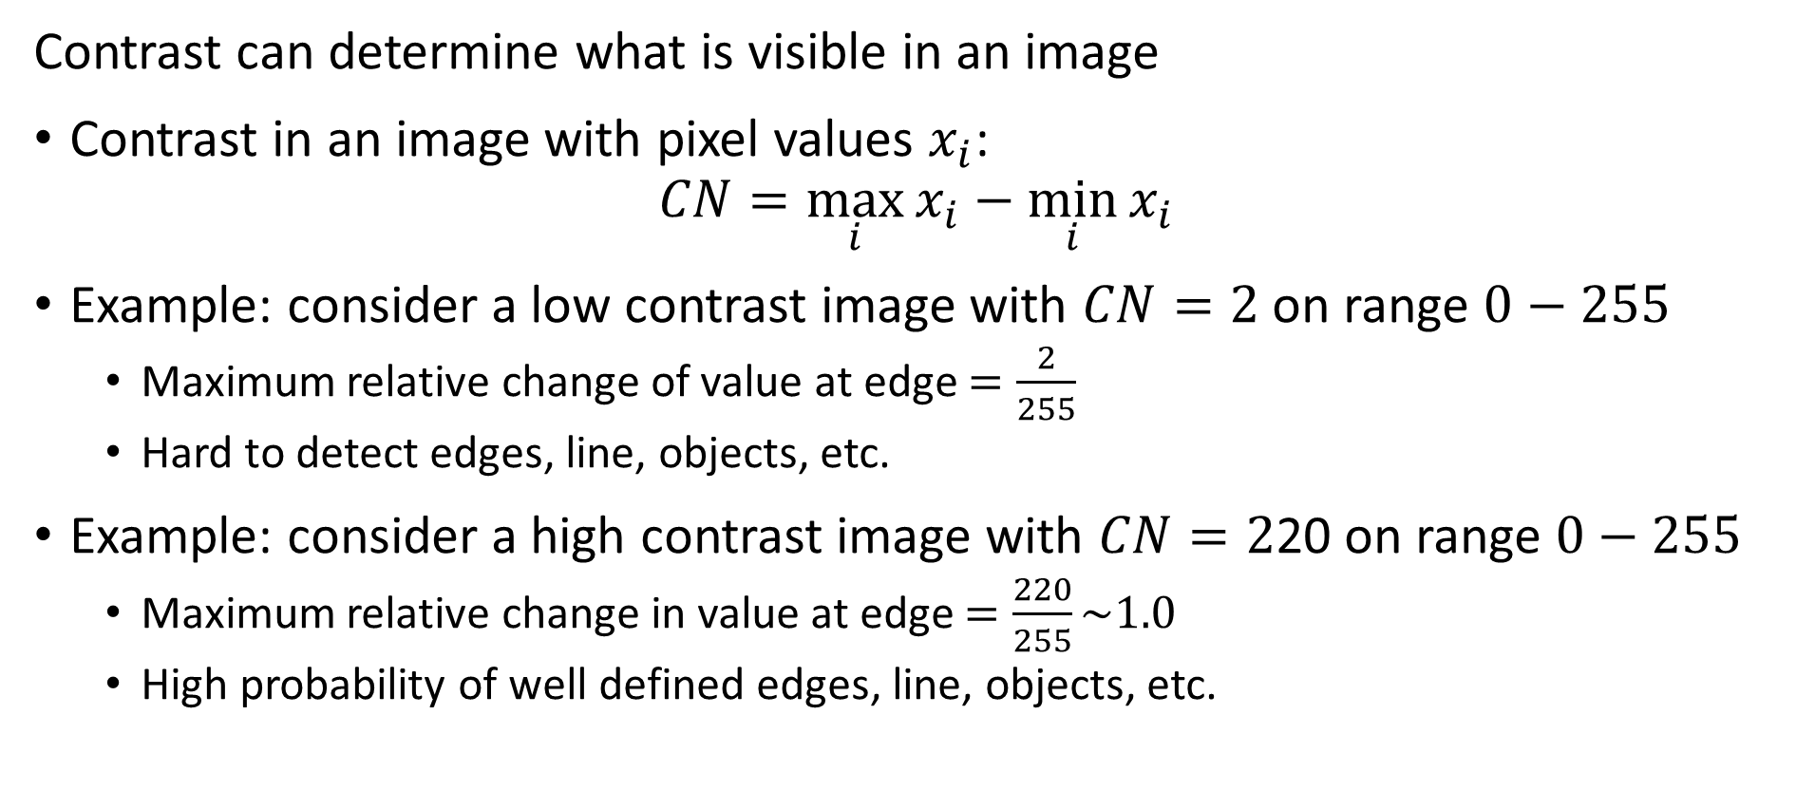
Contrast and Illumination
Contrast can determine what is visible in an image
Contrast in an image with pixel values $x_{i}$:
$$CN=\max_{i}{x_{i}−\min_{i}{x_{i}}}$$
Example: consider a low contrast image with $CN=2$ on range $0−255$
Maximum relative change of value at edge $=\frac{2}{255}$
Hard to detect edges, line, objects, etc.
Example: consider a high contrast image with $CN=2$20 on range $0−255$
Maximum relative change in value at edge $=\frac{220}{255}\sim 1.0$
High probability of well defined edges, line, objects, etc.

Slide 45
Contrast Improvement
Contrast is the difference between the lightest and darkest components of a patch of an image
How can we improve the contrast of an image?
Find a transform to redistribute the pixel values
Ideally, want a uniform distribution of pixel values
Uniform distribution maximizes contrast

Slide 46
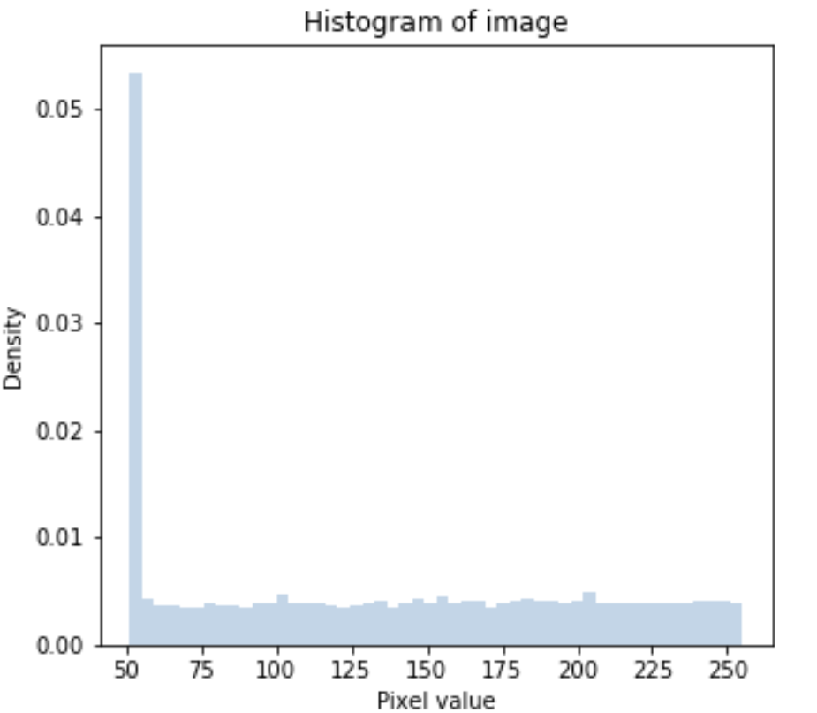
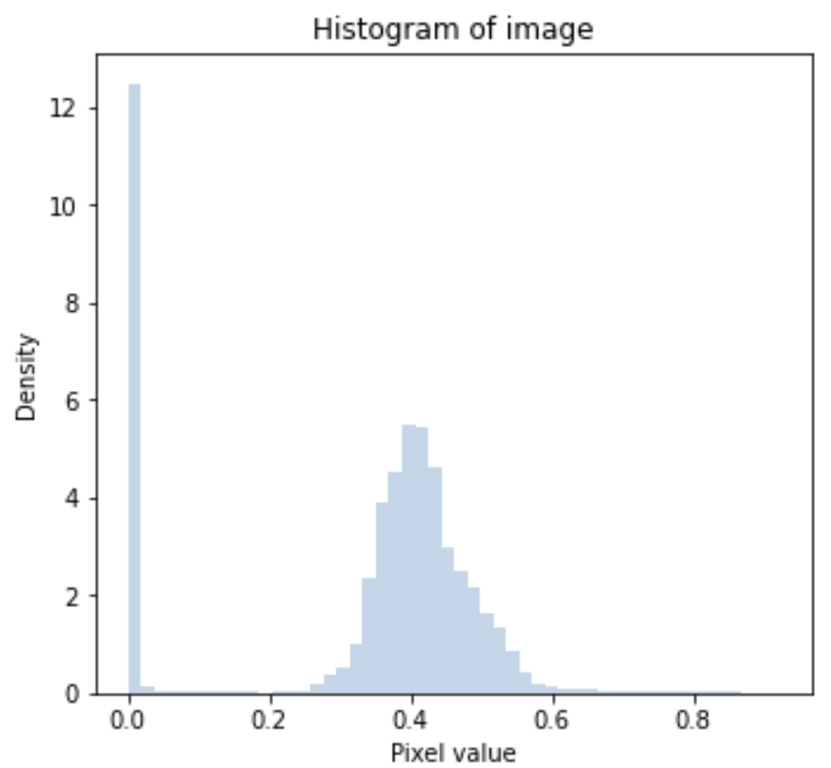
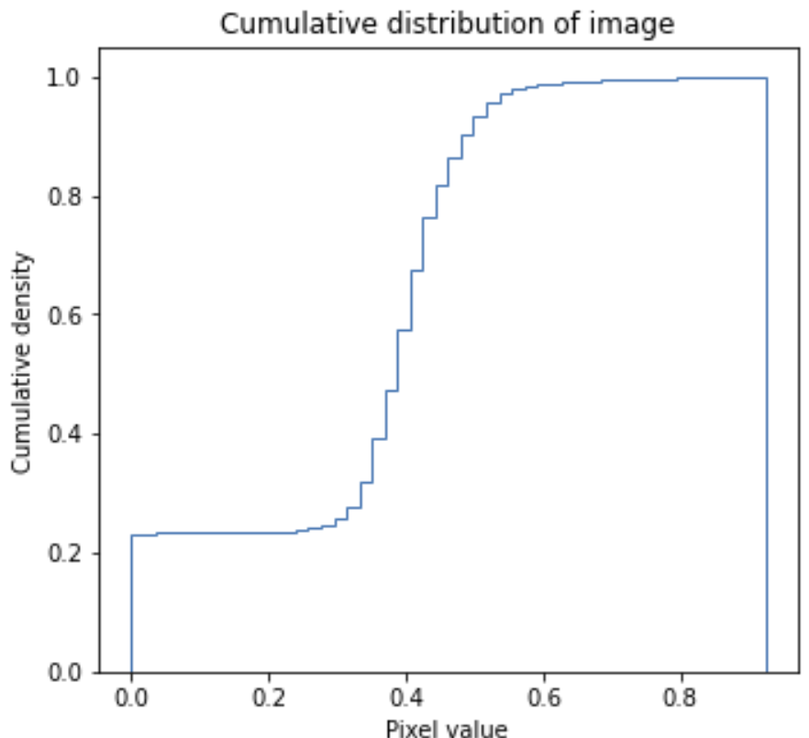
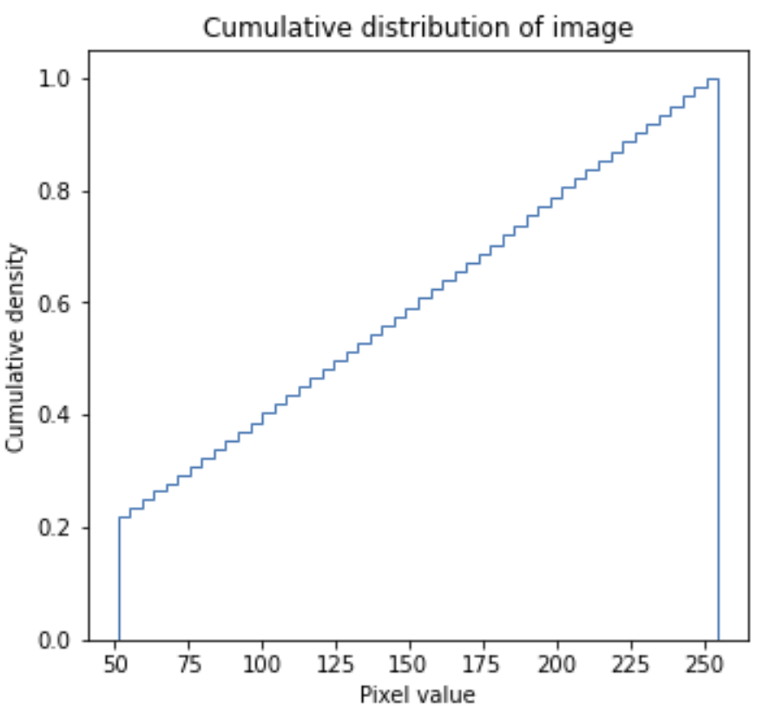
Contrast Improvement
Want a transformation to redistribute pixel values
Transform pixel values to uniform distribution

Slide 47
Contrast Improvement
Contrast improvement transformations
Many algorithms and methods for improving image contrast
Illumination control
Practical and widely used in industrial solutions
Commonly used algorithms include:
Histogram equalization, global and local
Gamma correction, pixel-wise
Logarithmic adjustment , pixel-wise
Sigmoidal adjustment , pixel-wise
Selection of methods dependent on situation
Notes:
ill

Slide 48
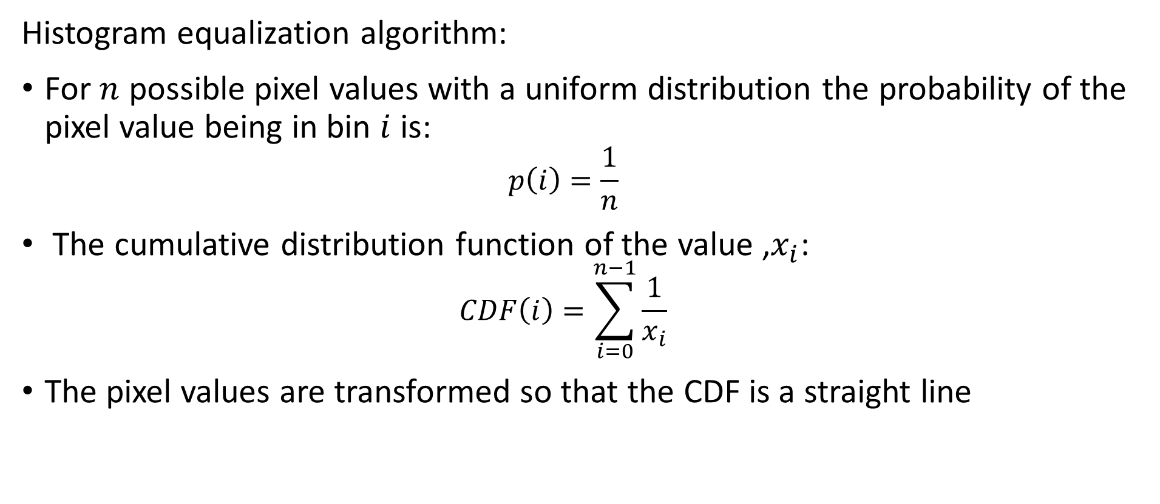
Contrast Improvement
Histogram equalization algorithm:
For $n$ possible pixel values with a uniform distribution the probability of the pixel value being in bin $i$ is:
$$p\left(i\right)=\frac{1}{n}$$
The cumulative distribution function of the value ,$x_{i}$:
$$CDF\left(i\right)=\sum_{i=0}^{n−1}{\frac{1}{x_{i}}}$$
The pixel values are transformed so that the CDF is a straight line

Slide 49
Contrast Improvement
Standard histogram equalization algorithm operates on the entire image
But illumination and color vary across an image
Contrast improvement may not be optimal globally
Can optimized contrast locally
Local contrast improvement
Improve contrast over local patches of the image
Adapts to local illumination and intensity
Other adaptive algorithms are commonly used

Slide 50
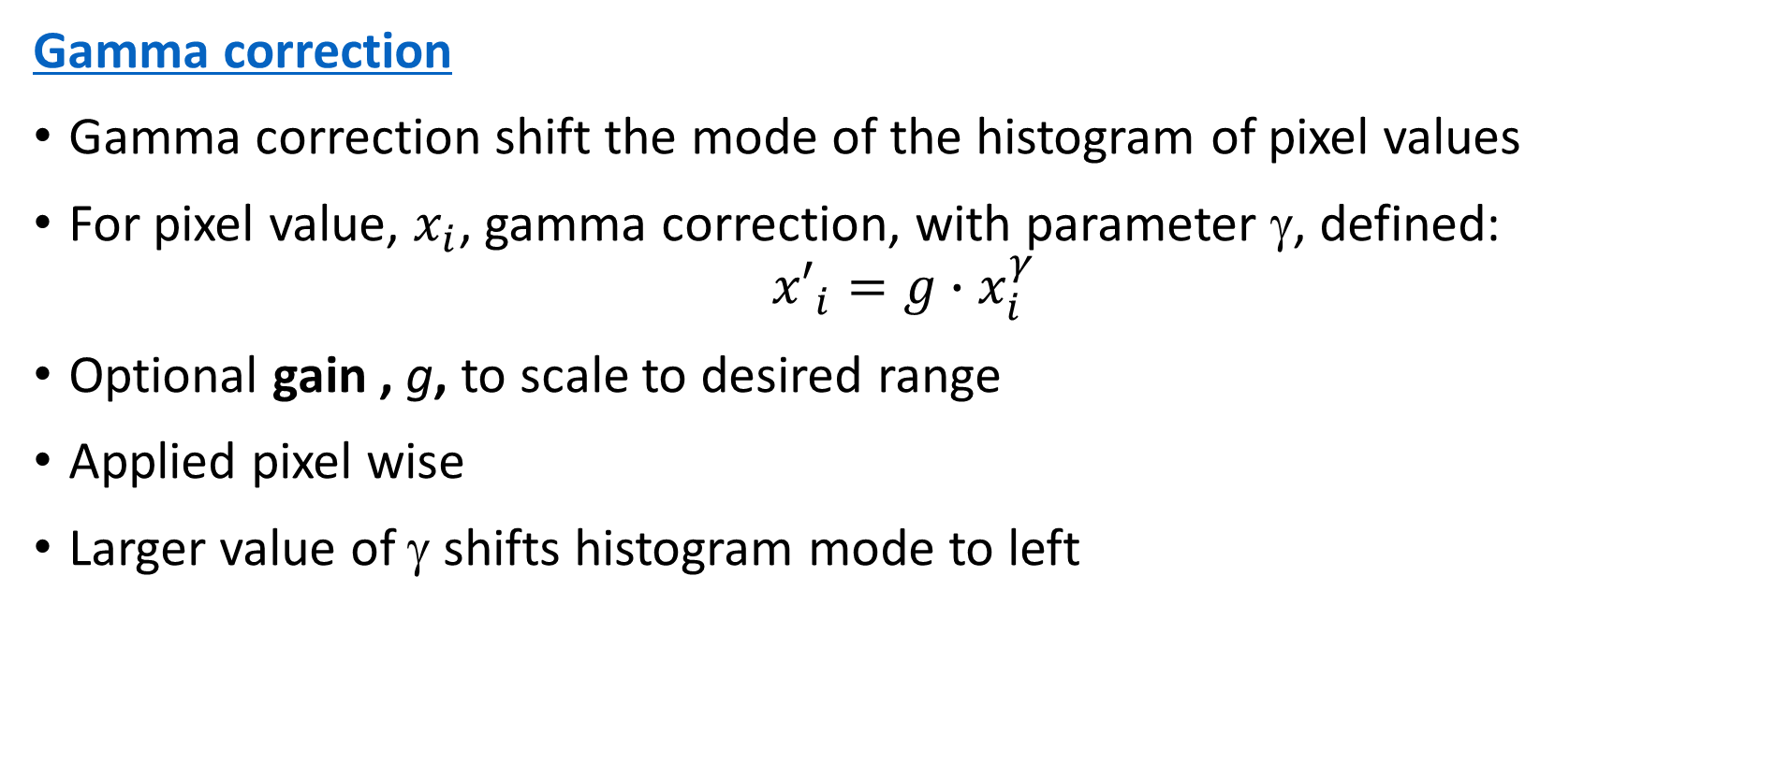
Contrast Improvement
Gamma correction
Gamma correction shift the mode of the histogram of pixel values
For pixel value, $x_{i}$, gamma correction, with parameter γ, defined:
$${x′}_{i}=g{∙x}_{i}^{γ}$$
Optional gain , g, to scale to desired range
Applied pixel wise
Larger value of γ shifts histogram mode to left
Notes:
ill

Slide 51
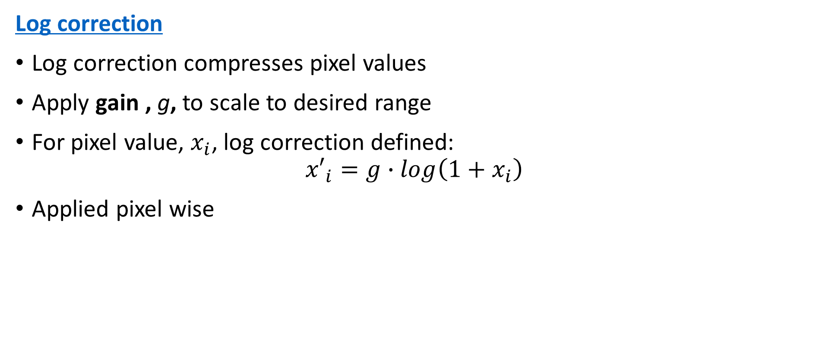
Contrast Improvement
Log correction
Log correction compresses pixel values
Apply gain , g, to scale to desired range
For pixel value, $x_{i}$, log correction defined:
$${x′}_{i}=g{∙log\left(1+x_{i}\right)}_{ }^{ }$$
Applied pixel wise
Notes:
ill

Slide 52
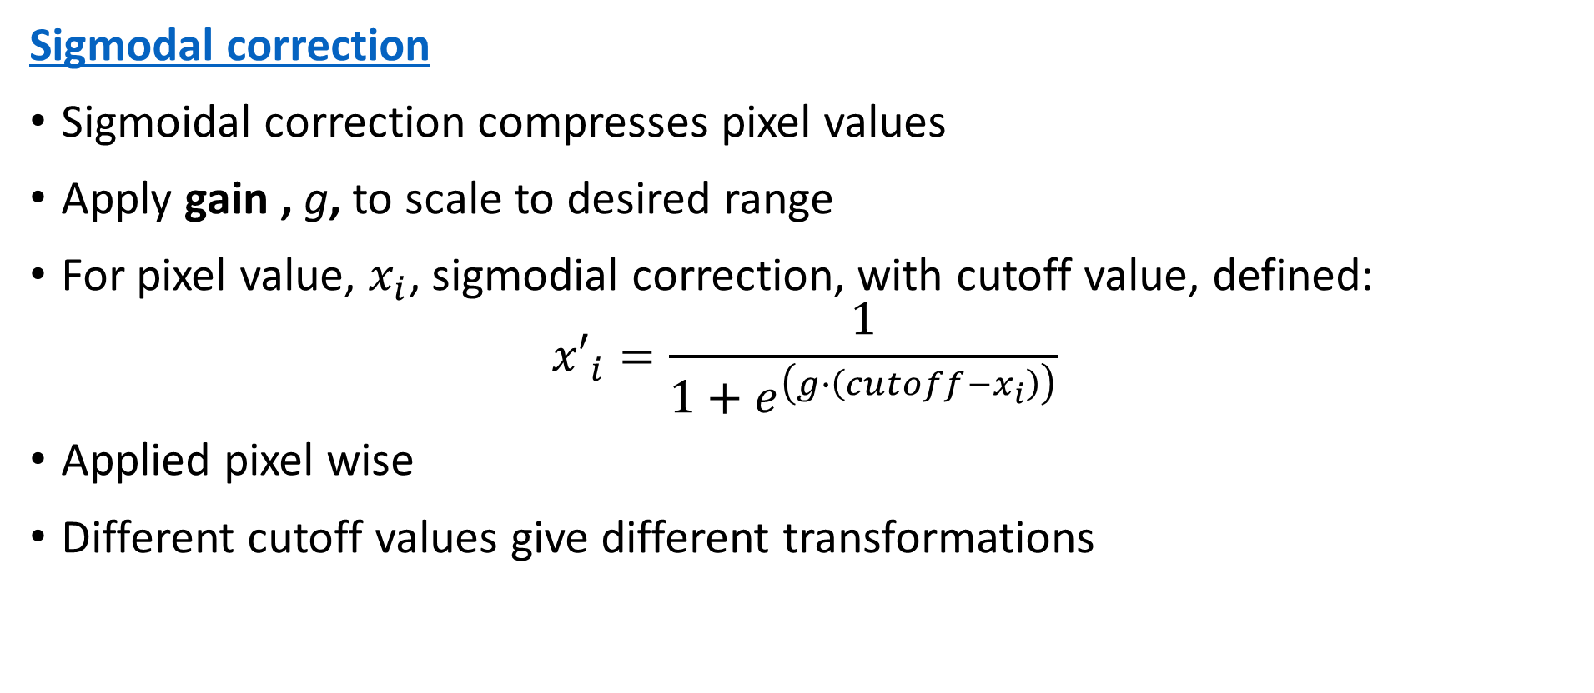
Contrast Improvement
Sigmodal correction
Sigmoidal correction compresses pixel values
Apply gain , g, to scale to desired range
For pixel value, $x_{i}$, sigmodial correction, with cutoff value, defined:
$${x′}_{i}=\frac{1}{1+e^{\left(g∙\left(cutoff−x_{i}\right)\right)}}$$
Applied pixel wise
Different cutoff values give different transformations
Notes:
ill

Slide 53
Summary
Key points for this lesson
The nature of image formation
Several possible representations for digital images
Digital image data sampling and aliasing effects
Basic image preparation

