Slide 1

CSCI E-25 Computer Vision
Convolutional Neural Networks and Feature Learning
Steve Elston
Copyright 2021, Stephen F Elston. All rights reserved.

Slide 2
Convolutional Neural Networks
Convolutional neural networks (CNNs) learn complex feature maps
Parameters of the feature maps are learned from the data
Features are optimal to reduce the loss function
CNNs are a powerful alternative to constructing hand engineered features
Feature maps created by CNNs are rich and complex
Feature maps have many layers or channels
More complex feature maps have greater capacity
Almost always outperform hand-engineered features

Slide 3
Convolutional Neural Networks
CNNs learn complex feature maps
Invariant to translation and distortion of features
Reduce the dimensionality of input tensors
Share weights and are relatively easy to train
CNNs have a long history
LeCun et. al. (1998) first employed CNNs for automatic check handling
Era of general use started when Krizhevsky et. al. (2012) won an ImageNet object recognition competition
Now commonly used for image, speech and text problems

Slide 4
Convolutional Neural Networks
Representation
Inference
Input = X
Output = Y
Learning

Slide 5
Convolutional Neural Networks
Key points for this lesson
CNNs learn complex feature maps
Feature maps have many layers or channels
CNNs use parameter sharing
Pooling and invariance
Deeper CNNs create feature maps with higher capacity
Training very deep NNs with ResNets
Multi-scale architectures use parallel feature map paths

Slide 6
Convolution in 2 and higher dimensions

Slide 7
2-D Convolution
4 x 4 input tensor
3 x 3 convolution operator
2 x 2 output tensor
Input
Output

Slide 8
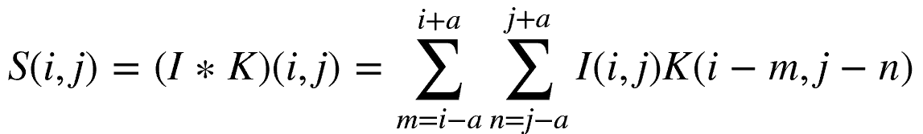
2-D Convolution
Mathematically, we express 2-d convolution as a weighted sum over a discrete rectangular kernel:
Where S, I and K are now tensors

Slide 9
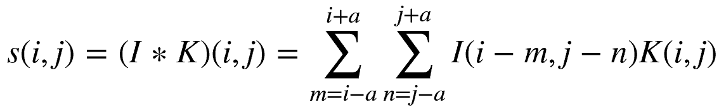
2-D Convolution
The image and kernel tensors are commutative in the convolution relationship
This allows an operation known as kernel flipping with the following alternative result:

Slide 10
Convolution in Higher Dimensions
Tensor notation allows easy extension to higher dimensions
Input tensor has multiple input channels
3-D for color image
4-D for video
Create multiple feature maps
Convolution kernel tensor has multiple output channels
Each output channel is a different feature map
Feature in a channel might be vertical lines, horizontal lines, corners, etc

Slide 11
Convolution in Higher Dimensions
Tensor of K output channels
Each channel is a part of feature map
Convolution kernel tensor
of K x L x Span x Span
weights
L input channels
i x j dimensions

Slide 12
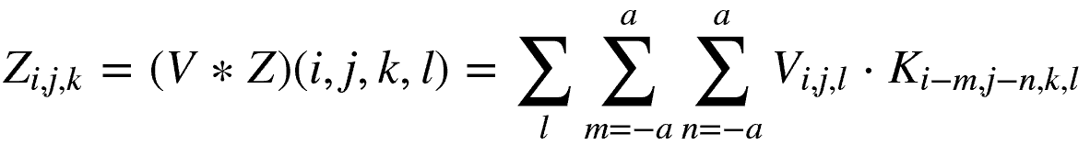
Convolution in Higher Dimensions
A multi-dimensional convolution relationship can be written:
Where:

Slide 13
Parameter Sharing

Slide 14
Parameter Sharing
The weights of the convolutional kernel are learned
Each weight of a fully connected network must be learned independently
CNNs are efficient to train
CNNs use parameter sharing
Statistical strength from more samples per weight
Reduced variance of parameter estimates
Weights are learned using backpropagation and gradient descent methods
Also called tied weights or sparse interaction

Slide 15
Parameter Sharing
Weights of fully connected network are independent
e.g. requires 5² = 25 weights

Slide 16
Parameter Sharing
Weights are shared in CNN
W₁
W₃
W₁
W₃
W₁
W₃
W₂
W₂
W₂
Requires 3 weights

Slide 17
Pooling and Invariance

Slide 18
Pooling and Invariance
Convolution provides reduced dimensionality of input tensor
How can we obtain greater reduction in dimensionality?
Pooling of convolution kernel output values reduces dimensionality
e.g. 2x2 operator pools the 4 values into 1
How to pool?
Average?
Max pooling; simple and highly effective

Slide 19
Pooling and Invariance
Max pooling provides invariance to small shifts of the input tensor:
0.3
1.0
0.3
0.3
1.0
0.2
0.3
0.1
1.0
0.2
0.1
0.3
0.2
0.3
0.1
1.0
0.2
0.1
Original
Shift Right by One

Slide 20
Pooling and Invariance
Max pooling provides invariance to small shifts of the input tensor:
1.0
1.0
1.0
0.2
1.0
0.3
1.0
1.0
0.3
1.0
1.0
0.3
1.0
0.3
0.1
1.0
0.2
0.1
0.1
0.3
0.1
1.0
0.2
Original
Shift Right by One

Slide 21
Early Example: LeNet5

Slide 22
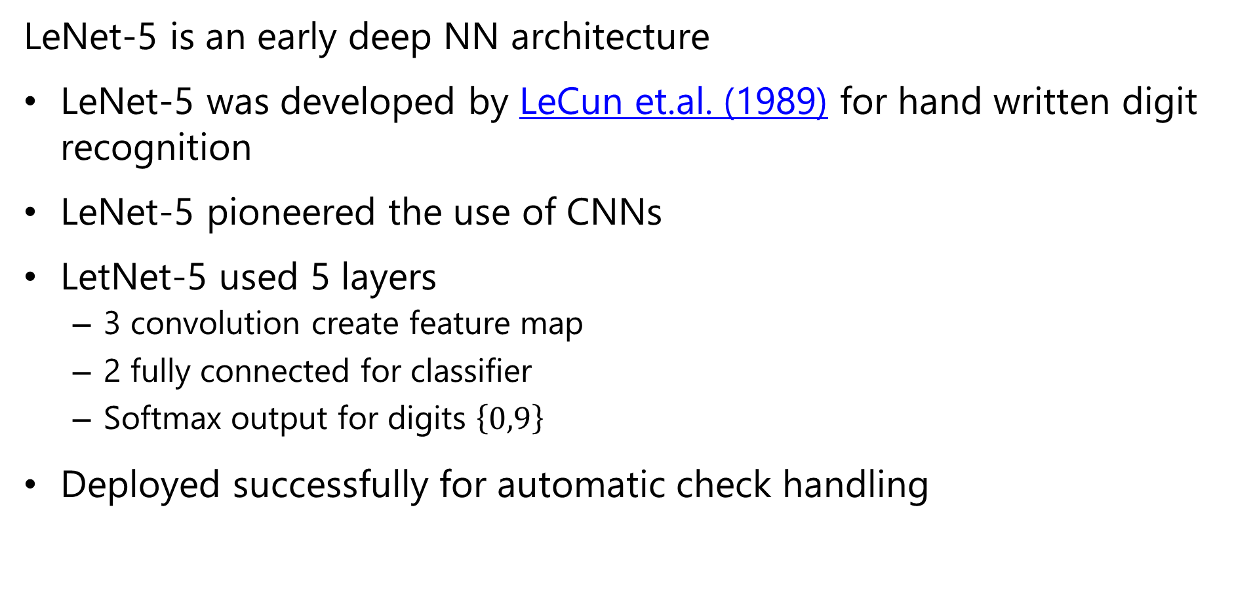
LeNet-5 Architecture
LeNet-5 is an early deep NN architecture
LeNet-5 was developed by LeCun et.al. (1989) for hand written digit recognition
LeNet-5 pioneered the use of CNNs
LetNet-5 used 5 layers
3 convolution create feature map
2 fully connected for classifier
Softmax output for digits $\left\{0,9\right\}$
Deployed successfully for automatic check handling

Slide 23
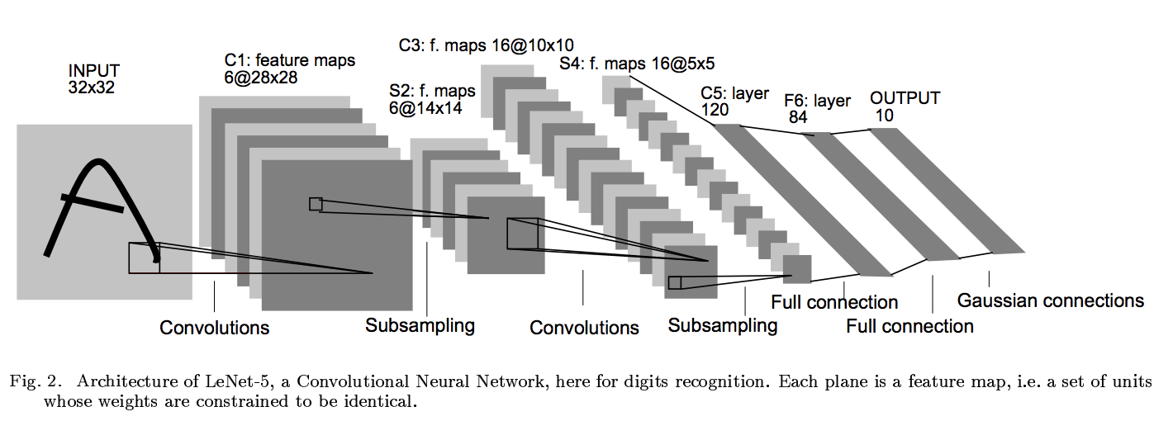
LeNet5: Model
# import the necessary packages
from keras.models import Sequential
model = Sequential()

Slide 24
LeNet5: Input
# import the necessary packages
from keras.datasets import mnist
(x_train, y_train), (x_test, y_test) = mnist.load_data()

Slide 25
LeNet5: Convolution
model.add(Convolution2D(6, 5, 5,
border_mode="valid",
input_shape=(depth, height, width)))

Slide 26
LeNet5: Non-Linearity
from keras.layers.core import Activation
model.add(Activation(" sigmoid "))

Slide 27
LeNet5: Pooling
from keras.layers.convolutional import MaxPooling2D
model.add(MaxPooling2D(pool_size=(2, 2), strides=(2, 2)))

Slide 28
LeNet5: Second convolution
model.add(Convolution2D(16, 5, 5,
border_mode="valid"))

Slide 29
LeNet5: Second NonLinearity
model.add(Activation(”sigmoid"))
Notes:
Mention again that sigmoid is a horrible idea, when you go deep.

Slide 30
LeNet5: Second Pooling
model.add(MaxPooling2D(pool_size=(2, 2), strides=(2, 2)))
Notes:
Mention again that sigmoid is a horrible idea, when you go deep.

Slide 31
LeNet5: Third Convolution
model.add(Convolution2D(120, 1, 1, border_mode='valid'))

Slide 32
LeNet5: Flattening
from keras.layers.core import Flatten
model.add(Flatten())
Notes:
Mention again that sigmoid is a horrible idea, when you go deep.

Slide 33
LeNet5: Dense Connections
from keras.layers.core import Dense
model.add(Dense(84))
model.add(Activation("sigmoid"))

Slide 34
LeNet5: Dense Connections
model.add(Dense(10))

Slide 35
LeNet5: Dense Connections
model.add(Activation('softmax'))

Slide 36
Deeper Architectures

Slide 37
Deeper Architectures
Deeper architectures create richer feature maps
Deep architectures create large and complex feature maps
Feature maps have a higher number of channels
Trained on very large benchmark datasets
Classification accuracy found to improve with depth

Slide 38
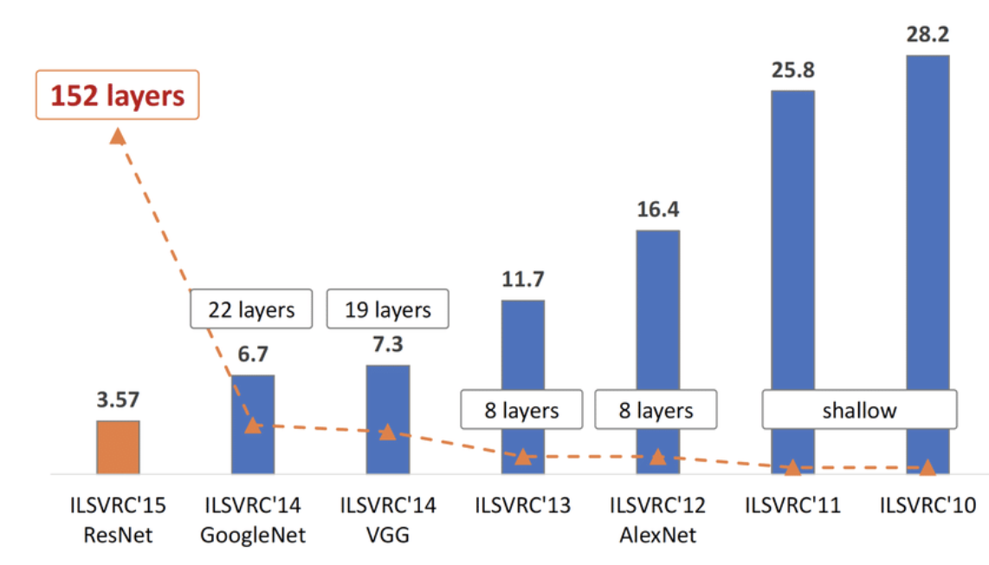
Deep Architectures

Slide 39
Deep and Multi-Scale Architectures
VGG11 - Simanyan and Zdisserman, 2015
Feature map with Increasing channels, decreasing dimensionality
Max pool
Max pool
Max pool
1000 Fully connected
3x3 conv, 256 channel
3x3 conv, 128 channel
3x3 conv, 64 channel
3x3 conv, 256 channel
Max pool
3x3 conv, 512 channel
3x3 conv, 512channel
3x3 conv, 512 channel
3x3 conv, 512channel
4096 Fully connected
4096 Fully connected
Max pool
Softmax
Convolution and max-pool create feature map
Classifier layers use feature map

Slide 40
Training Very Deep Networks and ResNet

Slide 41
Deep and Multi-Scale Architectures
Very deep CNNs can provide significant improvements in accuracy
But, learning is hard in very deep networks

Slide 42
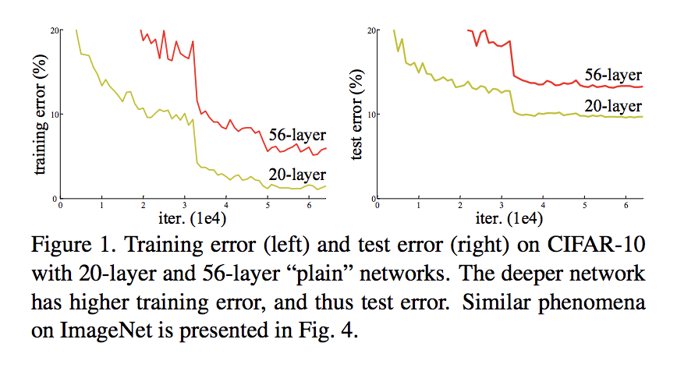
Limitations on Learning with Stacked Layers
What happens when we use backpropagation to train deep NNs with larger number of layers?
How can the behavior in the charts be explained?
Vanishing gradients?
Exploding gradients?
Overfitting?
None of the above!
Vanishing gradients – batch normalization
Exploding gradients – gradient clipping
Overfitting – dropout regularization
https://arxiv.org/pdf/1512.03385.pdf
Notes:
The last architecture we are going to look into is the resnet. Microsoft researchers in 2015 came to a good understanding of limits of deep networks. Going deeper after a certain degree make the learning suffer. Sounds familiar? Why do you think this was the case?
Quote from ResNet paper: We argue that this optimization difficulty is unlikely to be caused by vanishing gradients. These plain networks are trained with BN, which ensures forward propagated signals to have non-zero variances. We also verify that the backward propagated gradients exhibit healthy norms with BN. So neither forward nor backward signals vanish.
It also isn’t overfitting as we can see the training error of 56 layers is higher than 20-layer version! So is it representation?

Slide 43
Limitations on Learning with Stacked Layers
What can explain this result?
There must be a limitation with the representation!
The learning with backpropagation on stacked layers no longer learns useful features past a certain depth
Notes:
The last architecture we are going to look into is the resnet. Microsoft researchers in 2015 came to a good understanding of limits of deep networks. Going deeper after a certain degree make the learning suffer. Sounds familiar? Why do you think this was the case?
Quote from ResNet paper: We argue that this optimization difficulty is unlikely to be caused by vanishing gradients. These plain networks are trained with BN, which ensures forward propagated signals to have non-zero variances. We also verify that the backward propagated gradients exhibit healthy norms with BN. So neither forward nor backward signals vanish.
It also isn’t overfitting as we can see the training error of 56 layers is higher than 20-layer version! So is it representation?

Slide 44
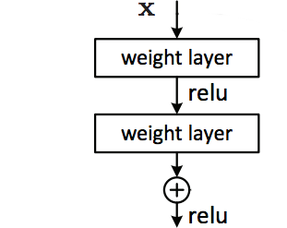


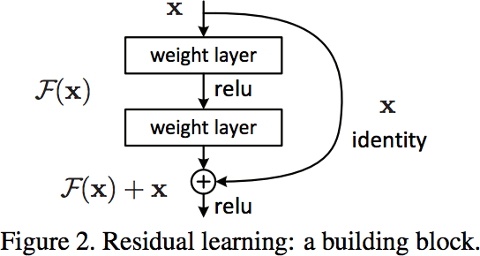


Limitations on Learning with Stacked Layers
Idea: Try to learn a different function
Ideally a subset of stacked layers learns a nonlinear function,
But, can also learn a residual function
Rearrange terms to derive a different residual mapping function
Or with explicitly showing weights,
Layers now have an identity shortcut

Slide 45
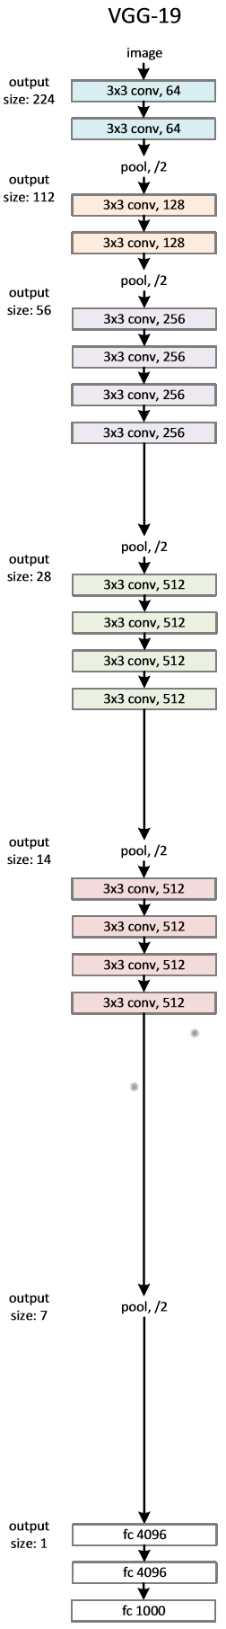
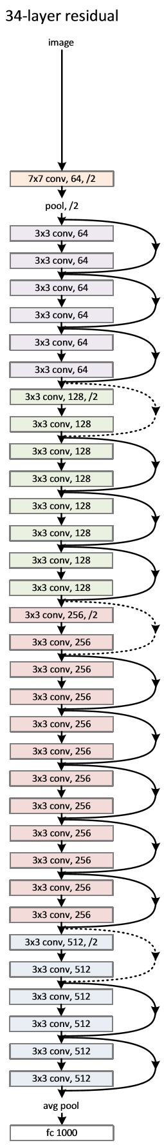
ResNet Representation with Residuals
Start with VGG19 architecture
34 stacked layer network
34 layer ResNet with identity shortcuts
Notes:
Example network architectures for ImageNet. Left: the VGG-19 model [41] (19.6 billion FLOPs) as a reference. Middle: a plain network with 34 parameter layers (3.6 billion FLOPs). Right: a residual network with 34 parameter layers (3.6 billion FLOPs). The dotted shortcuts increase dimensions. Table 1 shows more details and other variants.
34 Layer non-residual network should at least be as good as the vgg-19. The 34 layer network has more capacity and can learn identity functions where it differs from the vgg. So it’s not representation either. Then why is it not learning the identity?
Although identity is representable, learning it proves difficult for optimization methods so they decide to tweak the network so it doesn’t have to learn identity connections

Slide 46
ResNet Representation with Residuals
How does computational complexity compare?
Notice ResNet has only 2 max pooling filters!
Forward propagation with VGG19 requires 19.6 B Floating Point Operations (GFLOPs)
Forward propagation with ResNet-34 requires 3.6 GFLOPs!
Notes:
Example network architectures for ImageNet. Left: the VGG-19 model [41] (19.6 billion FLOPs) as a reference. Middle: a plain network with 34 parameter layers (3.6 billion FLOPs). Right: a residual network with 34 parameter layers (3.6 billion FLOPs). The dotted shortcuts increase dimensions. Table 1 shows more details and other variants.
34 Layer non-residual network should at least be as good as the vgg-19. The 34 layer network has more capacity and can learn identity functions where it differs from the vgg. So it’s not representation either. Then why is it not learning the identity?
Although identity is representable, learning it proves difficult for optimization methods so they decide to tweak the network so it doesn’t have to learn identity connections

Slide 47
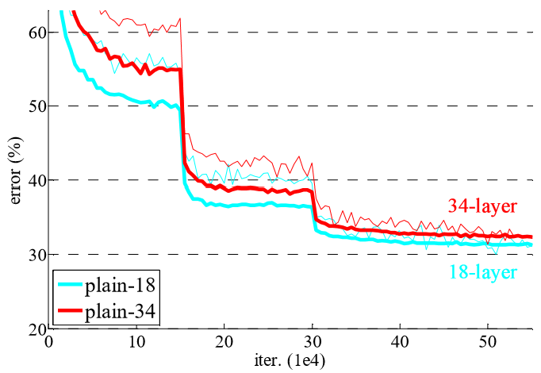
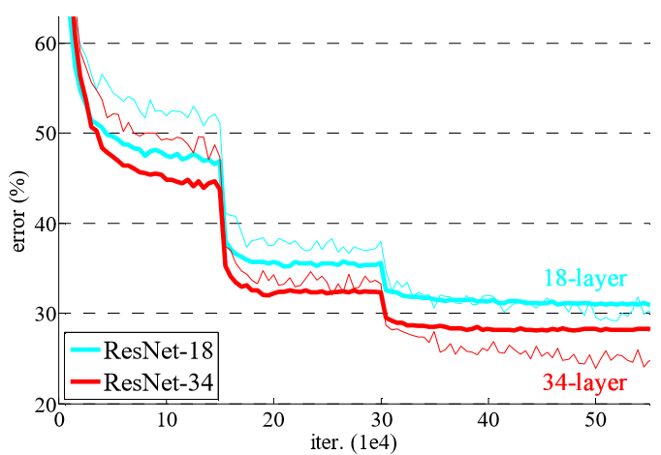
ResNet Representation with Residuals
How well does ResNet work?
Compare 18 and 34 layers stacked network performance
Next, compare 18 and 34 layer ResNets
Notes:
Example network architectures for ImageNet. Left: the VGG-19 model [41] (19.6 billion FLOPs) as a reference. Middle: a plain network with 34 parameter layers (3.6 billion FLOPs). Right: a residual network with 34 parameter layers (3.6 billion FLOPs). The dotted shortcuts increase dimensions. Table 1 shows more details and other variants.
34 Layer non-residual network should at least be as good as the vgg-19. The 34 layer network has more capacity and can learn identity functions where it differs from the vgg. So it’s not representation either. Then why is it not learning the identity?
Although identity is representable, learning it proves difficult for optimization methods so they decide to tweak the network so it doesn’t have to learn identity connections

Slide 48
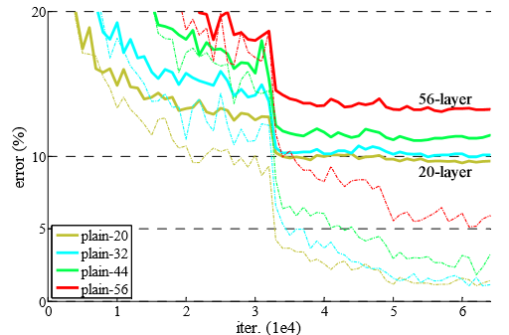
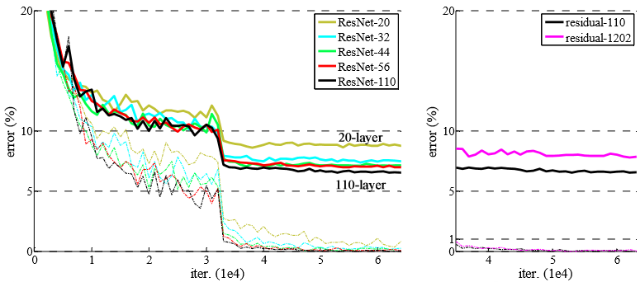
ResNet Representation with Residuals
What are the limits of ResNet Learning?
Compare stacked network performance drops past about 20 layers
ResNets allow greater depth and accuracy, but with limits!
Notes:
Example network architectures for ImageNet. Left: the VGG-19 model [41] (19.6 billion FLOPs) as a reference. Middle: a plain network with 34 parameter layers (3.6 billion FLOPs). Right: a residual network with 34 parameter layers (3.6 billion FLOPs). The dotted shortcuts increase dimensions. Table 1 shows more details and other variants.
34 Layer non-residual network should at least be as good as the vgg-19. The 34 layer network has more capacity and can learn identity functions where it differs from the vgg. So it’s not representation either. Then why is it not learning the identity?
Although identity is representable, learning it proves difficult for optimization methods so they decide to tweak the network so it doesn’t have to learn identity connections

Slide 49
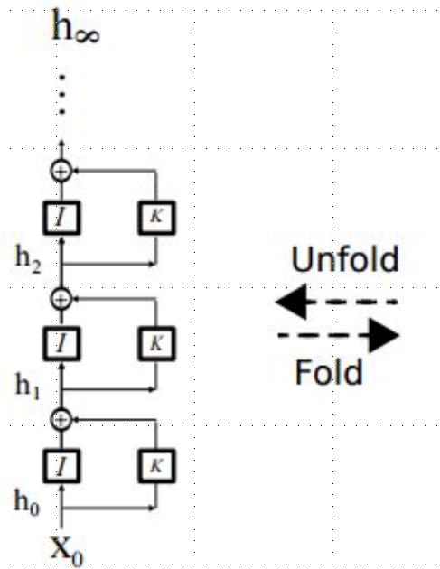
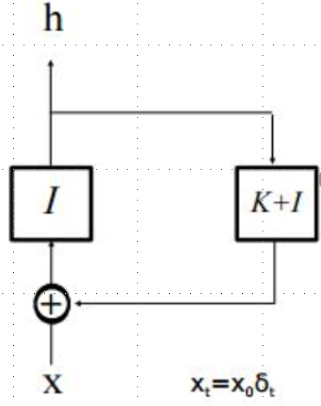
Why do ResNets work?
Why is learning easier with ResNets?
Start with ResNet feed-forward layers
Now, unroll the recurrence for several learning steps
Learning in the unrolled model resembles ensemble learning
Notes:
Ensembling: Dropping a layer doesn’t effect the accuracy much unlike VGG. There are L residual layers, we can either pick it or not pick it, 2^L modules in the implicit ensemble.
These networks do not compute entirely new representations; instead, they engage in an unrolled iterative estimation of representations that refine/improve upon their input representation, thus preserving feature identity.

Slide 50

Scaling with ResNets
How do we deal with shortcut connections with different scales of layers?
Zero pad
Use linear projection connection to up or down sample ta
Zero pad is nearly as good projection connection, but many fewer weights to learn
Zero padding used in ResNet

Slide 51
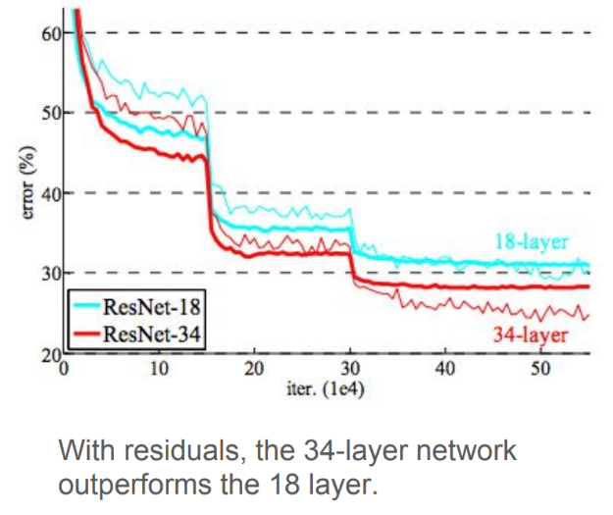
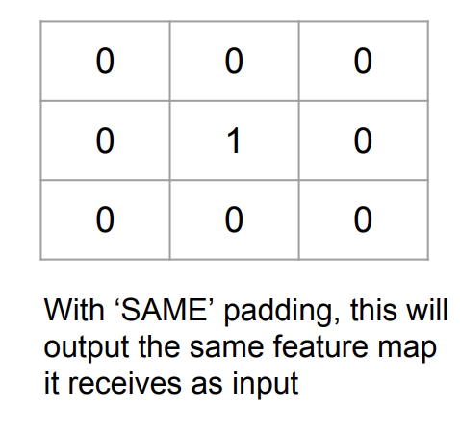
ResNet: Residual Learning Building Block
Notes:
Far left, without residuals: we are trying to learn a mapping from x to H(x). X gets mapped to H(x) after the application of these two weight layers. Instead of trying to learn H(x), we will assume we have identity ‘x’ present already (middle pic), and force the network to learn H(x) – x. Seems to work better! What is identity function (far right pic). With these settings, the error rate goes down again!

Slide 52
ResNet
https://arxiv.org/pdf/1512.03385.pdf
How can the behavior in the above charts be explained?
Vanishing gradients?
Overfitting?
Representation power?
Notes:
The last architecture we are going to look into is the resnet. Microsoft researchers in 2015 came to a good understanding of limits of deep networks. Going deeper after a certain degree make the learning suffer. Sounds familiar? Why do you think this was the case?
Quote from ResNet paper: We argue that this optimization difficulty is unlikely to be caused by vanishing gradients. These plain networks are trained with BN, which ensures forward propagated signals to have non-zero variances. We also verify that the backward propagated gradients exhibit healthy norms with BN. So neither forward nor backward signals vanish.
It also isn’t overfitting as we can see the training error of 56 layers is higher than 20-layer version! So is it representation?

Slide 53
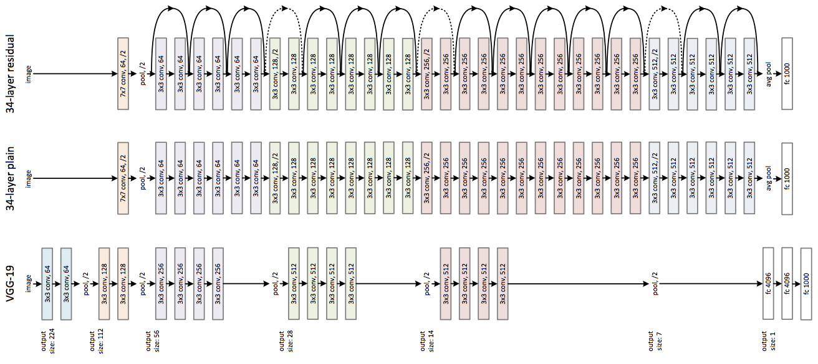
ResNet Representation Power
https://arxiv.org/pdf/1512.03385.pdf
Notes:
Example network architectures for ImageNet. Left: the VGG-19 model [41] (19.6 billion FLOPs) as a reference. Middle: a plain network with 34 parameter layers (3.6 billion FLOPs). Right: a residual network with 34 parameter layers (3.6 billion FLOPs). The dotted shortcuts increase dimensions. Table 1 shows more details and other variants.
34 Layer non-residual network should at least be as good as the vgg-19. The 34 layer network has more capacity and can learn identity functions where it differs from the vgg. So it’s not representation either. Then why is it not learning the identity?
Although identity is representable, learning it proves difficult for optimization methods so they decide to tweak the network so it doesn’t have to learn identity connections

Slide 54
ResNet: Residual Learning Building Block
Notes:
Far left, without residuals: we are trying to learn a mapping from x to H(x). X gets mapped to H(x) after the application of these two weight layers. Instead of trying to learn H(x), we will assume we have identity ‘x’ present already (middle pic), and force the network to learn H(x) – x. Seems to work better! What is identity function (far right pic). With these settings, the error rate goes down again!

Slide 55
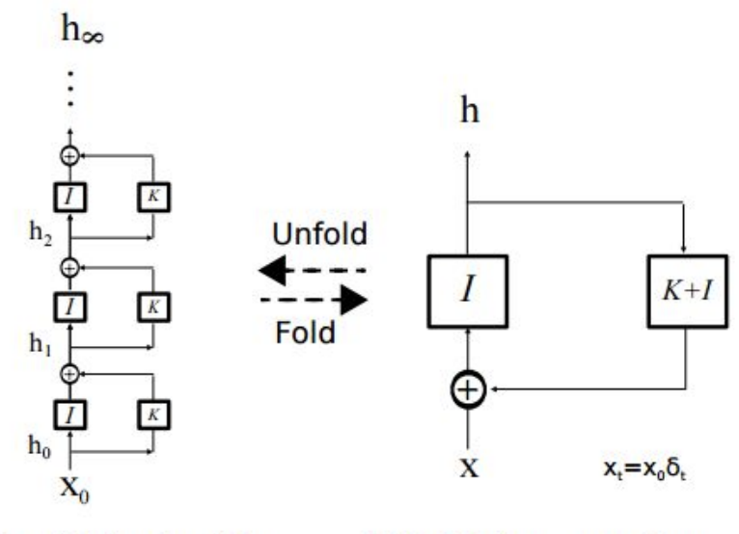
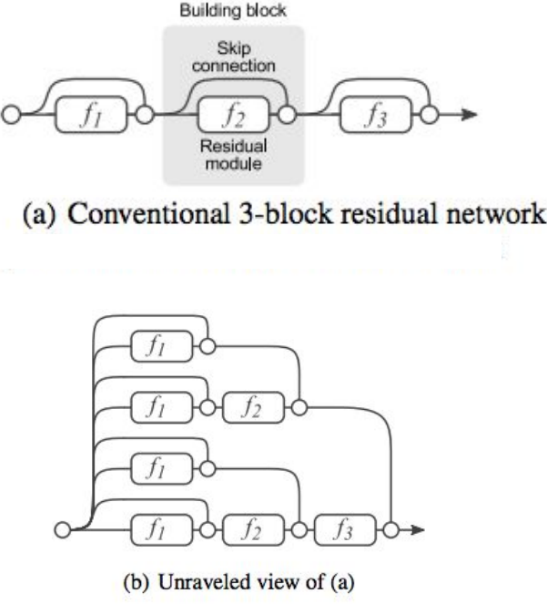
Why do ResNets work?
gd
Notes:
Ensembling: Dropping a layer doesn’t effect the accuracy much unlike VGG. There are L residual layers, we can either pick it or not pick it, 2^L modules in the implicit ensemble.
These networks do not compute entirely new representations; instead, they engage in an unrolled iterative estimation of representations that refine/improve upon their input representation, thus preserving feature identity.

Slide 56
Multi-Scale Architectures

Slide 57
Multi-Scale Architectures
How can convolutional layers be expanded to multiple scales
Single convolutional layers work at single scale
But, real-world images contain objects with different scales
Need architecture that supports multiple scales
CNN layers with different scales in parallel
Concatenate the results
Numerous pretrained models, using complex architectures, are now available
Trained on very large benchmark datasets
Built into deep learning frameworks; Keras, PyTorch, etc.

Slide 58
Example: Multi-Scale Architecture
Xception
Chollet, 2017
Input tensor
1x1 Conv
Ave Pool
1x1 Conv
1x1 Conv
3x3 Conv
3x3 Conv
3x3 Conv
3x3 Conv
Concatenated multi-scale feature map

Slide 59
Transfer Learning
Transfer learning exploits learning of a model trained with similar data
Transfer learning can greatly speed learning for specific solutions
Train Mode
From Scratch
Fine Tune
Pretrained model
Size of Data
Fine tune not
just the output
layer but hidden
Layers
Fine Tune
the output
layers
Data Similarity
Notes:
Data small but similar. Can’t fine tune, we will overfit. Just learn the top layers using a linear classifier.
Data large and similar. No concern with overfitting. Fine tune the whole network.
Data small and not similar. Overfitting problems if we were to finetune the whole network. Data not similar, so only earlier filters are applicable, not the later ones. Fine tune from somewhere in the middle.

