Slide 1
CS 341 Lab 10
FALL 2020

Slide 2
Lab 10
Goal: Setup a servo motor so that it rotates according to a potentiometer
This one should be easy

Slide 3

Potentiometer
Variable resistor
We can turn the knob to vary how much current goes through
We used this before in lab 5

Slide 4

Servo Motor
controlled using the <Servo.h> library
Servo myServo;
myServo.attach(9); //we will use pin 9
myServo.write(val);
Simple to control
Rotate with a lot of precision

Slide 5
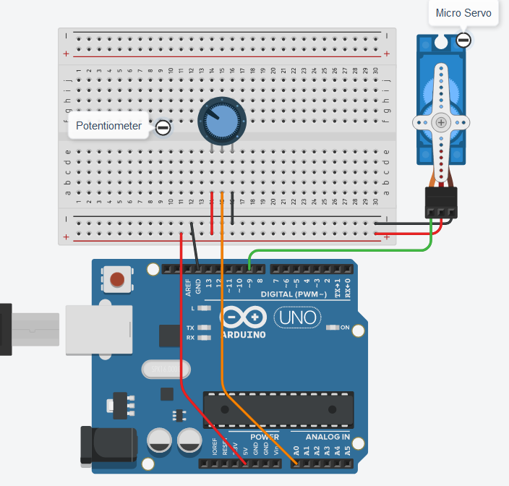

Slide 6
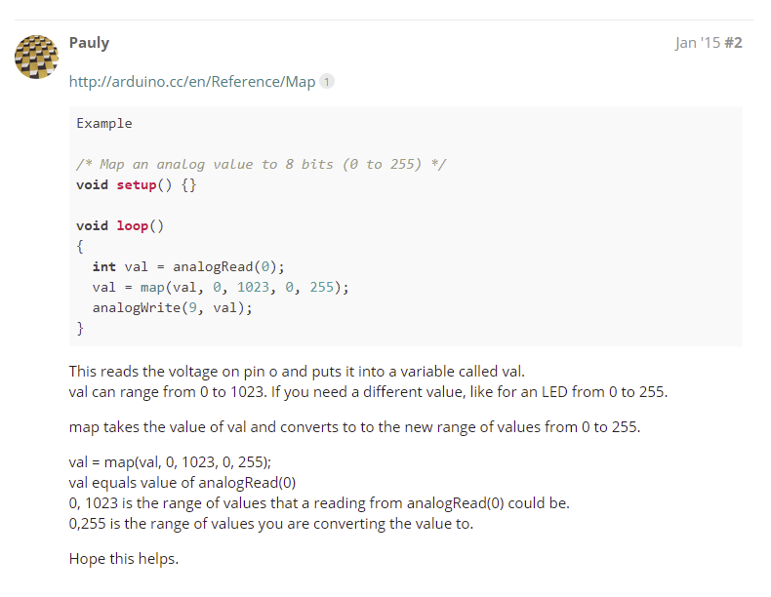
map():translate analog read to appropriate value
Syntax
map(value, fromLow, fromHigh, toLow, toHigh)
Parameters
value: the number to map.
fromLow: the lower bound of the value’s current range.
fromHigh: the upper bound of the value’s current range.
toLow: the lower bound of the value’s target range.
toHigh: the upper bound of the value’s target range.

Slide 7
Lab 10
The starter code is already complete
Complete the circuit

