Slide 1
Lab 3:EEPROM
CS341 Spring ‘21

Slide 2

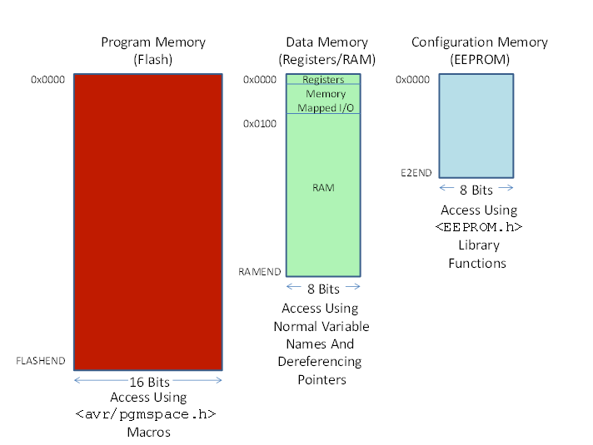
From last week:
Configuration memory (EEPROM) 1K bytes or 0.000001 gb :
Non volatile.
Read or written into from program
Slower than ram. We can only read it and write to it byte by byte.
The technology used to write to it takes longer and consumes more power.
Good for long term storage, like settings or if running out of ram
Limit on how many times it can be written too.

Slide 3
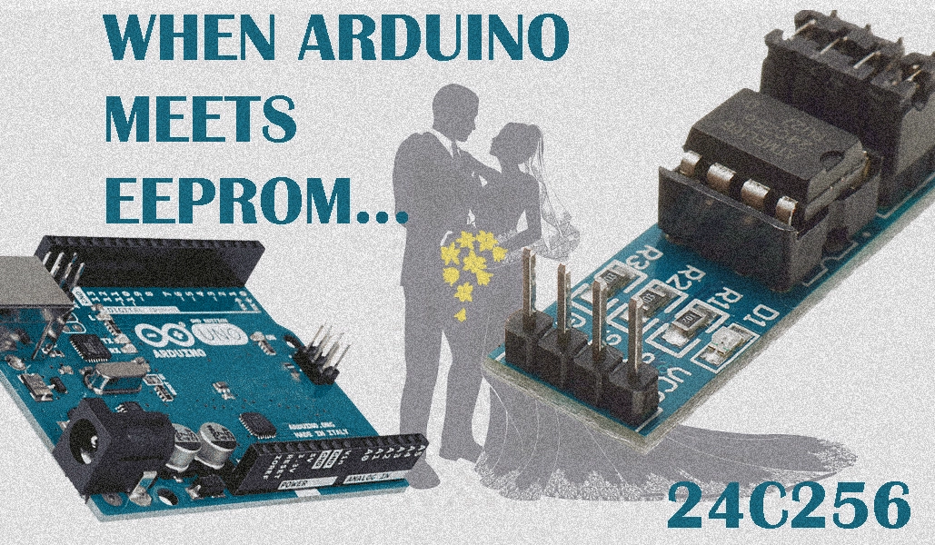
Today’s lab:
Part 1:
Store 8 chars in EEPROM
Write checksum function
Make use of bitwise operators, ~ and ^
Part 2:
Observe the effects of putting two bytes in EEPROM
Ftr that is external EEPROM. This lab requires no components just the arduino board and the internal EEPROM already in the board’s microcontroller

Slide 4
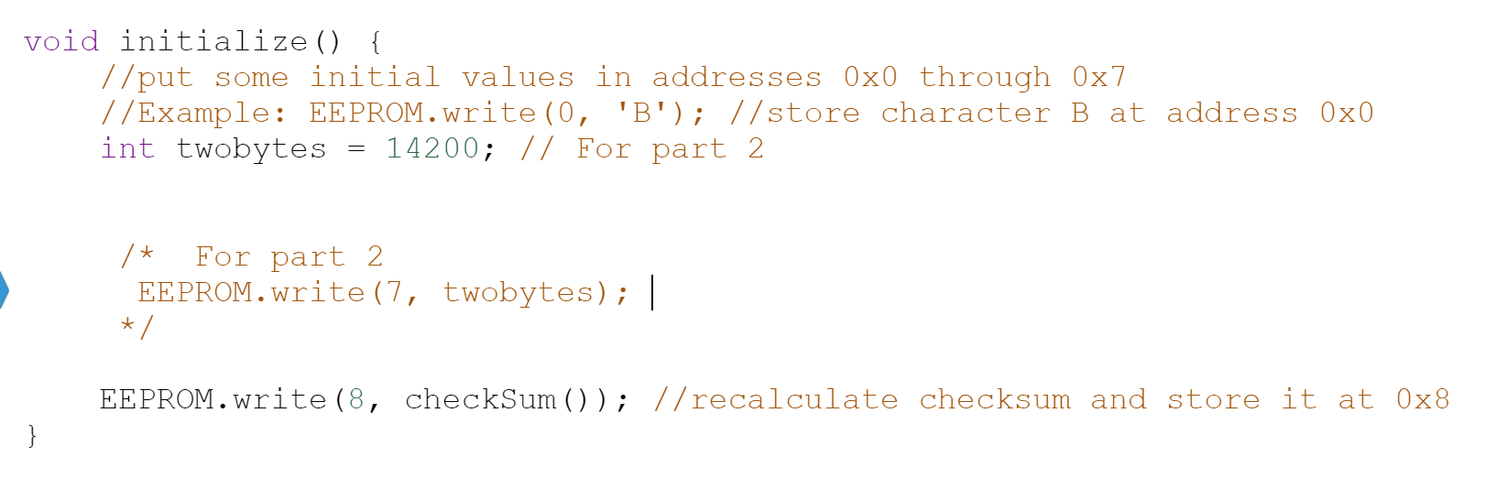
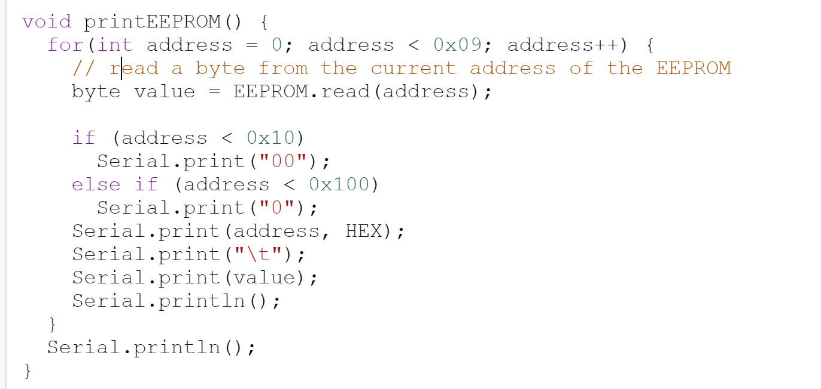
Functions of today:
Arduino EEPROM.h library functions
EEPROM.write(int address, int value);
EEPROM.write(5, 0x41);
Writes a byte of data, 0x41 (‘A’) to EEPROM
You’ll use this in initialize() to store 8 chars
EEPROM.read(int address);
byte a = EEPROM.read(5);
char a = EEPROM.read(5);
You’ll use this to make checksum()
Functions we provide:
void printEEPROM(); \\prints addresses 0-8 of EEPROM
//used in the starter code to print //from EEPROM & display as chars
// a will print as 65₁₀ //unless hex specified then 0x41

Slide 5
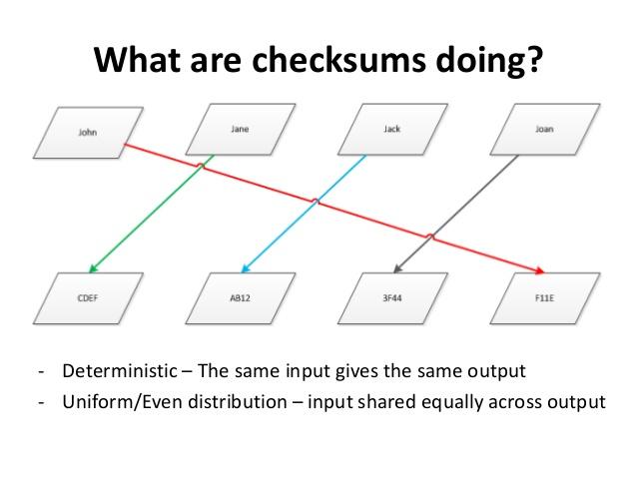
Checksum()
Checks if data is corrupted by performing operations on the data’s memory address. The value produced is stored and used for later comparisons. If the data has been corrupted, then performing the same checksum operation will result in a different value
Used to check for corruption after downloading, transfering, or from hardware malfunctions
Today we will write a simple checksum function to check the integrity of our 7 chars in EEPROM after a reset
(ours will only be one byte)

Slide 6
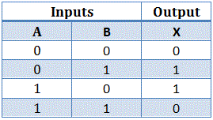
Checksum() continued: using bitmasking
Logical not/compliment/~
We will use two bitwise operators to mask our data
Exclusive or/ XOR / ^
‘!’ ‘o’ ‘\’
33₁₆ 6F₁₆ 5c₁₆
00110011₂ ^ 01101111₂ = 01011100₂
’Q’ ‘®️’
51₁₆ AE₁₆
~ 01010001₂ = 10101110₂
Arduino uses extended ascii table
Input | Output
A | X
1 | 0
0 | 1
Allows us to “combine” our data into one value while making sure it remains a certain size (a byte in our case)

Slide 7

Checksum()continued: Today’s simple version
CheckSum Algorithm
1010₂ ^ 1111₂ = 0101₂
0101₂ ^ 1100₂ = 1001₂
1001₂ ^ 0100₂ = 1101₂
~1101₂ = 0010₂
Read from eeprom, perform checksum, return checksum.
Index | Value
0 | 1010
1 | 1111
2 | 1100
3 | 0100
4

Slide 8
Quick part 2
After checksum complete, look at how EEPROM deals with more than one byte
What does that tell us about how the data is read?

