Slide 1
Lab 6: Analog and Digital input
CS444 2021

Slide 2
Today’s Lab:
Through arduino, you will create a light that turns on with motion. You will use:
A motion sensor (to detect motion
A light sensor (to determine if the light is already on)
To code:
Read digital input from motion sensor
If motion, read from analog input from sensor
If no light, turn light on
If no motion, turn light off

Slide 3
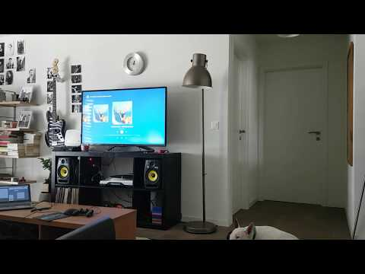
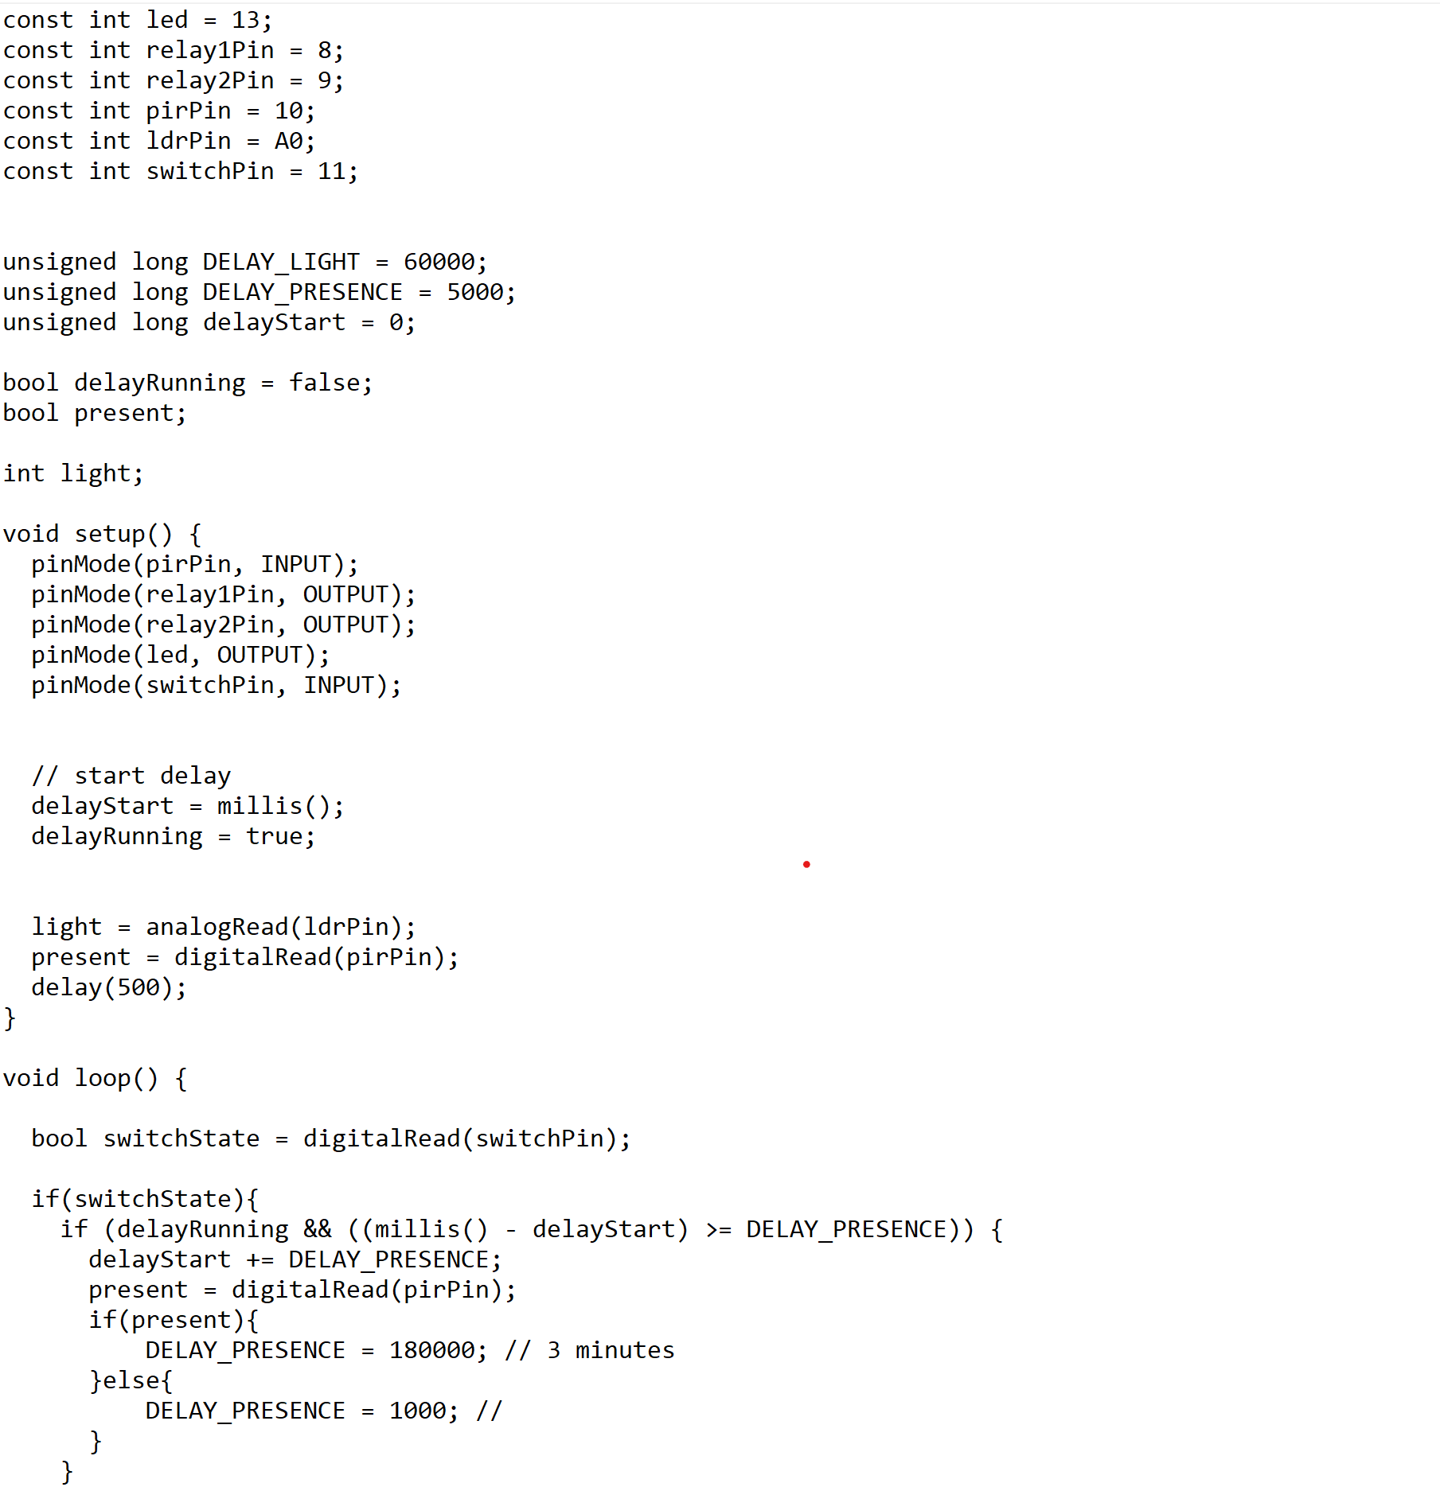
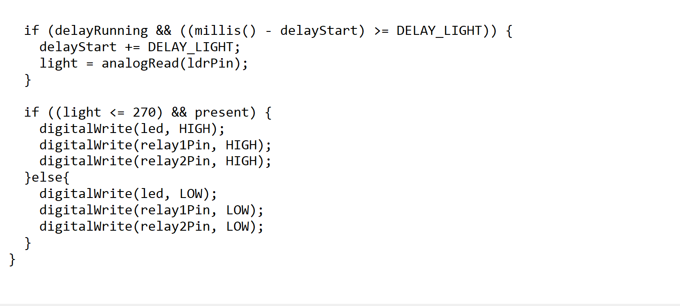
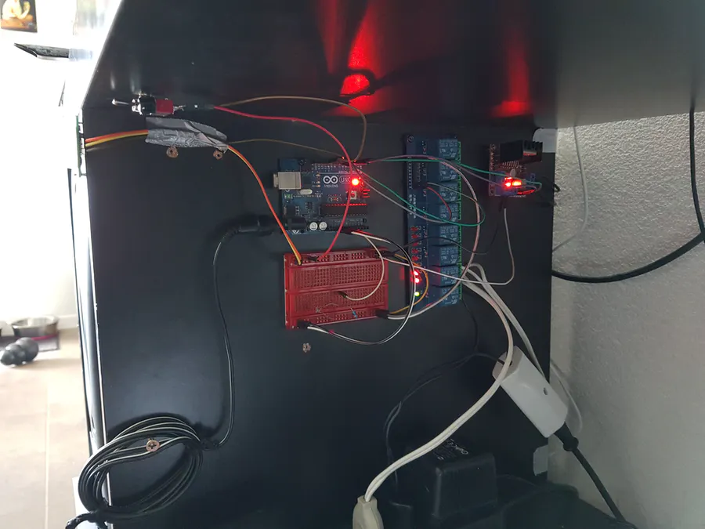
Example:

Slide 4
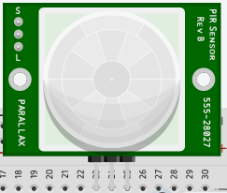
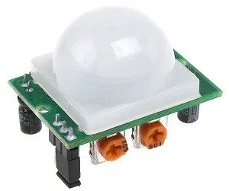
Component of Today: Infrared Motion Sensor
Send digital output:
1 = movement
0 = no movement
Detects motion by looking at changes in heat
Looks for changes in temperature.
Body heat is infrared energy

Slide 5

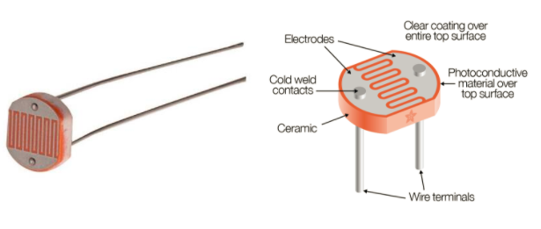
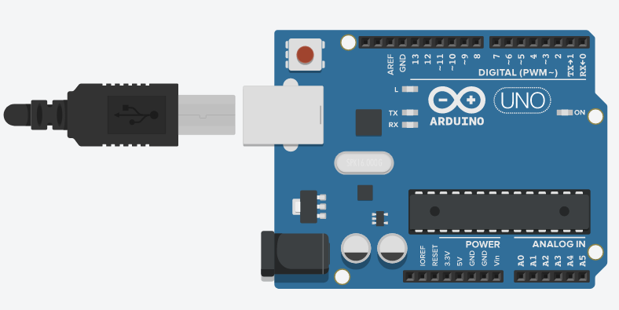
Component of Today: Photoresistor
A variable resistor that changes based on light detection
Gives off analog output:
A voltage between 0V and 5V
Analog Pins
Reads a value between 0V and 5V
In this code, Adruino interprets it as a value between 0 - 1023
Can also be used as digital pins
To read an output from an analog component:
analogRead(AO)

Slide 6
What you’ll do:
Complete the circuit
Implement the logic in loop()
Loop() {
if (motion) {
if (light < 200) {
// light bulb on
}
} else {
//turn the light off if there's no motion
}
delay(200);
}

