Slide 1
Lab 7: Simplifying with Decoders
CS444 S21

Slide 2
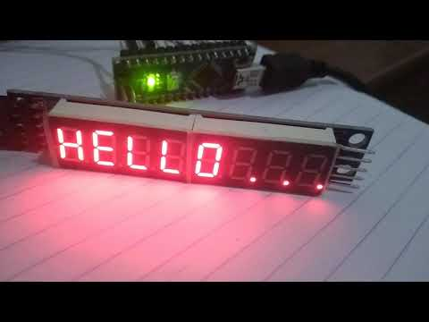
Today’s lab
Program 7 segment display to count from 0-9 on a loop
Use 7 segment decoder to simplify input to the 7 segment display
Here is 8 7 segment displays together, we will only be using 1

Slide 3
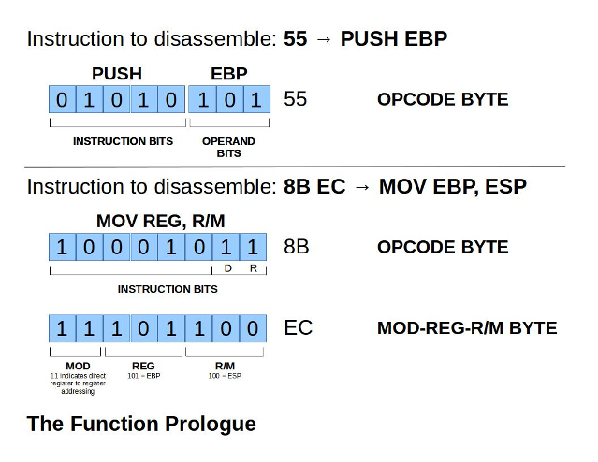
Decoding: Code to machine
How does the cpu know what our assembly code means?
The assembler, a low level compiler, translates it to all binary machine code.
The cpu then uses an instruction decoder to execute these commands by sending directions through the control bus
By this process of assembling and decoding, code becomes easier to write (Assembly vs Machine language)

Slide 4
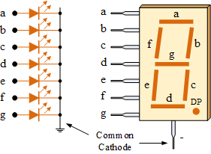

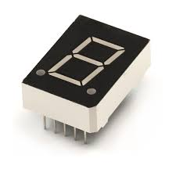
Component of Today: 7 Segment Display
Displays numbers by turning 7 LEDS on and off
Needs 7 digital inputs to control it
Ex. turning on pins a,b, and c would produce a 7
7 Segment display used to be used in the countdown clock for rocket launches

Slide 5
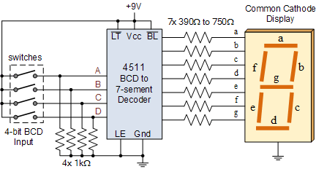
Component of Today: 7 Segment Decoder
By using a decoder for the 7 Segment display, we simplify the input
Instead of using 7 pins, we only have to use four. The decoder then inputs the correct values for the 7 pins
Inside the decoder, a circuit maps the inputs to the correct outputs
Example: 7
7 in binary is 0111₂
Input 0111 to decoder
Output 1110000
We see 7 on display
For more info on how the decoder works: https://www.electronicshub.org/bcd-7-segment-led-display-decoder-circuit/

Slide 6
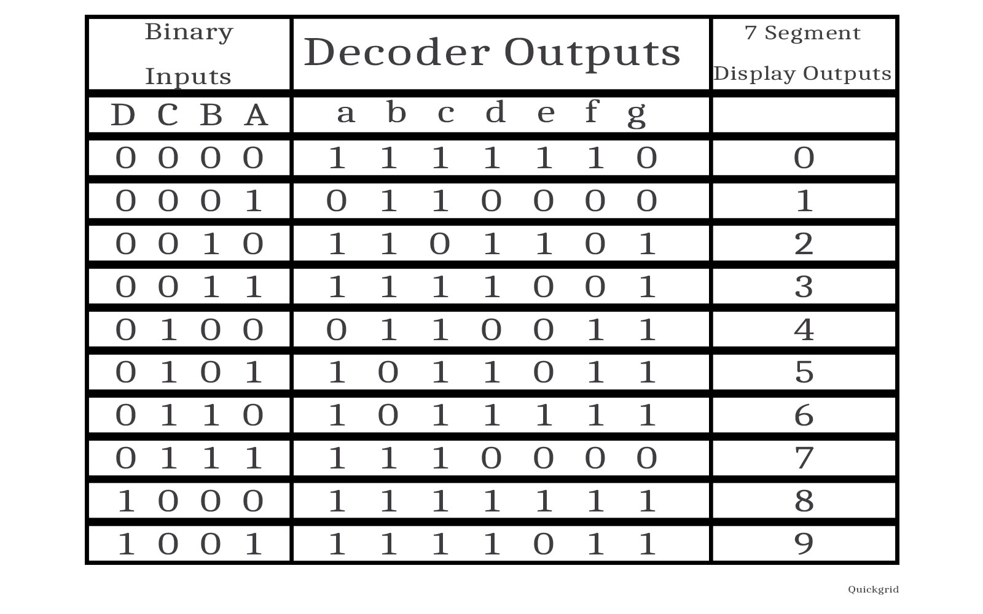
Decoder continued
10 options that correspond to 0-9
1101-1111 (10-15) are not used
Could we use 3 input pins instead of four?
Nah, 2 choices for 3 wires amounts to at most 8 results (2^3 = 8).
Instead, 2^4 = 16 provides us with the option for 10 results.

Slide 7
To do:
Complete the circuit
Create a counter that starts at 0, and counts up to 9, then loops back to 0
Either write out 10 cases to output either 1 or 0 to all four lines or figure out a more universal approach to all cases.
Make sure seven segment display is set to cathode!!

