Slide 1
AI-Based Clinical Decision Support System Using Historical Medical Prescriptions and Symptom Analysis
Department of Computer Science and Engineering
Project Work Phase – 1 (CSE 784/CSEIOT 784)
Review - 0
Student Name – Sunith K
Register No – 2360471
Section – 7BTCS A
Guide Name - Dr. Jyothi Thomas

Slide 2
Table of Contents
Domain
  Sub -Domain
  Application
Problem Statement & Motivation
Objectives
Methodology
Expected Outcomes

Slide 3
Domain
Domain: Artificial Intelligence & Data science
Sub -Domain: Machine Learning (Predictive Modeling) & Natural Language Processing (RAG/LLMs)
Application:
Rural Healthcare Support
Clinical Decision Support System (CDSS)
Emergency Patient Triage
Telemedicine Assistance
Disease Risk Prediction

Slide 4
Problem Statement & Motivation
Problem Identification
Rural and low-resource clinics often lack access to specialist doctors and advanced diagnostic facilities. Manual analysis of patient records can lead to delayed diagnoses, medication errors, and inefficient patient triage. As a result, patients may receive unnecessary hospital transfers or miss timely emergency care.
Motivation
This project aims to improve healthcare accessibility in rural areas using Artificial Intelligence. By assisting doctors with disease risk prediction and medical record analysis, the system helps reduce diagnosis time, improve treatment accuracy, and enhance patient safety.
Solution
The proposed system combines Machine Learning and Retrieval-Augmented Generation (RAG) to predict disease risks and analyze patient records. It identifies treatment risks, provides AI-assisted recommendations, and classifies patients based on urgency through an interactive dashboard, enabling faster and more informed clinical decisions.

Slide 5
Objectives
To develop a clinical data processing system that accurately structures and aggregates a single patient's longitudinal medical history by analyzing past prescriptions, clinical summaries, and historical diagnoses.
To implement a context-aware clinical recommendation engine that generates personalized medication strategies and summarizes treatment timelines based on the patient's previous medical history and current symptoms.
To design an interactive Clinical Decision Support dashboard that visualizes the patient's historical prescription timeline, flags safety risks, and provides real-time, explainable treatment insights for clinicians.

Slide 6
Objectives In-Detail
To develop a clinical data processing system that accurately structures and aggregates a single patient's longitudinal medical history by analyzing past prescriptions, clinical summaries, and historical diagnoses.
  i. Longitudinal Data Integration: Collect and chronologically map multi-visit patient records, including vitals, lab reports, previous prescriptions, and symptoms, under a unified, unique patient identifier.
  ii. Data Preprocessing: Clean clinical narratives, parse structured prescription fields (such as dosage, drug name, and frequency), and handle missing or inconsistent patient medical values.
  iii. Sequential Feature Engineering: Extract sequential medical features that capture the timeline of disease progression, historical medication changes, and long-term treatment patterns.
To implement a context-aware clinical recommendation engine that generates personalized medication strategies and summarizes treatment timelines based on the patient's previous medical history and current symptoms.
  i. LLM-Based Medical Summarization: Implement a Large Language Model (LLM) pipeline to automatically synthesize a concise clinical summary of the patient's past prescription history and treatment adherence.
  ii. RAG Pipeline Development: Design a Retrieval-Augmented Generation (RAG) network to query medical knowledge bases and clinical guidelines, anchoring the AI's response to the patient's specific health record.
  iii. Multi-Timeline Safety Check: Build real-time algorithmic checks using clinical knowledge bases to detect drug-drug interactions, recurring patient allergies, and therapeutic redundancies across past and proposed prescriptions.

Slide 7
Objectives In-Detail
To design an interactive Clinical Decision Support dashboard that visualizes the patient's historical prescription timeline, flags safety risks, and provides real-time, explainable treatment insights for clinicians.
  i. Dashboard Interface Design: Build an interactive web dashboard using Streamlit tailored for fast-paced healthcare settings, providing an intuitive, clear visualization of a single patient's longitudinal clinical timeline.
  ii. Real-time Risk Alerting: Configure active user-interface banners that immediately flag clinical safety violations, critical drug interactions, and conflicting medical flags before a prescription is finalized.
  iii. Explainable Clinical Guidance: Integrate text-based AI explanations behind generated treatment recommendations to offer clear, evidence-backed clinical justifications to the attending doctor.

Slide 8
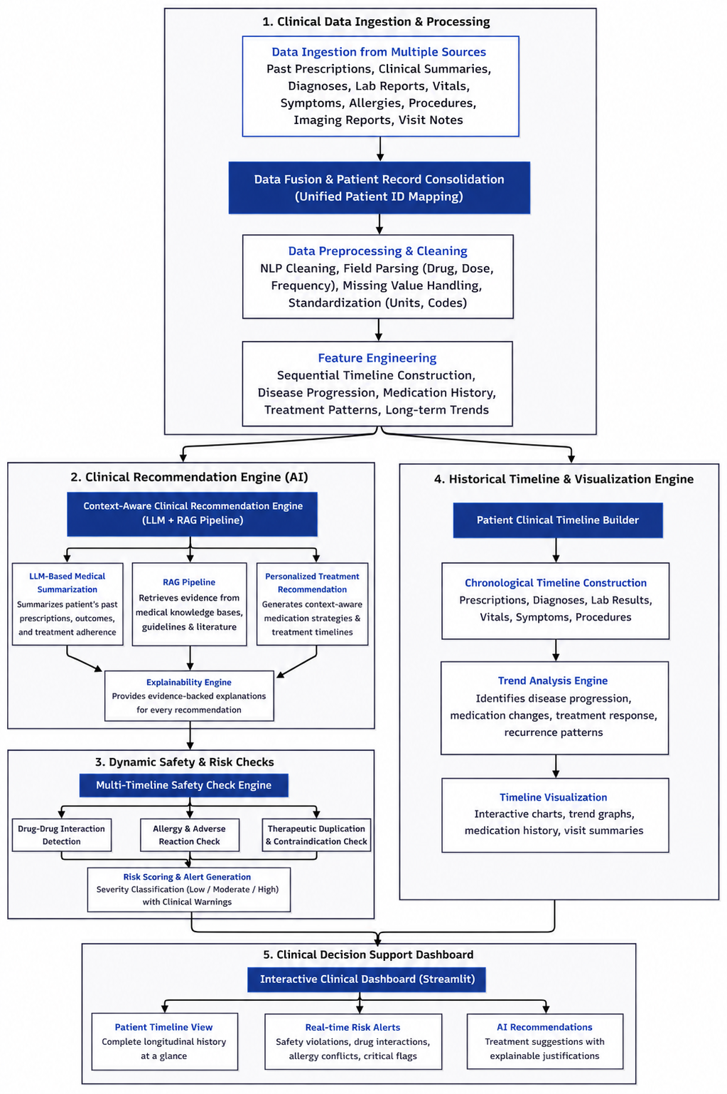
Methodology

Slide 9
Expected Outcomes
A fully functional, multimodal Streamlit web dashboard ready for clinical testing.
High-accuracy prediction of disease progression based on tabular lab vitals.
Automated extraction of medical red flags (e.g., allergies, conflicting conditions) from unstructured text, actively preventing treatment conflicts.
A reliable triage classification system that safely reduces unnecessary hospital transfers from rural areas.

Slide 10
Thank You

