Slide 1

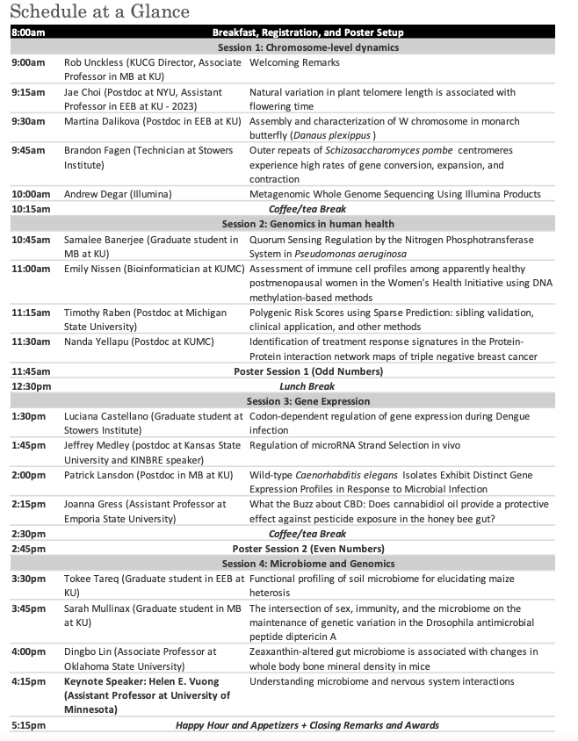
WIFI: Maceli’s Guest
Password: Catering

