Slide 1
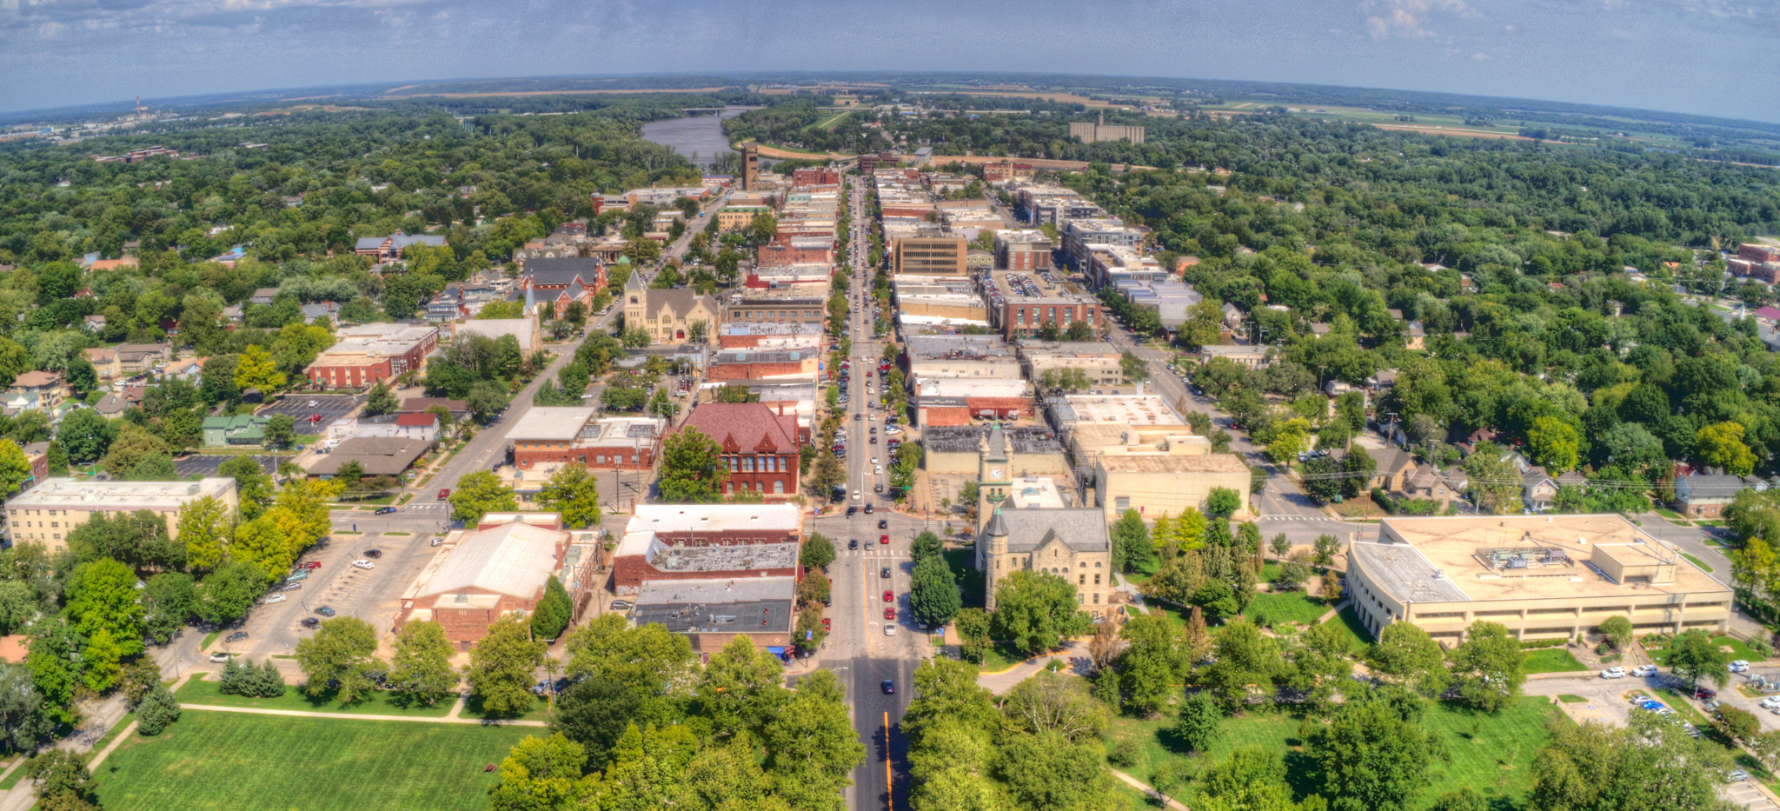
20220520
DATE
PAY TO
THE ORDER OF
$
DOLLARS
MEMO
MP
|:314159265359|:299792458 (0NGR4T5

