Slide 1


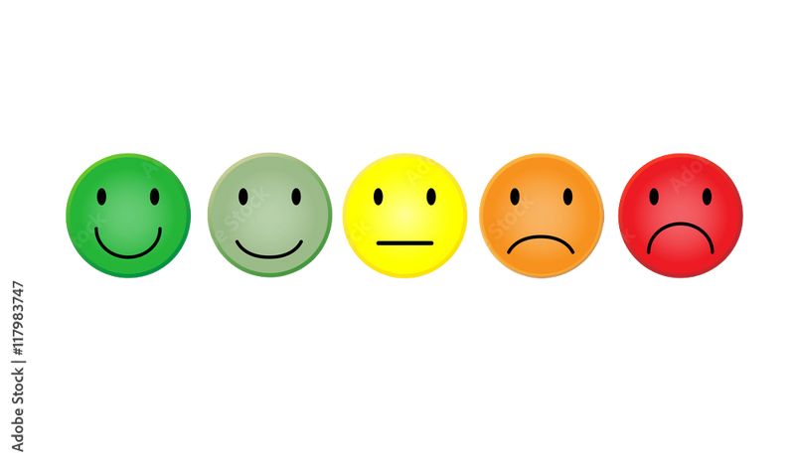


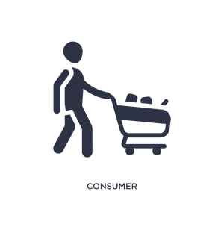


Consumer Behavior
MKTG50
Motivation, Ability and Opportunity

Slide 2

MOTIVATION
Motivation is what moves people, “an inner state of
Activation ”with the activated energy directed to achieving a goal.
The motivated consumer is energized, ready and willing to engage in a goal-relevant activity.

Slide 3

High-effort Behavior
Motivation not only drives the final behaviors that bring a goal close but also creates a willing-ness to spend time and energy on preparatory behaviors.
If the consumers believe that their effort is too much—they will simplify it, and vice versa.

Slide 4

High-effort information Processing and Decision Making
When consumers are highly motivated, they are more likely to pay careful attention to it, think about it, attempt to understand or comprehend goal-relevant, information, evaluate the information critically, and try to remember it for later use.
When consumers have low motivation, they devote little effort to processing the information and making their decisions.

Slide 5
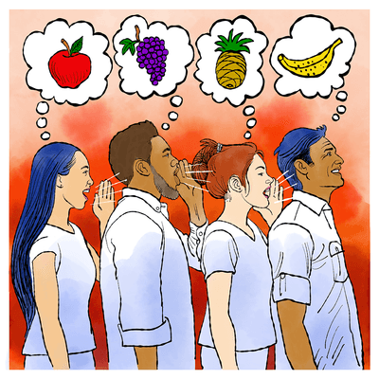
High-effort information Processing and Decision Making
Motivation Reasoning pertains to processing information in a way or a biased way that allows consumers to reach the conclusion that they want to reach.

Slide 6

High-effort information Processing and Decision Making
Felt Involvement refers to the consumer’s experience of being motivated with respect to a product or service, or decisions and actions about
these.

Slide 7

MOTIVATION
Motivation tends to get influenced by the following factors:
Personal Relevance. Something that has a direct bearing on the self and has potentially significant consequences or implications for our lives.
Self-Concept. Our mental view of who we are, helps us define ourselves.
Values. Abstract, enduring beliefs about what is right/wrong, important, or good/bad.

Slide 8
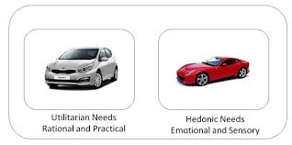
MOTIVATION
Types of needs
Functional Needs - reflect either our needs socially or personal for the sake of consumption.
Symbolic Needs - reflect on how we perceive ourselves and the others perceive us.
Hedonic Needs - reflect our inherent desires for sensory pleasure
Needs is an internal state of tension experienced when there is a discrepancy between the current and an ideal or desired physical or psychological state.

Slide 9
MOTIVATION
Types of Goals
Concrete - Specific to a certain behavior or actions at the situation in your hand.
Abstract - Endure over a long period or has to be consistent over a long time.
Promotion-focused - Consumers act to achieve positive outcomes.
Prevention-focused - Consumers act to avoid negative outcomes
Goals and Emotions
Goal is the particular end state or outcome that we would like to achieve. Goals are more complicated and specific than the needs.
Emotions falls on appraisal theory that proposes that our emotions determine who we assess certain situations or outcomes that are relevant to the goals.

Slide 10
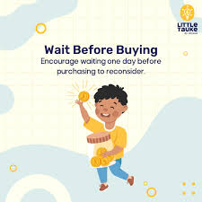
MOTIVATION
Self-control is a process consumers use to regulate feelings, thoughts and behavior in line with their long-term goals, rather than pursuing short-term goals.

Slide 11
MOTIVATION
Two components to perceived risk are:
Uncertainty component - the anticipation of outcomes and how certain and uncertain these are
Consequences component - the negativity of the outcomes and how severe these are.
Inconsistency with attitudes is the extent to which new information is consistent with previously acquired knowledge or attitude
Perceived Risk is the extent to which the consumer anticipates negative consequences of an action by buying, using, or disposing of an offering to emerge and positive consequences to not emerge.
Some types of perceived risk are financial, social, psychological and time.

Slide 12
ABILITY
Ability is the extent to which consumers have the required or necessary resources to make an outcome happen
Types of Resources
Financial Resources is the use of money instead of other resources to enhance their ability to make decisions and take actions.
Cognitive Resources is the use of gained knowledge from products or services from their experiences to certain offerings they received.
Emotional Resources is the use of the experienced empathy and sympathy that affects their processing of information and decisions to purchase.
Physical Resources is the use of their physical capabilities—“body power ” which affects how, when, where, and whether consumers make decisions and take actions.
Social and Cultural Resources is the use of network social relationships that people have with others and the access to the system of cultural institutions in a society.

Slide 13

OPPORTUNITY
Opportunity is the action of consumers to engage in such opportunity in different behavior
The factors that tends to influence the Opportunity:
Time is the one that affects the consumers to process the information, make decisions and perform certain behaviors.
Consumers under time pressures will be more likely to acquire less information, unprocessed information and less systematically, and will put pressure on acquiring negative information.

Slide 14
OPPORTUNITY
Complexity, amount, repetition and control of information
Consumers find technical or quantitative information more difficult to handle than non technical and qualitative data, a situation that inhibits processing.
If the amount of information is too much they get overwhelmed and fail to process it.
If the consumers are repeatedly exposed to this information, they have more time to think and process the complexity of the information will be easier. Consumers remember and learn more when they can control the flow of information that is presented to them by the marketers.

Slide 15


