Slide 1


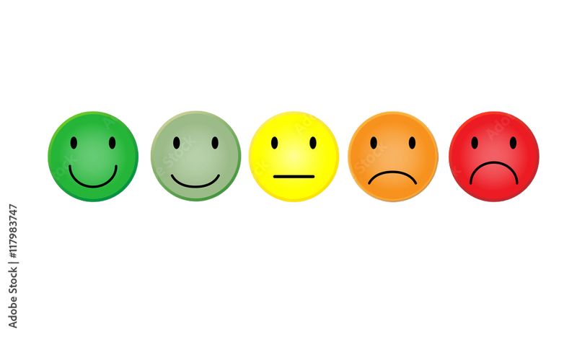





Consumer Behavior
MKTG50
From Comprehension to Exposure

Slide 2

EXPOSURE AND CONSUMER BEHAVIOR
Exposure is the process by which the consumer comes in physical contact with stimulus.
Marketing stimuli is the Information about commercial offerings communicated either by the marketer.

Slide 3

Factors influencing exposure
The position of an ad within a medium
Product distribution and shelf placement

Slide 4
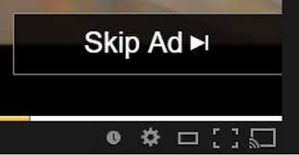
EXPOSURE
Selective exposure is when consumers actively seek out certain stimuli and avoid or resist others.
Ad avoidance
Zipping - Fast-forwarding through commercials on a program recorded earlier.
Skipping - Skipping pre-roll commercials in online channels, such as YouTube.
Zapping - Use of a remote control to switch channels during commercial breaks.
Cord-cutting - Dropping cable or satellite television subscriptions in favour of streaming services such as Netflix, Amazon Prime Video, etc.

Slide 5

ATTENTION AND CONSUMER BEHAVIOR
Attention is the amount of mental activity a consumer devotes to a stimulus.

Slide 6
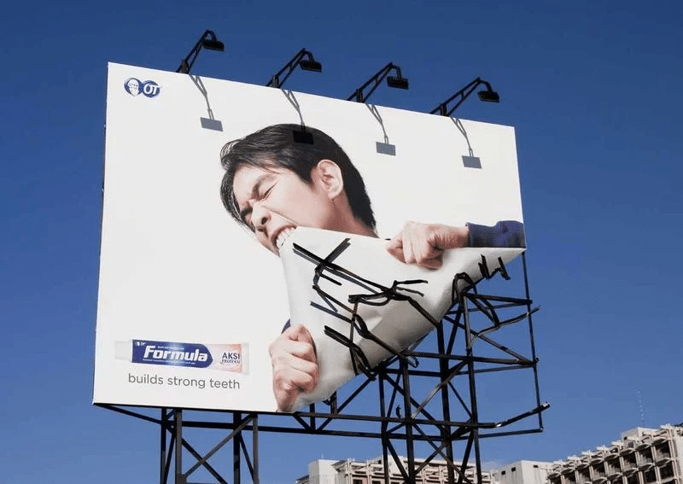
CHARACTERISTIC OF ATTENTION
1) Attention is limited - Consumers cannot possibly attend to all stimuli in the environment, even if they would want to see everything.
2) Attention is selective - Because attention is limited, consumers need to select what to pay attention to and simultaneously what not to pay attention to.
3) Attention can be divided - We can divide our attentional resources over time, by allocating some attention to one task and some to another, or by very rapidly switching attention between tasks.

Slide 7

ATTENTION
Focal attention - Focusing on a stimulus.
Non-focal attention - While focusing on a stimulus, simultaneously being exposed to other stimuli.
Pre-attentive processing - The nonconscious processing of stimuli. Devote just enough attention to an object in our peripheral vision to process something about it, we are usually not aware that we are absorbing and processing that information.

Slide 8
Four ways to attract attention
1) Making stimulus personally relevant
2) Making stimulus pleasant
3) Making stimulus surprising
4) Making stimulus easy to process

Slide 9
ATTENTION
a. Prominence: The intensity of stimuli that causes them to stand out relative to the
environment.
b. Concreteness: The extent to which a stimulus is capable of being imagined.
C. Habituation: The process by which a stimulus loses its attention-getting abilities by virtue of its familiarity.
.
- Grouping: The tendency to group stimuli to form a unified picture of impression
- Preference for the whole: The tendency to perceive more value in a whole than in the combined parts that make up a whole, even if the parts have the same objective value as the whole.

Slide 10

COMPREHENSION AND BEHAVIOR
Comprehension is the process of extracting higher-order meaning from what we have perceived in
the context of what we already know.

Slide 11
COMPREHENSION
Source identification is the process of determining what the perceived stimulus actually is, that is what category it belongs to.
Message comprehension : Is influenced by:
- Objective and subjective comprehension - (matches the sender’s idea) (based on his own feelings-bias)
- Miscomprehension (wrong idea based on lack of understanding) – ex. Shoppee keratin
- Effect of MAO (Motivation, Ability, and Opportunity) -
- Effect of culture (cultural context also influences the use of figurative language, such as idioms or irony, which can lead to miscomprehension if not understood)

Slide 12
COMPREHENSION
Consumer Interference is the conclusions that consumers draw or interpretations that they form based on the message.
the outcome of this process, where a consumer develops an understanding or a conclusion about an attended stimulus
(Stimuli that influence)
    - Brand names and symbols
    - Product features and packaging (first physical interactions )
    - Price (can be interpreted as a signal of quality or value.)
    - Message wording (language used in advertising and product descriptions influences comprehension)
    - Retail atmospherics, displays and distribution – contribute to the consumer’s perception

Slide 13


