Slide 1
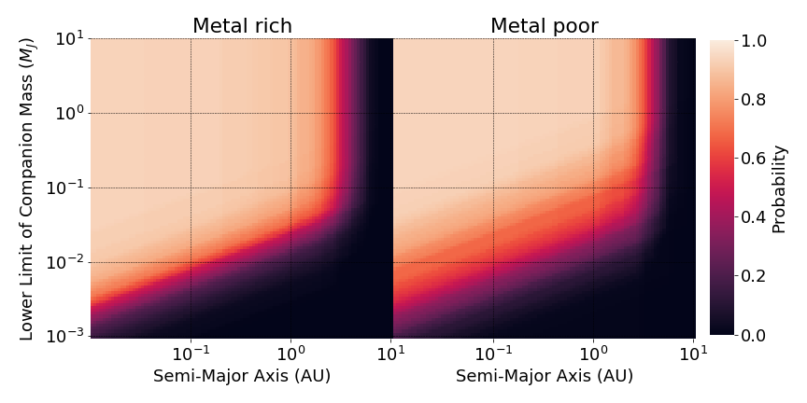
(a)
(b)
Input data
(Metal rich)
X
Selection bias
(Metal poor)
=
Output data
(Metal rich)
Input data
(Metal poor)
X
Selection bias
(Metal rich)
=
Output data
(Metal poor)

Slide 2
(a)
(b)

