Slide 1
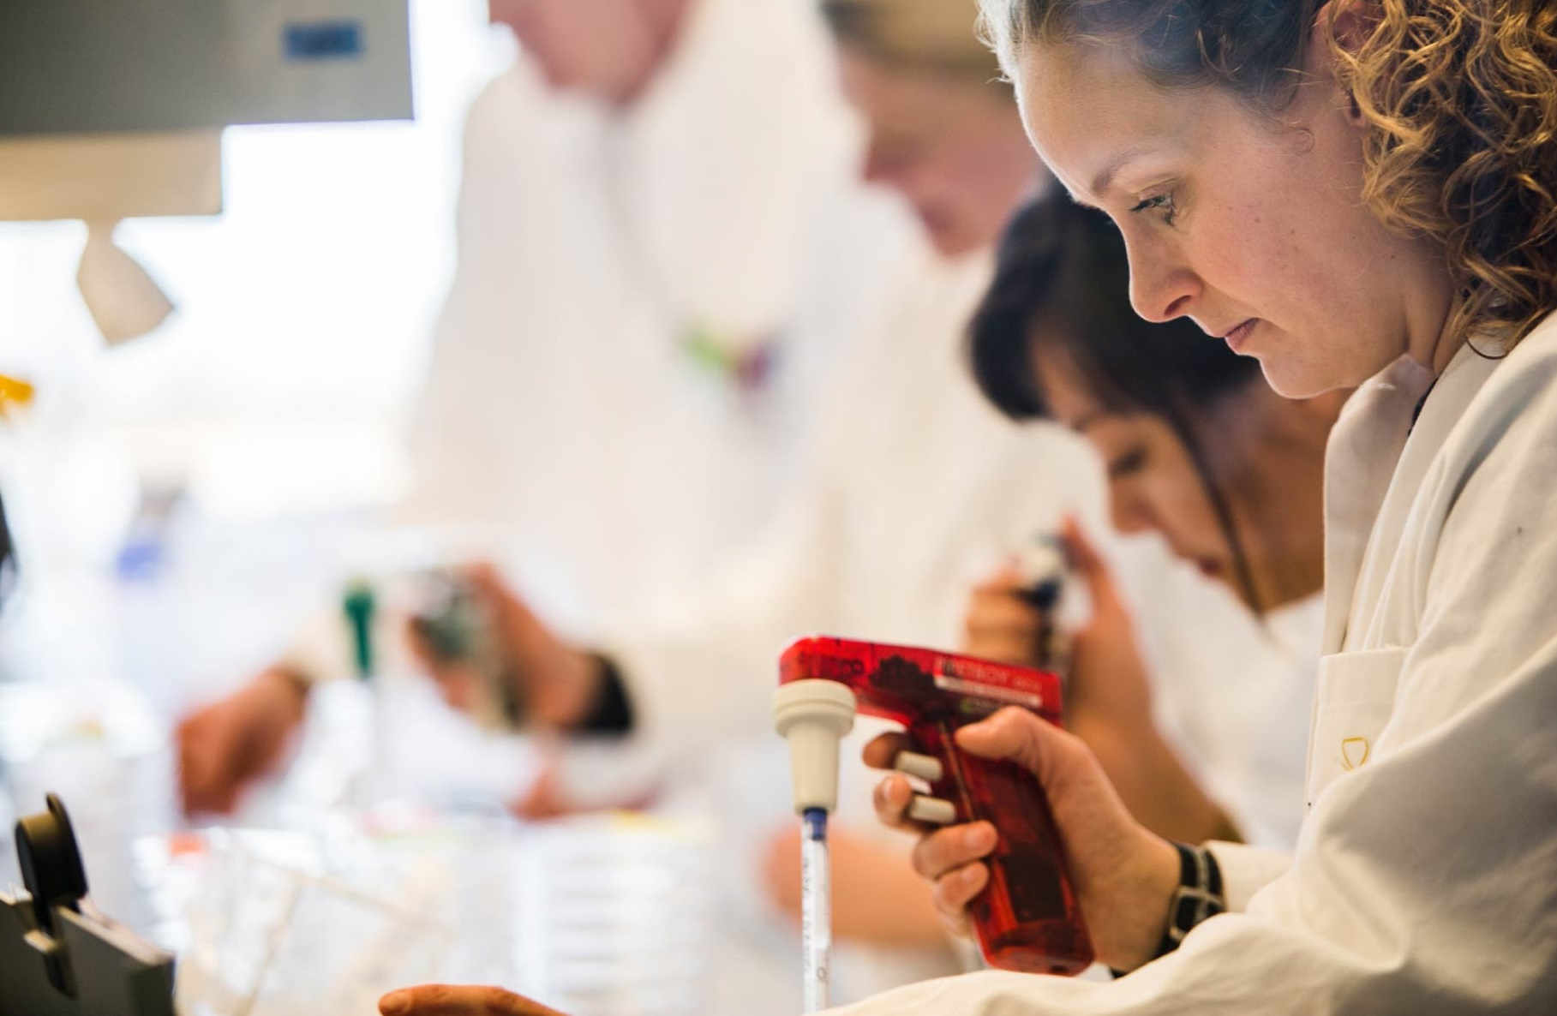
Novozymes’ R&D
引领世界生物创新
Novozymes innovates closely with customers and partners to create superior results.
Novozymes stays on the cutting edge of innovation.
Our worldwide R&D community allows us to develop solutions that meet both global and local needs.
creates impact for customers, paves the way for a brighter future
Notes:
More than 1,300 Zymers work in our R&D community in Denmark, the U.S., China, India, Japan and Brazil
We focus on our strong technology platform combined with dedicated application teams.

Slide 2


Draw a better line to the world’s most competitive biorefineries
Differentiate
Stay ahead
of changing
demand
Optimize
Increase
efficiency and
flexibility
Expand
Adopt next-generation technologies
at scale
Notes:
Operating in a highly competitive field, where margins are tight and every improvement counts, you need to constantly optimize your processes to enable your plant to grow at the lowest possible cost and get ahead of your competition.
You know every step of your production, and Novozymes is with you every step of the way. With the most innovative product portfolio and the deepest expertise in the industry, we help you transform the quality and sustainably of your business.
Together we draw a better line to your most competitive biorefinery.

