Slide 1
Teamwork
Choy-Valentine and Company

Slide 2
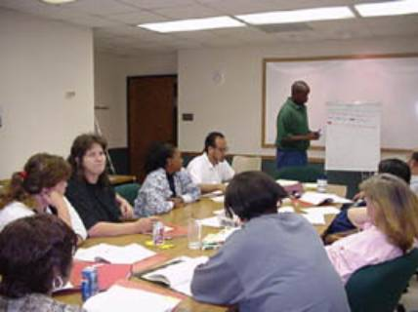

Teamwork
Team or Group
Group?
Team?
What makes the difference?
Chasing Perfection

Slide 3
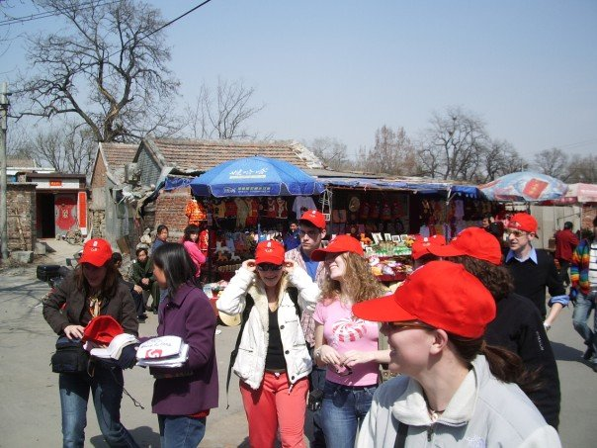
Teamwork
Groups
People who interact with one another
Friends, Neighbors, Colleagues
Psychologically aware of each other
Perceive themselves as a group
Common identity or interest
Chasing Perfection

Slide 4
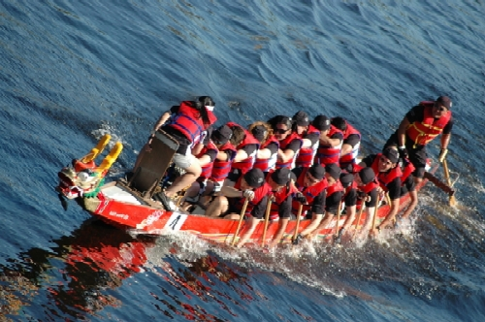
Teamwork
So what is a Team?
Chasing Perfection

Slide 5
Teamwork
A Team
“A team is a small number of people with complementary skills who are committed to a common purpose, performance goals, and values for which they hold themselves mutually accountable.”
Chasing Perfection

Slide 6
Teamwork
Characteristics of Successful Teams
A Common Goal
An agreed upon goal that every member of the team is committed to achieving.
Productive Participation of all Members
Contributing data and knowledge
Sharing in the decision making process
Making the decision
Making the imposed decision work
Shared Values
Communication
Open honest and effective exchange between team members
Trust
Openness in giving and receiving feedback
Respecting team confidentiality
Chasing Perfection

Slide 7
Teamwork
Characteristics of Successful Teams
A Sense of Identity
Members proud of the team
Diversity
Wide range of views and experiences
Creativity and Risk Taking
Collective security
No blame
Evaluation
Able to self correct
Flexible and able to adapting to change
Participatory Leadership
Everybody must lead in one way or another
Chasing Perfection

Slide 8
Teamwork
Individual Exercise 1
a) Think of a team you were part of;
b) Write down
The common purpose of the team
The goal of the team
The values of the team
How team members held themselves to be mutually accountable.
Chasing Perfection

Slide 9
Teamwork
Individual Exercise 2
a) Think of a team you are part of now;
b) Write down
The common purpose of the team
The goal of the team
The values of the team
How team members hold themselves to be mutually accountable.
Chasing Perfection

