Slide 1
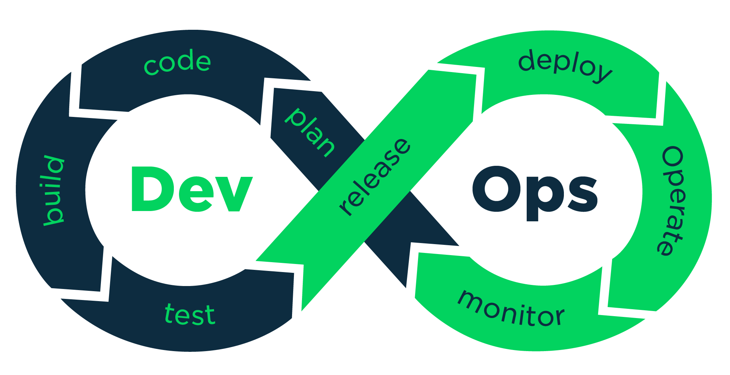
Continuous Development

Slide 2
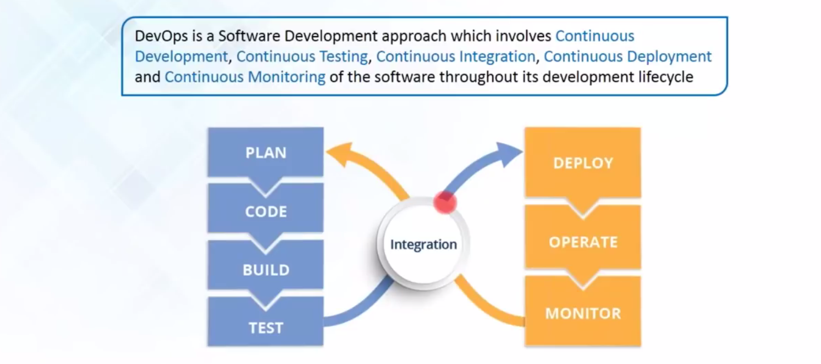
What is DevOps ?

Slide 3
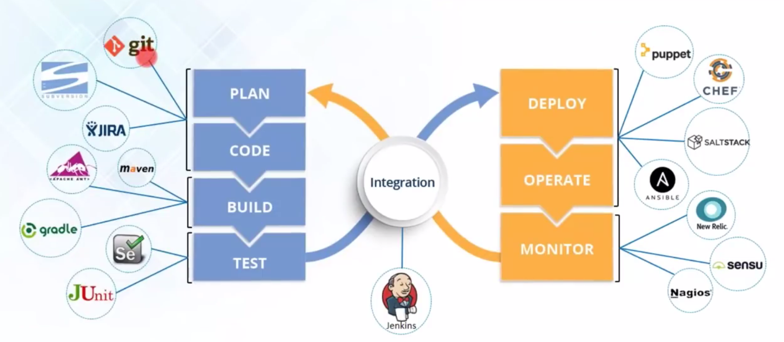
DevOps Tools

Slide 4
DevOps Life Cycle Phases
Continuous Development
Continuous Testing
Continuous Integration
Continuous Deployment
Continuous Monitoring

Slide 5
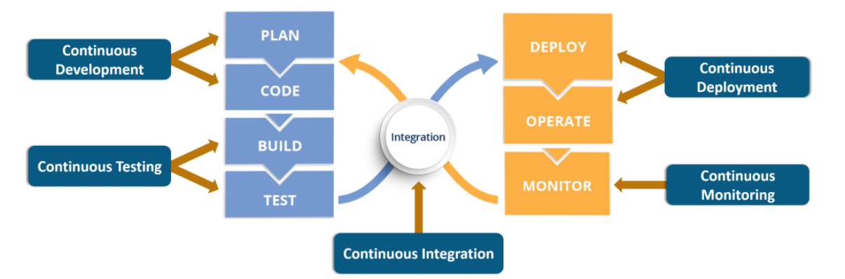
DevOps LifeCycle Phase

Slide 6
Continuous Development
This phase involves ‘planning‘ and ‘coding‘ of the software application’s functionality.
The vision of the project is decided during the ‘planning’ phase.
Code can be done in Any Language but maintain by Version Control System.

Slide 7
Why Code Versioning is Imp
Versions are maintained to hold a single source of Application.
Using Centralized single source code, Operations can access the same code what they plan to release.
Easy to Rollout the faulty snippet of code or complete release.

Slide 8
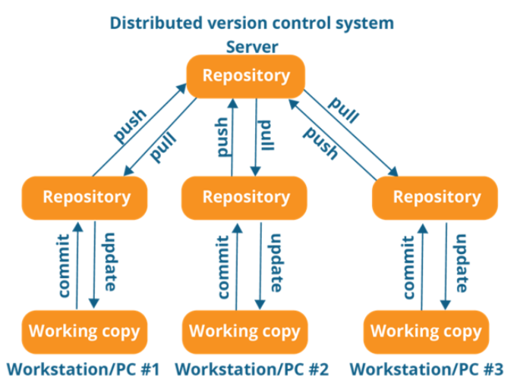
DevOps Tools for this Phase
Git & GitHub is vastly used tools for Versioning of Code.

Slide 9


