Slide 1
E-Commerce Performance & Data Insights
Translating 1M+ Transactions into Growth, Efficiency, and Risk Mitigation

Slide 2


Ensuring Data Reliability at Scale
Our data infrastructure successfully processed over one million records with precision, maintaining financial audit integrity while eliminating pipeline errors.
1.04M
1.80%
2,071
Total Sales Records
Overall Return Rate
Orphaned Returns Handled
Sales transactions ingested and processed across the full dataset
Lean return rate maintained across all product categories
Returns missing a parent sale resolved via relational nullification
Scale
Data Hygiene
Impact
Outcome
Successfully ingested and processed 1,041,670 sales records and 18,744 returns without pipeline disruption.
Maintained a lean 1.80% overall return rate while cleanly handling 2,071 orphaned returns via relational nullification.
Preserved critical financial audit trails without breaking warehouse pipelines or inflating phantom error metrics.
Clean, reliable data foundation enabling confident executive decision-making across all downstream analytics.

Slide 3
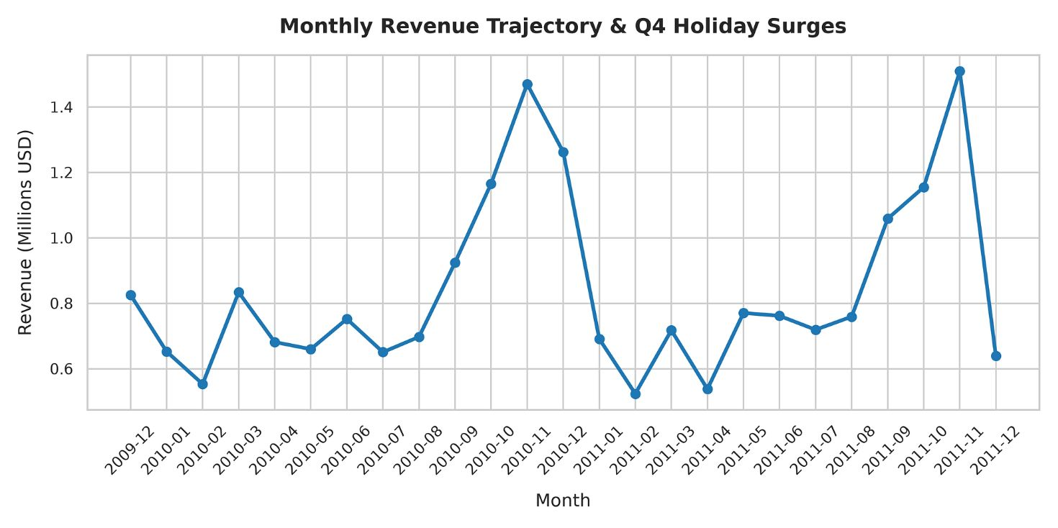
Revenue Trends & Q4 Holiday Surges
Peak Performance
November consistently drives massive revenue spikes — $1.47M in Nov 2010 and $1.51M in Nov 2011 — fueled by 26–30%+ MoM growth surges in autumn months.
Post-Holiday Contractions
Noticeable revenue dips occur every January (-45.2% in Jan 2011) and December closeouts, reflecting predictable seasonal drawdown.
Strategic Implication
Business model is heavily dictated by Q4 holiday seasonality, requiring forward-looking inventory planning starting in Q3.

Slide 4
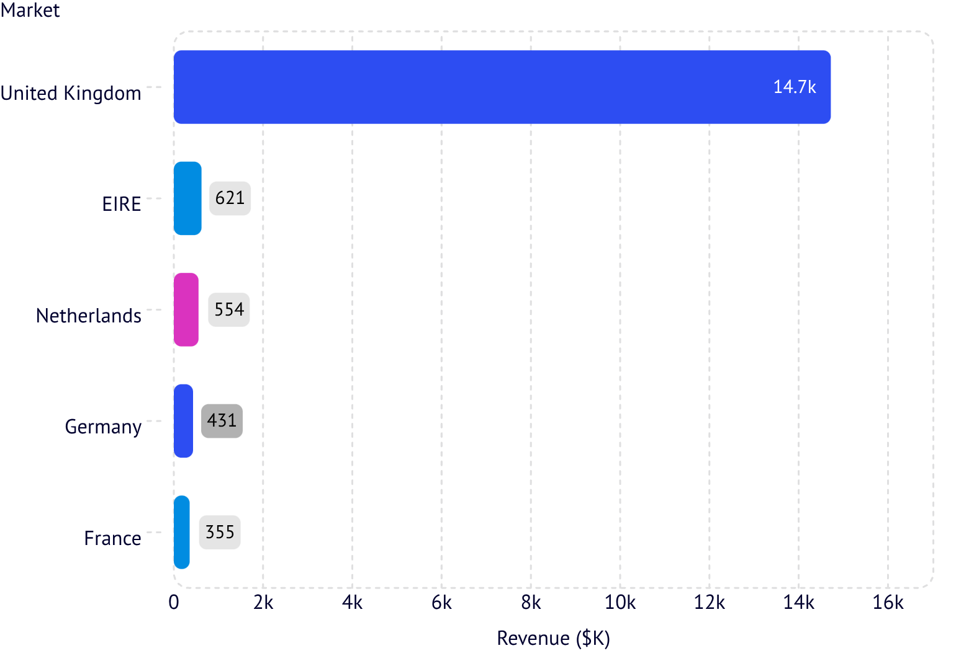
Geographic Breakdown: The United Kingdom Dominance
Market Concentration Analysis
The United Kingdom generates $14.72M in revenue, acting as our primary core market and anchoring overall cash flow.
International markets follow at a significant distance:
EIRE: $621K
Netherlands: $554K
Germany: $431K
France: $355K
While the UK anchors cash flow, emerging European markets show strong secondary demand that can support targeted localized marketing and geographic diversification.

Slide 5
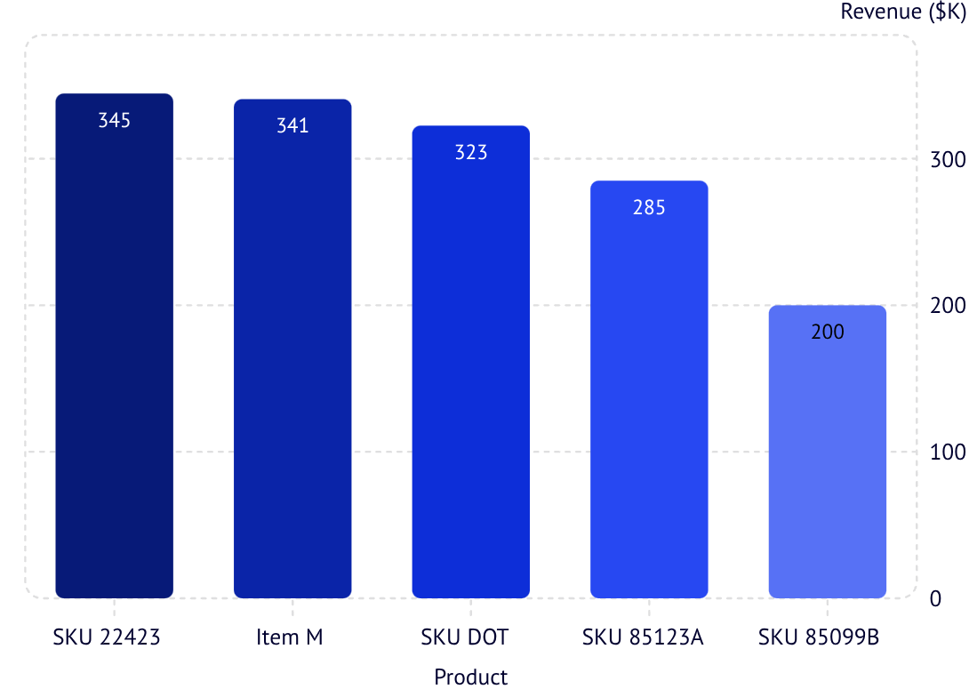
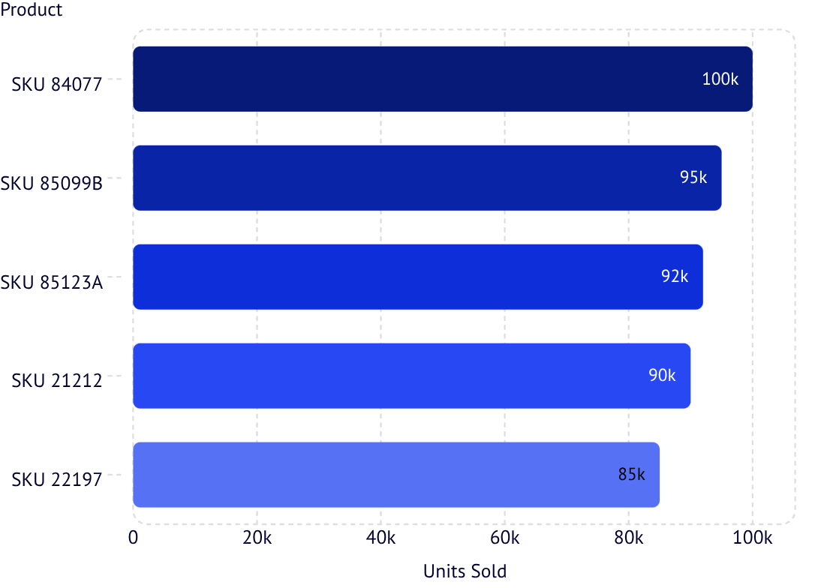
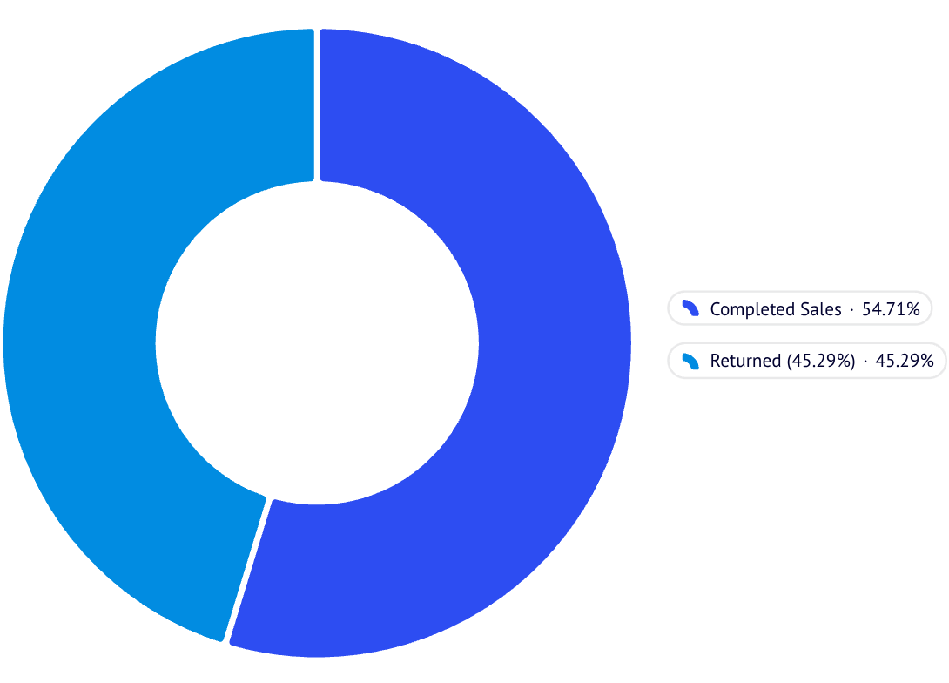
Product Analytics: Volume vs. Margin Bleed
Top-line revenue numbers can be deceptive — high-revenue products are simultaneously bleeding profit through reverse logistics and operational friction.
Revenue & Volume Leaders
Top Products by Unit Volume
Return Rate Risk: Item M
SKU 84077 leads in raw unit volume with 110,138 units sold.
Item M Return Rate: 45.29% — 399 returns out of 881 sales. Hidden margin erosion and customer dissatisfaction demand immediate investigation.

Slide 6



Transaction Economics: Average Order Value
$523.31
Business Validation
A high AOV indicates strong basket sizes, validating our current product bundling and multi-item purchasing behavior across the customer base.
Strategic Advantage
Provides healthy breathing room for customer acquisition costs and supports sustainable unit economics across our entire customer base.
Average Order Value
Per transaction invoice across the full dataset
Benchmark Significance
At $523.31, the AOV benchmark positions the business favorably for margin expansion through upsell and cross-sell optimization.

Slide 7



Actionable Next Steps for Executive Growth
1
2
3
Audit High-Return Flagships
Pre-Position Q4 Inventory Early
De-risk Geographic Concentration
Immediately investigate Item M (45.29% return rate) to resolve sizing, quality, or description mismatches draining margins and customer satisfaction. Engage product, logistics, and customer experience teams in a structured root-cause review.
Capitalize on predictable Q4 holiday spikes (November surges exceeding $1.5M) by locking down supply chains and warehouse staffing by late Q3. Seasonal demand patterns are consistent and forecastable.
Protect against domestic market saturation by scaling localized acquisition efforts in high-performing European hubs like the Netherlands ($554K) and Germany ($431K) to reduce UK dependency.
Robust data architecture transforms raw transactions into protective, profit-driving strategies.

