Slide 1
Static Website Deployment on AWS using Terraform
Course: DLBSEPCP01_E – Cloud Programming
Student: Kennedy Kinyua Wanjohi
Date:

Slide 2
Project Objective
Host a simple static website with high availability and HTTPS
Automate all infrastructure using Terraform
Learn and demonstrate core AWS cloud services

Slide 3
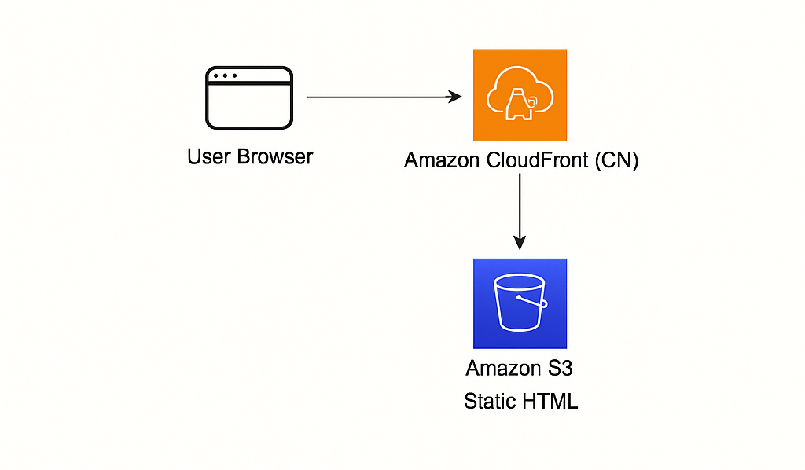
Architecture Diagram

Slide 4
Tools & Services Used
Terraform – infrastructure as code
AWS S3 – stores static content
CloudFront – global CDN + HTTPS
IAM – access control and bucket policies

Slide 5
Terraform File Breakdown
main.tf: Defines S3, CloudFront, IAM
variables.tf: Holds region/project settings
outputs.tf: Displays live URLs
index.html: My live webpage

Slide 6
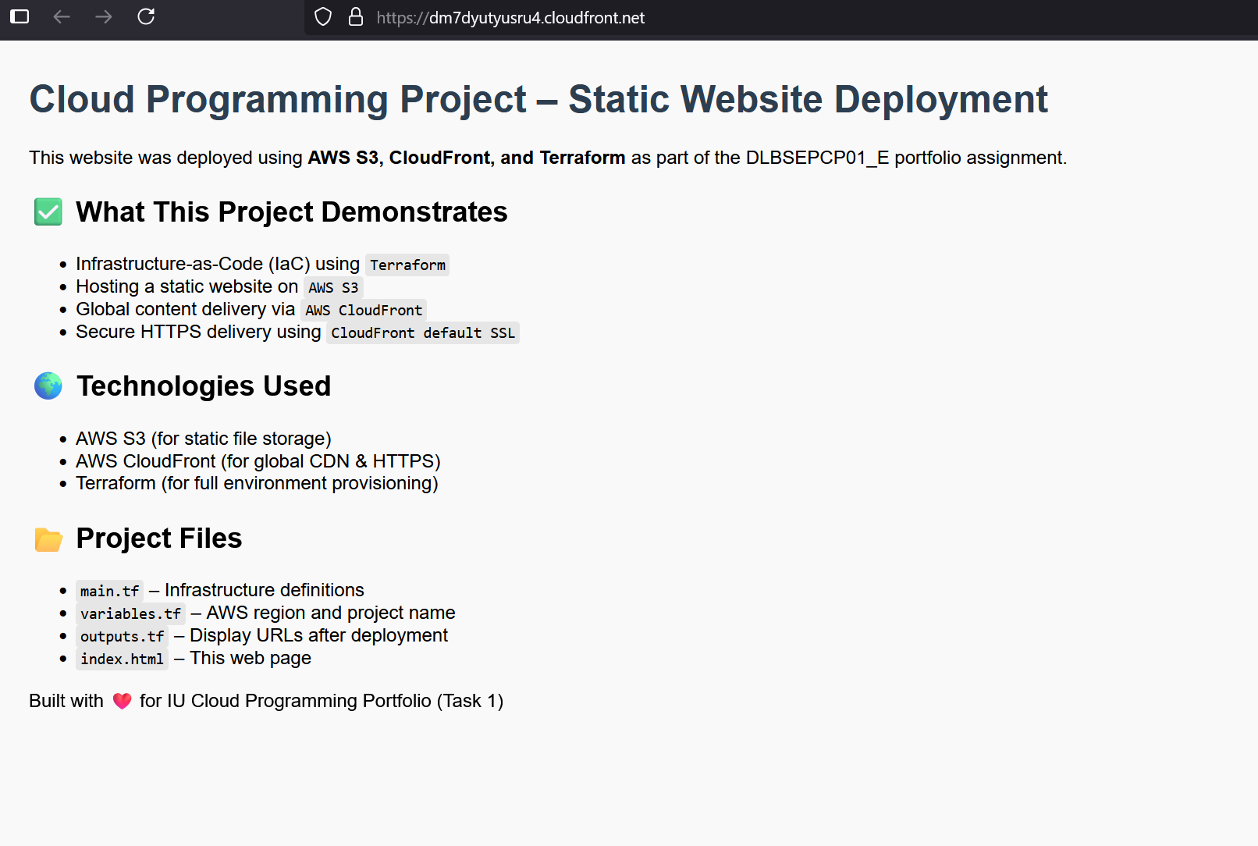
HTML Page Purpose
Content explains the project
Hosted live on CloudFront
Uses clean, professional HTML layout

Slide 7
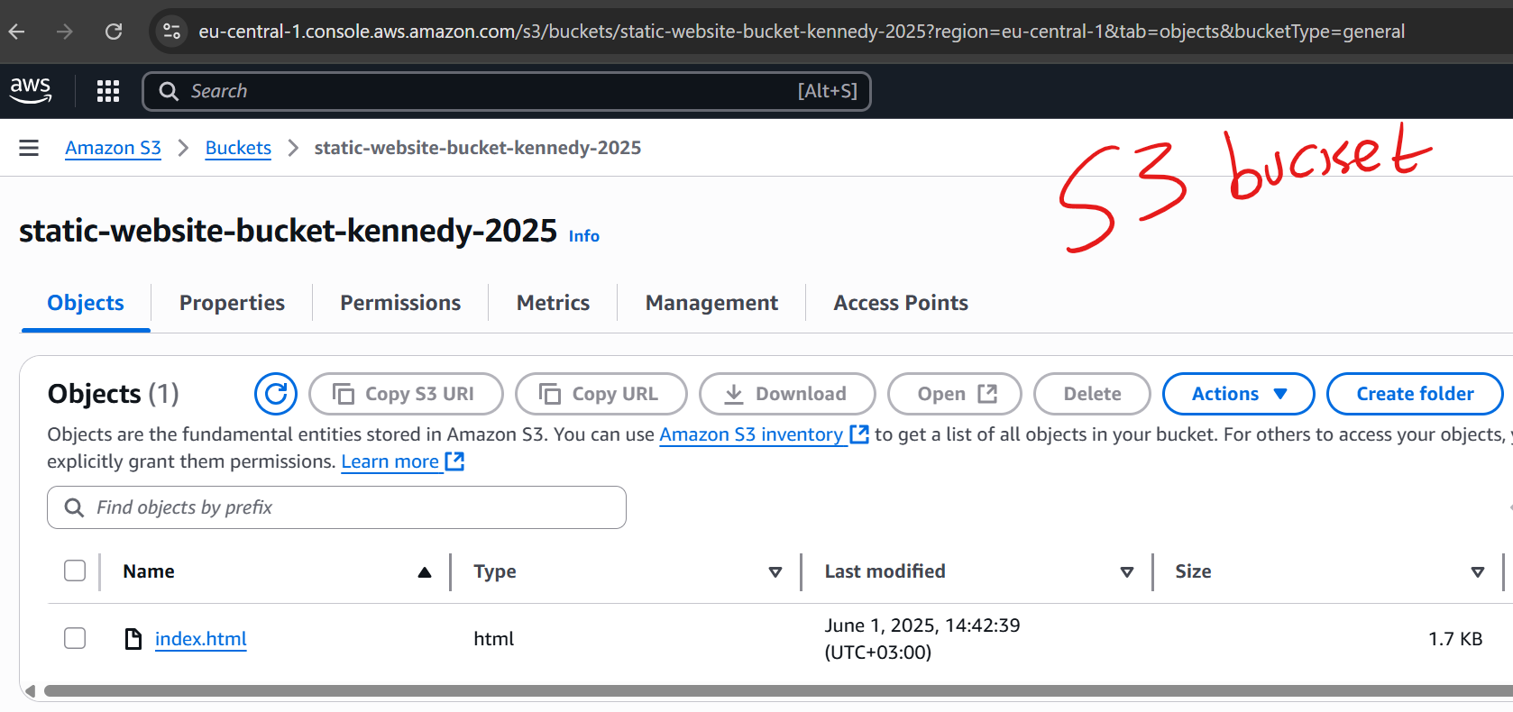
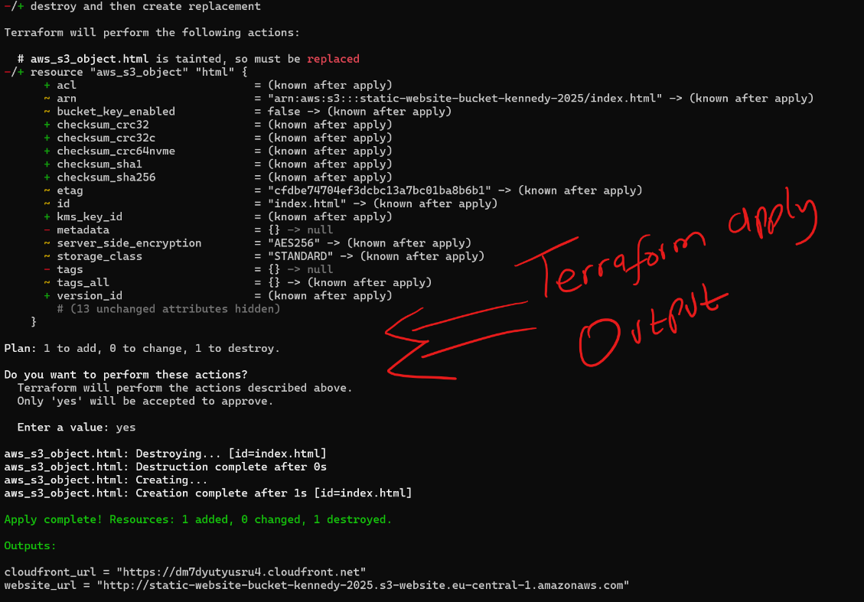
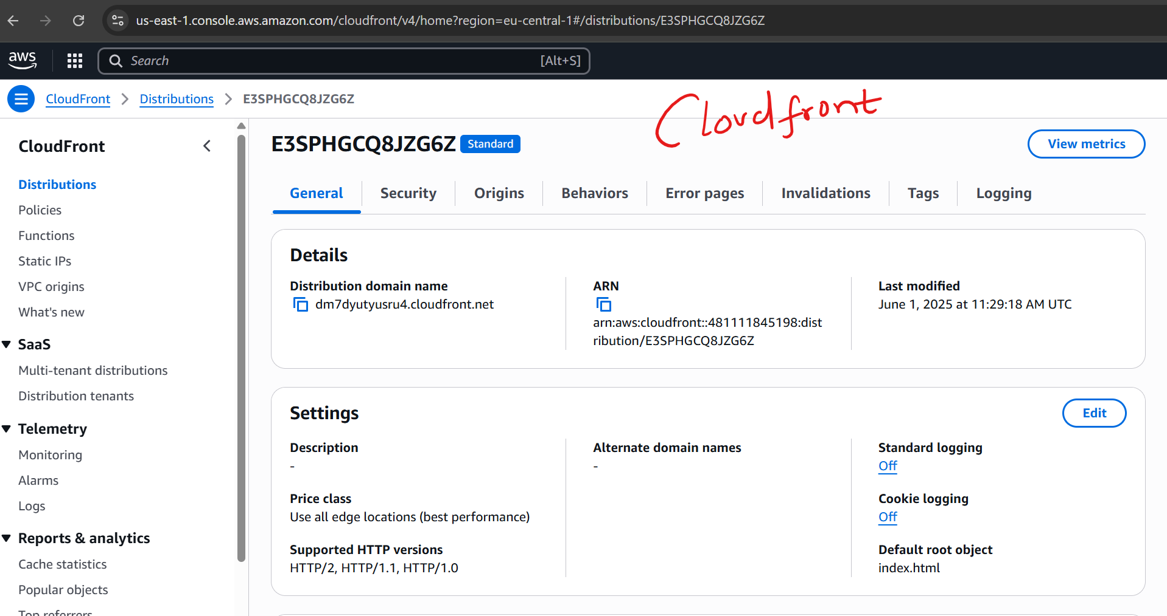
Deployment Screenshots

Slide 8
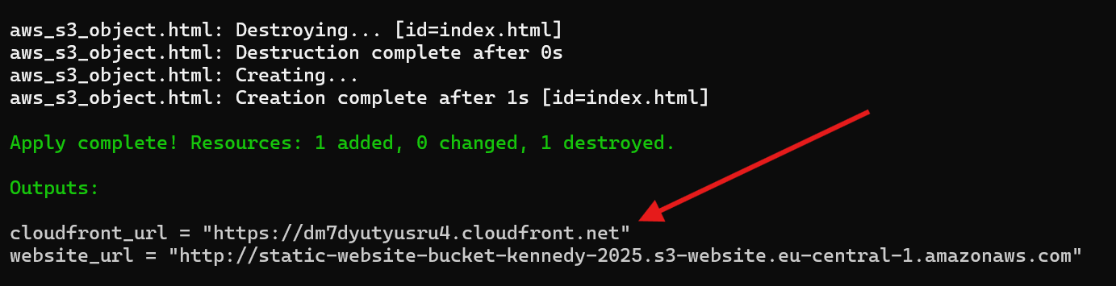
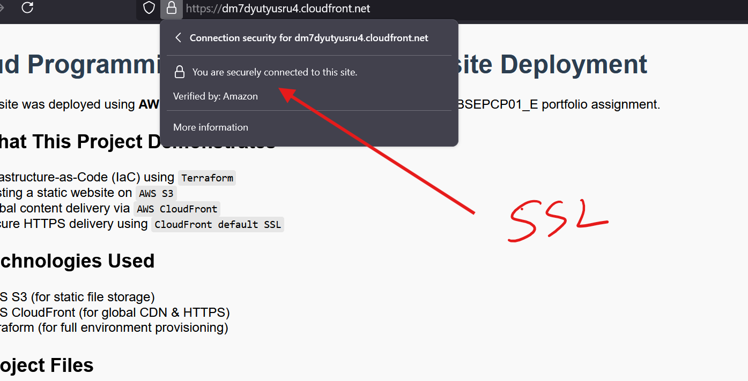
Final Result

Slide 9
Challenges
Initial attempt at Lambda + Docker failed (bootstrap errors)
Pivoted to S3+CloudFront for simplicity and reliability
Learned value of adapting when roadblocks arise

Slide 10
Lessons Learned
Practical Terraform deployment
Cloud resource configuration and IAM
Simplicity often beats complexity
Confidence using AWS for real-world scenarios

