Slide 1
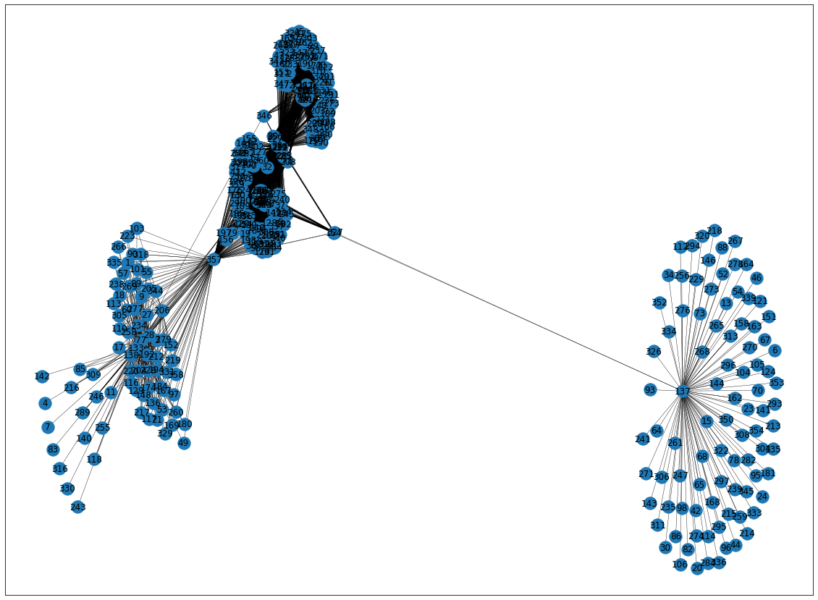
225 – Seatac?
357 – Seattle Center
137 – Seattle Premium Outlets

Slide 2
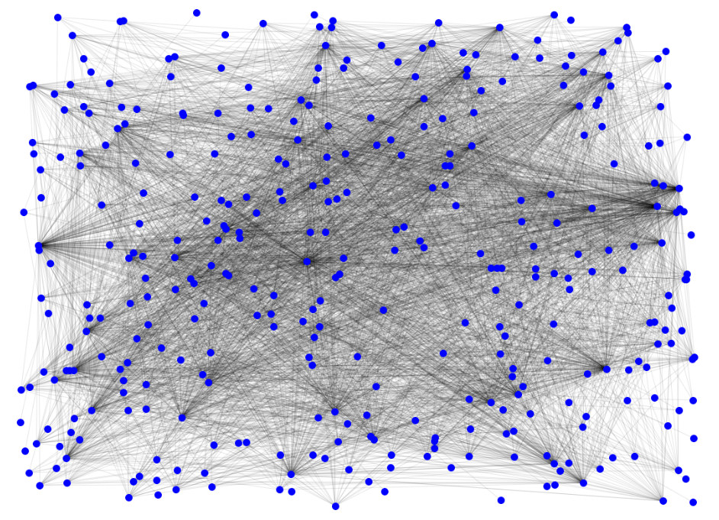
Sea-tac Doubletree
Sea-tac Marriot
Larkspur Landing
Sea-tac
Seattle Center

Slide 3
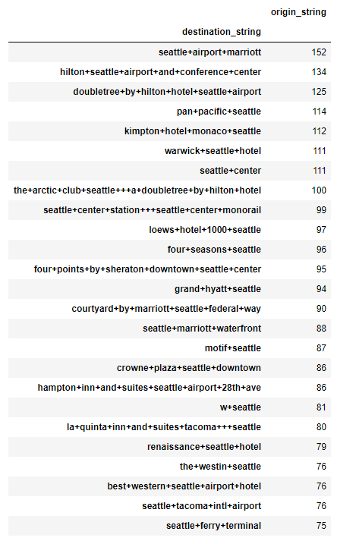

Slide 4
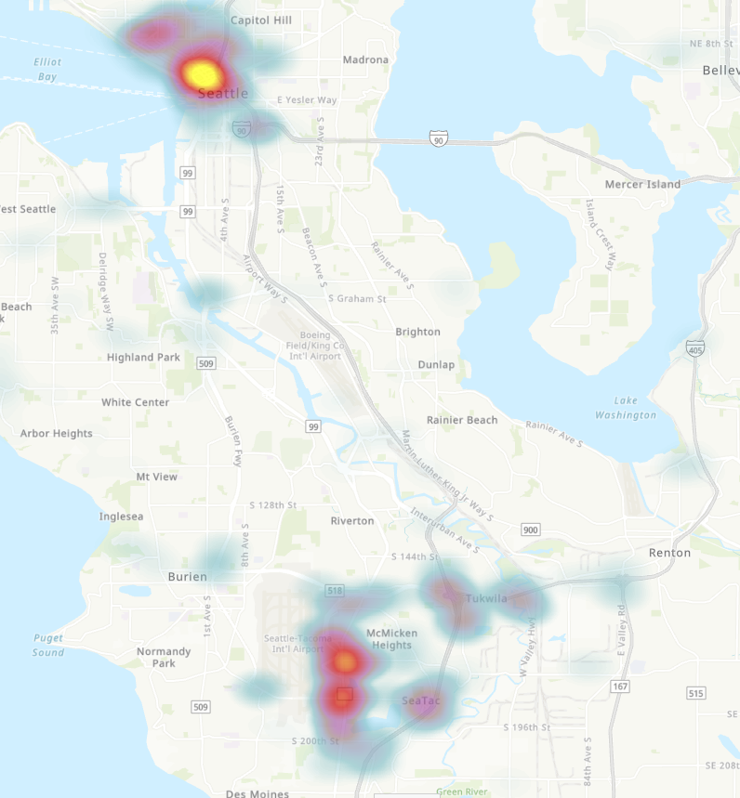

Slide 5
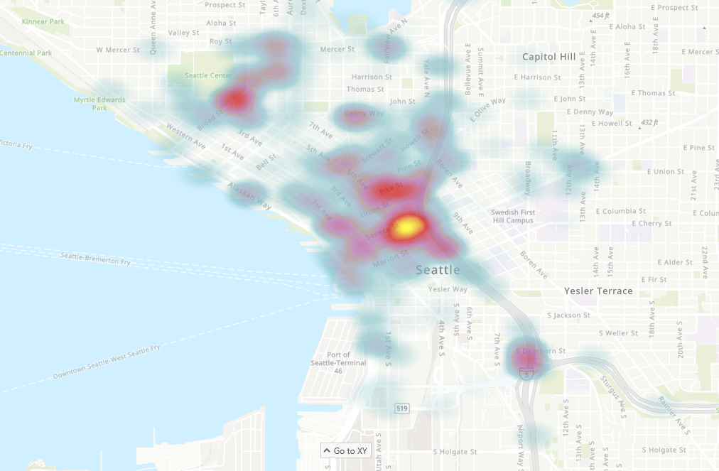

Slide 6
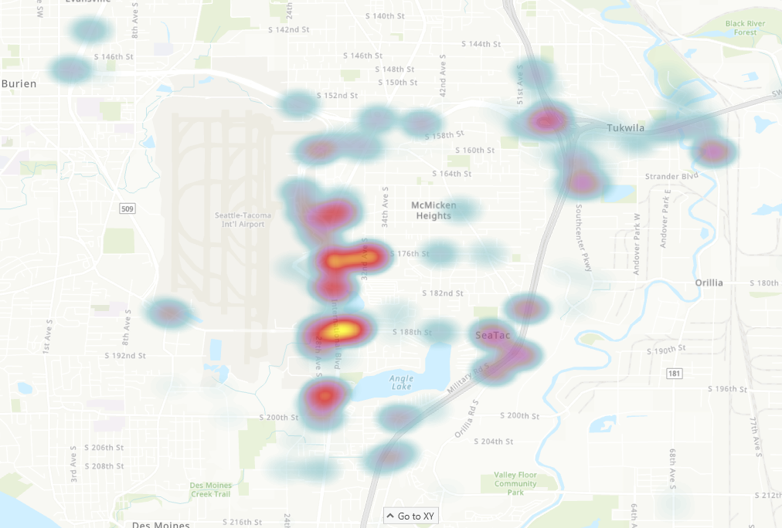

Slide 7
