Slide 1
Foundations of AI Final presentation
Kendall smith
CS5100 Spring 2020

Slide 2
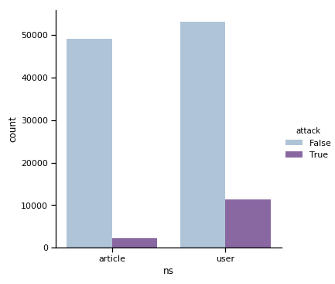
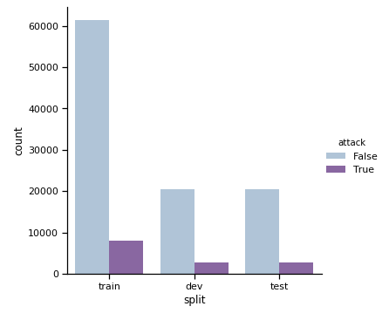
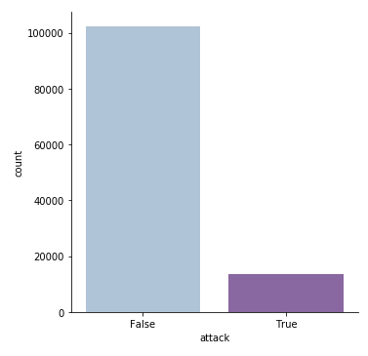
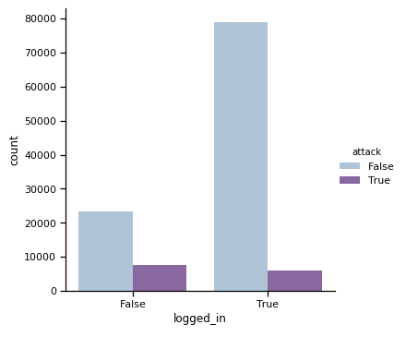
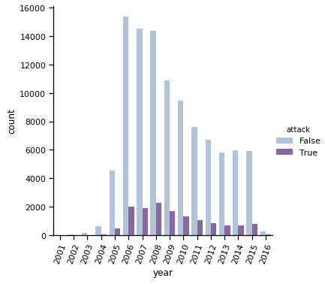
Large class imbalances usually skew model training
The classes were found to be highly imbalanced. Here we can see that there are over five times non-attacks as attacks from the data set.
Within this class imbalance, there is divergence in where the comments came from, if someone logged in or not, and the namespace.
Likewise, the “split” feature is imbalanced, and observations were not evenly distributed across the full date range.

Slide 3
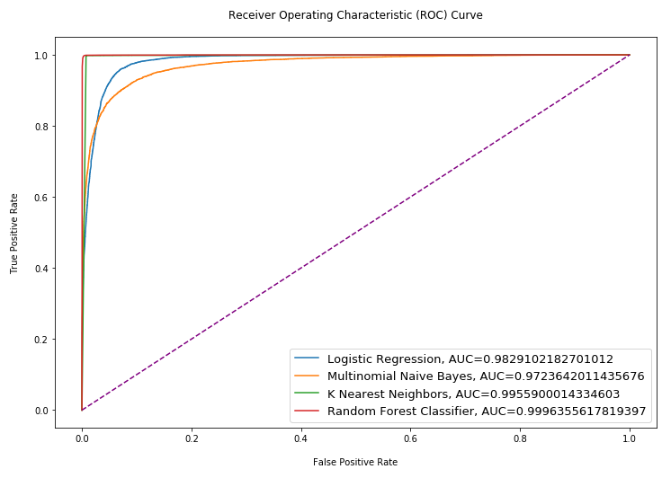
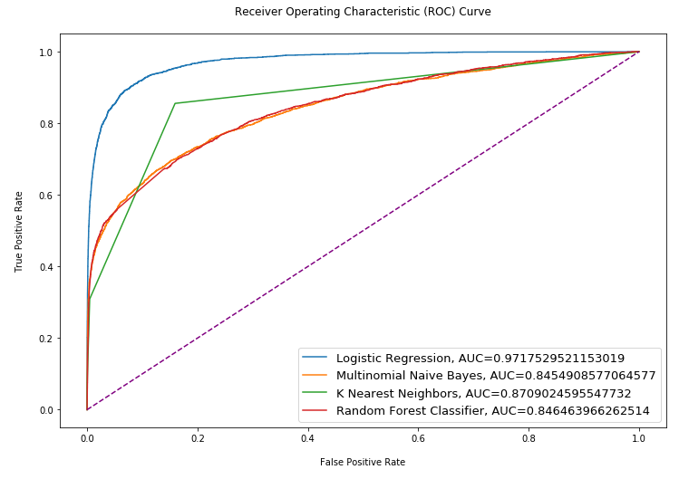
Exploring performance of different sklearn models
After refining the text preprocessing tasks and rebalancing* the classes by upsampling the minority class (attack==True), the Random Forest and KNN models suddenly outperformed Logistic Regression and Multinomial Naïve Bayes models.
The other two models tested did not improve significantly, if not worsened:
SGDClassifier
Accuracy = .905
AUC = .905
PassiveAggressiveClassiver
Accuracy = .967
AUC = .967
* (sklearn.utils.resample)
Initially, the AUC performance of Logistic Regression, both with and without using GridSearch parameter optimization, performed significantly better than the other models.
The AUC of the hyperparameter tuned model achieved .972, compared to the baseline/strawman model with .957
The scores of two other models tested that don’t provide predict_proba() method:
SGDClassifier
Accuracy = .905
AUC = .905
PassiveAggressiveClassiver
Accuracy = .970
AUC = .971
Notes:
New AUC scores after upsampling – add animation to hide pre-upsampling graphic to reveal post-upsampling results

Slide 4
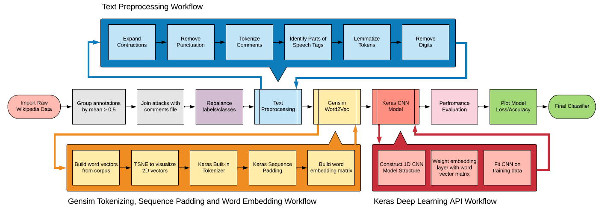
Text preprocessing and GENSIM+KERAS model pipeline
Note on Text Preprocessing Tasks:
The text preprocessing workflow was aggregated into a single function “customTokenizer”, which expanded contractions, removed punctuation, made strings into tokens, and used NLTK POS tagging to lemmatize word to shared roots.
Notes:
Due to issues integrating the Sklearn Pipeline() with the Keras API, this function was not used in the model. Given more time on this project, I would have liked to completed troubleshooting this to integrate the different frameworks.

Slide 5
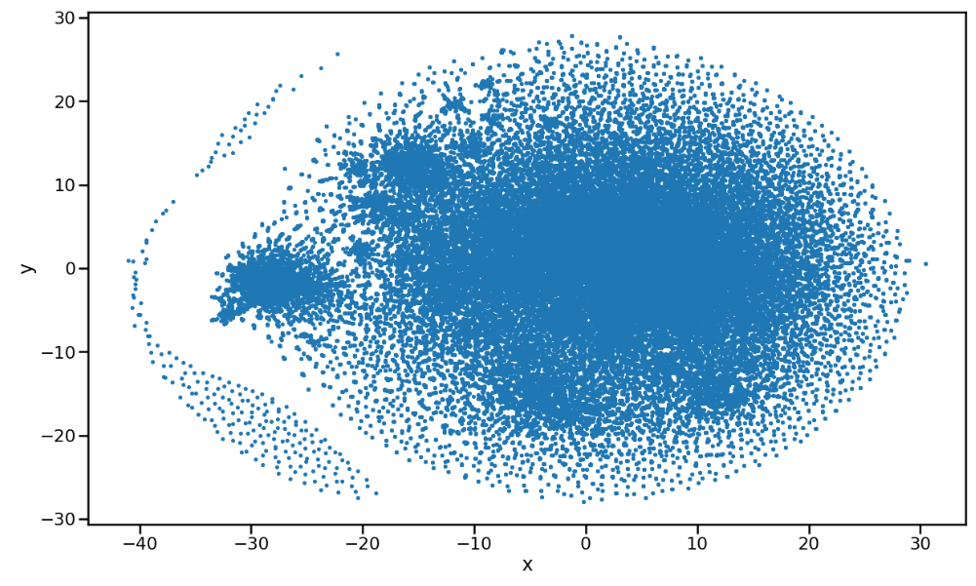
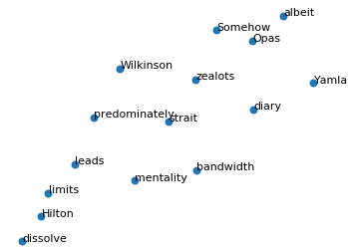
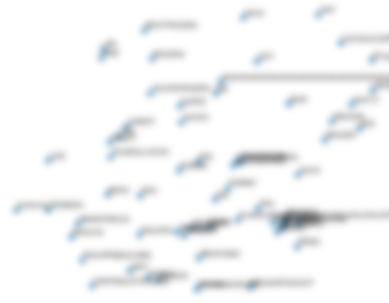
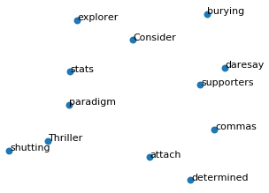
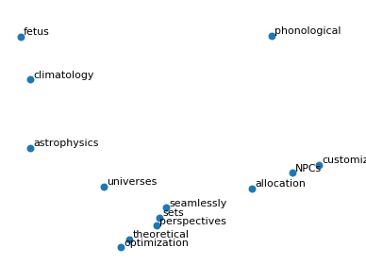
Word embeddings reveal interesting relationships
Scatter plot of 2-Dimensional T-Distributed Stochastic Neighbor (Word) Embedding
CONTENT
CENSORED
(HATE SPEECH
FOUND!!!)
http://jmlr.org/papers/volume9/vandermaaten08a/vandermaaten08a.pdf

Slide 6
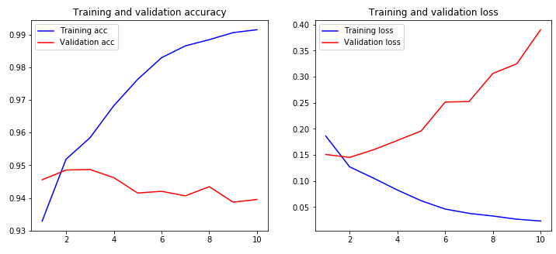
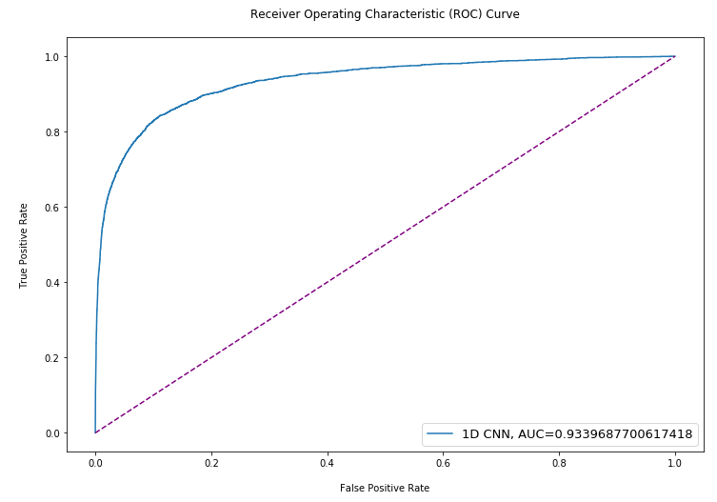
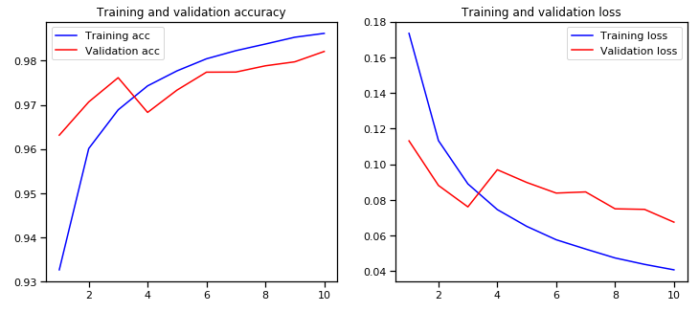
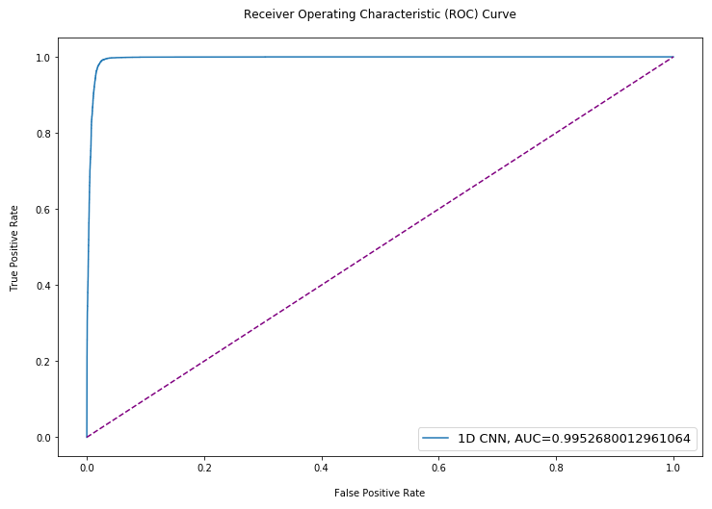
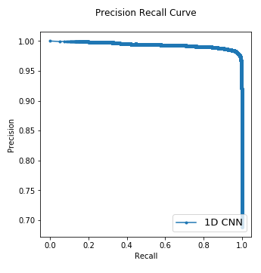
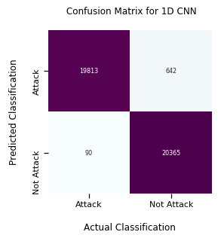
Performance evaluation of 1-d cnn
Accounting for overfitting by weighting the CNN Embedding layer with a word matrix improved scores
This can be seen in how the accuracy and loss initially were diverging significantly with each epoch, but after weighting, they converged quickly.
Notes:
Need animation for accuracy/loss/roc curve transitions, and bring precision/recall curve and confusion matrix forward
.934 AUC -> .995, compared to baseline of .957
.94 Acc -> .9998
.40 Loss -> .08
F1: .982, compared to baseline .688

Slide 7
Summary of analysis Findings
Model Results:
The final CNN model with an embedding layer weighted by the Word2Vec word vector matrix achieved equally accurate, if not better results, and likely less overfit than its statistical language model counterparts.
Here is the summary of metrics improvements in the CNN model, and comparisons to the “strawman” model:
AUC: .934 rose to .995 (compared to .957 baseline)
F1 Score: Achieved .982 (compared to .688 baseline)
ACC: .94 rose to .9998 or ~100% (compared to .94 baseline)
Loss: .40 decreased to .08
Weighting the CNN layer with word vector matrix aside, hypter-tuning or gridsearch methods were not used
This is an area that possibly could have squeezed out a slightly higher AUC and F1 score, but due to time and resource constraints, running grid search optimization on a neural network would potentially take days (or weeks).
Also, the non-text features were not included because with minimal exploration, a DNN model that could be concatenated with the CNN only achieved marginal results, somewhere between .73-.81 AUC.

Slide 8
Appendix

Slide 9
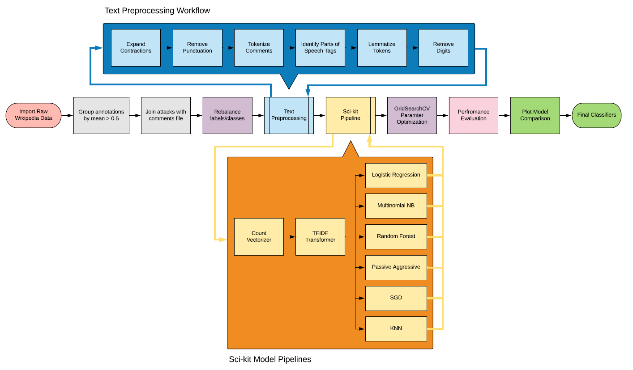
Text preprocessing and SKLEARN model pipelines
Text Preprocessing Tasks:
The text preprocessing workflow was aggregated into a single function “customTokenizer”, which expanded contractions, removed punctuation, made strings into tokens, and used POS tagging to lemmatize roots
Model Pipeline Object:
The sklearn built-in pipeline and gridsearchcv methods were used to fit together multiple tasks in a single model. The gridsearch took a long time depending on complexity of parameter grid

Slide 10
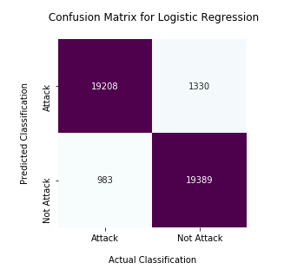
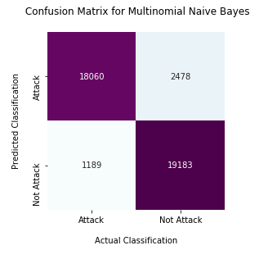
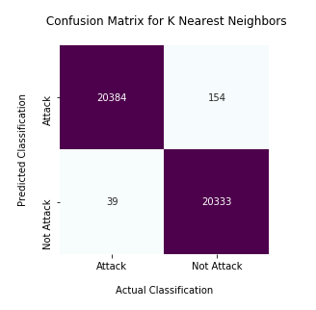
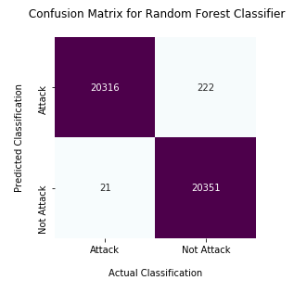
Confusion matrix of sklearn models

Slide 11
PERFORMANCE EVALUATION OF ALL Models
Comparative AUC Before and after hyperparameter tuning/optimization
Model | Preliminary Model AUC | Final Model AUC
Random Forest Classifier | .705 | .999
KNN | .571 | .996
CNN | .934 | .995
Logistic Regression | .963 | .983
Multinomial NB | .858 | .972
Passive Aggressive Classifier | .823 | .967
SGD Classifier | .732 | .905

