Slide 1

CP420: Machine Learning Techniques
University of Washington Data Science Certificate Program
CP420 Capstone Project
Kendall Smith
May 28, 2018

Slide 2
Project Overview
Problem Statement:
If I’m a day trader, how do I know where the price of a stock or exchange-traded fund (ETF) will be at the end of the day?
Project Goal:
In the stock market, one can trade both equities and/or ETFs, which are derived from a basket of stocks. There are other financial instruments which can be bought and sold, but these are the primary indicators of price fluctuation in any given day.
The goal of this project is to determine if/what any correlation is there between the first 60 minutes of trading, also the most active part of the trading day, and the closing price at end of the day. In other words, can we predict if the equity will close either higher or lower for the day based on activity in the first hour.

Slide 3
Overview
 | How long did you spend in this phase? (mins/days) | Additional Notes
Gathering the data | 8 hours | Ran into issues early on obtaining equity price data from API
Data Exploration | 2 hours
Features / Feature Engineering | 8 hours | Struggled in shaping and scaling the data to fit into the models
Building the Model | 4 hours | Only used Random Forest Classifier
Evaluating the Model | 2 hours | Changed data from 4 classes to 2
Operationalizing the model (Optional) | N/A | Documented in next steps
**Note: actual time taken on different phases may vary from the times indicated**

Slide 4
Data Overview
In order to obtain stock/ETF pricing data, I first had to develop a script that fetched data directly from the TD Ameritrade developer’s API.
Minute granularity for this data set was limited to only 2-4 weeks maximum depending on the equity. As the granularity of the data scaled up to 15 minutes, an hour, 4 hours, a day, etc. the date range of availability becomes much greater.
Originally I was only going to use pricing for the S&P 500. However, due to limitations in data available (10 days only), I had to expand the number of ETFs, and also chose some of the largest stocks by market cap (# of outstanding shares x current share value) to include in the analysis.
This resulting data set of 10 ETFs and 25 stocks available was 6660 rows of data at the daily granularity, and 263,215 rows of data at the minute granularity.

Slide 5
Features
The feature set included:
Price close ($) for each minute in the first 60 minutes of the trading day
Trading volume in 15 minute chunks, e.g. 1-15, 16-30, 31-45, 46-60 (idk why)
Daily open, high, low, close, and volume for daily aggregate
Day of week (expressed as an integer)
Binary flag if it was ETF or not
Features considered but not included:
Change between previous day and current day’s open (log and standard)
Exploring ranges of intraday movement
Originally wanted arrays of minute ranges, but ML models don’t support

Slide 6
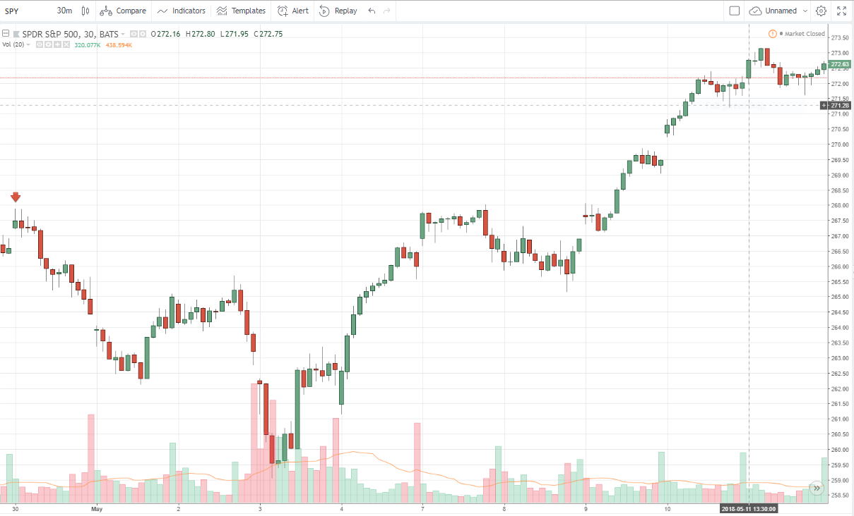
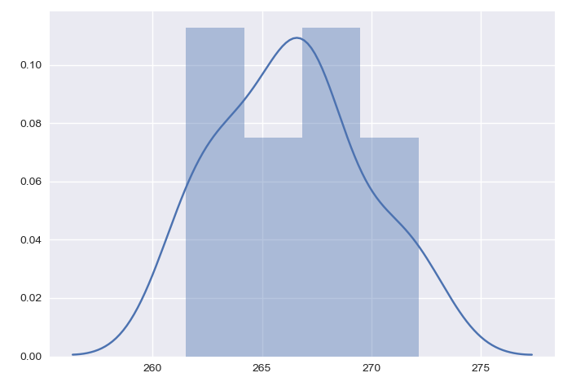
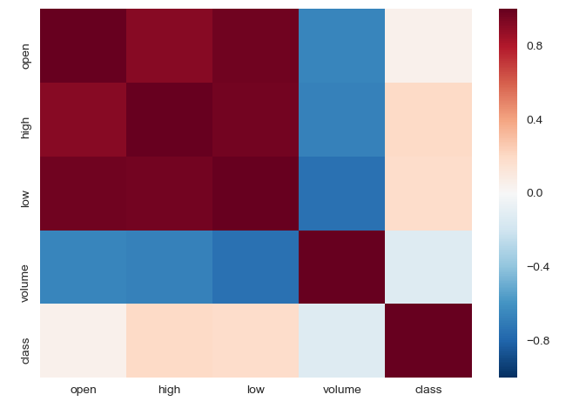

Slide 7
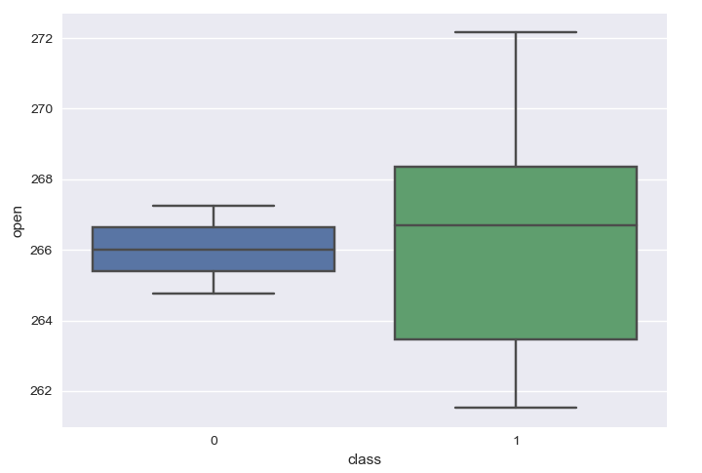
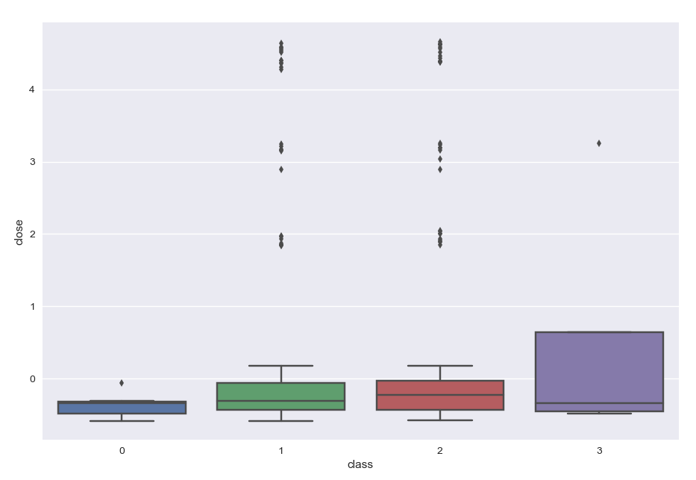
Data Exploration – Classes
Instead of using the final closing price of the day, I used two different criteria to classify each day’s price movements. In the initial model, I used four categories, but this was not appropriate for measuring accuracy of model accuracy requiring two classes, e.g. ROC curves
4 Class Logic:
0 = closes lower than open and makes new low
1 = closes lower than open but above daily low
2 = closes above open but below daily high
3 = close above open and makes new high
2 Class Logic:
0 = 0 and 1 from above, closes below open price
1 = 2 and 3 from above, closes above open price
S&P 500 2-classes =>

Slide 8
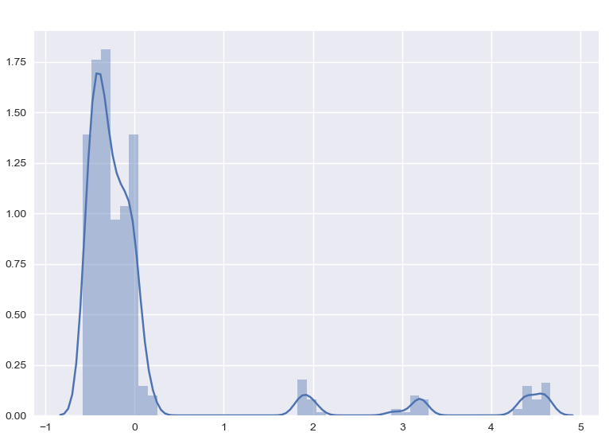
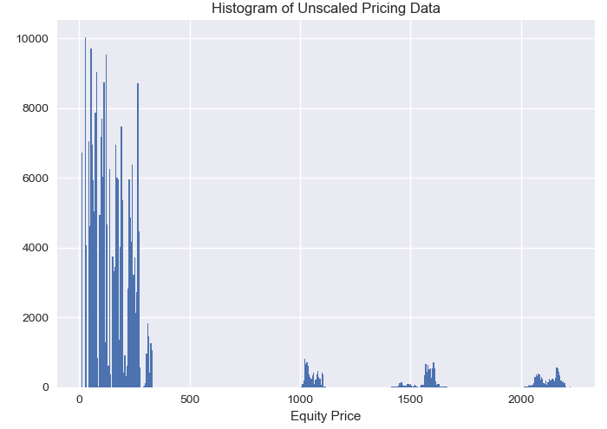
Data Exploration – Unscaled Distributions
The pricing data is very far spread out, given that some of the equities are < $50 and others > $2000
ETFs make up most of outlying peaks in the multimodal distribution, except for stocks like GOOG and AMZN
Highly non-normal and non-linear data set required standard scaling for each equity individually

Slide 9
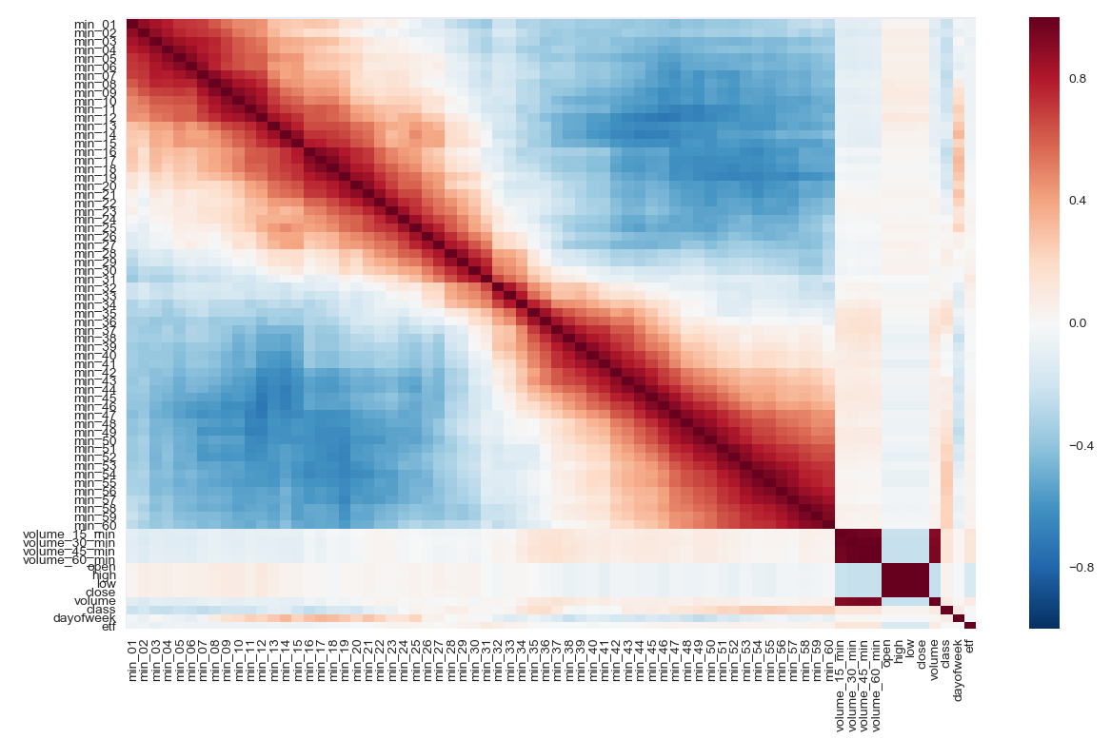

Slide 10
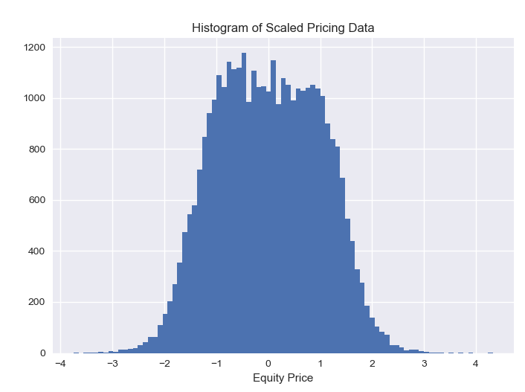
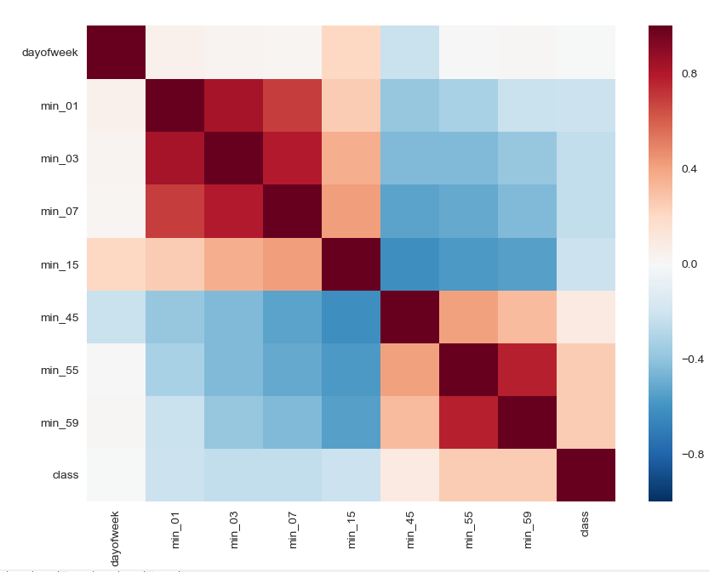
Feature Engineering
As mentioned earlier, the data was very non-normal and non-linear, therefore it was appropriate to scale using StandardScaler
Once the closing data was scaled for the 60 minute windows for all equities, a normal distribution becomes visible, as hoped
Attributes were then chosen based on the preliminary feature importance score from a random forest regression model

Slide 11
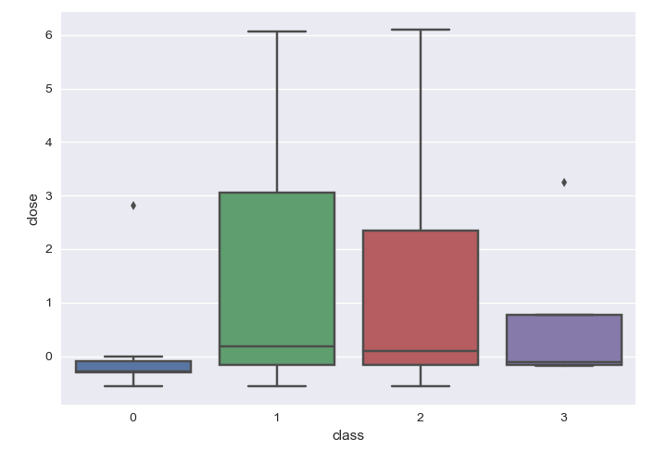
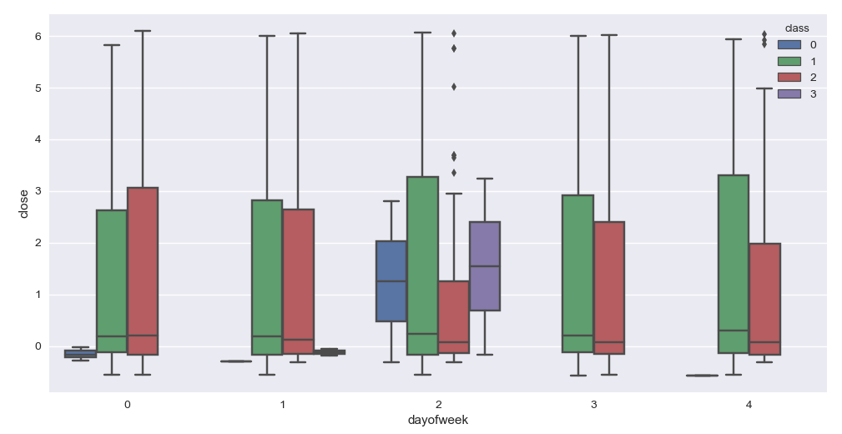
Data Exploration – Post Scaling
Becomes apparent that there is greater variance in price for equities not making new highs or new lows
The positive correlation between day of week to the first 30 minutes is shown on Wednesdays, which appears to be the day that all of the chosen equities often make either new highs or new lows

Slide 12
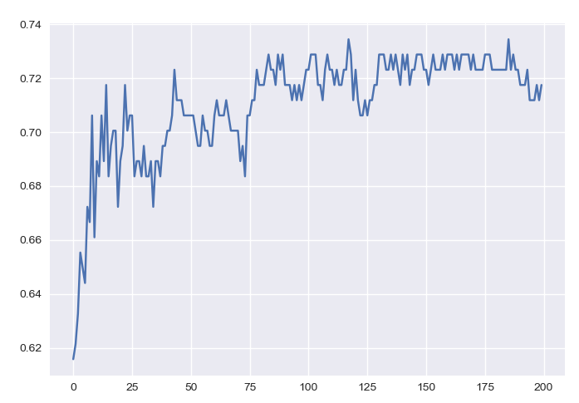
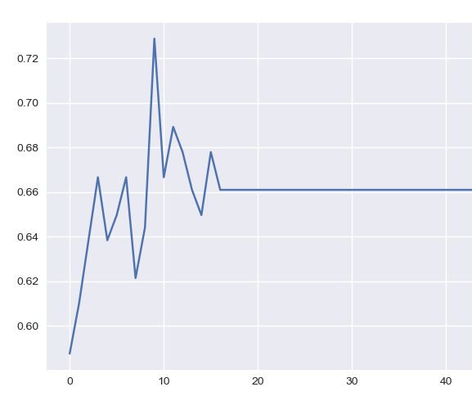
Model Building
Accuracy by N Estimators
I used a Random Forest Classifier model as it seemed most appropriate when researching in comparison to Decision Trees, SVMs; they are easy to train non-linear data and appropriate for dealing with multiple classes
Feature selection used a wider variety of tools than in actually building the model:
Preprocessing
StandardScaler
LinearRegression & RFE
Plotted accuracies to find optimal estimators and depth
Accuracy by Max Depth

Slide 13
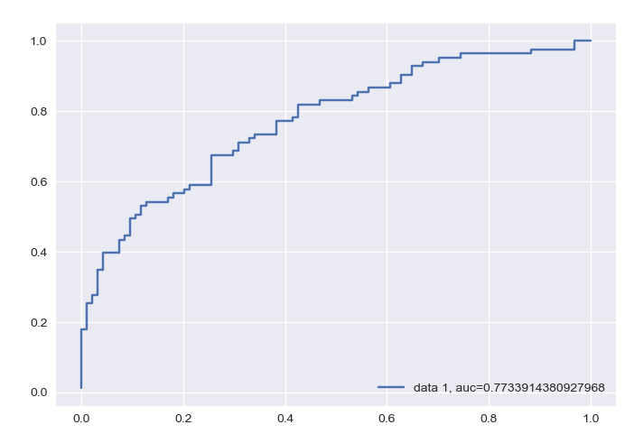
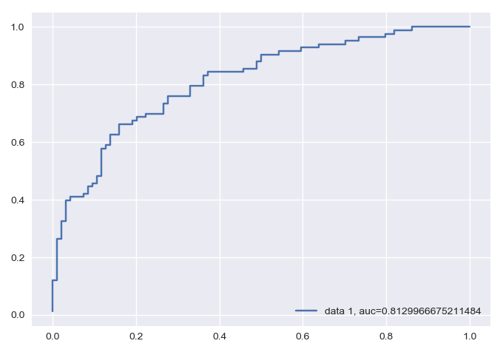
Model Evaluation
The max accuracy score achieved with a random forest classifier model was ~84%, but this shifted when some of the daily features were scaled
A lower performance was obtained when using selected features with the highest importance to the model
Final Accuracies Achieved:
Selected Features = 77.3% AUC
All Features = 81.3% AUC
Leads me to believe that there could be overfitting if I only chose limited minute ranges or specific times to train models on
ROC of Selected Features
ROC of All Features

Slide 14
Key Takeaways
Pricing data was initially very difficult to obtain (for free) at the minute granularity to perform this analysis. The availability of data using the specific API seemed to have changed over project time.
Stock market data is also very non-normal and non-linear which required creating an algorithm to scale the data for each equity
First 30 minutes (0-30) seem negatively correlated to daily outcome, while last 30 minutes (31-60) conversely seem positively correlated
Wednesdays seem to be when equities make more new lows or highs
Model accuracy doesn’t always necessarily improve when employing feature selection, especially with smaller datasets

Slide 15
Next Steps
Experiment with regression models instead of classifier models
Utilize PCA to perform dimensionality reduction in the model
Operationalize the model by frequently testing it with new data

