Slide 1
Bike Sales Performance Report
Good [morning/afternoon], everyone. I'm excited to walk you through our latest findings from the Bike Sales Analytic Dashboard. Today, we'll not just look at the numbers — we'll uncover the story behind them: where we’ve succeeded, where opportunities lie, and how we can steer our business forward.

Slide 2
Outline
introduction
objectives
Dataset Overview
Exploratory Analysis
Insights
Key Recommendations

Slide 3
Introduction
Sales of bikes have grown so well due to rising health awareness and urban commuting needs. this analysis hightlights key trends and customers insights to support data driven decisions.
Purpose of the analysis: Identify trends, optimise inventory and boost revenue

Slide 4
Objectives
Understand sales patterns and trends.
Segment Customers by demographics.
Identify high and low product categories.
Provide actionable business insights

Slide 5
Dataset Overview
The dataset contains a total record of 113,026 sales transactions with occurs within a period of January 2011 to July 2016.
Key Variables:
Dates (For trend analysis).
Customer age, age group, and gender (for demographic analysis).
Product, Product, sub-Category, Product Category (for product analysis).
Cost, revenue and profit (for financial growth analysis).

Slide 6
Exploratory Data Analysis

Slide 7
key Performance indicator (KPI)
Over the analysis period, a total cost of $53M and a total revenue of $85M was recorded, giving a healthy profit of $32M.
Within this period, 1 million products that fall into different product categories have been sold, with $18M in revenue in the present year (2016).
The year-over-year revenue growth stands at 59%, signaling a strong upward momentum.
Despite the month-over-month revenue growth being modest at 1%, it signals a steady business revenue growth.
These numbers tell a promising story - the business is scaling with profit.

Slide 8
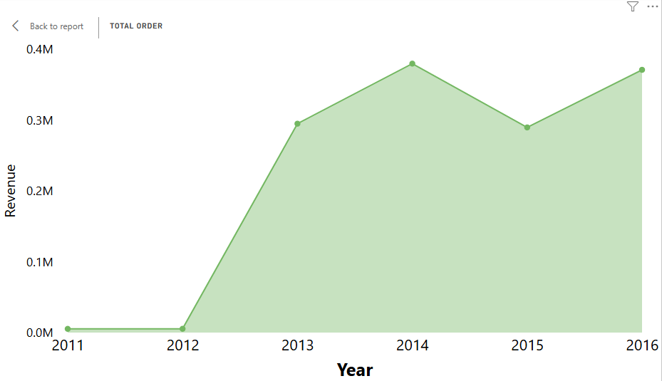
Total Order Trend
Product cost increased sharply in 2013 and 2015, compared to 2011 - 2012

Slide 9
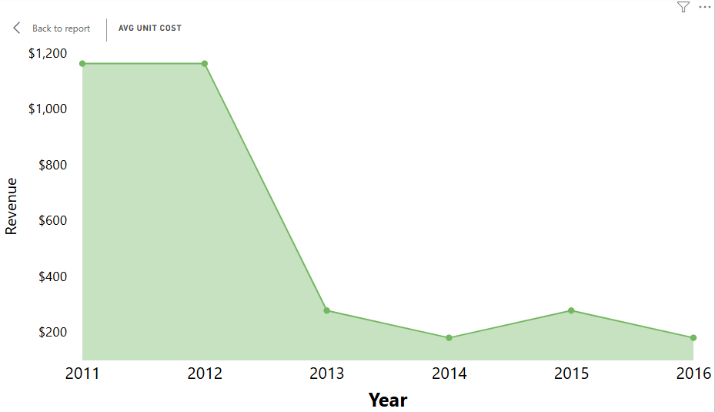
Average Unit Cost
Product cost increased sharply in 2013 and 2015, compared to 2011 - 2012

Slide 10
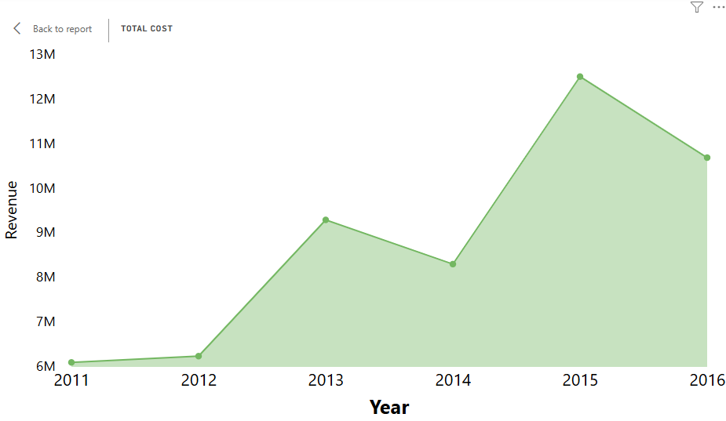
Product Cost Trend
Product cost increased sharply in 2013 and 2015, compared to 2011 - 2012

Slide 11
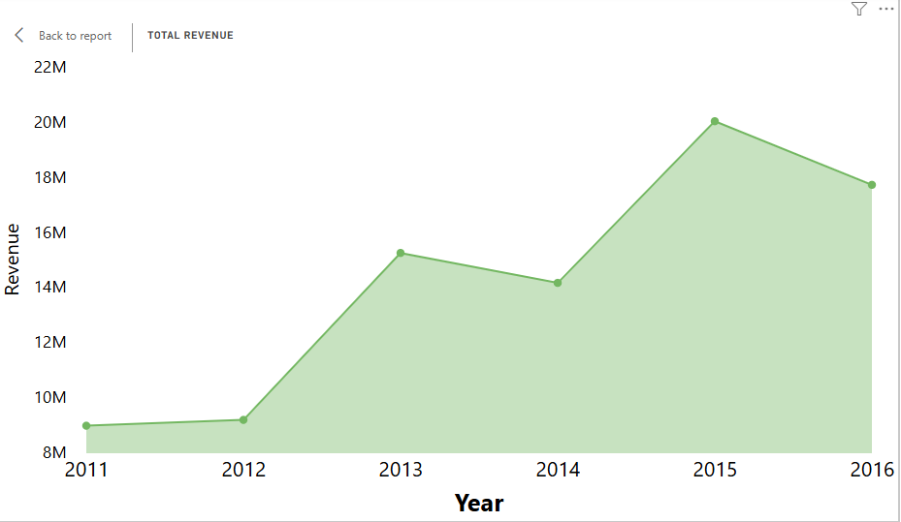
Total Revenue Trend
Total revenue also increased sharply in 2013 and 2015, compared to 2011 - 2012

Slide 12

YoY Revenue Trend
Similar to total cost and total revenue, the YoY revenue growth increased sharply in 2013 and 2015, compared to 2011 - 2012

Slide 13
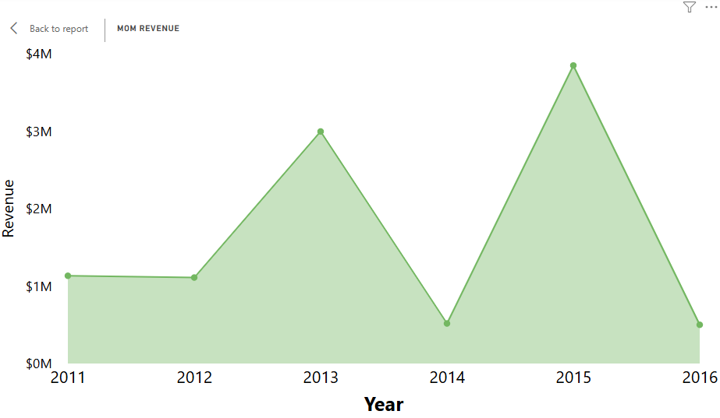
MoM Revenue Trend

Slide 14
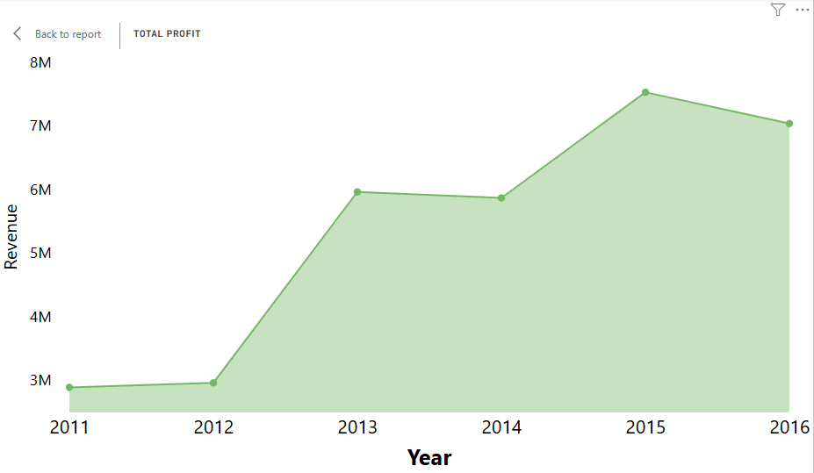
Profit Trend
Profit increased all through the years but slightly dips in 2014 and 2016.

Slide 15
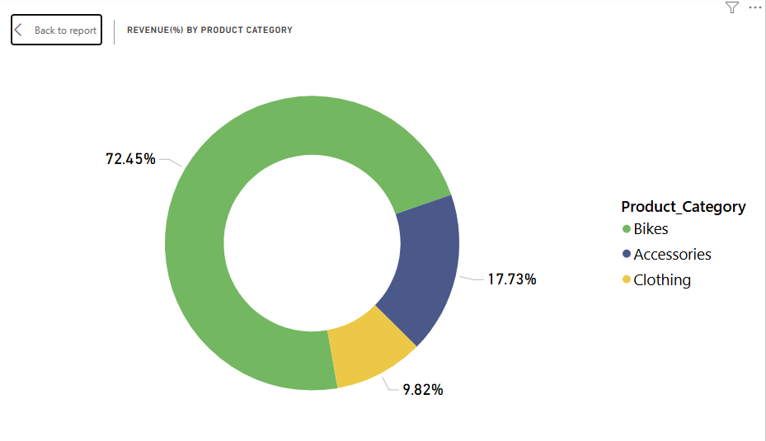
Revenue by Product Category
Revenue % by Category:
- Bikes: 72.45%
- Accessories: 17.53%
- Clothing: 9.82%

Slide 16
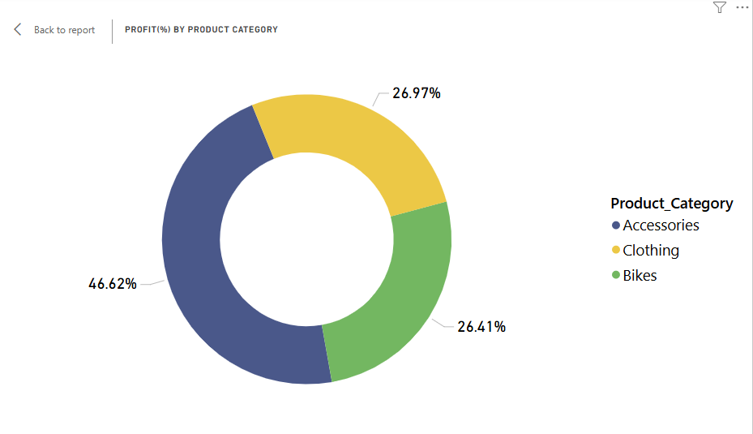
Profit by Product Category

Slide 17
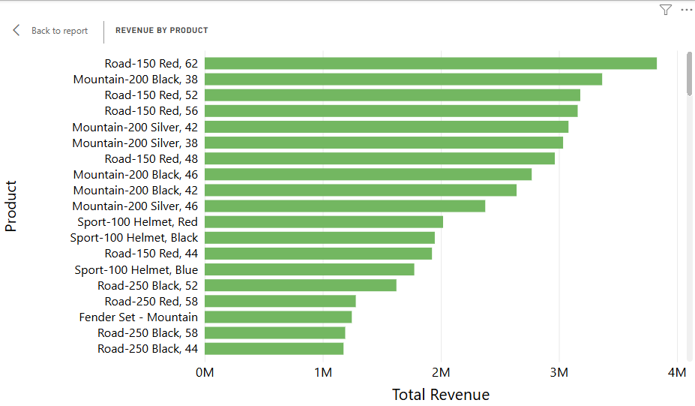
Revenue Breakdown by Product
Top Products:
1. Road-150 Red, 62
2. Mountain-100 Black, 38
3. Road-150 Red, 52
4. Road-150 Red, 44
Insight: High-end road bikes dominate revenue. Investment in expanding the Road-150 series may yield strong returns.

Slide 18
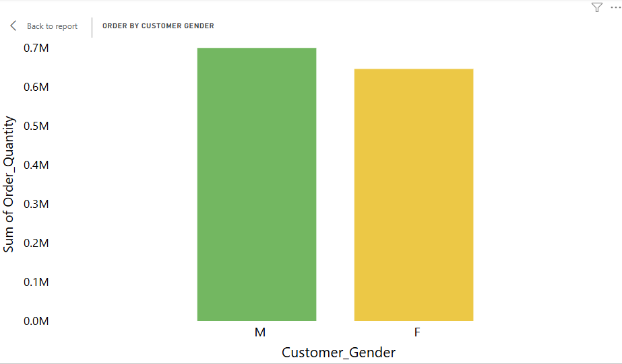
Orders by Customer Gender
Male: Higher purchase frequency.
Female: Lower but consistent volume.
Insight: Marketing could better target female customers to expand customer base.

Slide 19
Revenue & Profit by Product Category
Profit % by Category:
- Accessories: 46.6%
- Clothing: 26.4%
- Bikes: 26.97%
Insight: Bikes drive revenue; Accessories yield the highest margin. Consider bundling to increase overall profitability.

Slide 20
Product Performance Table
Top Performer: All Purpose Bike Stand (Accessories)
- Revenue: $342K
- Profit: $207K
- Profit %: 60%
Insight: Focus on high-margin items like Accessories for promotional campaigns.

Slide 21
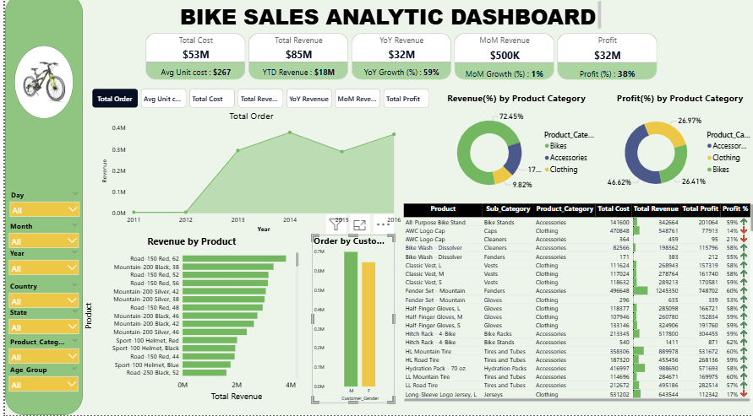
https://app.powerbi.com/view?r=eyJrIjoiZGIwMDFhNjctZDdjMC00ZmUwLWE1MjYtZWEyMDlkNDZiYTgxIiwidCI6IjYzYzQ3MTVmLTExNzAtNDFmYy04OTAwLWMwMTgzMzMwNGQ3YiJ9

Slide 22
Insights
Comparing the sharp drop in average unit cost and the sharp increase in cost, total revenue and YoY revenue in 2013 and 2015, the spike is not due to higher prices per unit (since unit cost actually decreased),but it was due to the massive increase in quantity sold.

Slide 23
Conclusion
The sharp increase in total cost, total revenue, and the YoY revenue in 2013 and 2015 was driven by a large surge in sales volume and not higher prices per item, it suggest a strategic shift, perhaps tha company started selling cheaper products in bulk, targeting larger market or more customers.

Slide 24
Recommendations
1. Promote Accessories More Heavily – They have a higher profit margin.
2. Target Female Customers – Untapped potential for market expansion.
3. Expand Top-Selling Products – Especially the Road-150 series.
4. Analyze Seasonal Peaks – Align inventory and marketing to capitalize.

Slide 25
Next Steps
Further Drilldown: Segment analysis by region and time.
Customer Insights: Understand buying patterns by demographic.
Operational Review: Evaluate supply chain costs for optimization.
Q&A: Open floor for stakeholder questions.

